Slide 1

Team: 13
Market Basket Analysis
Using Deep Learning Techniques
Project Associates | Project Guide
20P31A1231 MOGILI VEERA LAKSHMI
20P31A1201 AKULA V S S D PHANI HASWANTH
20P31A1211 UPPALAPATI GAYATRI NANDINI
20P31A1230 MATCHA VICTOR RAJ KUMAR
Dr. CH V RAGHAVENDRAN
M.Tech, Ph.D
Department of Information Technology
Aditya College of Engineering & Technology (A)

Slide 2
Abstract
In the dynamic realm of retail, grasping customer behavior is crucial for success. Deciphering the intricate patterns of shopper’s choices has long been a challenge for traditional methods.
This project boldly employs deep learning to unlock hidden insights within market basket data, providing a key to optimizing retail strategies. Through pattern recognition, customer segmentation, and predictive modelling, this project aims to reveal valuable associations, allowing retailers to tailor marketing efforts, optimize pricing, and strongest matches overall shopping experience.
The anticipated outcome include actionable strategies for revenue maximization, improved customer satisfaction, and a competitive edge in the ever-evolving retail landscape.

Slide 3
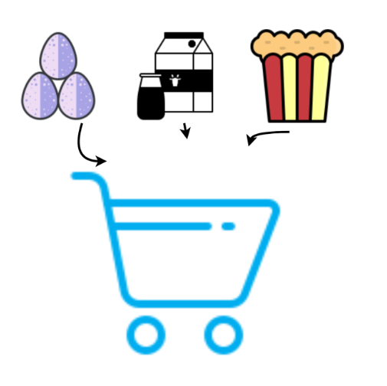
Introduction
What is Market Basket Analysis?
Market Basket Analysis is a technique used to identify relationships and associations between products based on customer purchasing patterns.
By understanding these relationships, businesses can make informed decisions about product placement, cross-selling, and customer segmentation.
Applications of Market Basket Analysis
Cross-selling and Upselling
Identify products that are often purchased together and create opportunities for cross-selling and upselling.
Customer Segmentation
Divide customers into distinct segments based on their purchasing behavior, demographics, and preferences.
Recommender Systems
Recommend relevant products to customers based on their past purchases and similar user patterns.

Slide 4
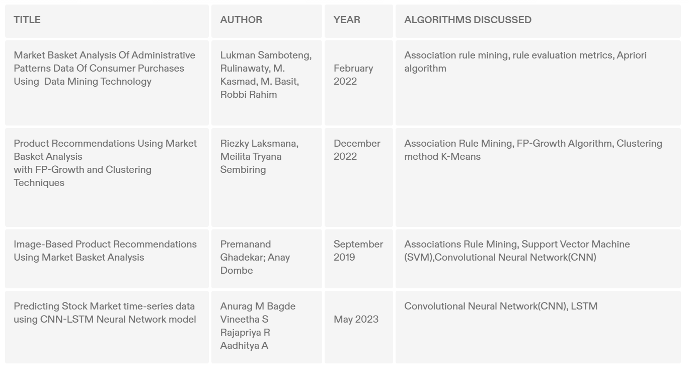
Literature Survey

Slide 5
Dataset Description
Online Retail Dataset
This is a transnational data set which contains all the transactions occurring between 01/12/2010 and 09/12/2011 for a different Countries-based and registered non-store online retail.
The company mainly sells unique all-occasion gift-ware.
Source: Kaggle competition hosted in 2019.
Size: It currently contains 46431 of Instances. Access: https://www.kaggle.com/datasets/lakshmi25npathi/online-retail-dataset/data
Attribute Information: Information on Online Retail, including:
-Invoice No -Stock Code
-Description -Quantity
-Invoice Date -Unit Price
-Customer ID -Country

Slide 6
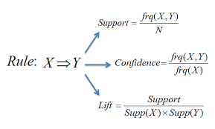
Key Concepts Of Market Basket Analysis
Association Rules
Association rules define the relationships between items based on their support, confidence, and lift values.
Support, Confidence, and Lift:
Support: Measures the frequency of a combination of items in a dataset.
Confidence: Measures the likelihood of an item being purchased, given the purchase of another item.
Lift: Evaluates the strength of association between items.

Slide 7
Example
Association Rule:
{Bread} => {Milk}
Support:
The support of the rule {Bread} => {Milk} is 4/5, or 80%.
This is because 4 out of the 5 transactions in the dataset contain both Bread and Milk.
Dataset:
Transaction ID | Items Purchased
------------------- | ---------------------
1 | Bread, Milk
2 | Bread, Milk, Cola
3 | Milk, Cola
4 | Bread, Milk, Cola
5 | Bread, Milk
Confidence:
The confidence of the rule {Bread} => {Milk} is 100%.
This is because all 4 of the transactions that contain Bread also contain Milk.
Lift:
The lift of the rule {Bread} => {Milk} is 1.25.
The association between Bread and Milk is slightly stronger than just random chance.
Conclusion:
This association rule has a high support, confidence and lift, which means that it is a strong rule.
This rule can be used to make predictions about future transactions.
For example, if a customer purchases Bread, we can be more confident that they will also purchase Milk.

Slide 8
Existing System
In current market basket analysis, they utilize a combination of algorithms including Convolutional Neural Networks (CNNs) for identifying spatial relationships in frequently bought items, alongside Apriori and FP-Growth algorithms to uncover basic association rules.
Strengths:
Efficient for discovering frequent item sets and basic association rules.
Relatively interpretable results, aiding under standing of relationships.
Limitations:
Traditional algorithms are able capture complex, non-linear buying patterns is restricted, potentially missing intricate associations between items.
Existing algorithms struggle to model sequential buying behavior, making it difficult to predict next items in purchase sequences.
As datasets grow in size, these methods may face scalability challenges, impacting their efficiency and effectiveness.

Slide 9
Proposed System
We propose a approach leveraging the power of Deep Learning to address these limitations and unlock superior market basket insights.
Our system will employ a combination of:
CNN Architecture: CNN model will capture complex spatial relationships within frequent item sets, identifying nuanced associations beyond the capabilities of traditional methods.
Bi-LSTM for Sequence Modeling: A Bidirectional Long Short-Term Memory (Bi-LSTM) network will be incorporated to analyze purchase sequences, allowing us to predict the next item a customer is likely to buy with enhanced accuracy.
Combining CNNs with Bi-LSTMs can be done by feeding CNN-extracted features into the Bi-LSTM model.
Unveiling Hidden Patterns: The model will uncover hidden associations and trends in customer behavior, providing valuable insights for sales strategies.
Next-Item Prediction: By modeling sequential patterns, we can predict the next item in a purchase sequence, enabling personalized recommendations and targeted promotions.

Slide 10
Requirements
Functional Requirements:
Ease of Use: This translates to a user-friendly system that can be easily adopted and used by its target audience.
High Performance: This refers to a system's ability to handle large workloads efficiently and respond quickly.
Maintainability: This ensures the system can be easily modified, repaired, and updated throughout its lifecycle.
Scalability: This refers to a system's ability to grow and accommodate increasing demands.
Cross-Platform Support: This ensures the system can run on different operating systems, providing flexibility in hardware choices.

Slide 11
Requirements
Non-Functional Requirements:
Software Requirements:
Software : Jupyter Notebook, Google Colab
Language Used : Python
Libraries/Packages : Keras over Tensorflow, pandas, numpy, sklearn
Hardware Requirements:
Processor : Core 2 Duo or above
Installed memory (RAM) : 2 GB
Hard Disk : 150 GB
Operating System : Windows 7 or above
Usability: This system is used to generate the summaries from documents or any types of news , articles , books and reviews.
Reliability: This system is used to make rouge scores , precision and recall for the extractive and abstractive summaries.
Performance: As it makes use of different models that help us to make the system high having performance output.

Slide 12
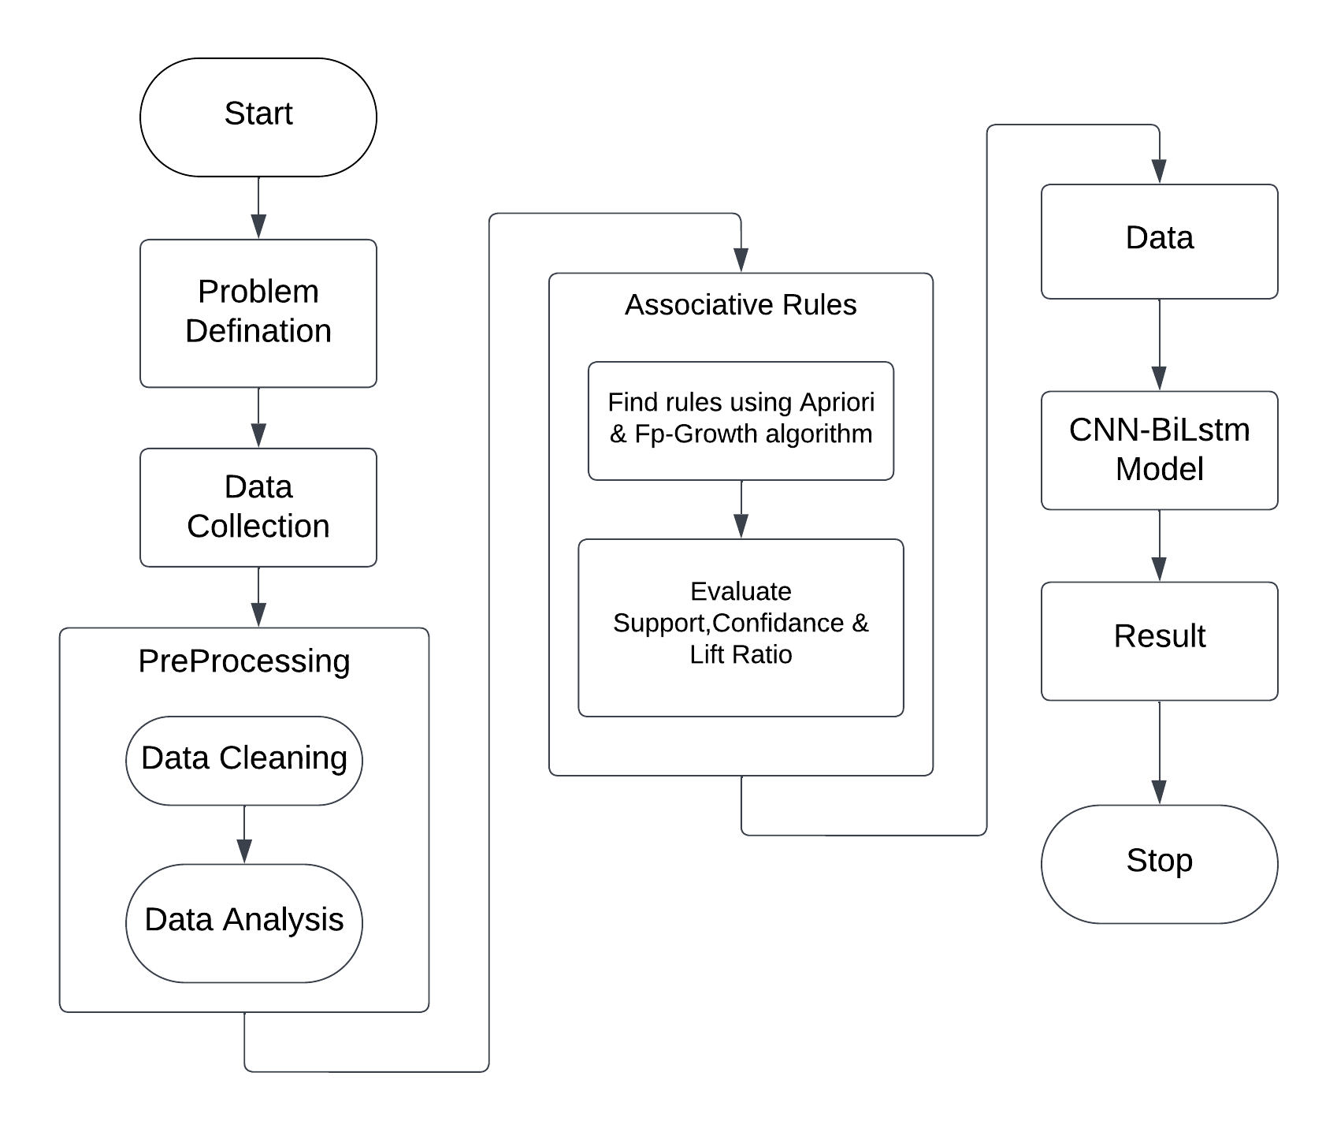
Architecture

Slide 13
Algorithms Used
Apriori algorithm:
It's a classic algorithm for frequent itemset mining.
It iteratively builds candidate itemsets by combining frequent single items and checks their support against a minimum threshold.
It generates association rules based on the frequent itemsets, indicating relationships between purchased items.
FP-Growth algorithm:
It uses a tree-like structure to store frequent itemsets, potentially leading to better efficiency for large datasets compared to Apriori.
It also operates on the principle of minimum support to identify frequent itemsets and generate association rules.
CNN Bidirectional LSTM algorithm:
A CNN BiLSTM is a hybrid bidirectional LSTM and CNN architecture.
It learns both character-level and word-level features.
The CNN component is used to induce the character-level features.
For each word the model employs a convolution and a max pooling layer to extract a new feature vector from the per-character feature vectors such as character embeddings and (optionally) character type.

Slide 14
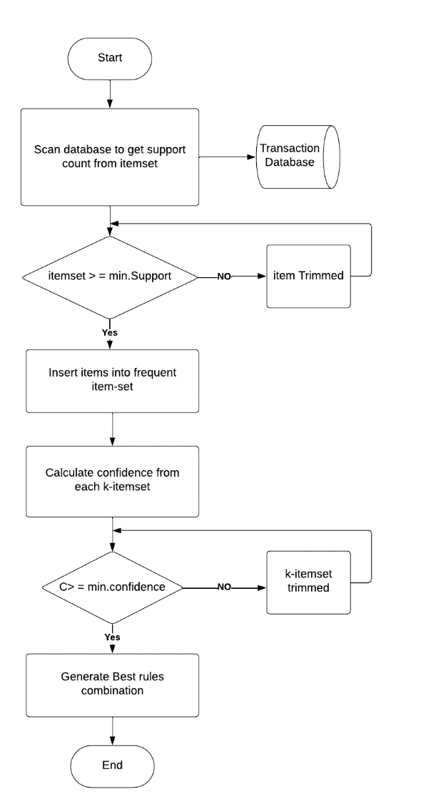
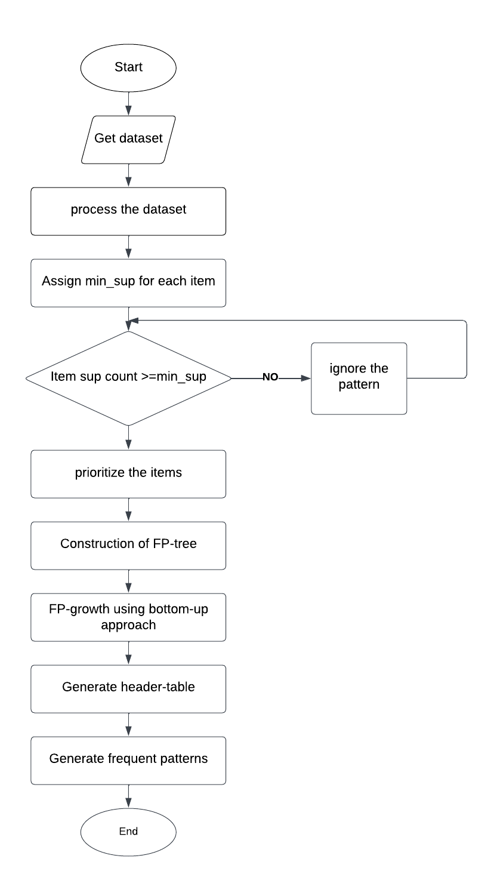
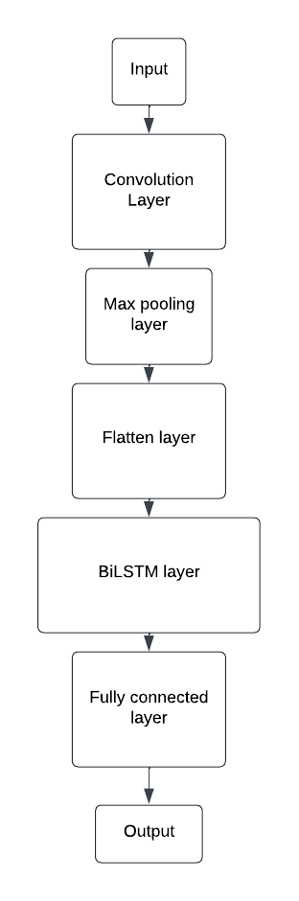
Flow Chart
Apriori Algorithm
FP-Growth Algorithm
CNN-BiLstm Algorithm

Slide 15
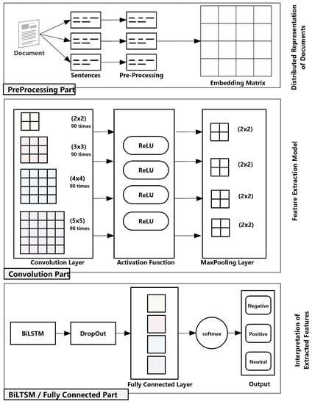
CNN-BiLstm Model
CNN-BiLstm Architecture

Slide 16
Implementation
Steps involved in Market Basket Analysis project:
Import Necessary Libraries: Importing essential libraries like NumPy, Pandas, MLxtend, Apriori, FP-Growth, Seaborn, Matplotlib, and others for the project.
Load Online Retail Dataset: Importing and loading a dataset related to online retail transactions.
Data Exploration: Exploring the dataset to understand its characteristics, such as the number of rows, attributes, and basic statistics. Additionally, analyzing the number of purchased items in different countries or other relevant metrics.
Data Cleaning: Preprocessing the data by removing duplicate values, handling null values, and potentially filtering out certain transactions based on specific criteria (e.g., transactions containing certain initial letters like ‘C’).
Data Analysis: Using bar graphs or other visualization techniques to analyze and present the data, such as visualizing the frequency of different items or transaction patterns.
One-Hot Encoding: Transforming categorical variables into a numerical format using one-hot encoding, where all values are converted into binary (0s and 1s). This step is crucial for further analysis and model training.
Apriori Algorithm: Applying the Apriori algorithm to generate association rules and identify frequent item sets within the dataset. This step helps in uncovering patterns and relationships between different items purchased together.
FP-Growth Algorithm: Utilizing the FP-Growth algorithm, an alternative to Apriori, to discover frequent item sets and association rules efficiently, especially for large datasets.
CNN-BiLSTM Model: Implementing a Convolutional Neural Network (CNN) combined with a Bidirectional Long Short-Term Memory (BiLSTM) model for predicting the next item in a sequence. This model leverages deep learning techniques to analyze sequential patterns in transaction data and make predictions based on the learned patterns.

Slide 17
Results Analysis
Our market basket analysis project aimed to understand customer buying patterns at Online Retail Data Set. We employed a two approachs:
Traditional methods: Apriori and FP-Growth algorithms were used to identify frequently bought-together itemsets.
Deep Learning: A CNN-BiLSTM model was trained to capture more nuanced relationships within customer purchase sequences.
Author | Technique | Accuracy
V. Umayaparvath, K. Iyakutti [8] | Baseline, FNN, CNN | 71.68%
Ghadekar (2019) [9] | CNN | 70.00%
Sharma & Omair Shafiq [10] | Random Forests, CNN, XGBoost | 81.84%
Proposed Model | Association rules as feature selection using CNN-BiLstm for next-item prediction | 85.14%

Slide 18
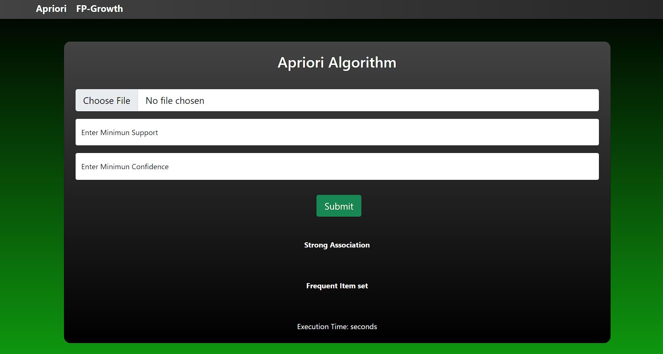
UI Design

Slide 19
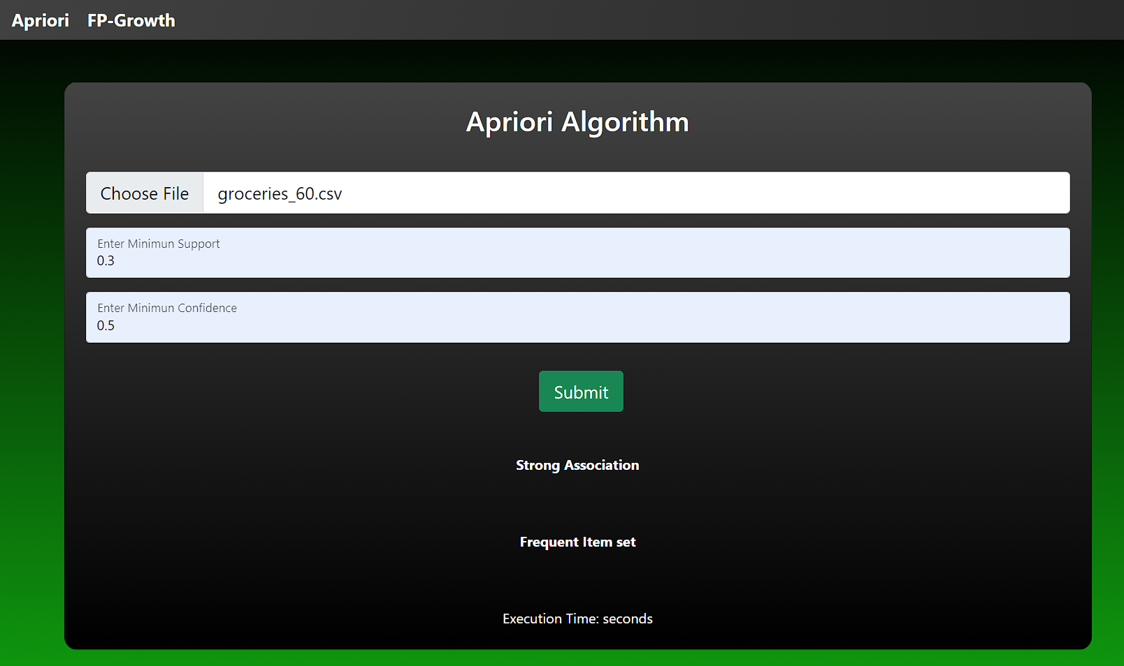
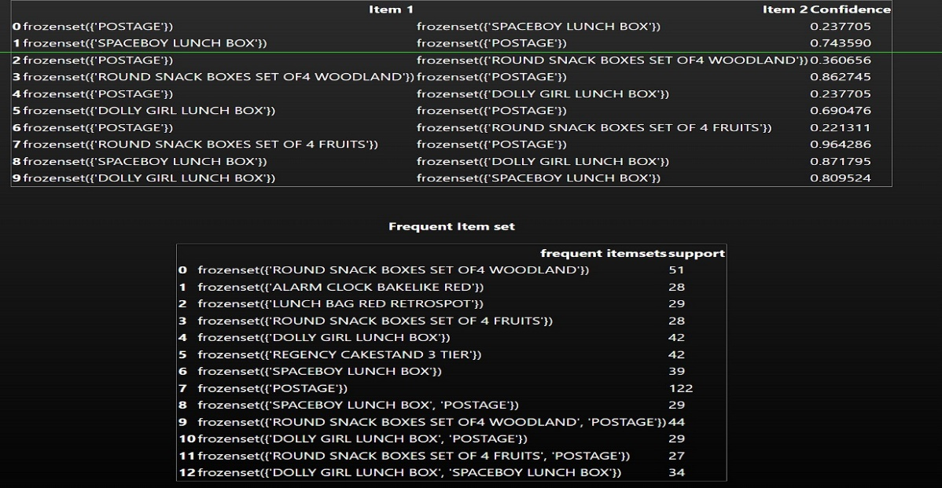
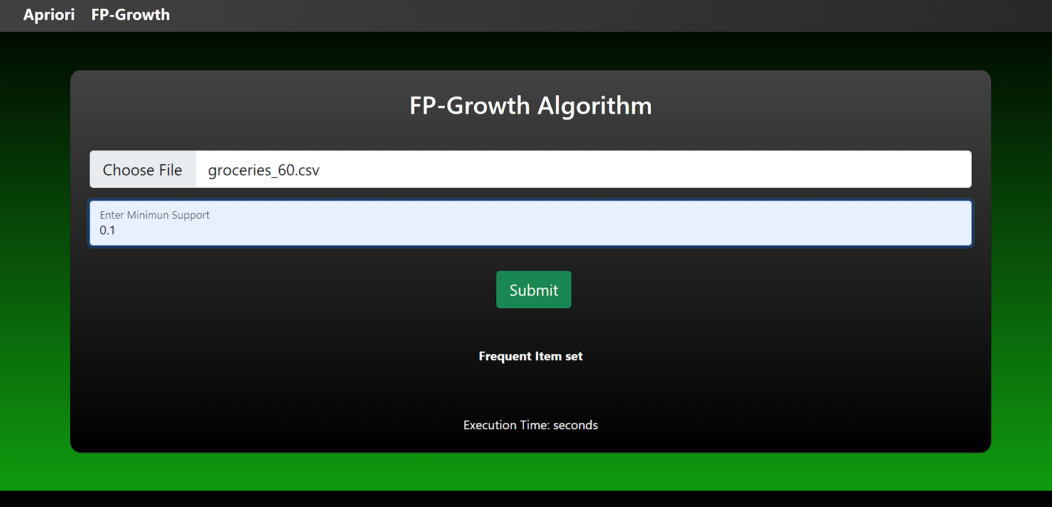
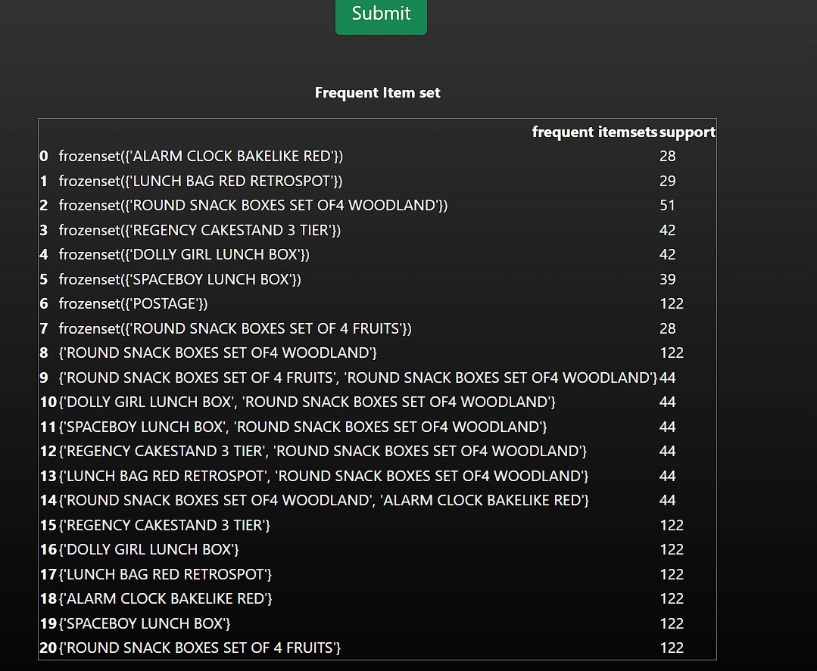
Results

Slide 20
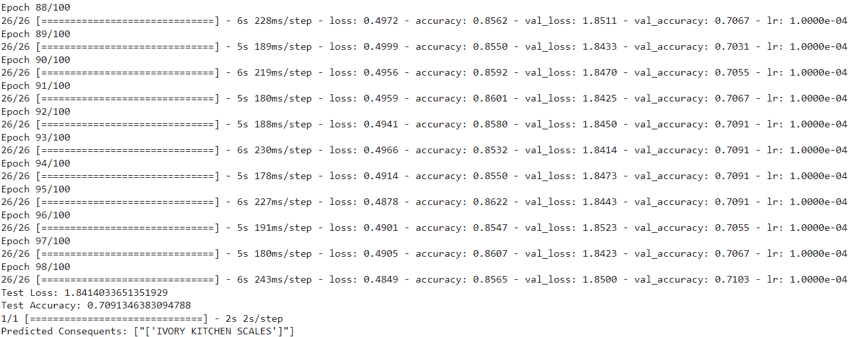
Results
CNN-BiLstm Prediction Results:
The frequent itemset for the test transaction ['GREEN REGENCY TEACUP AND SAUCER’] is ["['IVORY KITCHEN SCALES’]”].
The accuracy of the prediction for this frequent itemset is 85%.

Slide 21
Conclusion
Our market basket analysis project explored the application of deep learning for market basket analysis on an online retail dataset. We employed a CNN-BiLSTM architecture to uncover association rules and predict the next item in a customer's basket. By setting appropriate support and confidence thresholds, we extracted valuable association rules, revealing frequently co-purchased items and offering insights into customer buying behavior.
The CNN-BiLSTM model achieved an accuracy of approximately 85% in predicting the next item set after training for 80-90 epochs. This highlights the model's ability to learn sequential patterns and effectively recommend products. These findings demonstrate the potential of deep learning for market basket analysis, enabling retailers to personalize recommendations, optimize inventory, and develop targeted marketing strategies.

Slide 22
Future Scope
Future research holds exciting possibilities to further enhance this approach. By experimenting with different support and confidence thresholds, we can tailor the discovered association rules to specific business goals. Higher support thresholds might reveal frequently purchased core items, while lower thresholds could uncover more niche but potentially lucrative product combinations. Additionally, incorporating lift into the analysis can prioritize rules that significantly exceed random co-occurrence, pinpointing the most strategically valuable associations.
Optimizing training efficiency presents another avenue for exploration. While our model achieved an accuracy of 85% after 80-90 epochs, investigating techniques like early stopping could potentially achieve similar or even better performance in less training time. This would not only reduce computational costs but also allow for faster model deployment and adaptation to changing customer behavior.

Slide 23
Thank You

