Slide 1
Tic-Tac-Toe
Group 03:
Bui Cong Thanh
Nguyen Quang Minh

Slide 2
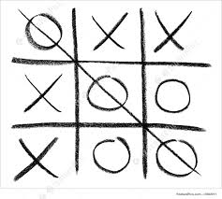
Application description
Tic-tac-toe for 2 persons
Player opens a game client to play
Login is required
Player need to wait for another player, first come first serve
Multiple clients connect to a server and transfer position data through that server

Slide 3
Game rule
Tic-tac-toe is a paper-and-pencil game for two players, X and O, who take turns marking the spaces in a 3×3 grid.
The player who succeeds in placing three of their marks in a horizontal, vertical, or diagonal row wins the game.

Slide 4
Application architecture
TCP client-server
Signal-driven I/O model
Multithread TCP server

Slide 5
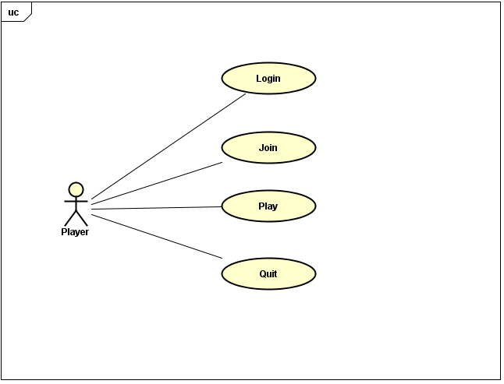
Functionality

Slide 6
Message design
Client to server:
LOGIN <username> <password>: Send username and password from client to server
JOIN: Send message from client to server when user joins a game
POS <x_position, y_position>: Send position from client to server
QUIT: Send message from client to server that user quits
Server to client:
OK <req> <message>: Send successful message from server to client
(req is request name of which this message responses, e.g. OK LOGIN logged)
FAIL <req> <message>: Send fail message from server to client
POS <x_position, y_position>: Send position from server receiving from a client to the other client
END <winner_turn>: Send message to clients to tell that the match is finished

Slide 7
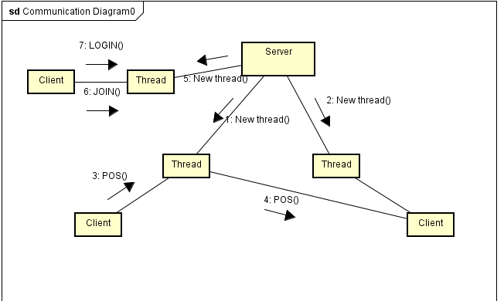

Slide 8
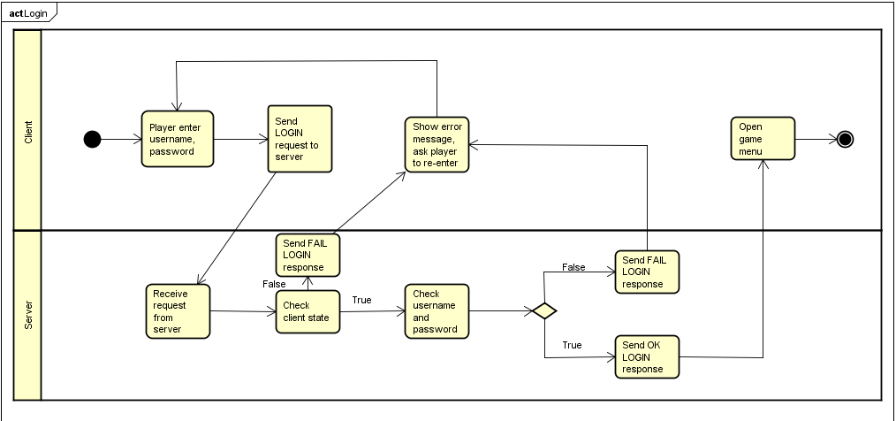
Working procedure - Login

Slide 9
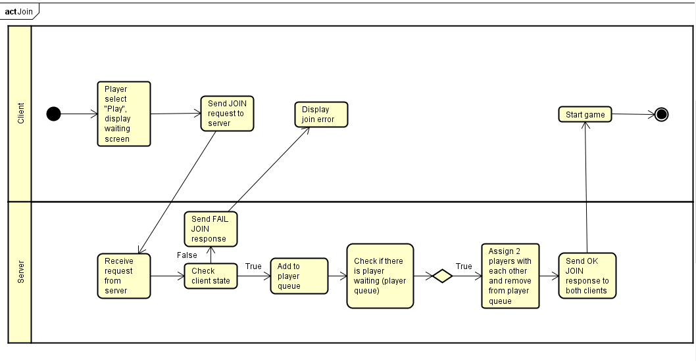
Working procedure - Join

Slide 10
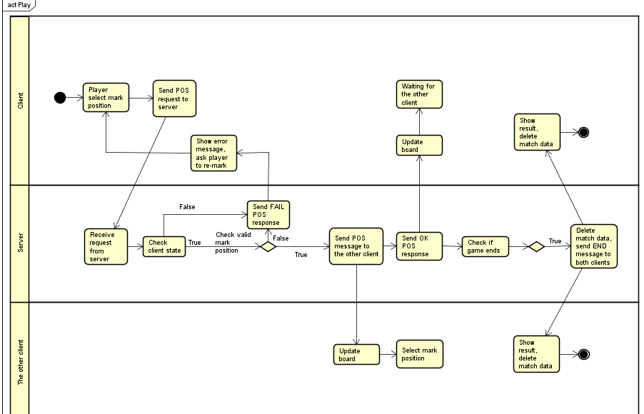
Working procedure - Play

Slide 11
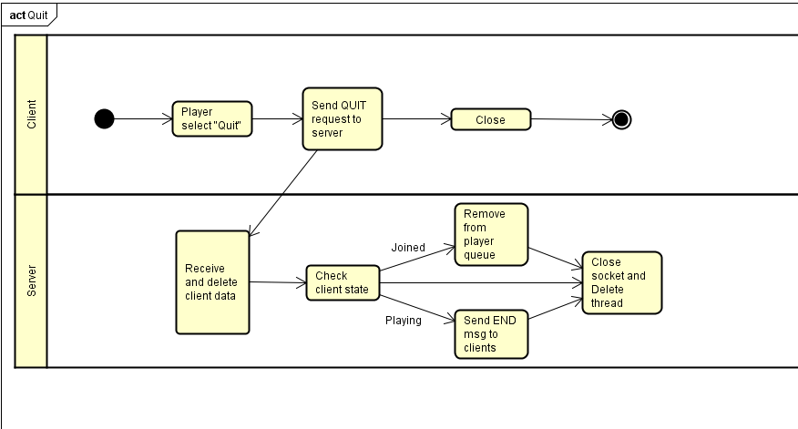
Working procedure - Quit

Slide 12
DEMO

Slide 13
Q&A
Thank you for listening

