Slide 3
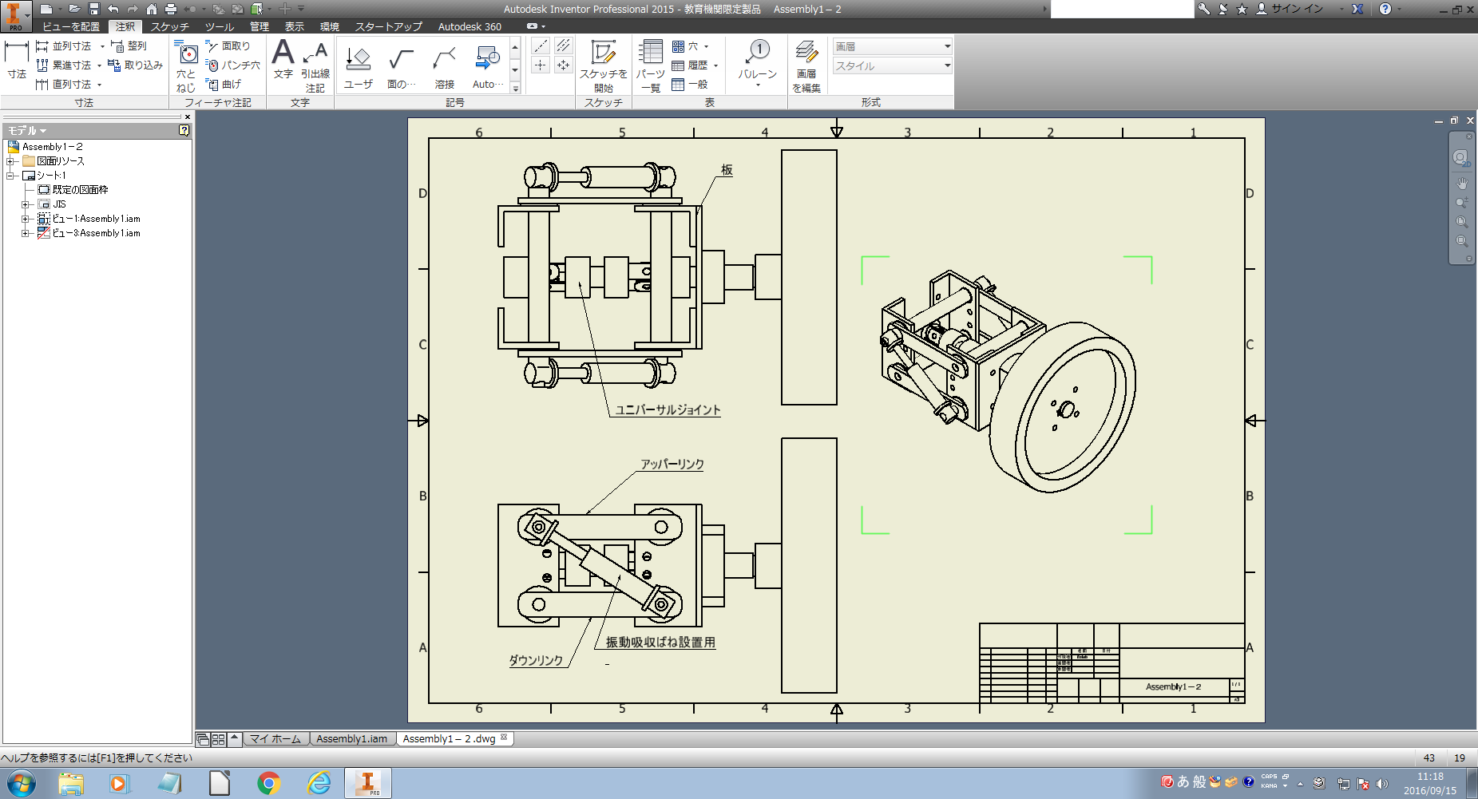

Slide 4
A
D
b
c
B
a1
C
a=60.0[mm]
c=38.0[mm]

Slide 5
D'
e1
a2
d'
E
D
A
e2
a3
C'
C
B

Slide 6
A
RAx
AC
RAy
F
B
θ
BC
C
RBx
RBy

Slide 7
A
FAC
RAx
F
FAC
RBy
RAy
RBx
B
FBC
FBC
C

Slide 8
