Slide 1
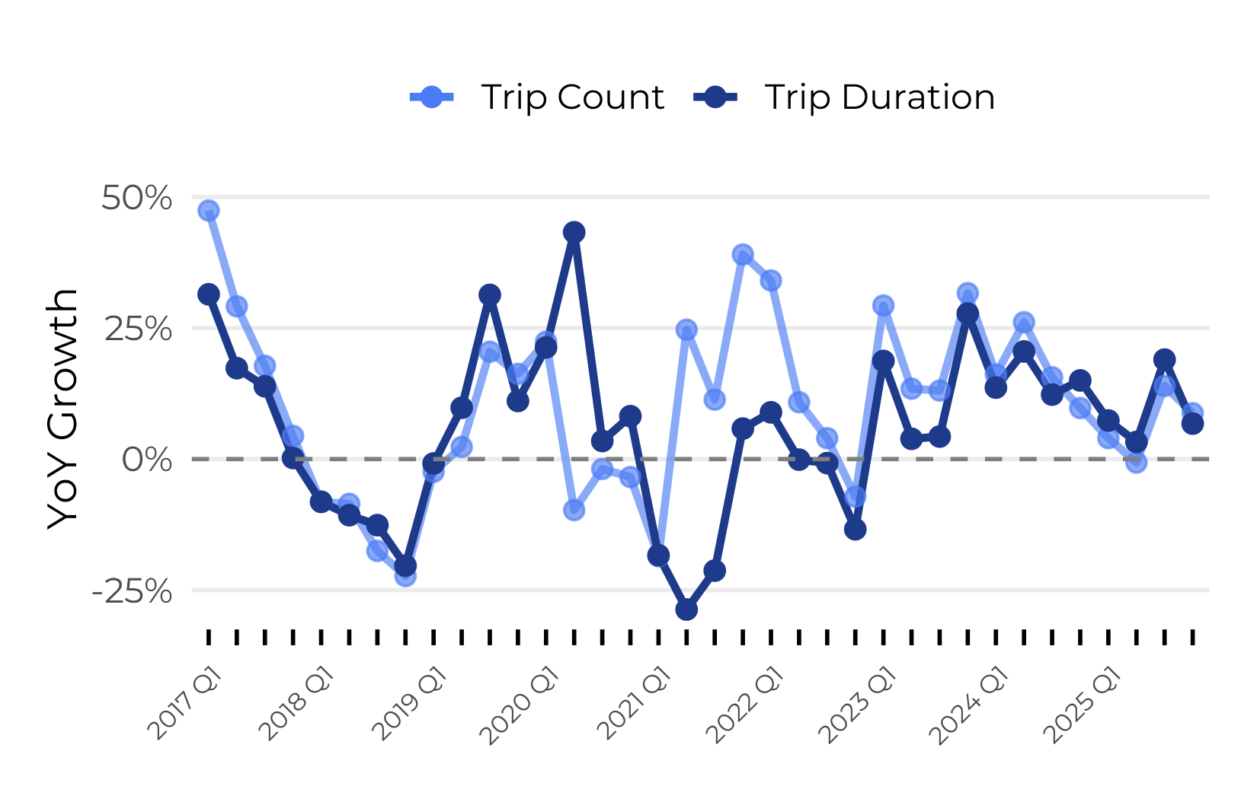
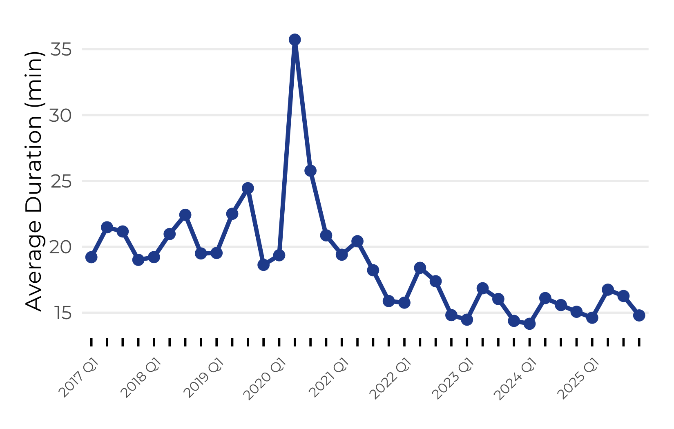
How Should Indego Quantify Growth?
Total trip duration (as a revenue proxy) and trip count are used as main measures of growth. Overall, they are quite closely linked. However, during the post-COVID period, trip count grew at a higher rate than trip duration. Possible reasons for this decrease in average trip duration could be the introduction of e-bikes¹ to the program or a change in consumer taste. Average trip duration displays minor seasonality.
6.8%
8.8%
14.8 min
Trip Duration YoY Growth (Q42024–Q42025)
Trip Count YoY Growth (Q42024–Q42025)
Average Trip Duration (Q4 2025)
COVID-19
COVID-19
¹E-bikes were introduced in mid-late 2019.

Slide 2
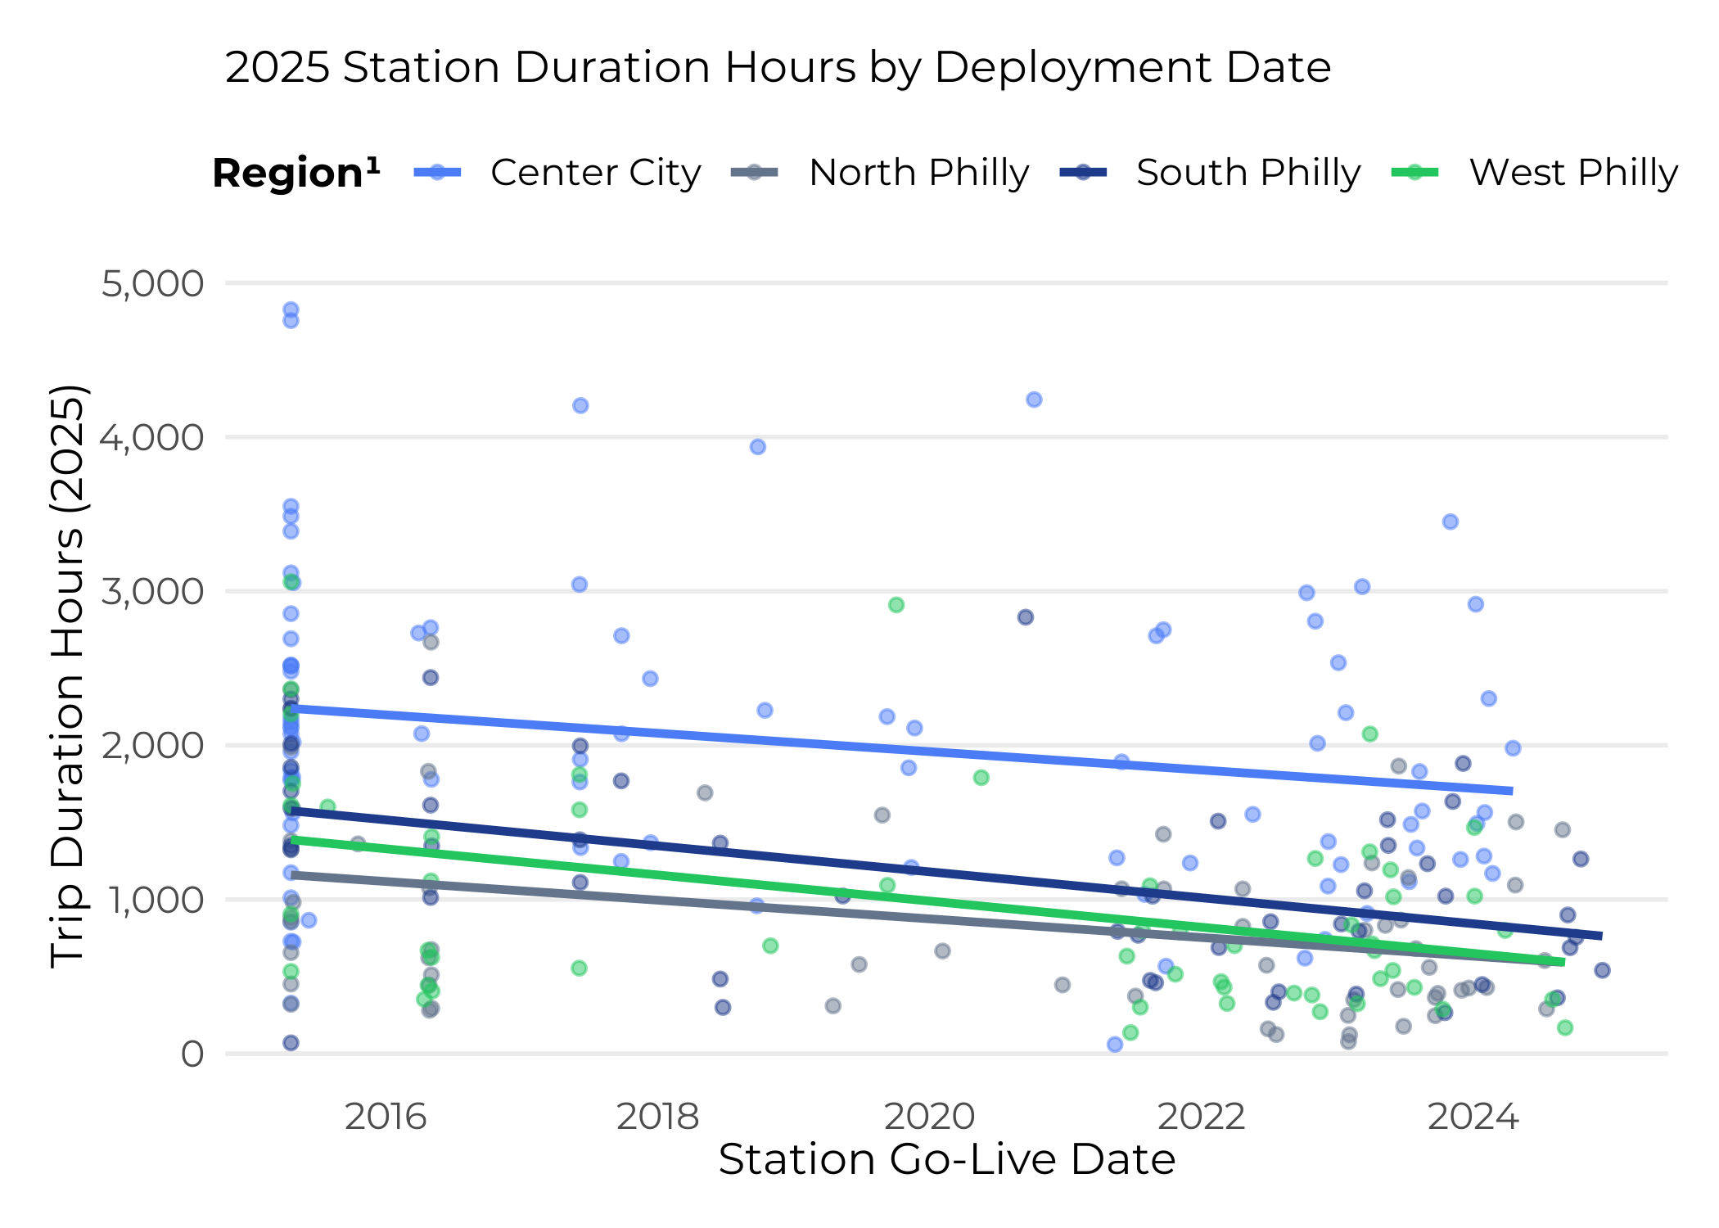
Is Indego Growing Too Fast or Too Slow?
Regional marginal revenue (in this case, duration) analysis reveals the expected revenue of a new Indego station depends on where the next station is placed. Center City, even with its high station density, still maintains an edge over other areas of Philadelphia with respect to the marginal revenue of an additional station.
KEY FINDINGS
Center City stations still generate the highest MR.
Outer regions show slightly steeper MR decline–could be a sign of saturation.
Whether Indego is growing too fast or too slow depends on where Indego is growing. It appears that Center City stations’ MR is still greater than for other regions.
RECOMMENDATIONS
Prioritize station expansion in Center City, where the marginal return is higher than in other areas of the city²
Consider ways to increase average trip duration by promoting leisure and tourism utilization
¹Region definitions were created using rough approximations of latitudinal and longitudinal lines.
²Possible limitations of this recommendation include that by building new stations in already served areas, this could cannibalize trip hours at nearby stations – we assume this is not the case for simplicity.

