Slide 1
McNair Academic Writing

Slide 2
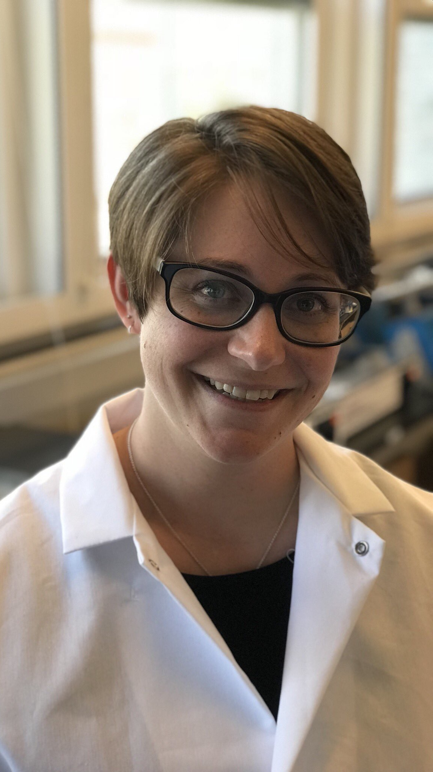
Heather Who?
University of Wyoming – Class of 2010
B.S. Microbiology/Physiology
McNair Scholar
7 out of 7 grants
University of Nebraska Medical Center – Class of 2017
Ph.D. Biochemistry and Molecular Biology
6 first-author publications, 3 out of 3 grants
Oregon National Primate Research Center
Postdoc
1 first-author publication (in prep), 2 out of 4 grants

Slide 3
Teaching Philosophy
“If a [student] can't learn the way we teach, maybe we should teach the way they learn”
-Ignacio Estrada
I have a long-standing passion for teaching science that has evolved into a teaching philosophy that focuses on teaching the way students learn and empowering learners to reach their maximum potential.

Slide 4
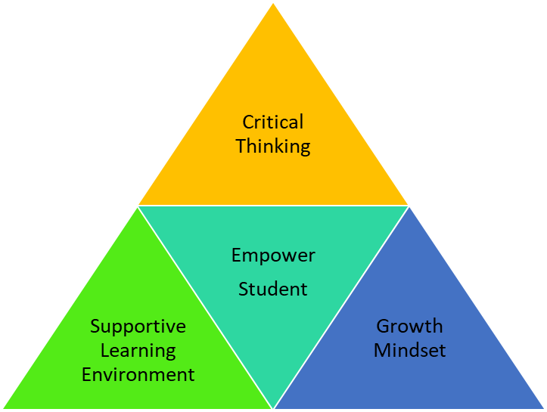
Learning Pyramid
Creating a Supportive Learning Environment
Encouraging a Growth Mindset
Development of Critical Thinking Skills

Slide 5

Course Goals
A submission-ready academic paper
Understand your writing process
Knowledge and tools to succeed at academic writing in graduate school

Slide 6


Academic Paper

Slide 7

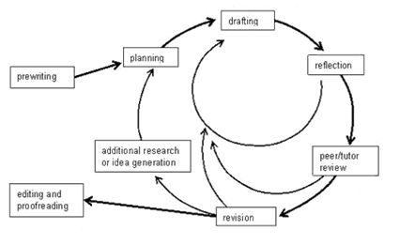
Writing Process
Notes:
https://www.lirvin.net/WGuides/wprocess.htm

Slide 8

Get through Grad School
Notes:
https://phdcomics.com/comics/archive.php?comicid=515

Slide 9
How?
Each week focus on one part of typical academic paper
Lecture, workshop, and small group discussions
Groups of 3-5 will be reviewing each other’s work each week.

Slide 10
Schedule
Class: Tuesday 2-4 PM MST
Online writing hours: M-F 8-10 AM MST, and 1-3 PM MST
Discord

Slide 11
New Course Structure and Goals
Need your feedback throughout the process
Completely Understand
Mostly Understand
Understand Pretty Well
Could Use Practice
Need Help
Don’t Understand at All

