Slide 1
McNair Academic Writing

Slide 2
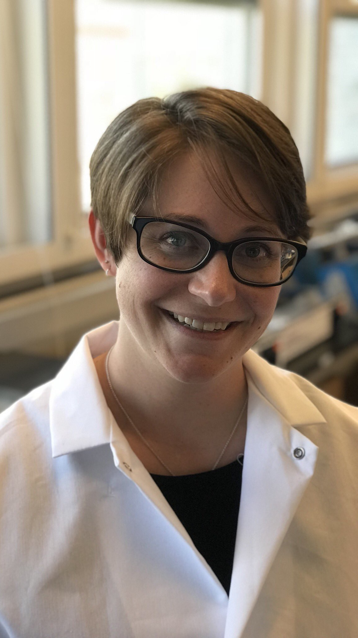
Heather Who?
University of Wyoming – Class of 2010
B.S. Microbiology/Physiology
McNair Scholar
7 out of 7 grants
University of Nebraska Medical Center – Class of 2017
Ph.D. Biochemistry and Molecular Biology
6 first-author publications, 3 out of 3 grants
Oregon National Primate Research Center
Postdoc
1 first-author publication (in prep), 2 out of 4 grants

Slide 3
Teaching Philosophy
“If a [student] can't learn the way we teach, maybe we should teach the way they learn”
-Ignacio Estrada
I have a long-standing passion for teaching science that has evolved into a teaching philosophy that focuses on teaching the way students learn and empowering learners to reach their maximum potential.

Slide 4
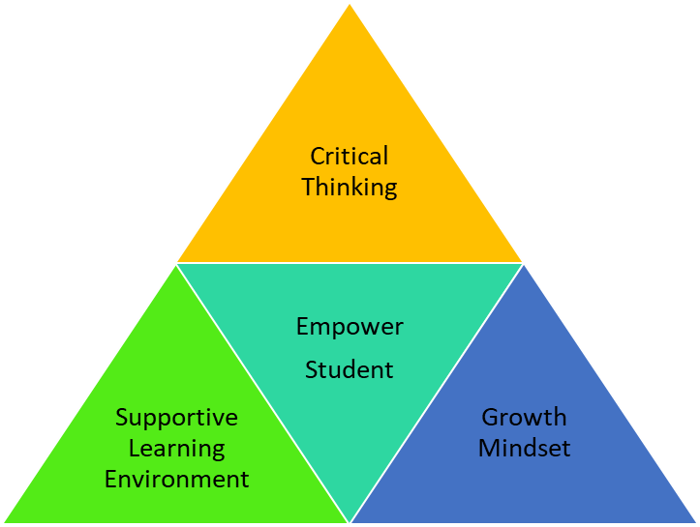
Learning Pyramid
Creating a Supportive Learning Environment
Encouraging a Growth Mindset
Development of Critical Thinking Skills

Slide 5

Course Goals
A submission-ready academic paper
Understand your writing process
Knowledge and tools to succeed at academic writing in graduate school

Slide 6


Academic Paper

Slide 7

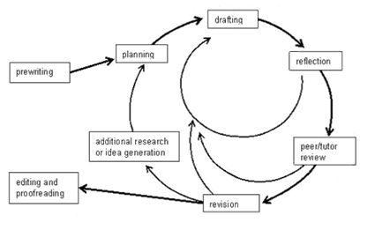
Writing Process
Notes:
https://www.lirvin.net/WGuides/wprocess.htm

Slide 8
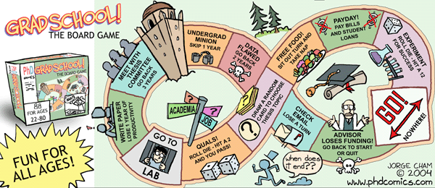
Get through Grad School

Slide 9
How?
Groups of 3-5 will be reviewing each other’s work each week.

Slide 10
Schedule
Class: Tuesday 2-4 PM MST
Online writing hours: M-F 1-3 PM MST
Discord

Slide 11
New Course Structure and Goals
Need your feedback throughout the process
Fist to five, understanding

