Slide 1
Introductions

Slide 2
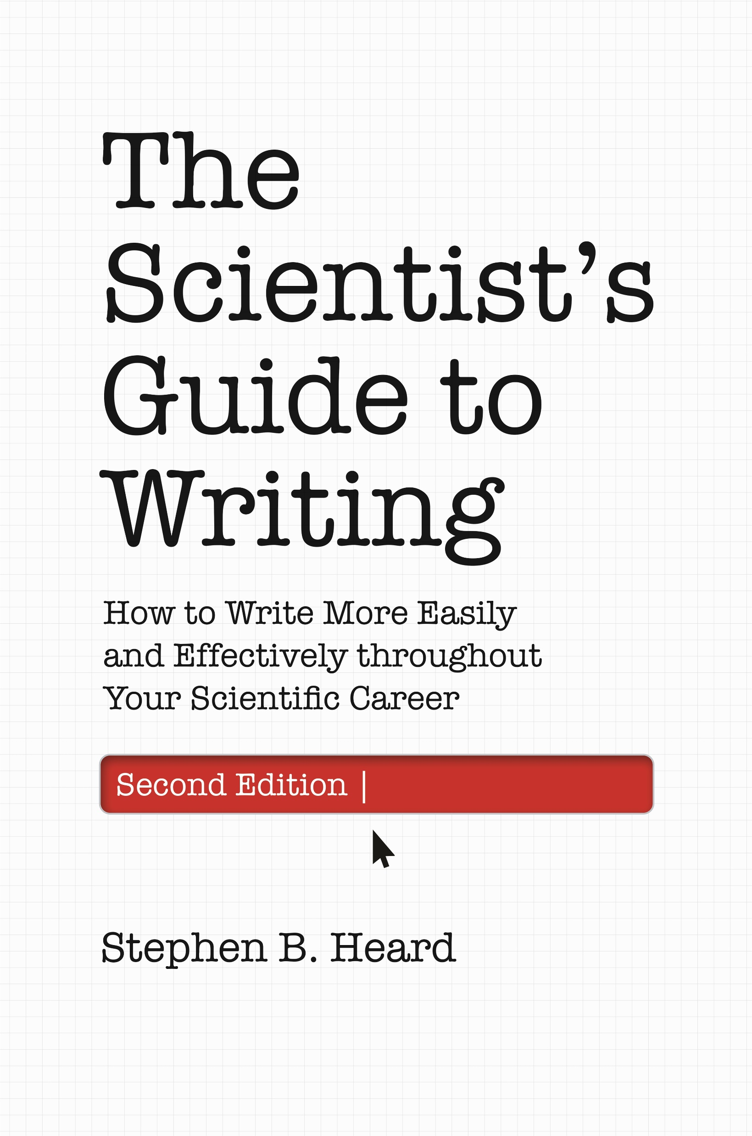
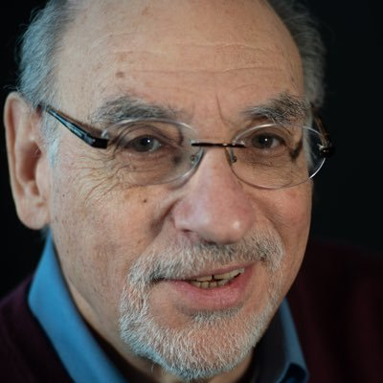

Sources and Inspiration
Stephen Heard, UNB, author of The Scientist Guide to Writing
Irving H. Zucker, UNMC
& Myron Toews, UNMC

Slide 3
BUT FIRST….

Slide 4
Titles and Abstracts
The most widely read part of any paper
Often the only parts read
…THEREFORE need to be the most well-written part

Slide 5
Title Styles
The colon title (“General issue: more specific point”)
The question title
The assertive sentence title
The funny/Witty title
The neverending title
Shortest possible summary of the paper

Slide 6
Abstracts
Summarizes paper in 150-500 words
IMRaD structure
Specific results
Open-Access
Stand-Alone

Slide 7
Back to Introductions

Slide 8
When to Write the Intro
Early
Reuse other material
“Easy” writing
In Order
Late
Focused to complement Paper “Meat”

Slide 9
Introduction Function
Set context
Advertise
Summarize

Slide 10


Components
CONTEXT - Define a research territory
KNOWLEDGE GAP - Establish a niche within the research territory
APPROACH - Occupy the niche

Slide 11
CONTEXT
What context is most important to readers

Slide 12
KNOWLEDGE GaP
ID concrete, narrow problem
State the research question

Slide 13
Approach
What did you do
why/how it answers the research question
Overview of major methods
CONTROVERSIAL: end with brief summary of results

Slide 14
Workshop: Introduction Dissection
Label the following elements:
(1a) general context of the work;
(1b) narrower research area, and its importance;
(2a) identification of knowledge gap;
(2b) specific research question to close that gap;
(3a) summary of approach to answer the research question.
Rewrite ending with (3b) announcement of principal findings or [3C] concise statement of question.

Slide 15
How - Introduction
Generally past tense
Third person (Person et al. showed XYZ…)
Active Voice
Generally to the point, no extraneous information

Slide 16
https://writingscientist.com/well-written-papers/

Slide 17
Small Group: Tell your Story
Short introductions
Tell your summer Research Plan Story
Context
Knowledge Gap
Approach
What’s Exciting about Project?
Any Concerns about project?

Slide 18
Assignment
Title
Abstract
Introduction

