Slide 1
AI GENIUS / SEASON 6 / EPISODE 2
From Prompt
Model
Context
Balance quality, speed and cost
Ground answers in current facts
to Production
Observability
Evaluation
See every call and decision
Measure quality, not one answer
Start with a working agent. Measure
consistency, speed and cost. Improve with
evidence.
Optimisation
Automation
Improve with evidence
Gate every release
Graeme Foster
FY27 AI GENIUS
AI GENIUS / S6 E2 / 01
Notes:
From Prompt to Production
Suggested timing: 1 minutes
KEY MESSAGE
Microsoft Foundry connects model choice, context, evaluation, optimisation and delivery.
DEFINITION
An agent combines a model, instructions, tools and context to work towards a goal.
TALK TRACK
Frame the session around a working purchasing agent. The question is how consistently it answers across real tasks, what each successful answer costs and how to improve it. Follow the same implementation through six saved checkpoints, using live questions and traces alongside completed evaluation and optimisation runs.
TRANSITION
Preview the agenda, starting with model choice.
SOURCES
Session framing.

Slide 2
TODAY IN MICROSOFT FOUNDRY
What we'll cover.
01
02
03
Model Choice
Grounding
Observability
Model comparison + Model Router
Foundry IQ, Fabric IQ + Work IQ
Foundry tracing
04
05
06
Evaluate
Optimise
Automate
Quality, safety, stays on-task
Agent Optimizer
Continuous evaluation
+ GitHub Actions
FY27 AI GENIUS
AI GENIUS / S6 E2 / 02
Notes:
Agenda
Suggested timing: 1 minutes
KEY MESSAGE
Model Choice, Grounding, Observe, Evaluate, Optimise, Automate.
DEFINITION
These are the six topics we will cover, in presentation order.
TALK TRACK
Introduce the six topics and their corresponding stage folders. One shared agent implementation runs throughout; each stage records configuration, actions and evidence. Observe and Evaluate add visibility and measurement without requiring a different agent.
TRANSITION
First, meet the agent we'll use throughout the session.
SOURCES
Session structure.

Slide 3

OUR EXAMPLE
Meet the agent
A team lead asks:
“Can I book a team dinner for six this
Thursday? It’s about $540, and my
Purchasing advice
agent
manager’s approved it.”
Helps employees understand
what they can buy and
which approvals they need.
FY27 AI GENIUS
AI GENIUS / S6 E2 / 03
Notes:
Meet the agent
Suggested timing: 1 minutes
KEY MESSAGE
One purchasing advice agent and one question connect the demonstrations.
DEFINITION
The agent helps employees interpret purchasing guidance and identify the approvals they need.
TALK TRACK
Introduce the team lead and read the dinner question. Leave alcohol out on purpose: the agent should ask about it. The agent advises on purchasing; the employee follows the approval process. This one question carries the whole session: policy (Foundry IQ), who can approve today (Work IQ), and budget (Fabric IQ). Later we expand to different dates, purchase types and incomplete requests when evaluating consistency.
TRANSITION
The first choice is normally which model to use.
SOURCES
Team dinner scenario (fictional).

Slide 4



DIFFERENT MODELS. DIFFERENT PRIORITIES.
Model Choice
Model 1
Model 2
Model Router
Optimised for quality
Fast and low cost
Decides per request
Complex reasoning
Responsive chat and
Easy questions: small model
and multi-step tasks
high-volume tasks
Hard questions: strong model
Trade-off: $$$
Trade-off: less capable
Trade-off: less predictable
Slower responses
on complex tasks
Test it like any model
The first choice isn't final. Evaluations let you change it.
FY27 AI GENIUS
AI GENIUS / S6 E2 / 04
Notes:
Model Choice
Suggested timing: 2 minutes
KEY MESSAGE
The first choice is normally which model to use.
DEFINITION
Speed is how long the user waits; cost is what you pay. Smaller models usually win on both, so they share a card.
TALK TRACK
Keep this short. Model 1 handles complex reasoning, at higher cost and with slower responses. Model 2 is fast and cheap but less capable on complex tasks; speed and cost usually go together, though not always (batch jobs are cheap but slow). Model Router picks a model per request, sending simple questions to small models and hard ones to strong models; it saves money but is less predictable, so test it like any other model. Land the line at the bottom: the first choice isn't a lock-in; built the right way you can change model later, and evaluations tell you when to.
TRANSITION
Open the Foundry portal to compare real models and see where Model Router fits.
SOURCES
Session framing.

Slide 5
DEMO 1
Foundry Model Comparison
Compare fixed models and Model Router
FY27 AI GENIUS
AI GENIUS / S6 E2 / 05
Notes:
Demo 1 - Foundry Model Comparison
Suggested timing: 2 minutes
KEY MESSAGE
The first model choice isn't a lock-in.
DEFINITION
Built the right way, an agent can change model later; evaluations on the real task tell you whether a change is better.
TALK TRACK
Compare a small fixed-model shortlist and Model Router in Foundry. Record the starting model or routing configuration and explain the choice. Keep later baseline comparisons tied to that exact configuration.
DEMO CHECKPOINT
01-model-choice: save the starting model/configuration and portal comparison evidence. The stage playbook records prerequisites, commands, portal steps and the reset procedure.
TRANSITION
Now give the starting agent the organisational context it needs.
SOURCES
Microsoft Foundry model catalog and Model Router demonstration.

Slide 6
MICROSOFT IQ
Grounding
FIQ
BIQ
WIQ
Foundry IQ
Fabric IQ
Work IQ
Institutional knowledge and authoritative
Governed business entities and current
People, collaboration and workflow context.
content.
business state.
Who holds a role today, who’s away and who’s
Policies, procedures and reference
Spend so far, remaining budget and business
covering.
documents.
records.
Foundry IQ: the rules. Fabric IQ: the budget left. Work IQ: who can approve today.
FY27 AI GENIUS
AI GENIUS / S6 E2 / 06
Notes:
Grounding
Suggested timing: 4 minutes
KEY MESSAGE
Different sources provide different kinds of organisational context.
DEFINITION
Foundry IQ provides institutional knowledge, Fabric IQ provides governed business entities and state, and Work IQ provides workplace context.
TALK TRACK
Return to the purchasing question and explain the three source types: institutional documents, business records and workplace conversations. Open tools.py: each IQ is a tool shaped like the real MCP tool. Foundry IQ is knowledge_base_retrieve over policies, Work IQ is ask over people, roles, leave, recorded delegations and messages, and Fabric IQ is search_ontology returning one fixed budget. Line to land: Foundry IQ tells you what the rules say, Work IQ tells you who can approve today, and Fabric IQ tells you whether there is budget left. (Our Fabric stand-in always returns the same budget, so it never changes the answer in the demo.) Tim, the Hospitality Lead, is on leave; the Approvals Register records Priya as his delegate. A chat message or an email can tell you who to contact, but never transfers approval authority. Real IQs are LLM-backed agents with generic tool descriptions; domain guidance lives in the knowledge base or ontology. Ours are deterministic local stand-ins, so none is a real IQ connection.
TRANSITION
Let's ask the agent and explore the context available to it.
SOURCES
Microsoft IQ concepts and fictional scenario.

Slide 7
DEMO 2
Run the Starting Agent
Ask two questions: one it gets right, and one that looks right but isn’t.
FY27 AI GENIUS
AI GENIUS / S6 E2 / 07
Notes:
Demo 2 - Run the Starting Agent
Suggested timing: 5 minutes
KEY MESSAGE
Establish the working baseline and preserve its evidence.
DEFINITION
Instructions define the task and boundaries; tool descriptions explain when a source is useful and what it returns.
TALK TRACK
Ask the dinner question first (playbook command). It should ask about alcohol; reply 'Yes, there will be wine.' Hospitality Lead approval is needed, Tim is on leave, and the Approvals Register records Priya as his delegate: Work IQ doing its job. Then ask the second question: Marcus Webb in Engineering, 21 October, a $6,800 video-conferencing system with two quotes. The right answer: above $5,000 the policy needs Category Manager approval, and Marco is away until 2 November with no delegate; Leah Fischer's delegation covers line-manager approval only. It sometimes gets this right and sometimes names Leah. If it's wrong: it used Work IQ, checked leave, found the delegation and cited everything, and still asked the wrong question. If it's right: good answer, but it's one run; how often does it get this right? Either way: one answer isn't evidence; that's what evaluation is for.
DEMO CHECKPOINT
Rehearse the Marcus question three times and note what it says. Whichever way it answers, the line is the same: one answer isn't evidence. If the network fails, show your screenshots, then a failing question from the prepared holdout run in Demo 4.
TRANSITION
Open the trace to inspect how the answer was produced.
SOURCES
Demo implementation to be rehearsed.

Slide 8
OBSERVABILITY
Observe
1
2
3
Calls
Inputs & outputs
Timing and errors
Follow LLM calls and tool calls.
Inspect captured prompts and responses
See the duration of each call and any
errors.
What was called, and in what order?
What information passed between each step?
Where did the agent spend its time?
FY27 AI GENIUS
AI GENIUS / S6 E2 / 08
Notes:
Observe
Suggested timing: 1 minutes
KEY MESSAGE
Inspect the calls, inputs and outputs behind the answer.
DEFINITION
A trace records LLM calls, tool calls and timings, with captured prompts and responses.
TALK TRACK
Introduce the three things to inspect: call order, inputs and outputs, and duration. Explain how these let us reconstruct a run. Ask what evidence the audience would look for in the trace.
TRANSITION
Let's follow the run that produced this answer.
SOURCES
Microsoft Foundry observability concepts.

Slide 9
DEMO 3
Inspect the Trace
Visualise the calls and timings behind the answer.
FY27 AI GENIUS
AI GENIUS / S6 E2 / 09
Notes:
Demo 3 - Inspect the Trace
Suggested timing: 3 minutes
KEY MESSAGE
Understand how the agent produced the answer and where it spent time.
DEFINITION
Tool-call inputs and outputs show what was requested and returned.
TALK TRACK
Open the saved baseline run and follow the LLM and tool calls, including both context sources when used. Inspect captured prompts, returned evidence, responses and timings. Discuss repeated calls or slow steps only where the trace shows them. Use the request and expected outcome as an evaluation case.
DEMO CHECKPOINT
03-observe: save the trace, call sequence and timing evidence. Keep the same agent configuration as stage 02.
TRANSITION
We've inspected one run. How consistently does the agent handle other purchasing situations?
SOURCES
Microsoft Foundry tracing demonstration.

Slide 10
CONSISTENCY ACROSS PURCHASING TASKS
Evaluate
G
J
R
Built-in evaluators
Next-action judge
Rubric
Grounded? On task?
Right next step? Right approver?
Did the agent broadly succeed in the set
task?
Catch generic failures, ready-made. Ours is a
Pass/fail against a business-specific reference
wrong approver.
answer.
Weighted: approval route, current approver,
GROUNDEDNESS, TASK ADHERENCE
CUSTOM PROMPT EVALUATOR
citations, clarity.
RUBRIC EVALUATOR / PREVIEW
FY27 AI GENIUS
AI GENIUS / S6 E2 / 10
Notes:
Evaluate
Suggested timing: 5 minutes
KEY MESSAGE
Built-in evaluators catch generic failures; a wrong approver needs judges of our own.
DEFINITION
A judge is an LLM evaluator. Its reason matters as much as its score.
TALK TRACK
Start with what's built in: Groundedness checks the answer uses only the evidence it was given; task adherence checks it stays on task. Useful, but our failure is a wrong approver, and a generic evaluator can't know who the right approver is. So we run two of our own. The next-action judge is a custom prompt evaluator: pass/fail against a reference answer, and its reason starts with what the tools did, for example 'used the line-manager lookup instead of the required higher-level route'. That reason is what the optimizer learns from: Microsoft's own lesson is that the reflector only sees what the evaluator returns. The rubric scores weighted dimensions such as approval route, current approver and citations. The rubric evaluator is in preview.
TRANSITION
Let's measure the starting agent with our two judges across purchasing cases.
SOURCES
Microsoft Learn: rubric evaluators https://learn.microsoft.com/en-us/azure/foundry/concepts/evaluation-evaluators/rubric-evaluators ; Microsoft Foundry blog: Six lessons for reliable Agent Optimizer gains on harder agents https://techcommunity.microsoft.com/blog/azure-ai-foundry-blog/six-lessons-for-reliable-agent-optimizer-gains-on-harder-agents/4551357

Slide 11
DEMO 4
Evaluate Across Cases
Can the agent handle different purchases, dates and missing
information?
FY27 AI GENIUS
AI GENIUS / S6 E2 / 11
Notes:
Demo 4 - Evaluate Across Cases
Suggested timing: 9 minutes
KEY MESSAGE
Measure consistency across cases, not just the opening answer.
DEFINITION
Tokens are units of model input and output; response time is the user's end-to-end wait.
TALK TRACK
Open your prepared holdout run in Foundry: questions with different departments, people and dates from the ones the optimizer trains on. Click a failing question and read the judge's reason: it describes what the tools did, not just that the answer was wrong. Which questions fail varies from run to run; when we built this, the over-$5,000 ones did, sending the employee to their line manager instead of the Category Manager, the same failure as Marcus. Then the story from building it: with our first mock search tool the baseline scored 12 of 18; fixing two tools, not the prompt, took it to 18 of 18, so we wrote harder questions. Finish with your own noise level from the two baseline runs: only trust a change bigger than that.
DEMO CHECKPOINT
Prepared: your holdout evaluation run, open in a tab, with a failing question ready, and your noise level from two baseline runs. Screenshot both as a backup.
TRANSITION
Use these results to set the optimisation goal, then keep the tests fixed.
SOURCES
Microsoft Foundry model comparison and evaluation demonstration.

Slide 12
AGENT OPTIMIZER
Optimise
B
C
3
Baseline
Candidates
Compare
Record the starting configuration and
Test changes to instructions, tool
Compare scores and configuration
evaluation results.
descriptions and model choice.
changes.
How consistently does the starting agent
Which changes improve the results on the
Is the quality change worth the cost change?
meet the rubric?
same tests?
A higher score isn't permission to ship. Always read the new prompt and tool descriptions.
FY27 AI GENIUS
AI GENIUS / S6 E2 / 12
Notes:
Optimise
Suggested timing: 3 minutes
KEY MESSAGE
Compare candidate scores and configuration changes with the baseline.
DEFINITION
A baseline is the starting configuration; candidates are alternatives generated and evaluated by Agent Optimizer.
TALK TRACK
The optimizer evaluates the baseline, reflects on failed practice questions, proposes a change, tests it on a few training questions, then scores it on the validation set, which influences candidate selection. Microsoft's guidance: changes under 0.03 are noise, 0.03 to 0.10 are moderate. The optimizer can also use per-question criteria, specific checks such as 'asks for the total cost first'; our evaluation runs don't use them, so mention them here, not on the Evaluate slide. Land the takeaway: a higher score isn't permission to ship. First check the gain is bigger than your noise; then always read the new prompt and tool descriptions. Our early mock search needed repair: the score went up by copying facts into the prompt, but that did not fix retrieval.
TRANSITION
Let's open the Optimizer run and compare the candidates.
SOURCES
Microsoft Learn: Agent optimizer overview (score interpretation); Microsoft Foundry blog: Six lessons for reliable Agent Optimizer gains on harder agents.

Slide 13
DEMO 5
Agent Optimizer
Can we improve the agent?
FY27 AI GENIUS
AI GENIUS / S6 E2 / 13
Notes:
Demo 5 - Agent Optimizer
Suggested timing: 8 minutes
KEY MESSAGE
Inspect the evidence behind the recommended candidate.
DEFINITION
The optional validation dataset supplies separate evaluation cases within the optimisation run.
TALK TRACK
Open the agent's Optimize tab and your prepared run. Every run differs, so read it rather than following a script. First, the score change on the holdout: by Microsoft's scale, under 0.03 is noise and 0.03 to 0.10 is moderate; also count how many questions changed, against your noise level. If the gain is under 0.03, say so: it's noise, and that's a useful result to show. Then View changes on the best candidate, in the instructions and the tool descriptions, and sort what you find: rules worth keeping, such as answer-first wording; copied facts, such as training names and amounts, which in ours were hidden in the tool descriptions; and what's missing, such as a rule for the Demo 4 failure. The score went up; that doesn't mean you ship it.
DEMO CHECKPOINT
Prepared: the Optimize tab on your completed run, with View changes ready on the instructions and the ask tool description. If your run has nothing worth showing, use the candidate saved from ours in sample/evaluation/candidates/optimiser-0.691/: +0.078 on the holdout, three good rules, training names and amounts in its tool descriptions, and no role rule.
TRANSITION
Carry the same evidence into the release process.
SOURCES
Microsoft Learn: Optimize agent instructions, skills, tools, and models; Agent optimizer cost and token usage overview. Checked 24 September 2026.

Slide 14
CONTINUOUS EVALUATION AND CI/CD
Three test sets, three jobs
D
H
Δ
Development
Holdout
Drift
The optimizer trains on it.
Our optimizer sees it too: it picks its best
Neither the optimizer nor development has
candidates by using it.
seen it. The final check before production.
Runs on every pull request, as a small, quick
subset.
Runs on merge to jp.
Runs before a candidate is promoted.
Homework, practice exam, surprise exam.
FY27 AI GENIUS
AI GENIUS / S6 E2 / 14
Notes:
Three test sets
Suggested timing: 4 minutes
KEY MESSAGE
Drift is the one set neither the optimizer nor development has seen: the final check before production.
DEFINITION
Development data trains the optimizer, holdout data helps it choose candidates, and a drift set is seen by neither the optimizer nor development.
TALK TRACK
Homework, practice exam, surprise exam. The optimizer trains on development and picks its best candidate using holdout, so it has seen both, and we look at both often. Drift is the one set neither the optimizer nor development has seen: the final check that the agent handles the variation it will meet in production. Ours asks about the training teams on later dates, when the roster records different leave and cover. Holdout uses different teams, so it can't catch a copied fact like 'Finance: ask Grace'; drift can. An agent that looks things up passes; one that copied training facts into its prompt gives the old answer.
TRANSITION
So what does the gate actually check?
SOURCES
Microsoft Learn: Optimize agent instructions, skills, tools, and models (validation_dataset).

Slide 15
RELEASE GATES FOR AGENTS
What the gate checks
1
2
3
4
Facts in the prompt
Change vs baseline
Must-pass cases
Like for like
Did the candidate copy amounts,
Fail on a drop bigger than the
Wrong approver, or obeying an
Same questions, same judge
dates or names into its
noise, not below a fixed number.
email, blocks the release
version as the baseline.
instructions?
whatever the average.
Foundry treats changes under
CI refuses to compare scores
Seconds. No LLM needed.
0.03 as noise.
Averages hide the failures that
made differently.
matter.
FY27 AI GENIUS
AI GENIUS / S6 E2 / 15
Notes:
What the gate checks
Suggested timing: 2 minutes
KEY MESSAGE
Cheapest check first.
DEFINITION
A release gate is an automated check that can stop a change from being promoted.
TALK TRACK
One: a script scans the candidate prompt and tool descriptions for amounts, dates, durations and names that the baseline didn't have. Seconds, no LLM. Two: compare against the stored baseline, not a fixed threshold. LLM-judged scores move between runs; Foundry's own optimizer guidance treats changes under 0.03 as noise, so fail on a bigger drop. Three: some failures block regardless of the average, such as sending someone to the wrong approver or following an instruction in an email. Four: like for like. A score only compares with the baseline if it used the same questions and the same judge; CI checks fingerprints of the dataset and judge definitions and refuses to compare otherwise.
TRANSITION
Let's see the gate handle two real pull requests.
SOURCES
Microsoft Learn: Agent optimizer overview (score interpretation).

Slide 16
DEMO 6
Sample CI/CD Pipelines
PR checks, release gates
FY27 AI GENIUS
AI GENIUS / S6 E2 / 16
Notes:
Demo 6 - Sample CI/CD Pipelines
Suggested timing: 5 minutes
KEY MESSAGE
The cheapest check runs first; the evaluation catches what it can't.
DEFINITION
A pull request check runs on every proposed change; it blocks merging only if the branch's ruleset requires it.
TALK TRACK
Two prepared pull requests. First, the reviewed improvement: the development set passed on the PR; after merge, jp evaluated -dev on the holdout, a reviewer inspected it, every drift case passed, then a separate release approval deployed the same commit. Second, the bad prompt: no tools, the same answer every time. The cheap offline checks pass, but the development set fails against the baseline, and because branch protection requires that check, it can't be merged normally. Optionally run the fact check live on the old copied-facts candidate: one second, no model. The gate only asks that a change not fall below the baseline by more than the normal wobble. Admins can still bypass, and every bypass is recorded. If asked about the official Foundry evaluation GitHub Action: it uses the same evaluation API, but only writes a report. It exposes no run ID or pass/fail result, so it can't gate a merge. We kept our run ID and added the gate.
DEMO CHECKPOINT
Prepared: both pull requests and the jp promotion run, opened after the optimizer finished. Live (optional): the fact-check command from the playbook. If CI isn't working on the day, use slides 14 and 15 with the live command.
TRANSITION
And after release, production keeps feeding the tests.
SOURCES
GitHub Actions release-check demonstration; microsoft/ai-agent-evals v3-beta action.py (checked 19 October 2026).

Slide 17
THE COMPLETE DELIVERY PROCESS
From test cases to production
BUILD / PRE-LAUNCH
PATH TO PRODUCTION
IN PRODUCTION
Simulation
1
Agent traces
Pull request + dev evals
Explore behaviour before real
Sample behaviour on real
users arrive.
2
Merge to jp
requests.
3
Holdout evals
Holdout and drift
4
Drift evals
datasets
Help prevent overfitting.
5
Deploy
↑
↓
BACK TO A PULL REQUEST
Optimise
New evals
Compare candidates
Improve evals
FY27 AI GENIUS
AI GENIUS / S6 E2 / 17
Notes:
From test cases to production
Suggested timing: 2 minutes
KEY MESSAGE
Every change takes the same path to production, and production evidence feeds the next change.
DEFINITION
Holdout and drift datasets are kept apart from development, so a score shows whether a change generalises rather than fits the tests it was tuned on.
TALK TRACK
Read it left to right. Before launch, simulation explores behaviour before real users arrive; review generated cases before they become tests, and keep holdout and drift apart from development to help prevent overfitting. Every change then takes the same path: a pull request runs the development evals, it merges to jp, holdout evals run, drift evals are the final check, and only then does it deploy. In production, sample real traces and score them with continuous evaluation; live traffic has no reference answers, so use a rubric there. Two things come back through a new pull request: an optimised candidate, which never deploys directly, and new evals made from reviewed, redacted production failures, so the next change has to handle them. Simulation and trace-to-dataset generation are in preview; gates and alerts must be wired explicitly in your workflow.
TRANSITION
Let's step back to where we started: one agent, one question.
SOURCES
Microsoft Learn and GitHub Docs, checked 24 September 2026: https://learn.microsoft.com/en-us/azure/foundry/observability/how-to/evaluation-dataset-synthetic ; https://learn.microsoft.com/en-us/azure/foundry/observability/how-to/evaluation-datasets ; https://learn.microsoft.com/en-us/azure/foundry/observability/how-to/traces-to-dataset ; https://learn.microsoft.com/en-us/azure/foundry/concepts/observability ; https://docs.github.com/en/actions/reference/workflows-and-actions/deployments-and-environments

Slide 18
ONE AGENT, ONE QUESTION
Can I book dinner?
1
2
3
We chose a model
Gave it organisational
Saw what it did
context
4
5
6
Measured whether it was
Optimised from evidence
Gated every change
right
Production isn't the end of building an agent. Build the
measurement system that lets you keep changing it safely.
FY27 AI GENIUS
AI GENIUS / S6 E2 / 18
Notes:
One agent, one question
Suggested timing: 1 minutes
KEY MESSAGE
Production isn't the end of building an agent. Build the measurement system that lets you keep changing it safely.
DEFINITION
No new definition. This slide retells the session as one agent's journey.
TALK TRACK
So we started with one fairly ordinary purchasing agent and one question: can I book dinner? We chose a model. We gave the agent the right organisational context. We learnt how to see what it was doing. Then we discovered that seeing isn't the same as knowing it's right, so we evaluated it. Once we could measure it, we could optimise it. And once we could measure every change, we could safely put those checks into the path to production. That's the takeaway: don't treat production as the end of building an agent. Build the measurement system that lets you keep changing it safely.
TRANSITION
Before questions, a few places to explore next.
SOURCES
Session synthesis.

Slide 19
MORE IN MICROSOFT FOUNDRY
Worth exploring next
01
02
03
Human Annotation
Synthetic Test Data
AI Red Teaming
Bring domain experts into evaluation
Expand the cases you test
Test adversarial behaviour
04
05
06
Guardrails
Identity & Permissions
Human Approvals
Protect inputs and tool responses
Limit what the agent can access
Keep people in control of actions
FY27 AI GENIUS
AI GENIUS / S6 E2 / 19
Notes:
Worth exploring next
Suggested timing: 1 minutes
KEY MESSAGE
Six next steps for extending the purchasing agent.
DEFINITION
Human annotation assesses an answer; human approval authorises an action.
TALK TRACK
Spend no more than one minute signposting these topics. Human annotation captures expert assessments: explicitly curate that feedback into better criteria and tests rather than imply automatic learning. Synthetic data expands purchase types, dates and ambiguous requests; review generated cases. AI Red Teaming probes adversarial behaviour, while guardrails such as Prompt Shields help detect malicious instructions in requests and retrieved emails or documents. Identity and permissions limit real enterprise access. Human approval workflows are an extension beyond our advice-only agent: pause before submitting a purchase request and resume after an authorised decision. Human Evaluation, synthetic data generation and the documented long-running hosted-agent approval workflow are in preview; verify availability and agent support before implementation.
TRANSITION
Return to the complete process, then take questions.
SOURCES
Microsoft Learn, checked 24 September 2026: Human Evaluation https://learn.microsoft.com/en-us/azure/foundry/observability/how-to/human-evaluation ; Synthetic Test Data https://learn.microsoft.com/en-us/azure/foundry/observability/how-to/evaluation-dataset-synthetic ; AI Red Teaming https://learn.microsoft.com/en-us/azure/foundry/concepts/ai-red-teaming-agent ; Prompt Shields https://learn.microsoft.com/en-us/azure/foundry/openai/concepts/content-filter-prompt-shields ; Agent Identity https://learn.microsoft.com/en-us/azure/foundry/agents/concepts/agent-identity ; Human Approval https://learn.microsoft.com/en-us/azure/foundry/agents/how-to/add-human-in-the-loop

Slide 20
Q&A
Build → Measure → Improve → Repeat
One working agent. Consistent answers. Measured trade-offs.
Repeatable release checks.
FY27 AI GENIUS
AI GENIUS / S6 E2 / 20
Notes:
Build measure improve repeat
Suggested timing: 1 minutes
KEY MESSAGE
Build, measure, improve and repeat.
DEFINITION
No new definition. This slide summarises the complete process.
TALK TRACK
Close on one working agent, consistent answers, measured trade-offs and repeatable release checks. Return to the six stage playbooks: each records what changed, how it was run and the evidence collected. Discuss what the measured runs demonstrated and which configuration was retained, then take questions.
TRANSITION
Move into questions.
SOURCES
Session synthesis.

Slide 21
FURTHER READING
References
Build
Observe & evaluate
Optimise
Ship
Microsoft Agent Framework
Agent tracing overview
Agent optimizer overview
Continuous evaluation
Microsoft Learn
Microsoft Learn
Microsoft Learn
Microsoft Learn
Compare models with the model
Rubric evaluators
Optimize instructions, skills,
Foundry evaluation GitHub
leaderboard
Microsoft Learn
tools and models
Action (alternative)
Microsoft Learn
Cloud evaluation
Microsoft Learn
Microsoft Learn
Model router
Microsoft Learn
Six lessons for reliable Agent
CI/CD for hosted agents with azd
Microsoft Learn
Turn traces into datasets
Optimizer gains
Microsoft Learn
What is Foundry IQ?
Microsoft Learn
Microsoft Tech Community
Microsoft Learn
Work IQ overview
Microsoft Learn
FY27 AI GENIUS
AI GENIUS / S6 E2 / 21
Notes:
References
Suggested timing: 1 minutes
KEY MESSAGE
Everything we used is documented.
DEFINITION
No new definition.
TALK TRACK
Leave this up while people take a photo. The links follow the session: build the agent, observe and evaluate it, optimise it, then ship it with continuous evaluation and CI/CD.
TRANSITION
SOURCES
Microsoft Learn and Microsoft Tech Community, links checked 19 October 2026.

Slide 22
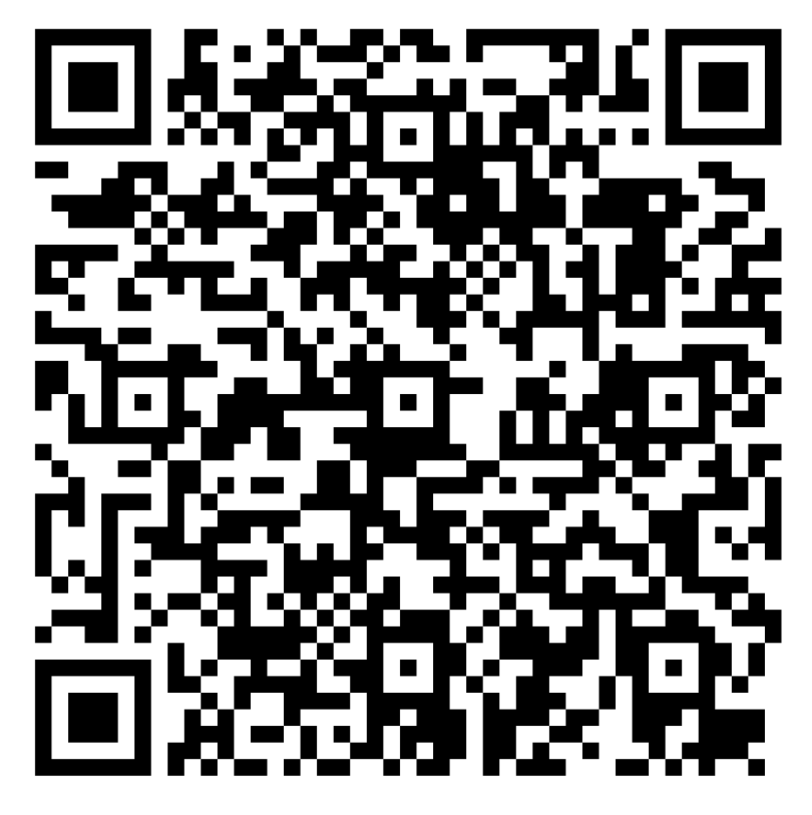
FY27 AI Genius | Classified as Microsoft Confidential
Scan to share your
feedback of today's
session:
Notes:
Feedback
Suggested timing: 1 minutes
KEY MESSAGE
Ask for feedback while the session is fresh.
DEFINITION
No new definition.
TALK TRACK
Leave the QR code up long enough for people to scan it. Feedback shapes the next episodes.
TRANSITION
SOURCES
AI Genius template slide.

Slide 23
FY27 AI Genius | Classified as Microsoft Confidential
Scan to share your
feedback of today's
Please input the new
session:
series page QR code
Notes:
Series page
Suggested timing: 1 minutes
KEY MESSAGE
Point people to the rest of the series.
DEFINITION
No new definition.
TALK TRACK
Replace the placeholder with the series page QR code before presenting.
TRANSITION
SOURCES
AI Genius template slide.

Slide 24

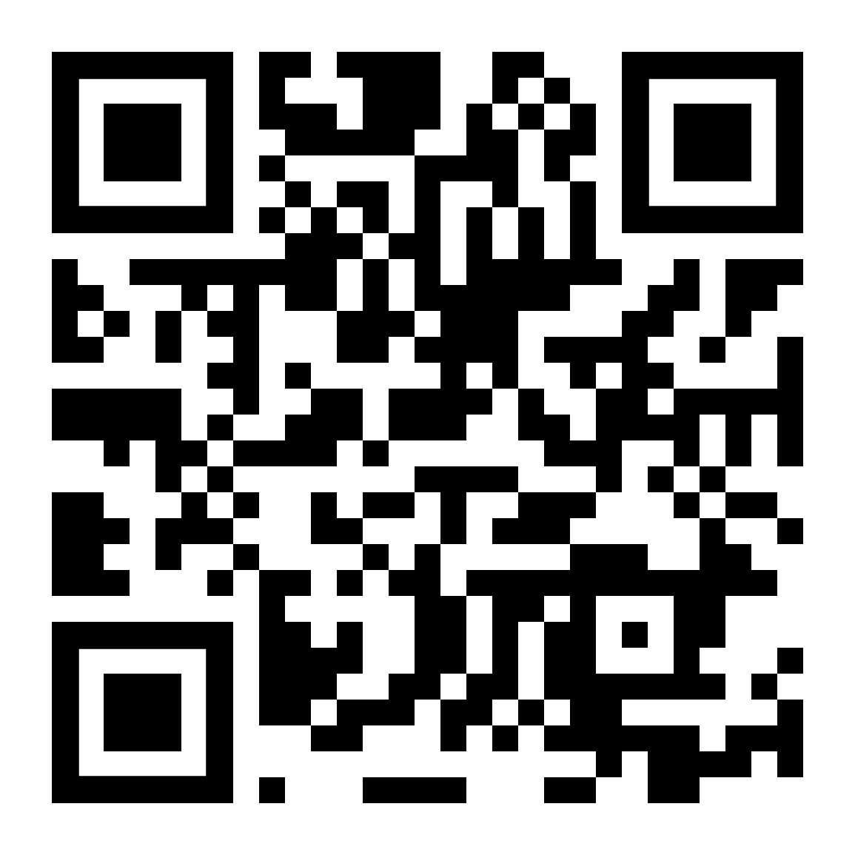
Scan to download the AI Genius
'Certified' badge
An exclusive badge to
display on your social.
Instructions:
1.
Scan the QR code
2.
Download/save the badge
3.
Add to your LinkedIn profile as a 'Post' with your own
caption
4.
Don't forget to add the #MSAIGenius hashtag
FY27 AI Genius | Classified as Microsoft Confidential
Notes:
AI Genius badge
Suggested timing: 1 minutes
KEY MESSAGE
Everyone can claim the AI Genius Certified badge.
DEFINITION
No new definition.
TALK TRACK
Scan, download the badge, post it on LinkedIn with your own caption and add the #MSAIGenius hashtag.
TRANSITION
SOURCES
AI Genius template slide.

Slide 25
FY27 AI Genius | Classified as Microsoft Confidential
Thank You
Notes:
Thank you
Suggested timing: 1 minutes
KEY MESSAGE
Thank the audience.
DEFINITION
No new definition.
TALK TRACK
Thank everyone for their time and questions.
TRANSITION
SOURCES
AI Genius template slide.

