Slide 1
Abstract of CG

Slide 2
Contents
Pipeline / Rasterisation
Framebuffer / Multiple Buffering
Space

Slide 3
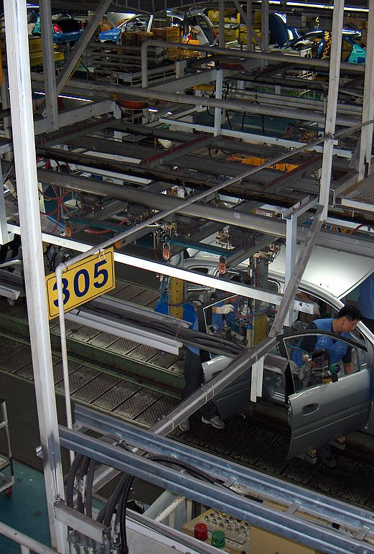
Pipeline
Sequence of steps used to create a 2D raster image
The 2D image represents a 3D scene

Slide 4
Graphics Pipeline(OpenGL)
Vertex
Specification
Vertex
Processing
Vertex
Post-processing
Primitive
Assembly
Fragment
Shader
Rasterising

Slide 5
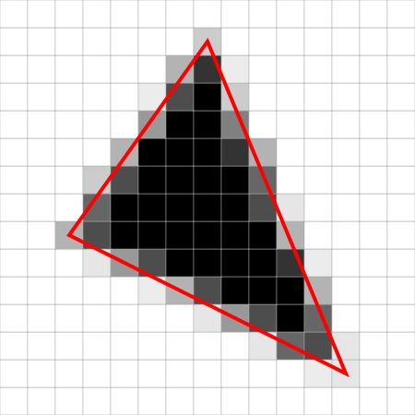
Rasterisation

Slide 6
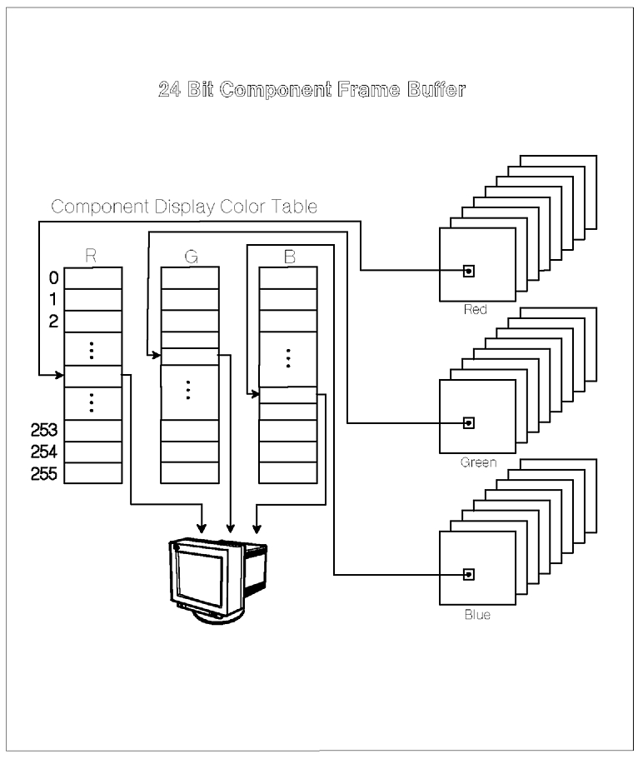
Framebuffer

Slide 7
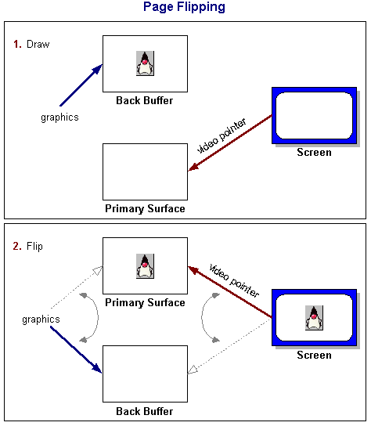
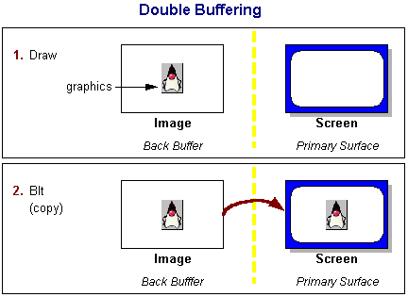
Multiple Buffering

Slide 8
Space
Local Space
World Space
Eye Space
Projection Space

