Slide 1
Introduction to ELF

Slide 2
Contents
What is ELF?
Magic number
ELF Header

Slide 3
What is ELF?
Executable and Linkable Format
Common standard file format for
Executable file
Object code
Shared libraries
Core dump

Slide 4
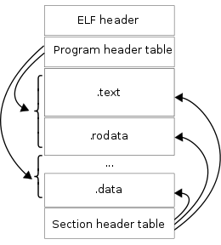
What is ELF?
Made up with of one ELF header, followed by file data
readelf tool can read / display information about ELF files
The ELF header is 52 bytes long for 32 bit, 64 bytes long for 64 bit addresses
(1)

Slide 5
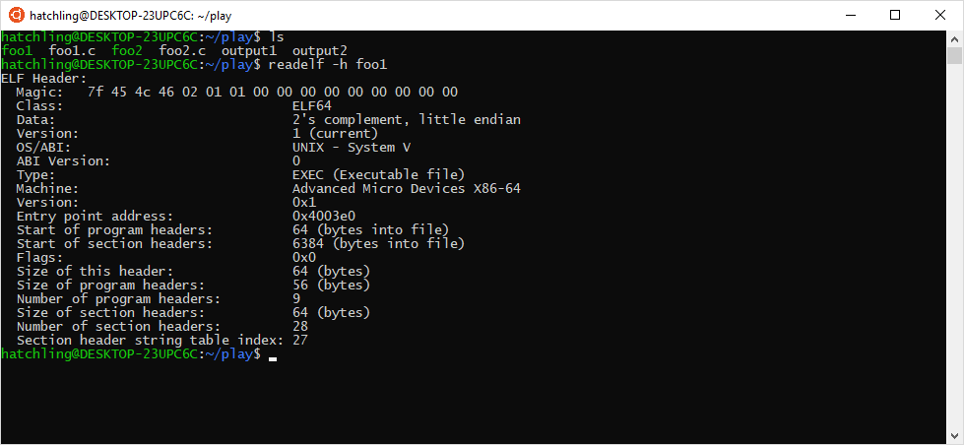
What is ELF?
ELF header

Slide 6
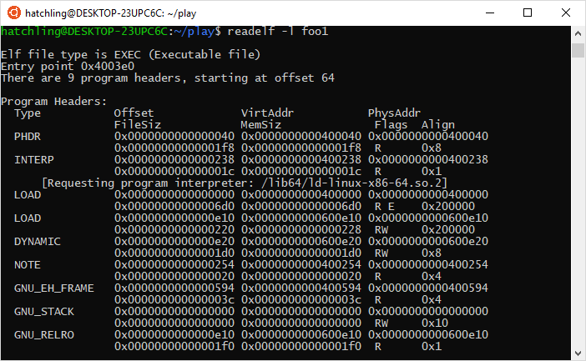
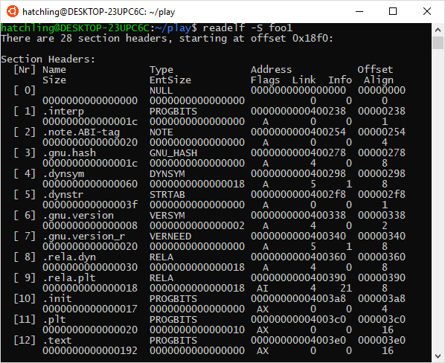
What is ELF?

Slide 7
Magic number
Data used to identify the contents of a file
In Unix-like system, filename extension is not mandatory
Therefore, we use file command to read / interpret magic numbers
Similar to MIME type

Slide 8
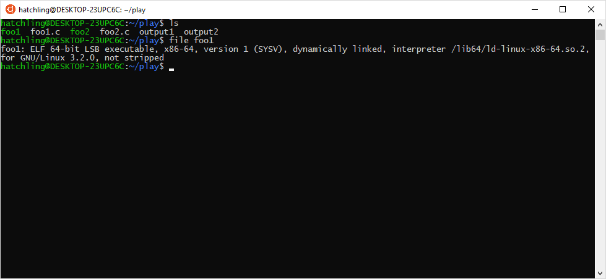
Magic number

Slide 9
What is ELF?
Program header table
Tells the system how to create a process image:
A copy of the process at a given point in time
Files used to execute a program must have one
Section header table
Contains information describing the file’s sections
Files used during linking must have one

Slide 10
ELF header

Slide 11
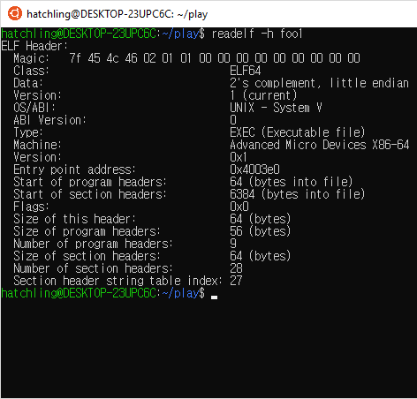
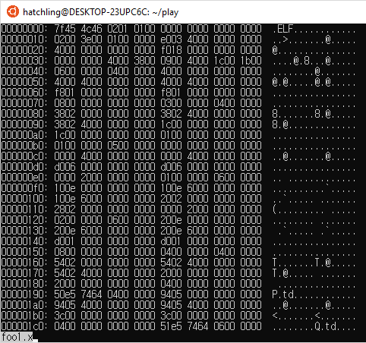
ELF header

Slide 12
Overall
ELF is common standard file format used in Unix-like system
Made up of one ELF header, followed by file data
Magic number is [ 0x7F, ‘E’(0x45), ‘L’(0x4C), ‘F’(0x46) ]
Difference between section vs. segment?

Slide 13
Citation
https://refspecs.linuxfoundation.org/elf/elf.pdf
(1) - https://en.wikipedia.org/wiki/File:Elf-layout--en.svg

