Slide 1
Concurrency vs. Parallelism
To make programmes a little bit more efficient

Slide 2
Contents
Parallelism?
Concurrency?

Slide 3
Parallelism?
In Korean : 병렬성
To physically do more than one thing at once
Requires hardware support

Slide 4
Bit-level parallelism
Ex) Operating two 16-bit integer with 8-bit processor
lower-order bits 1
higher-order bits 1
lower-order bits 2
higher-order bits 2
Clock Cycle
Operation Result
Operation Result

Slide 5
Bit-level parallelism
Ex) Operating two 16-bit integer with 16-bit processor
All bits 1
All bits 2
Operation Result

Slide 6
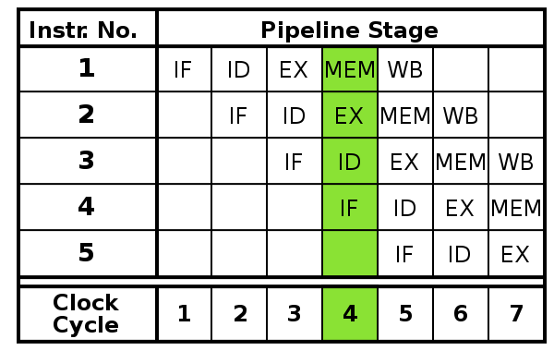
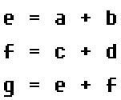
Instruction-level parallelism
Instruction pipelining, Superscalar, etc…

Slide 7
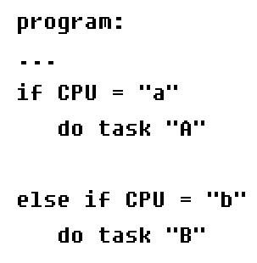

Task parallelism

Slide 8


Parallelism

Slide 9
Concurrency?
In Korean : 병행성 / 동시성
Let “→” as “happened before”
If a → b, then it is possible for a to casually affect b
Two events are concurrent if…
!(a → b) && !(b → a)
neither can casually affect the other

Slide 10
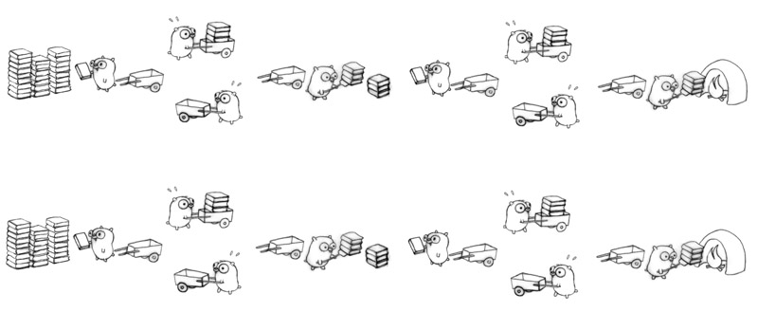
So what?
Concurrency is programming as the composition of independently executing processes!

Slide 11

Concurrency

Slide 12

Concurrency

Slide 13

Concurrency

Slide 14

Concurrency

Slide 15

Concurrency

Slide 16

Concurrency

Slide 17
Concurrency

Slide 18
Todo
MutEx?
Semaphore?
Maybe example codes?

