Slide 1
MutEx & Semaphore
Ways to control programme concurrently

Slide 2
Contents
MutEx
Semaphore
Ex code
Todo

Slide 3
MutEx?
Short form of “Mutual Exclusion”
Kind of locking mechanism, monopolising resource
To prevent race condition

Slide 4
Race condition?
Occurs when…
1. Two or more threads can access shared data
2. They try to change it at the same time
These shared data needs to be in critical section

Slide 5
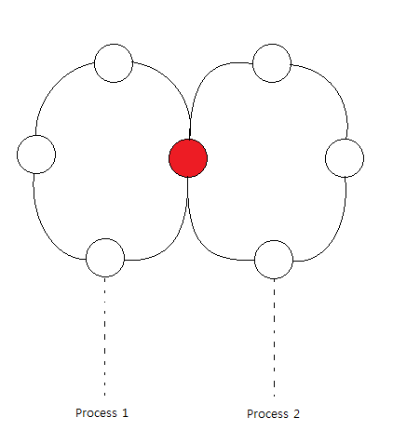
Critical section?
Parts of the program where the shared resource is accessed
Cannot be executed by more than one process
Ex) When different codes/processes needs to access same variable

Slide 6
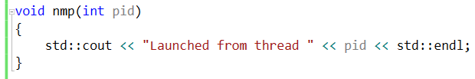
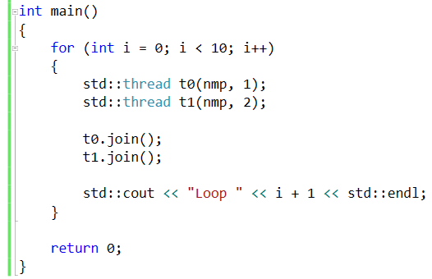
Ex code for MutEx(Dekker’s Algorithm)

Slide 7
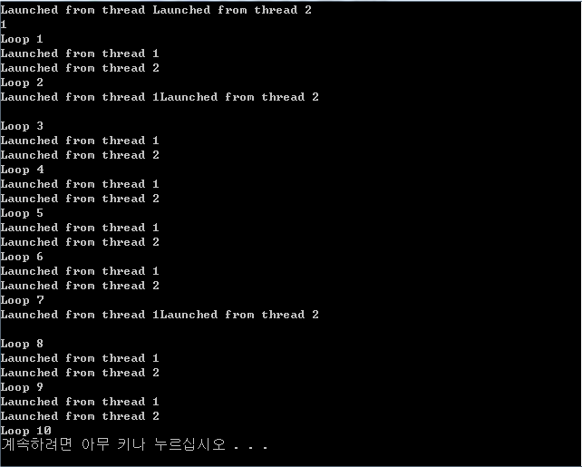
Ex code for MutEx(Dekker’s Algorithm)

Slide 8

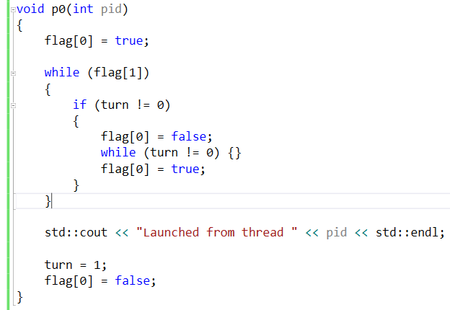
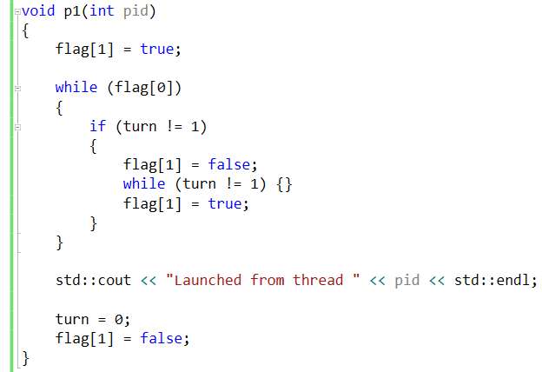
Ex code for MutEx(Dekker’s Algorithm)

Slide 9
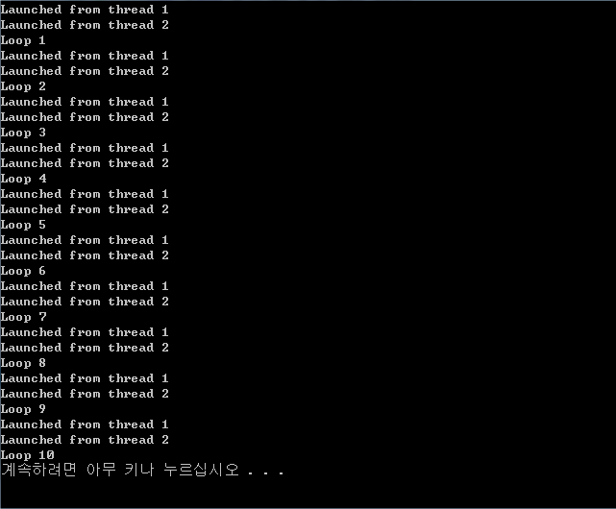
Ex code for MutEx(Dekker’s Algorithm)

Slide 10
Semaphore?
A variable or abstract data type
Kind of signalling mechanism, sharing resource
To control access to a common resource by multiple processes
MutEx is-a Semaphore(MutEx ≈ Binary Semaphore)

Slide 11
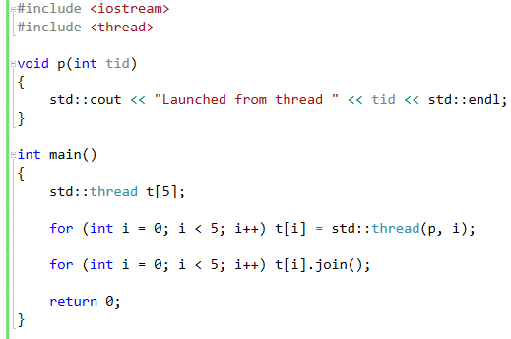
Ex code for Semaphore

Slide 12
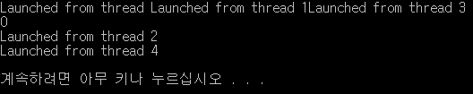
Ex code for Semaphore

Slide 13
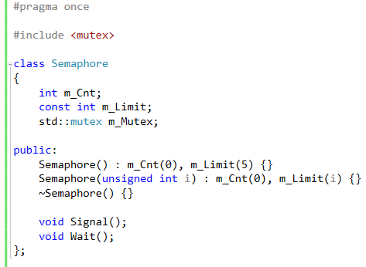
Ex code for Semaphore

Slide 14
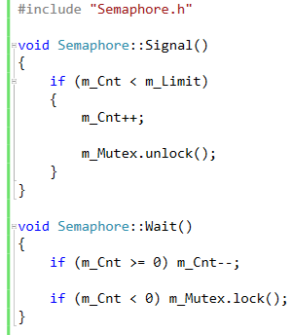
Ex code for Semaphore

Slide 15
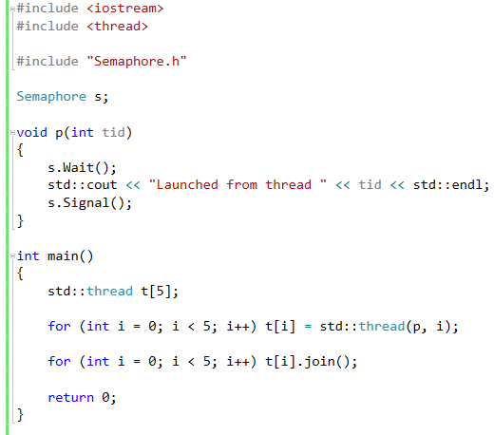
Ex code for Semaphore

Slide 16
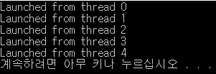
Ex code for Semaphore

Slide 17
Todo
Application of multithread programming to computer graphics
Especially on physic simulation(optics, dynamics and so on)

