Slide 1
VK_Prerequisite
Generic programming and syntactic sugar in modern C++

Slide 2
Contents
Generic programming?
Lambda function & Function object
Type deduction
and a little bit more…

Slide 3
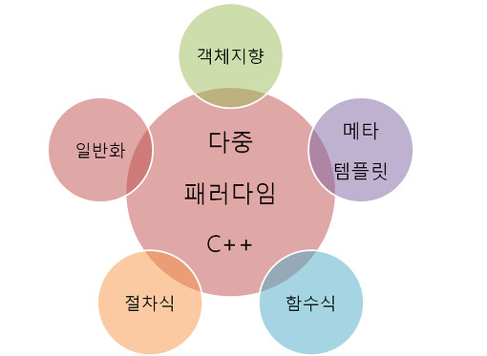
Generic programming?

Slide 4
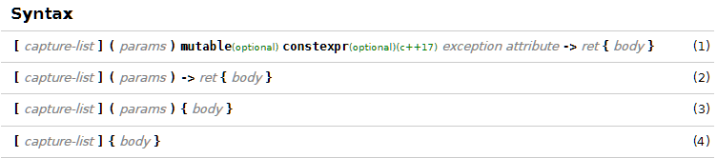
Lambda function
A function definition that is not bound to an identifier

Slide 5
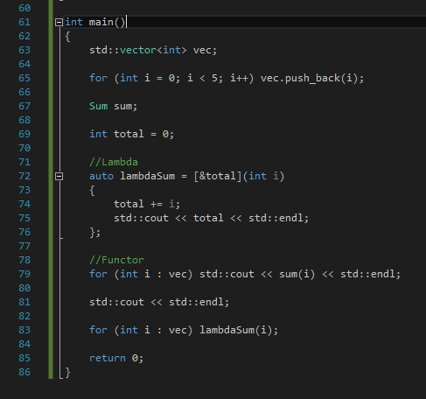
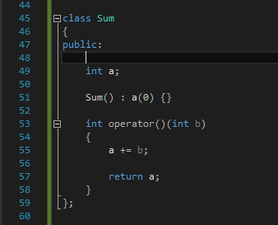
Function Object vs Lambda

Slide 6
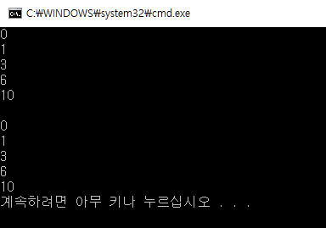
Function Object vs Lambda

Slide 7
Pros
1. Can ‘capture’ the state of a function
2. Lazy evaluation
3. Widely used in many powerful libraries(Ex. STL, Boost…)

Slide 8

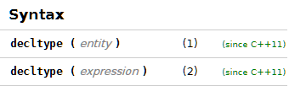
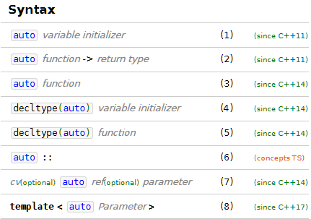
Type deduction
template
decltype
auto

Slide 9
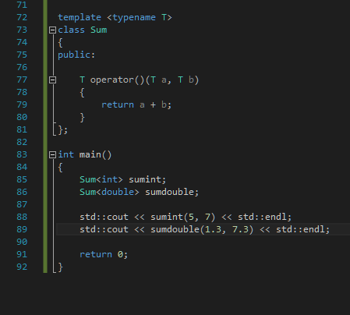
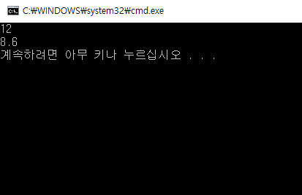
Template

Slide 10


auto & decltype

Slide 11
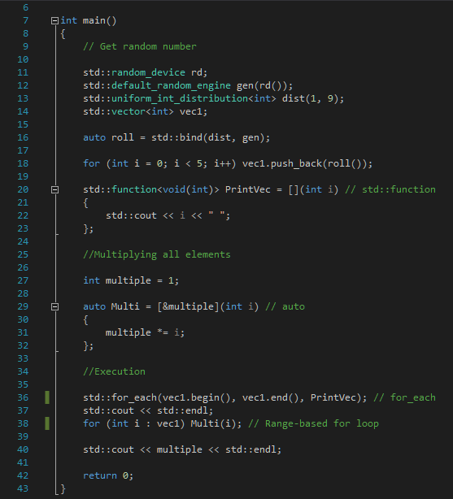
Example

Slide 12
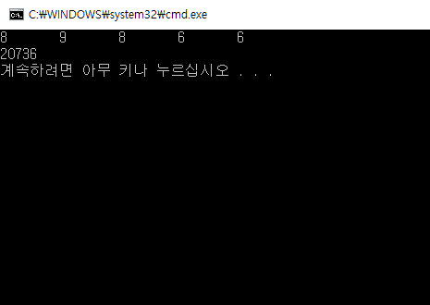
Example

