Slide 1
VK Tutorial - 1
Drawing a triangle(1)

Slide 2
Contents
GLFW
Basic logic / concept
Validation layers
Physical device
Queue families
Logical device

Slide 3
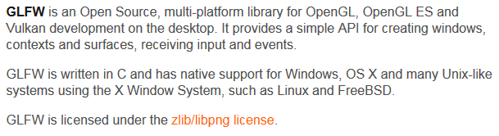
GLFW?

Slide 4
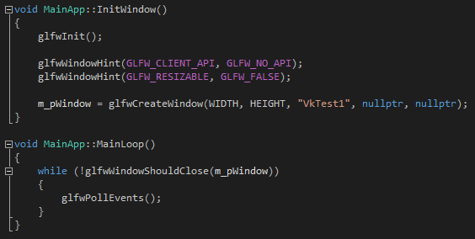
GLFW

Slide 5
Basic concept / logic
1. Declare some structure contains information about creation
2. Fill in the attributes
3. Call vkCreateSth(CreateInfo, AllocateInfo, Interface) function

Slide 6
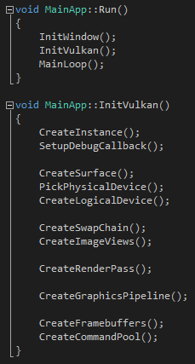
Basic concept / logic

Slide 7
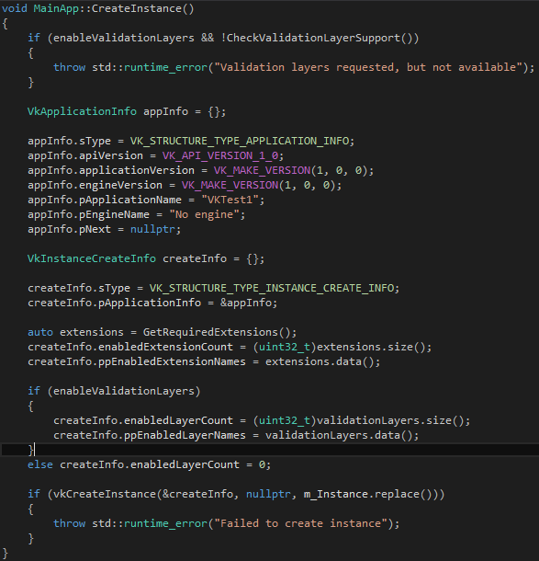
Instance creation

Slide 8
Validation layers?
Checking the values of parameters against the specification to detect misuse
Tracking creation and destruction of objects to find resource leaks
Checking thread safety by tracking the threads that calls originate from
Logging every call and its parameters to the standard output
Tracing Vulkan calls for profiling and replaying

Slide 9
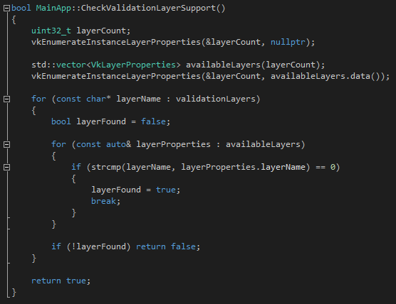
Validation layers?

Slide 10
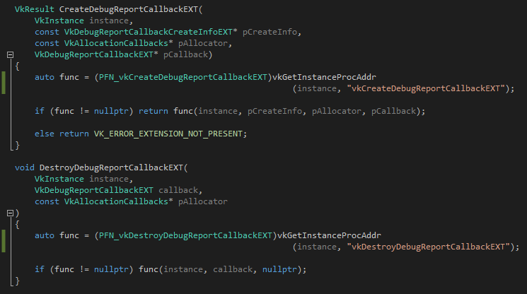
Validation layers?

Slide 11
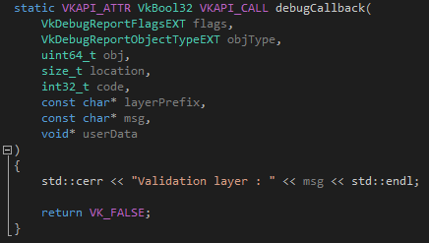
Validation layers?

Slide 12
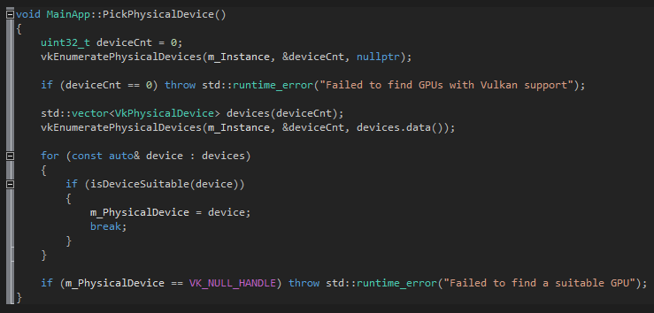
Physical device

Slide 13
Queue families
There are different types of queues that originate from different queue families
Each family of queues allows only a subset of commands
For example, there could be a queue family that only allows processing of compute commands or one that only allows memory transfer related commands.

Slide 14
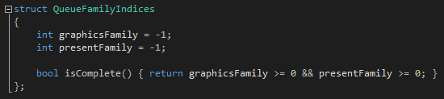
Queue families

Slide 15
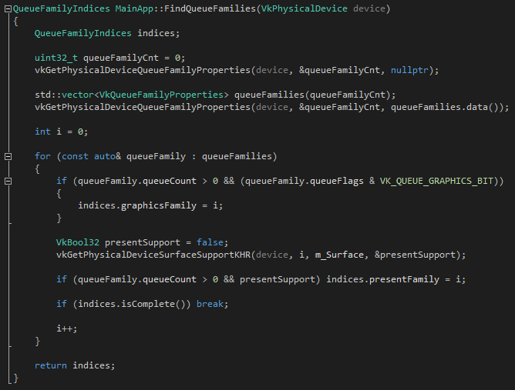
Queue families

Slide 16
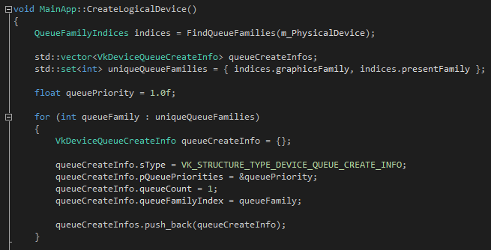
Logical device

Slide 17
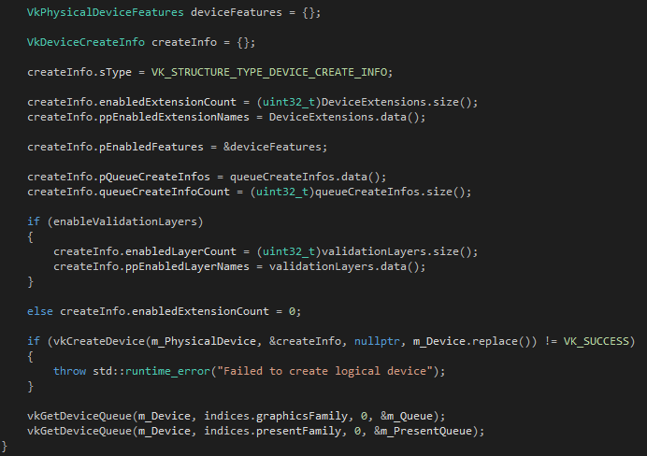
Logical device

Slide 18
Todo
Swap chain
Image views
Render pass
Graphics pipeline

Slide 19
Todo
Frame buffers
Command pool/ buffers
Semaphore

