Slide 1
WebAssembly

Slide 2
Contents
Overview
Semantic Phases
Future Works

Slide 3
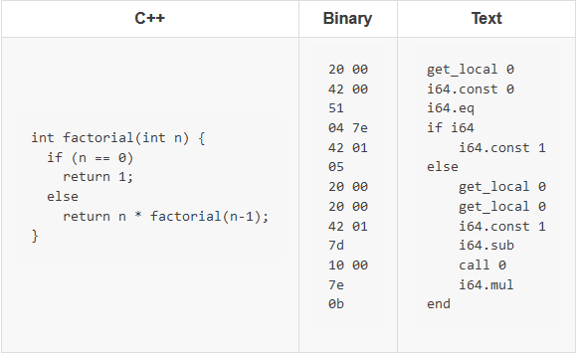
Overview
가상 명령어 집합 구조 – Virtual Instruction Set Architecture(V-ISA)

Slide 4
Overview
Uses only four variable types
i32, i64, f32, f64
i32 and i64 are not inherently signed or unsigned
Can be used with Web APIs
DOM, IndexedDB, Web Workers, etc…
Not a substitute for JavaScript!

Slide 5
Semantic Phases
Decoding -> Validation -> Execution
Execution is divided into two phases:
Instantiation vs. Invocation

Slide 6
Decoding
0061 736d 0100 0000 01ef 0337 6001 7f01
7f60 037f 7f7f 017f 6003 7f7f …
fetch()
(Fixed-length raw binary)
compile()
WASM File
Typed Array
ArrayBuffer
WASM Module

Slide 7
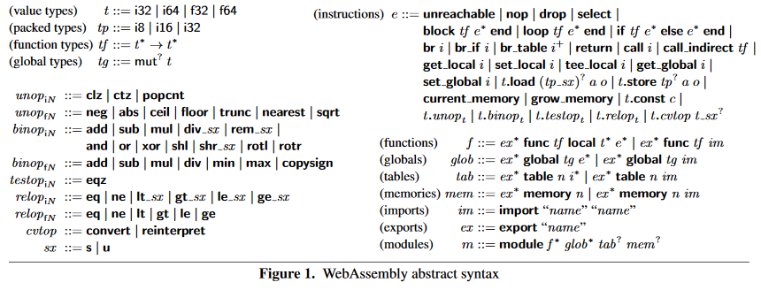
Validation / Execution

Slide 8
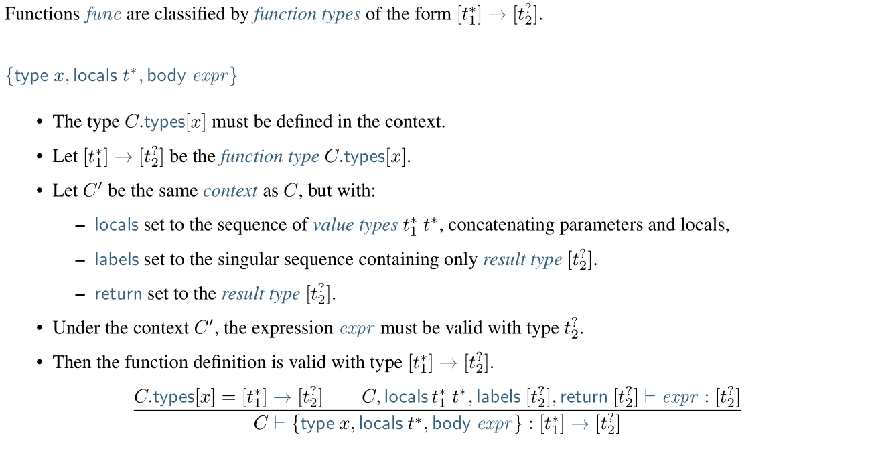
Validation / Execution

Slide 9
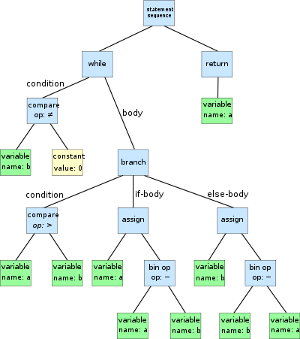
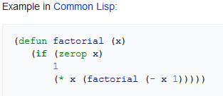
Module
AST
Abstract Syntax Tree
S-expression
Notation for nested tree-structured data
Unit of deployment / loading / compilation

Slide 10
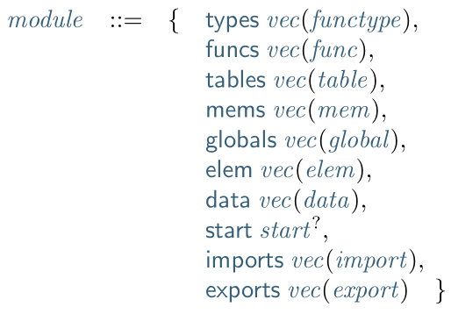
Module
Can declare…
init logic or start function
imports and exports

Slide 11
imports / exports
import/exportable definitions(defined and referenced with indices):
Functions
Tables
Memories
Globals

Slide 12
Validation / Execution
Instantiation
Complete with its own state and execution stack
Executes given definitions for all its imports
= Initialises globals, memories and tables
Returns the instances of the module’s exports
Invocation
Executes the exported functions and returns its results

Slide 13
Future Works
Linear Memory
Table
Implementation without emscripten

