Slide 1
WebAssembly - Last
Application of WASM to WebApp

Slide 2
Content
Memory / Table
Application of WASM
What have I learnt
Todo

Slide 3
Memory / Table
 | Memory | Table
Similarity | Array-like structure Accessible and mutable from both JS and WASM
Difference | Resizable ArrayBuffer Holds raw bytes of memory | Given size and element type Stores function references

Slide 4
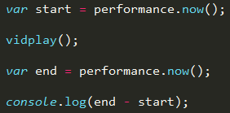
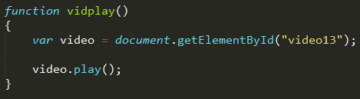
Application of WASM

Slide 5
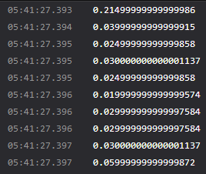
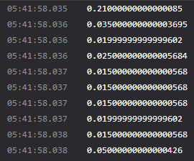
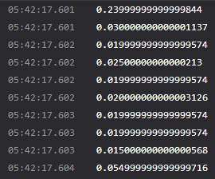
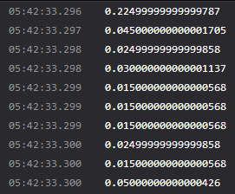
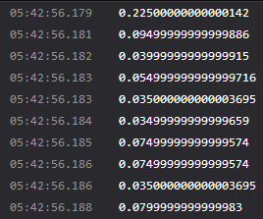
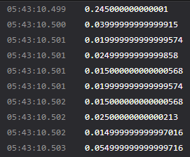
Application of WASM

Slide 6
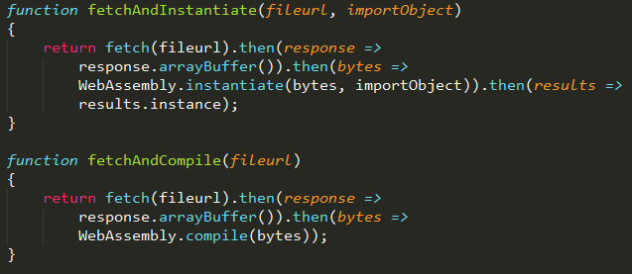
Application of WASM

Slide 7

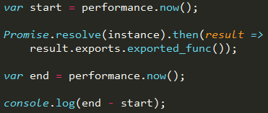
Application of WASM

Slide 8
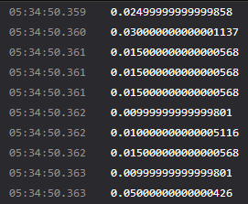
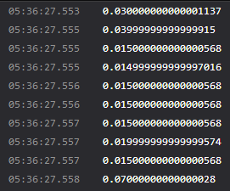
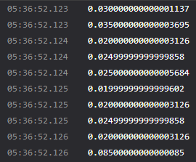
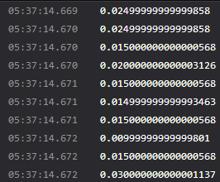
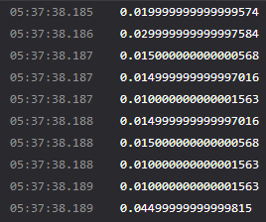
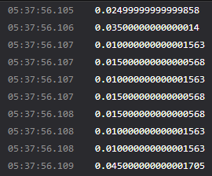
Application of WASM

Slide 9
Application of WASM
?

Slide 10
Application of WASM - Conclusion
Can manage suitable JS func with appropriate WASM code together
Expected to “stick” JS code with other languages supports WASM
Shows equal or slightly better performance compared to pure JS
Can choose when to load / instantiate codes
Caching compiled modules via IndexedDB
To complicated for general project
Promise, WAST(S-expression)
Necessity of compiler’s development / IDE

Slide 11
What have I learnt
How to use Promise object
Compilation pipeline of C/C++ to WASM
How WASM works in web browser
Complexity of raw s-expression

Slide 12
Todo
Find a role in the project
Concentrate on real implementation of web page / server app

