Slide 1
WebAssembly - III
Another approach

Slide 2
Contents
Existing / Another way to get .wasm file
Another approach to execute WASM

Slide 3
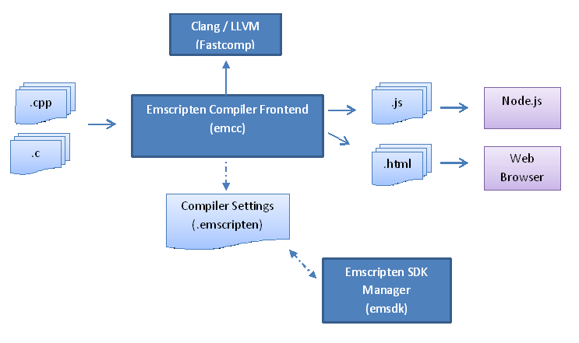
Existing way to get .wasm file
[1]

Slide 4
Existing way to get .wasm file
Including full C standard library, syscalls, etc
Running a WebAssembly interpreter(wasm.js)[2]
Too much complicated and verbose

Slide 5
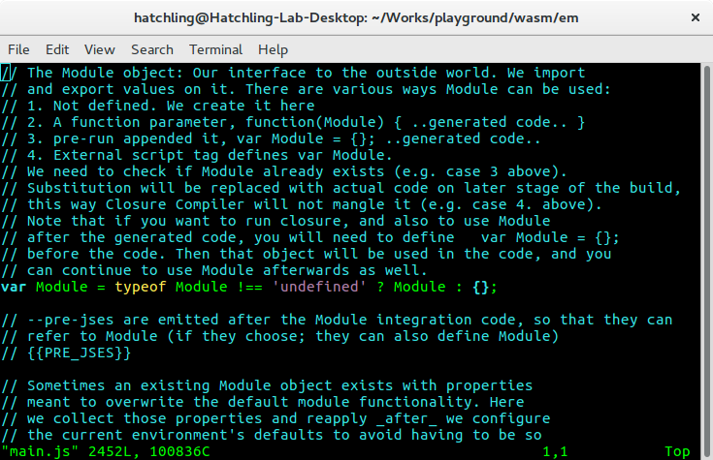
Existing way to get .wasm file

Slide 6
Another way to get .wasm code
foo.c
foo.s
foo.wat
foo.wasm
clang -S
--target=wasm[32/64]
s2wasm
wasm-as
Binaryen
Binaryen github

Slide 7
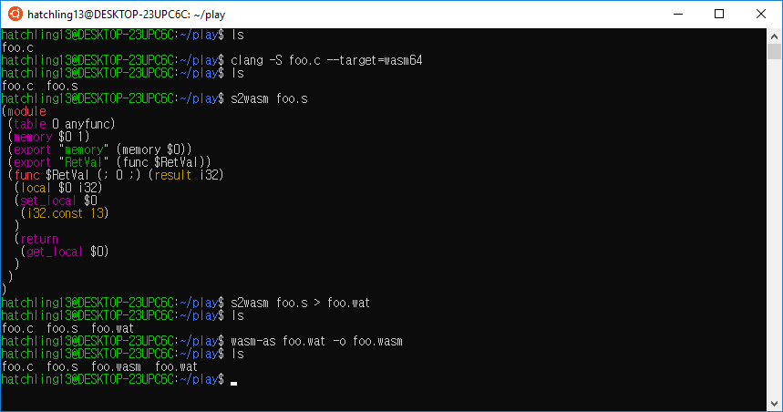
Another way to get .wasm code

Slide 8
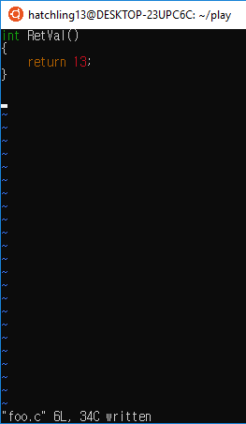
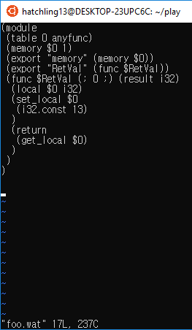
Another way to get .wasm code

Slide 9
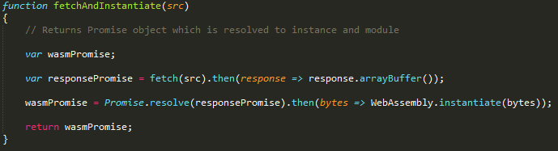

Another approach to execute WASM

Slide 10
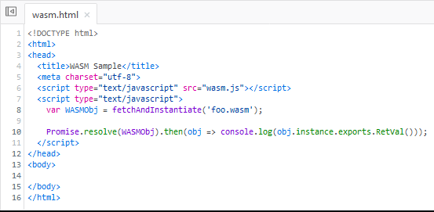
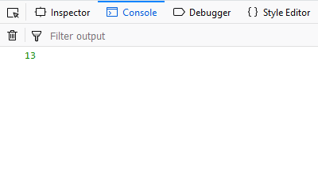
Another approach to execute WASM

Slide 11
Overall
Understand C POSIX library http://pubs.opengroup.org/onlinepubs/9699919799/
Apply standard I/O to base WASM

Slide 12
Citation
[1] – Emscripten Official Website
[2] – Emscripten and WebAssembly

