Slide 1
WebAssembly - II
Prerequisites / How to use it

Slide 2
Contents
How to load / compile / instantiate / run WASM code?
Promise object
Synchronous / Asynchronous?
Future Works

Slide 3
How to load WASM code?
0061 736d 0100 0000 01ef 0337 6001 7f01
7f60 037f 7f7f 017f 6003 7f7f …
Fetch()
XMLHttpRequest()
WASM File
JavaScript ArrayBuffer

Slide 4
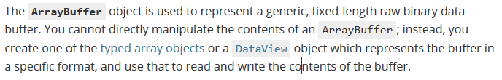
How to load WASM code?

Slide 5
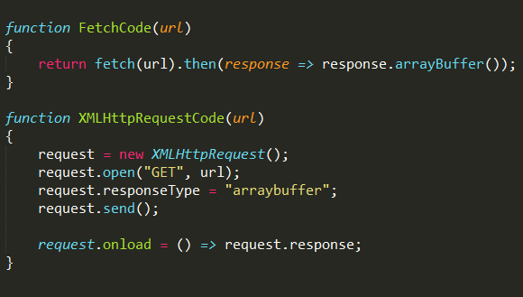
How to load WASM code?

Slide 6
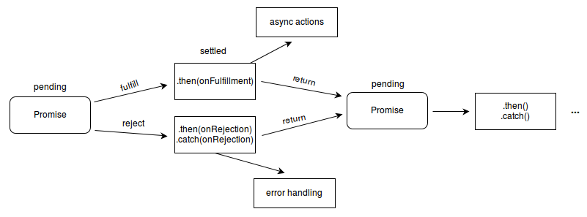
Promise object

Slide 7
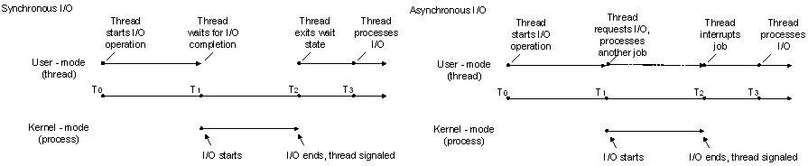
Synchronous / Asynchronous

Slide 8

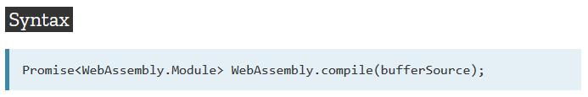
How to compile WASM code?

Slide 9

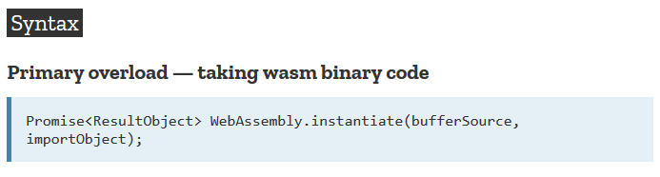
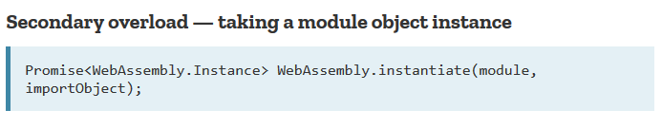
How to instantiate WASM code?

Slide 10
How to instantiate WASM code?
importObject
JavaScript ArrayBuffer
WebAssembly.instantiate()
Module
Instance
ResultObject

Slide 11
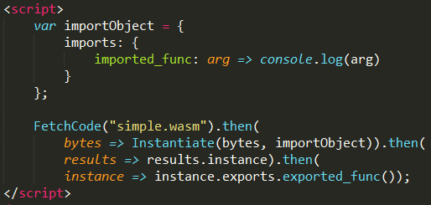
How to run WASM code?

Slide 12
Future Work
Import / Export
Import Object
S-expression

