Slide 1
Future of web techs
Experimental features of HTML5

Slide 2
Contents
1. Evolution of Web
2. WebSocket?
Duplex communication
Polling, Long polling, streaming
3. WebAssembly?
asm.js, LLVM, Emscripten

Slide 3
The Evolution of the Web
http://www.evolutionoftheweb.com/

Slide 4
Duplex communication
Half-duplex communication
Server
Client
Request
Response

Slide 5
Polling
Server
Client
Request
Data
Response

Slide 6

Long-Polling
Server
Client
Request
Data
Response

Slide 7
Streaming
Server
Client
Request
Data
Response

Slide 8
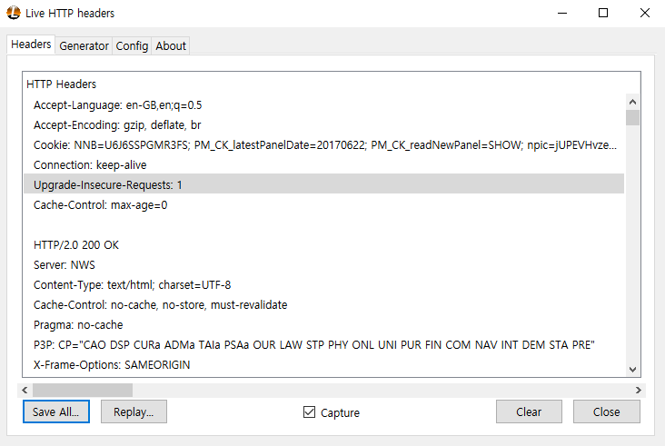
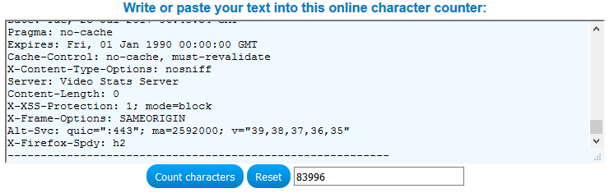
Inefficient HTTP Request

Slide 9
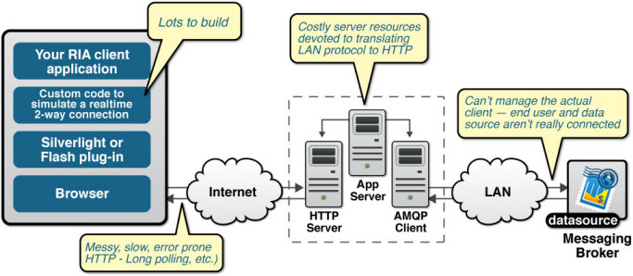
Inefficient HTTP Request

Slide 10
WebSocket!
A TCP-based, standardised communication protocol
IETF Standard - RFC 6455
Related API is being standardised by the W3C
Provides full-duplex communication
Low overhead
Easy-to-use API

Slide 11
Duplex communication
Full-duplex communication
Send/Receive
Simultaneously
Server
Client
Data
Data

Slide 12
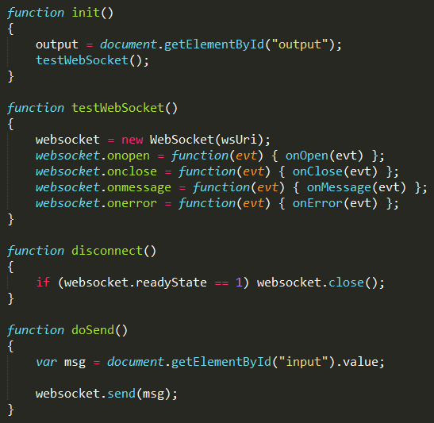
Sample client

Slide 13
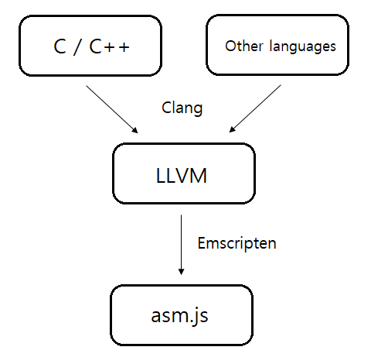
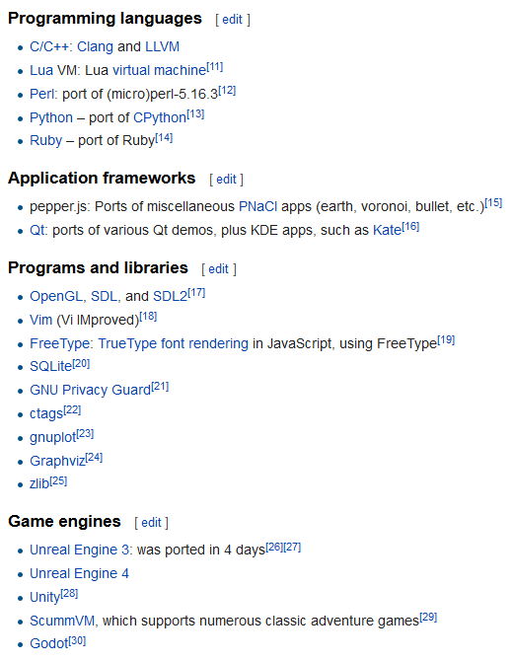
asm.js

Slide 14
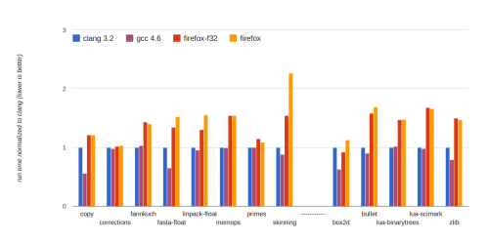
Performance of asm.js

Slide 15
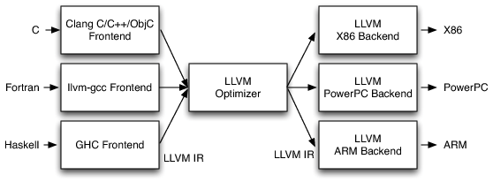

LLVM compiler design
Traditional static compiler design
LLVM compiler design

Slide 16
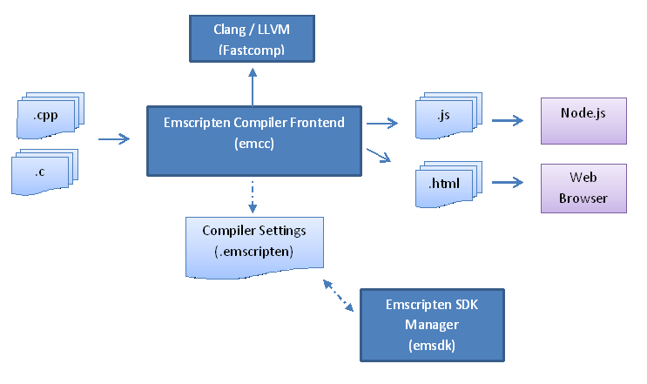
Emscripten

Slide 17
WebAssembly!
LLVM IR
(Intermediate Representation)
WASM Binary code
PL Code
Virtual Machine

Slide 18
Virtual Machine?
Performance↑
Subset of JS
asm.js
Runtime
PNaCl
Runtime
Sandboxing
Technology
Javascript Runtime
LLVM IR Bytecode

Slide 19
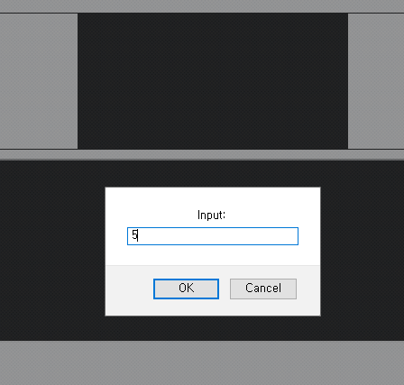
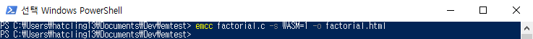
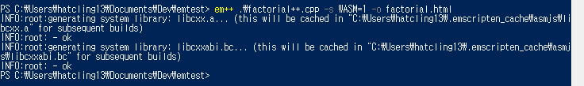
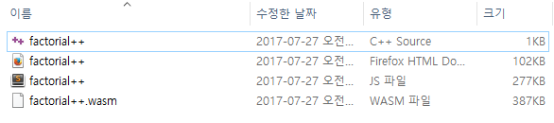
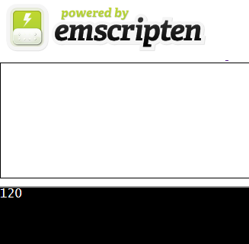
Example

Slide 20
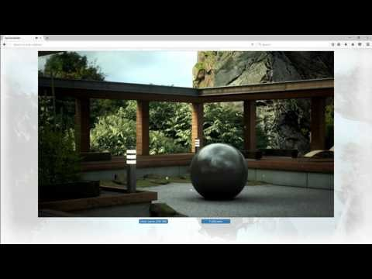
Performance of WebAssembly

