Slide 1
rmdprep(working)
Markdown preprocessor, 1st groundwork for my static site

Slide 2
Contents
Markdown?
Preprocessor?
Development environment
Features to implement

Slide 3
Markdown?
A lightweight markup language with plain text formatting syntax
Designed to be easy to write using any generic text editor
Easy to read in its raw form
Often used to create rich text(formatted text)

Slide 4
Preprocessor?
A program that processes its input data to produce output that is used as input to another program
Plain Text
Other program
Preprocessor
Preprocessed Text

Slide 5
Development environment
Programming language : Rust
IDE : Visual Studio Code + Rust plugin
OS : Windows 10

Slide 6
Syntax
TOML-compatible
https://github.com/alexcrichton/toml-rs
Tera - A powerful, easy to use template engine for Rust

Slide 7
Todo
Practise Rust(MVP : File I/O)
Analyse markdown structure
Set features to implement
Research about Travis
Design and confirm build process

Slide 8
Features to implement
Input : ‘pseudo’ markdown file
Output : markdown file that can be consumed by certain SSG
Get external code snippet file from directory and display the content(use built-in syntax highlighting?) with executed result
Get and display elapsed time to build articles

Slide 9
Markdown Structure
Front-matter / Content
SSG deals with front-matter, focus on content
#, =, -, *, _, >, +, ! are already used
Need to use some other mark to make commands($ or %)

Slide 10
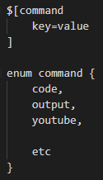
Markdown Structure

Slide 11
Structure
Front-matter is processed depending on which SSG is used
Zola(primary), Hugo, etc…
Content is processed with certain command
code, execute result, youtube, etc…

Slide 12
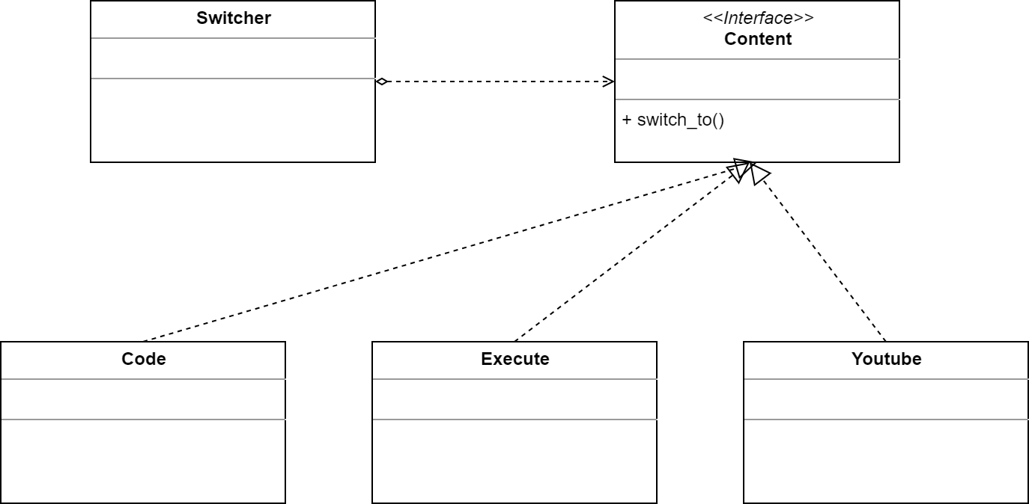
non-normative

Slide 13
Process
Start
Prep is on
Read command, parameters
Generate content
Yes
No
Turn prep on when token is found
Output result in file

