Slide 1
Retail Analytics Dashboard
Power BI Project Presentation
Author: Lokesh

Slide 2
Project Overview
Analyze retail sales performance
Identify regional trends
Evaluate product profitability
Interactive business dashboard

Slide 3
Dataset Description
Fields used: ProductName, Category, Region, CustomerName, UnitPrice, Quantity, Date

Slide 4
Tools & Technologies
Power BI Desktop
Data Modeling
DAX Measures
Interactive Visualizations

Slide 5
Dashboard Architecture
Data Import → Data Model → DAX Measures → Visual Dashboard

Slide 6
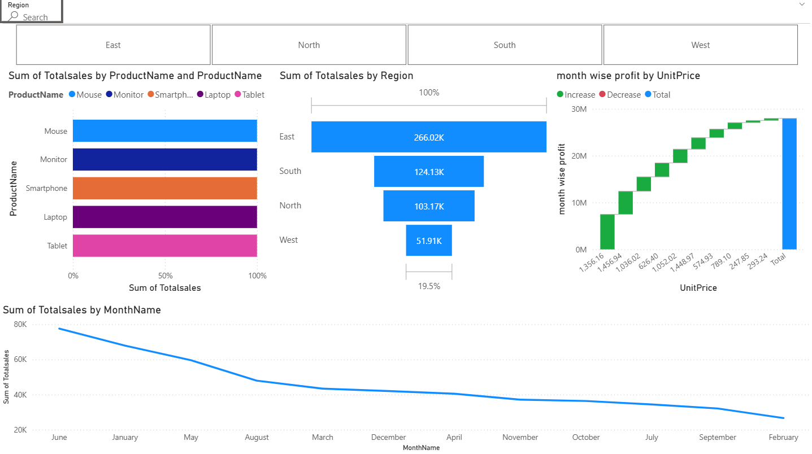
Sales Overview Dashboard

Slide 7
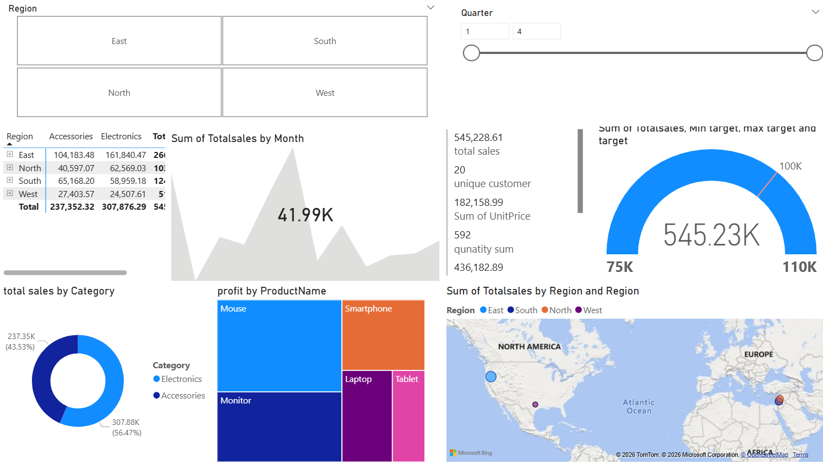
Sales Performance Dashboard

Slide 8
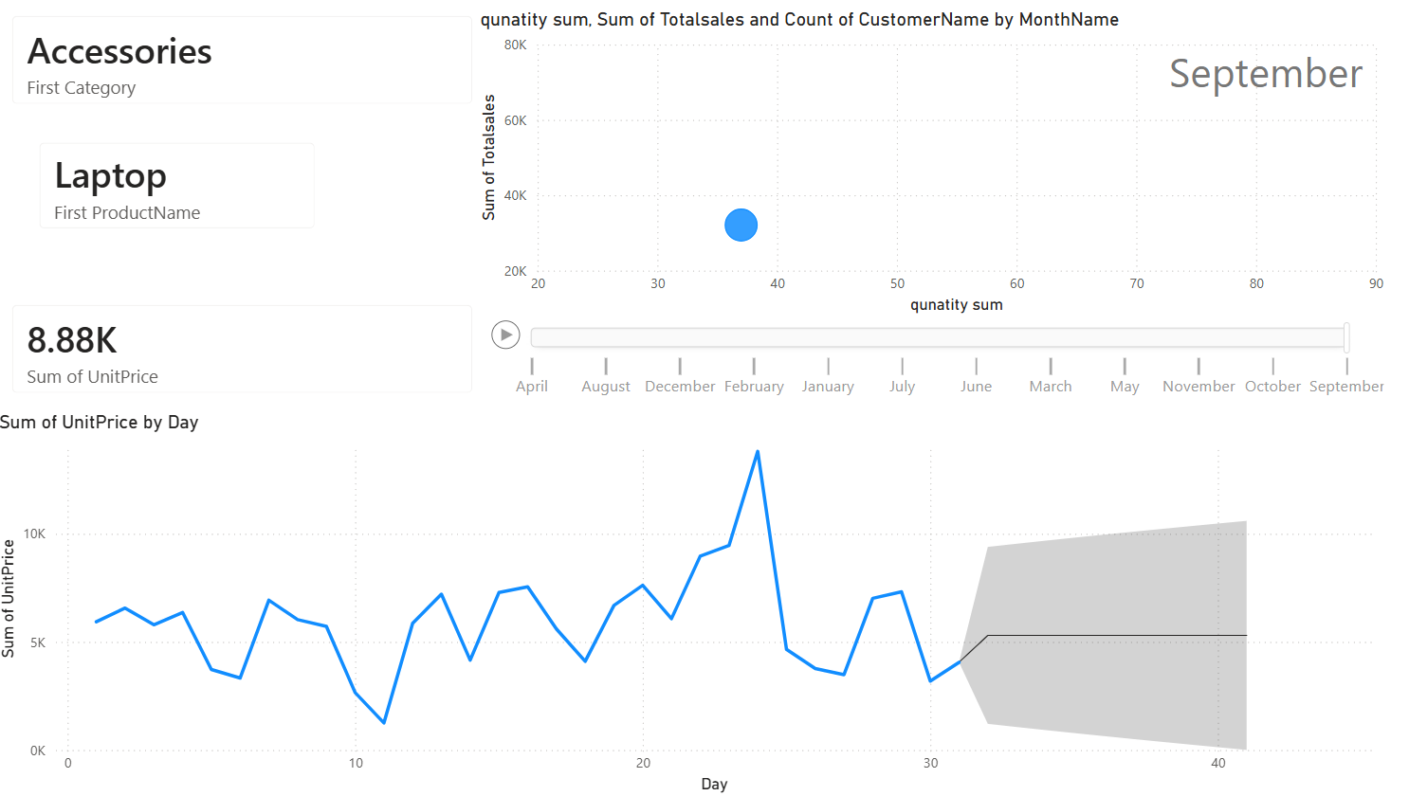
Product Analysis Dashboard

Slide 9
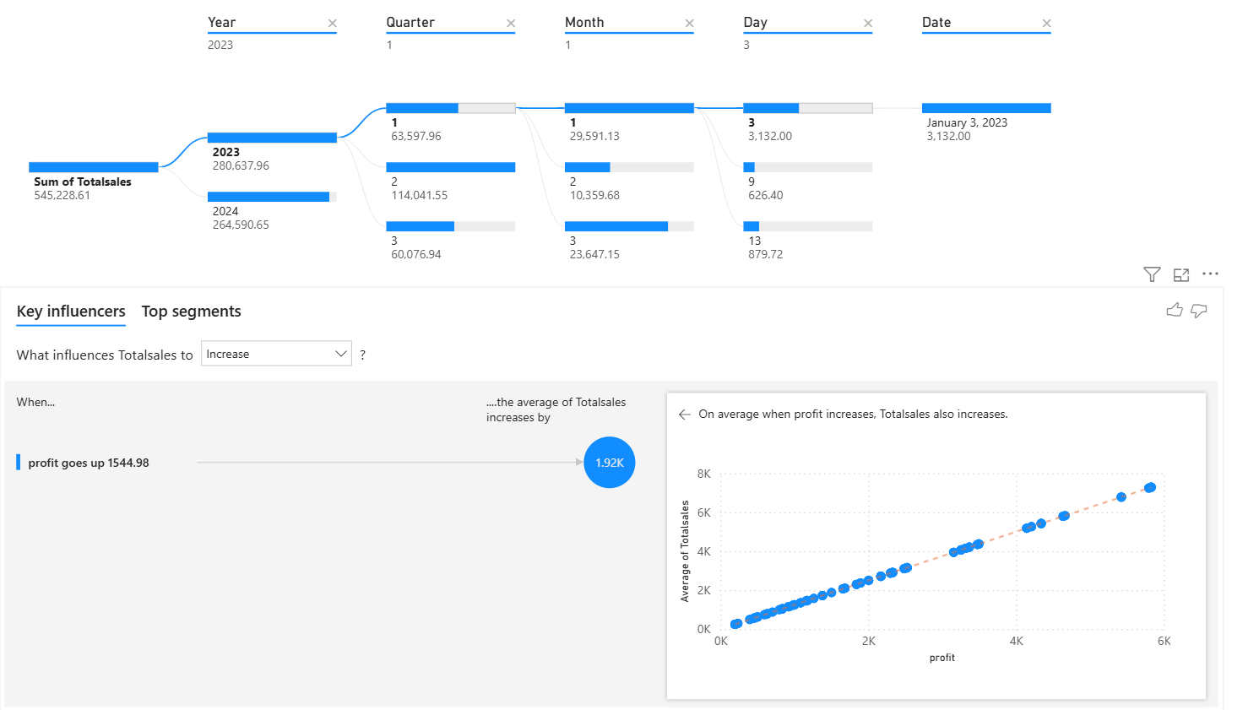
Advanced Analytics Dashboard

Slide 10
Key Insights
East region shows highest sales
Electronics category dominates revenue
Sales vary across months

Slide 11
Business Benefits
Better sales monitoring
Product performance analysis
Regional sales insights
Customer trend identification

Slide 12
Future Improvements
Real‑time data integration
Predictive sales forecasting
Automated reporting dashboards

Slide 13
Conclusion
Power BI enables interactive analytics
Helps organizations make data‑driven decisions

