Slide 1

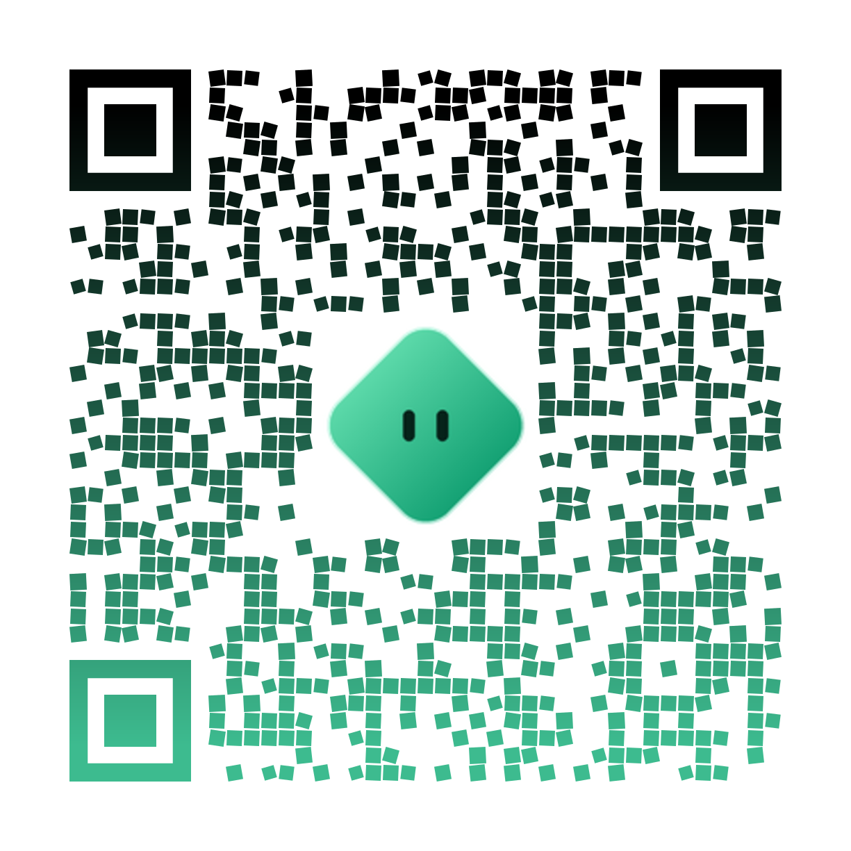
CyberBoard AI
An agentic retrieval augmented advisory board over corporate filings
Hatem Isa | ID 202508993 | MSc in Artificial Intelligence, Bahrain Polytechnic
Supervisor: Dr. Joshua Samuel Second marker: [Second Marker] Date: 1 September 2026
github.com/hatemmsc-ops/CyberBoard-AI | commit 9660fb8
scan for the repo
Notes:
30s. Title slide. Introduce the system in one line: a board advisory agent that answers from real filings with cited evidence, evaluated on US and GCC markets. Fill in the second marker and the date before the demo. The repo QR is already on the slide, bottom right.

Slide 2
AGENDA
Roadmap of the next 20 minutes
Motivation and problem
Research questions
Related work and the gap
1
2
3
Method and proposed approach
Data and pre processing
Experimental setup
4
5
6
Headline results
Ablations, errors, responsible AI
Contributions and future work
7
8
9
02 / 16
Notes:
30s. Walk the roadmap in one breath. Signpost that results and the honest ablation are the core, and that a live demo follows the slides.

Slide 3
MOTIVATION
Boards decide from documents no tool really reads
A single annual filing runs to hundreds of pages. A board member must reach a defensible decision from it, and general question answering tools answer each question in isolation, with no traceable evidence.
hundreds
of pages per filing, across
A chatbot will answer fluently about a 10 K risk section. The board cannot tell whether the answer came from the filing or from the model's memory. In governance, an ungrounded answer is worse than none.
123 filings from 27 companies
two markets, US and GCC
03 / 16
Notes:
90s. Lead with the concrete pain: a board reading a 300 page filing under time pressure. Land the key idea early: the value is not fluent prose, it is an answer the board can check against the source. 123 filings = 116 US plus 7 GCC company report sets.

Slide 4
PROBLEM STATEMENT
One system, three capabilities, two markets
No existing system combines hybrid retrieval, agentic reasoning, and answer level explainability for corporate governance advisory, and evaluates that combination on both a United States benchmark and Gulf Cooperation Council filings.
1
Board level
2
Evidence grounded
3
Cross market
answers phrased for a decision, not a chat
every claim tied to a cited filing section
tested on US filings and GCC disclosure
04 / 16
Notes:
60s. Read the one sentence problem slowly. Then justify the three scope choices: board level phrasing, evidence grounding, and cross market evaluation. This frames every design decision that follows.

Slide 5
RESEARCH QUESTIONS
Three questions the thesis answers
RQ1
How effectively can an agentic retrieval augmented system retrieve and combine information from corporate filings to support board level decisions, measured by retrieval precision and answer faithfulness?
RQ2
Does a multi tool agent architecture produce higher answer quality and fewer hallucinations than a single pass through retrieval augmented generation?
RQ3
Can the system explain each answer, through source attribution and a reasoning trace, so that a board member can verify it?
05 / 16
Notes:
60s. Read the three RQs. Note the mapping: RQ1 retrieval and faithfulness, RQ2 the agent versus a plain baseline, RQ3 explainability. Results are organised the same way.

Slide 6
RELATED WORK
Strong parts, no assembled whole
FinSage, Wang et al.
The gap
Gives: Strong two phase financial retrieval and reranking.
Missing: No agentic reasoning layer; not tested on GCC disclosure.
No prior system unifies hybrid retrieval, an agentic reasoning layer, and answer level explainability for governance, and then measures it on two markets. That intersection is this thesis.
ReAct, Yao et al.
Gives: Interleaves reasoning with tool calls; inspectable.
Missing: General purpose; not specialised to or grounded in filings.
XAI in finance, Fritz Morgenthal; CFA Institute
Gives: Argues explanations must suit boards and regulators.
Missing: No evaluated end to end governance system.
06 / 16
Notes:
90s. Three closest works. For each, say what it gives and what it lacks. Close on the gap card: the unoccupied intersection is the contribution.

Slide 7
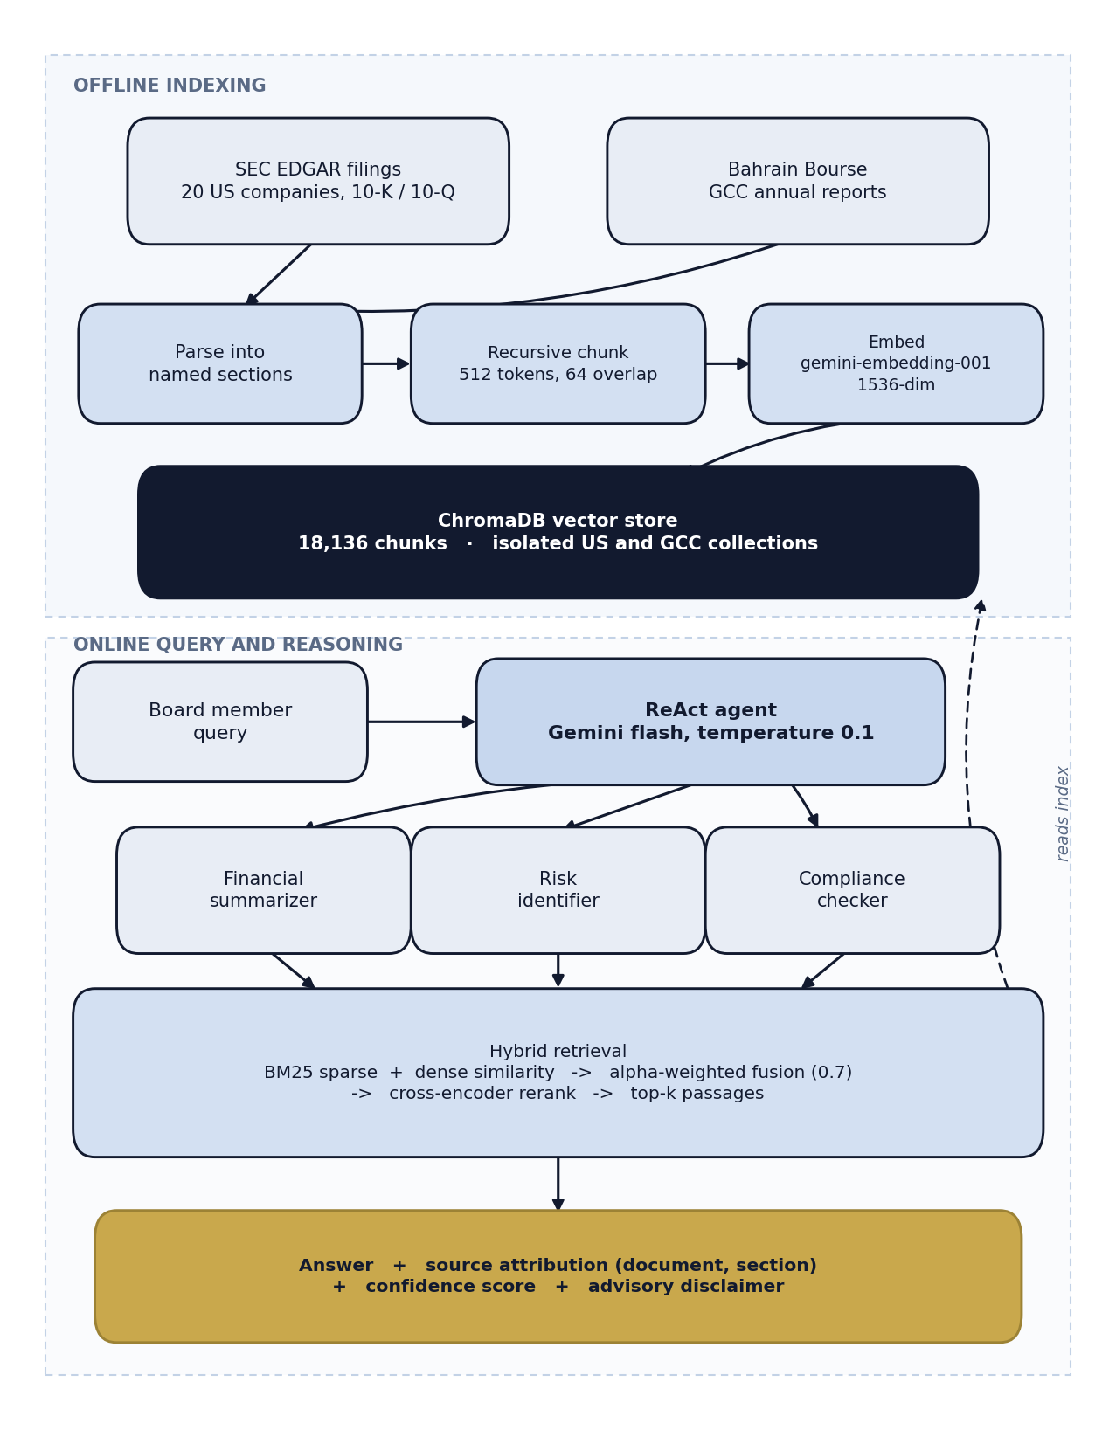
METHODOLOGY OVERVIEW
An offline index and an online agent
Offline
Filings are ingested, parsed into named sections, chunked recursively, embedded with gemini embedding 001, and indexed in ChromaDB.
Online
A board query drives a ReAct agent that selects one of three tools, retrieves with hybrid search and reranking, and returns a grounded, cited answer.
07 / 16
Notes:
120s. Two stages. Offline builds the index once. Online is the agent loop per query. Point at the diagram: ingestion and indexing on top, the agent and tools below. Keep it high level; detail comes next.

Slide 8
DATA AND PRE PROCESSING
Two corpora, one pipeline
116
US SEC filings, 10 K and 10 Q, 20 companies
18,136
US chunks embedded at 1536 dimensions
7
Bahrain Bourse company reports, GCC market
845
GCC chunks in the same index
Chunking 512 tokens with 64 overlap, split by regulatory section. Evaluation sets FinanceBench for US retrieval, 35 hand verified GCC questions, 19 recent US numerical questions.
08 / 16
Notes:
60s. Two corpora, same pipeline. Stress that GCC is the harder, unmemorised market. Chunking respects regulatory sections. Note that FinanceBench is used for retrieval only, because its years predate the corpus.

Slide 9
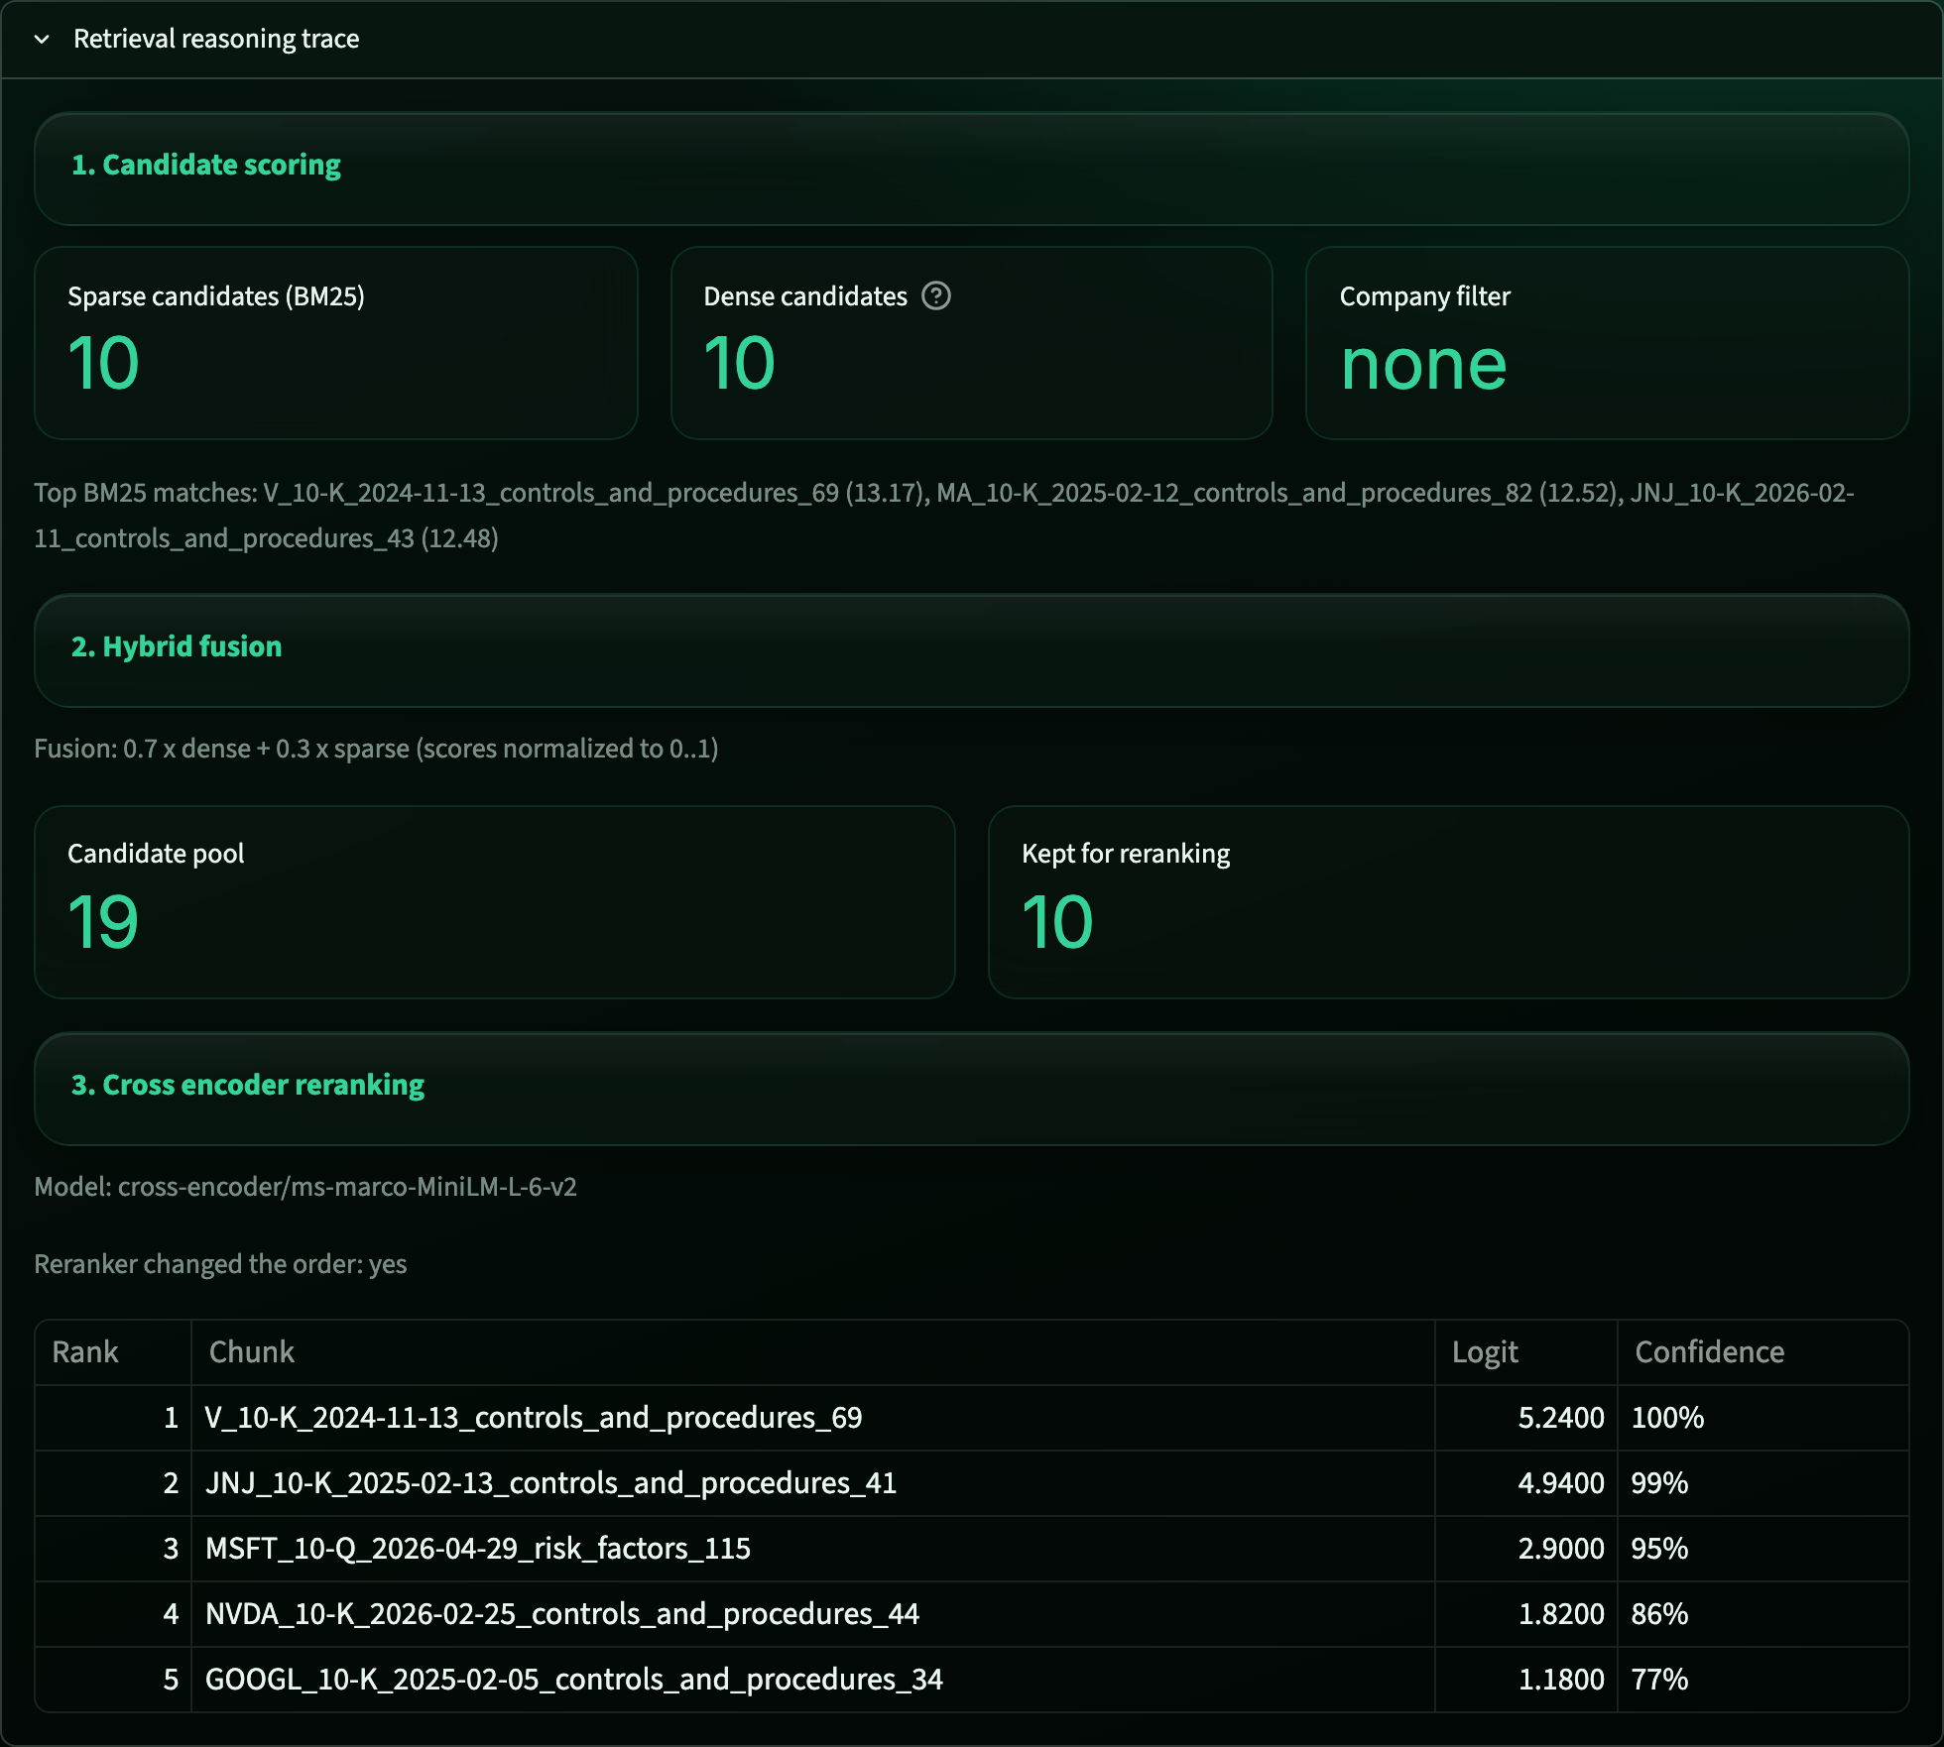
PROPOSED APPROACH
Hybrid retrieval, an agent, and a visible trace
Hybrid retrieval
1
BM25 sparse and dense vectors fused 0.7 to 0.3, then a cross encoder reranker.
ReAct agent, three tools
2
financial summarizer, risk identifier, compliance checker, selected per question.
Explainability
3
source, filing, section, and a confidence score on every answer, with a full reasoning trace.
The retrieval reasoning trace, exposed in the dashboard
09 / 16
Notes:
120s. The core contribution. Hybrid retrieval plus reranking, a ReAct agent with three scoped tools, and explainability by construction. The screenshot is the real trace: candidate scoring, fusion, and reranking with confidence. This is what makes an answer checkable.

Slide 10
EXPERIMENTAL SETUP
Paired baselines and a validated judge
Baselines
Metrics
Closed book, no retrieval. Single pass naive RAG. Both scored on the same questions as the agent, so comparison is paired.
Answer accuracy, faithfulness, hallucination rate, and retrieval hit rate.
Statistics
Compute
An LLM as judge at temperature zero, a paired McNemar test, and variance across five repeated runs.
No training. One workstation for retrieval, a small number of Gemini flash calls per question.
10 / 16
Notes:
60s. Emphasise the paired design: agent and baselines answer identical questions, so McNemar is the right test. Faithfulness is judged only against retrieved context. Five runs give the variance reported next.

Slide 11
HEADLINE RESULTS
The agent is accurate and grounded
GCC answer accuracy
No retrieval (closed book)
96.8%
accuracy
11.4%
plus or minus 0.1, over five runs
Single pass naive RAG
82.9%
99.4%
faithfulness
Full agent (proposed)
plus or minus 1.2, over five runs
96.8%
Paired McNemar on the primary run: 5 wins, 0 losses, exact p 0.0625.
11 / 16
Notes:
120s. The money slide. Accuracy climbs from 11 percent closed book, to 83 percent for naive RAG, to 96.8 percent for the agent. Faithfulness 99.4 percent. Report the five run mean, not a single lucky 100 percent. McNemar direction is unambiguous; the small p reflects only 35 questions.

Slide 12
ABLATIONS AND ERRORS
An honest ablation and a real bug
Reranking helps where it should
A defect found by end to end testing
US corpus: 83.9% to 96.8% hit rate (+12.9 pts) GCC corpus: a small net cost, 100% to 97.1% The cross encoder helps on the larger, mixed US corpus and slightly hurts recall on the small, homogeneous GCC set. The thesis reports this rather than hiding it.
Ticker filtering ran after global top k selection, so a company's own passages were discarded before the filter applied. Fixing the order raised the FinanceBench hit rate from 54.8% to 96.8%, and lifted the measured reranking gain from 3.2 to 12.9 points.
Where the agent still fails
One compound GCC question asks for two quantities at once, the owner equity and the earnings per share of the KFH Bahrain entity, and the agent occasionally returns only one. This is answer scoping, not a retrieval failure, and it is the residual gap behind the 96.8 percent mean.
12 / 16
Notes:
90s. Two honest findings. Reranking is not a universal win: it helps the US corpus and slightly costs recall on GCC. The ticker bug shows the value of end to end testing over unit tests. Name the one failing compound question so the viva cannot surprise you.

Slide 13
RESPONSIBLE AI
Grounded by design, modest by footprint
1
Grounding and abstention
2
Privacy
When no evidence is retrieved the agent abstains. Closed book faithfulness of zero is by design, not a defect.
Public regulatory filings only. No personal data is gathered or stored.
3
Misuse
4
Environment
Every answer ends with an advisory only disclaimer. The system supports a decision, it does not make one.
No model training. The corpus is embedded once and inference is a few short flash calls per query.
13 / 16
Notes:
60s. Four points. The strongest is grounding and abstention: the system prefers no answer to an unsupported one, which is the right default in governance. Note the small compute footprint and the advisory only framing.

Slide 14
CONTRIBUTIONS
What this thesis contributes
A single system that unifies hybrid retrieval, agentic tool use, and answer level explainability for corporate governance advisory.
1
A cross market evaluation of that system on a United States benchmark and on hand verified Gulf Cooperation Council filings.
2
An honest component ablation and a documented, corrected retrieval defect, offered as a transferable engineering lesson.
3
A reproducible evaluation harness where every reported result is written to a result file in the public repository.
4
14 / 16
Notes:
60s. Four numbered contributions. If asked for the single biggest, choose the first: the assembled and evaluated whole, not any one component. The reproducibility harness is the credibility anchor.

Slide 15
LIMITATIONS AND FUTURE WORK
Honest limits, clear next steps
Limitations
Future work
• The hand verified GCC set is 35 questions, so the McNemar test is underpowered at p 0.0625 despite unbroken direction.
• Expand the hand verified GCC set well beyond 35 questions to reach conventional significance.
• A single ReAct agent with three fixed tools; no multi agent routing.
• Add multi agent routing and test whether it beats the single agent under the same paired protocol.
• FinanceBench measures retrieval only, since its years predate the 2024 to 2026 corpus.
• Broaden GCC coverage and complete the second corpus variance study.
15 / 16
Notes:
60s. Own the limitations before the markers raise them: sample size is the honest headline. Pair each with a concrete next step. The first future item directly fixes the statistical power limitation.

Slide 16
Thank you
Questions welcome. The live demonstration follows.
Repository github.com/hatemmsc-ops/CyberBoard-AI Commit 9660fb8 Contact 202508993@student.polytechnic.bh
CyberBoard AI | Hatem Isa | MSc Artificial Intelligence, Bahrain Polytechnic
Notes:
30s. Thank the panel, invite questions, and transition to the live demo. The QR on this slide opens the repository at the commit of record, so invite the markers to scan it. Have your key results table printed in hand.

