Slide 1

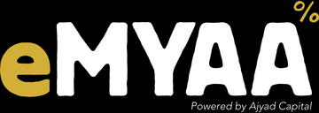

eMYAA in Saudi Arabia
MARKET ENTRY DISCUSSION
Channels, timing and cost | October 2026
Confidential. Prepared by eMYAA Marketing, Ajyad Capital.
Notes:
1

Slide 2
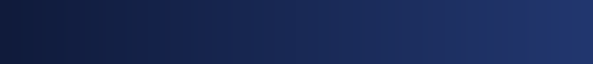


WHO WE ARE
eMYAA: a Shari'ah-compliant trading app for GCC investors
Shari'ah compliant
Arabic and English
Automated Shari'ah screening and purification calculator
Full bilingual app with AI support
USD 50 to start
Four markets
No account opening fees, and very competitive trading fees.
US, Saudi (Tadawul), Dubai (DFM), Hong Kong
Licensed Powered by Ajyad Capital, an Islamic investment firm (Category 1) regulated by the Central Bank of Bahrain. Live since May 2026.
eMYAA Trading Platform | Saudi Market Plan
2
Notes:
Ajyad Capital is licensed by the Central Bank of Bahrain as an Islamic investment firm, Category 1. eMYAA went live in May 2026.
2

Slide 3
DIGITAL PERFORMANCE CHANNELS
Two New Channels Targeting the Saudi Market
Channel and market
Budget, Sep to Dec
Target
Status
Google Search, Saudi
USD 9,000
Riyadh first
Live since 22 Sep
LinkedIn, Saudi
USD 9,000
Lead generation forms
Live since 6 Oct
Google Search, rest of GCC
USD 6,000
Qatar, UAE, Kuwait, Bahrain, Oman
To be live early Oct
LinkedIn, rest of GCC
USD 6,000
Qatar, UAE, Kuwait, Bahrain, Oman
To be live early Oct
Total
USD 30,000
INITIAL RESULTS
A one-month test result for each channel will decide where the budget goes next.
70%
97% / 87%
of website visits
engagement rate
came from Saudi Google Ads
English ads / Arabic ads
eMYAA Trading Platform | Saudi Market Plan
3
Notes:
Google Ads targets Saudi Arabia and Riyadh, Saudi residents only (Ignite). GA4, 1-28 Sep: 409 of 587 site sessions (70%) from google / cpc; English ads 212 sessions (97.2% engagement), Arabic 176 (86.9%).
4

Slide 4
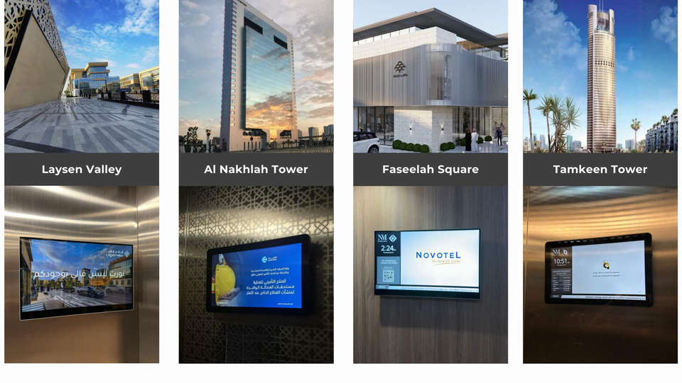
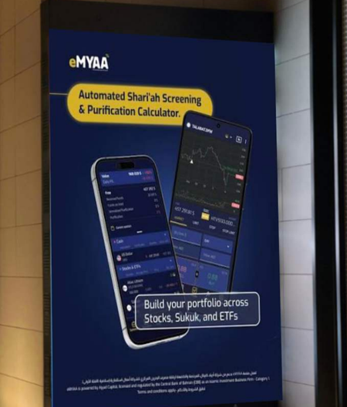
OUTDOOR AND ELEVATOR MEDIA, SAUDI ARABIA
Outdoor options from Nadher Media: 91 screens in Saudi Arabia
LATEST OFFER, 23 SEP
USD 44,800 + VAT
8 weeks, 91 screens, 30% below the original rate of USD 64,000.
Elevator screens, 83 towers | The Zone LED screens, 8 faces (eMYAA mock-up)
Duration
Original rate
eMYAA rate
Ad plays
83
8
2 weeks
-
USD 16,000
0.84M
4 weeks
USD 32,000
USD 27,200
1.67M
towers
LED faces
elevator screens
The Zone, Riyadh
8 weeks
USD 64,000
USD 44,800
3.35M
12 weeks
USD 96,000
USD 67,200
5.02M
eMYAA Trading Platform | Saudi Market Plan
4
Notes:
Nadher Media proposals 16 and 23 Sep 2026, Saudi screens only (the Al Liwan Bahrain weekend screens in the 16 Sep offer are left out). Elevator screens in 83 commercial towers (Al Nakhlah, Tamkeen, Faseelah Square, Laysen Valley and others in Riyadh and the Eastern Province) and 8 LED screens at The Zone, Riyadh. Plays per Nadher: 2,490 an hour (ad plays, not unique viewers). 2-week rate has no original price in the offer. USD at 3.75.
5

Slide 5
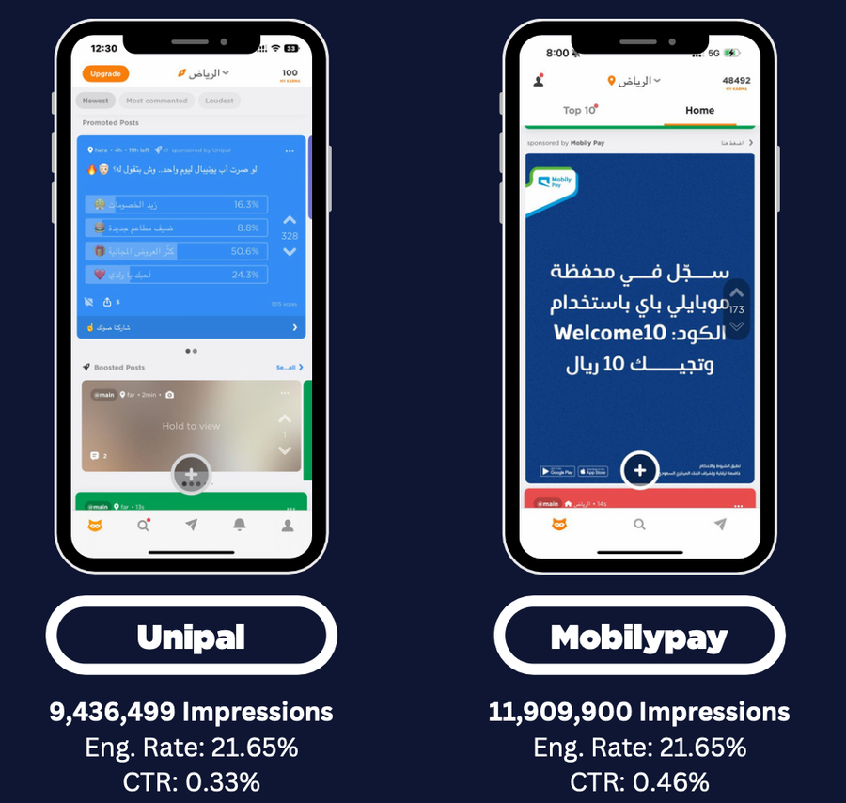

JODEL, SAUDI ARABIA
Jodel: 2.5 million impressions in 7 days for USD 3,862.50
THE OFFER
USD 3,862.50 + VAT
7 days | all of Saudi Arabia
525,000 display and video impressions + 24-hour takeover poll (2,000,000 impressions)
2.5M
USD 1.53
21 to 35
impressions
per 1,000
audience age
in 7 days
impressions
2.5M users in KSA
eMYAA Trading Platform | Saudi Market Plan
5
Notes:
Nadher Media proposal for eMYAA, 16 Sep 2026: USD 3,862.50 + VAT, 7 days, all KSA: 525,000 display and video impressions plus a 24-hour takeover poll of 2,000,000 impressions, one round of ad consulting, unlimited creatives. Cost per 1,000 impressions: about USD 1.53. Jodel KSA: 2.5M active users, 800,000 monthly unique users, average CTR 0.44%. BISB case study (Nadher Media, Oct 2025).
6

Slide 6
FOR DISCUSSION
Where eMYAA and Vision Bank could work together
01
02
03
Market insight
Influencer Marketing
Sponsor Ad
What Saudi digital customers expect, and what has worked in your marketing strategy the most.
Which influencer categories, platforms, and audience profiles deliver the strongest engagement and customer acquisition results for financial services in Saudi Arabia?
What budget is required for sponsorship advertising, which locations should we prioritise beyond Riyadh, and where can we achieve the most efficient cost per click?
We would value your advice as we enter the Saudi market.
eMYAA Trading Platform | Saudi Market Plan
6
Notes:
Discussion topics only; nothing here is agreed.
7

Slide 7
Thank You
Invest Wisely. Trade Precisely.
Hatem Isa Hatem | Marketing Officer, WealthTech
hhatem@ajyadcapital.com | +973 17 565 007
Ajyad Capital, 37th Floor, Almoayyed Tower, Manama, Kingdom of Bahrain
Ajyad Capital is an Islamic investment firm (Category 1) licensed by the Central Bank of Bahrain.
Notes:
8

