Slide 1

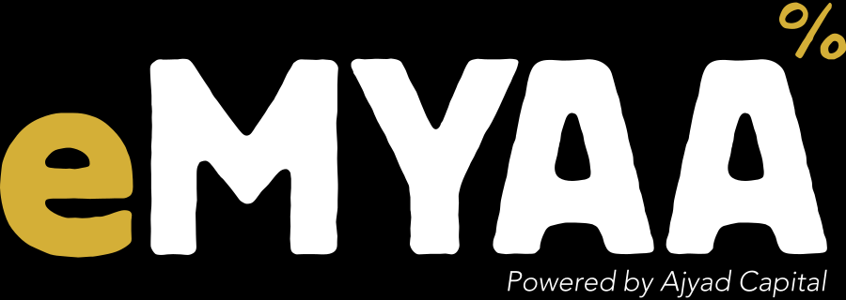

eMYAA in Saudi Arabia
MARKET ENTRY PLAN
Channels, timing and cost | Vision Bank | October 2026
Confidential. Prepared by eMYAA Marketing, Ajyad Capital.

Slide 2
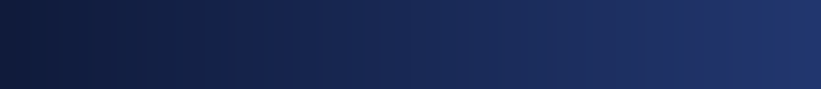
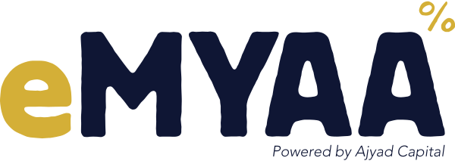
WHO WE ARE
eMYAA: a Shari'ah-compliant trading app for GCC investors
Shari'ah compliant
Arabic and English
Automated Shari'ah screening and purification calculator
Full bilingual app with AI support
USD 50 to start
Four markets
No account fees
US, Saudi (Tadawul), Dubai (DFM), Hong Kong
Licensed Powered by Ajyad Capital, an Islamic investment firm (Category 1) regulated by the Central Bank of Bahrain. Live since May 2026.
eMYAA Trading Platform | Saudi Market Plan
2
Notes:
Ajyad Capital is licensed by the Central Bank of Bahrain as an Islamic investment firm, Category 1. eMYAA went live in May 2026.

Slide 3
SAUDI MARKET PLAN
The Saudi plan at a glance: channels, timing and cost
Channel
Target
Timing
Cost
Status
Google Search ads, Saudi
Starter and Emerging
Sep to Dec
USD 9,000
Live since 22 Sep
LinkedIn lead generation, Saudi
Affluent
Oct to Dec
USD 9,000
Launching Oct
Google and LinkedIn, rest of GCC
All segments
Nov to Dec
USD 12,000
Planned
Jodel launch burst, all KSA
Students, ages 21 to 35
7 days
USD 3,862.50 + VAT
Proposed
Outdoor and elevator screens, KSA
Professionals, high-end
8 weeks
USD 44,800 + VAT
Proposed
Saudi creator videos
Starter
Monthly
Per creator
Live
USD 30,000
Approved: Google and LinkedIn, Sep to Dec
About USD 48,700
Proposed: Jodel and outdoor, before VAT
All prices in USD (SAR converted at 3.75). Outdoor and Jodel are vendor proposals, not yet approved.
eMYAA Trading Platform | Saudi Market Plan
3
Notes:
Google Ads and LinkedIn: $30,000 approved for Sep to Dec 2026 from the reserved budget (Board update, 17 Sep 2026): Google Search Saudi $9,000, LinkedIn Affluent Saudi $9,000, Google and LinkedIn for Qatar, UAE, Kuwait, Bahrain and Oman $6,000 each. Jodel: Nadher Media proposal, 16 Sep 2026, USD 3,862.50 + VAT. Outdoor: Nadher Media proposal, 23 Sep 2026, 8 weeks, USD 44,800 + VAT (quoted in SAR, converted at 3.75). Jodel and outdoor are proposals and not yet approved.

Slide 4
DIGITAL PERFORMANCE CHANNELS
Google Ads and LinkedIn: USD 30,000, Saudi first
Channel and market
Budget, Sep to Dec
Target
Status
Google Search, Saudi
USD 9,000
Starter and Emerging, Riyadh first
Live since 22 Sep
LinkedIn, Saudi
USD 9,000
Affluent, lead generation forms
Launching October
Google Search, rest of GCC
USD 6,000
Qatar, UAE, Kuwait, Bahrain, Oman
After the Saudi test
LinkedIn, rest of GCC
USD 6,000
Qatar, UAE, Kuwait, Bahrain, Oman
After the Saudi test
Total
USD 30,000
FIRST RESULTS, SEPTEMBER
A one-month test result for each channel will decide where the budget goes next.
70%
97% / 87%
of website visits
engagement rate
came from Saudi Google Ads
English ads / Arabic ads
eMYAA Trading Platform | Saudi Market Plan
4
Notes:
Google Ads targets Saudi Arabia and Riyadh, Saudi residents only (Ignite). GA4, 1-28 Sep: 409 of 587 site sessions (70%) from google / cpc; English ads 212 sessions (97.2% engagement), Arabic 176 (86.9%).

Slide 5
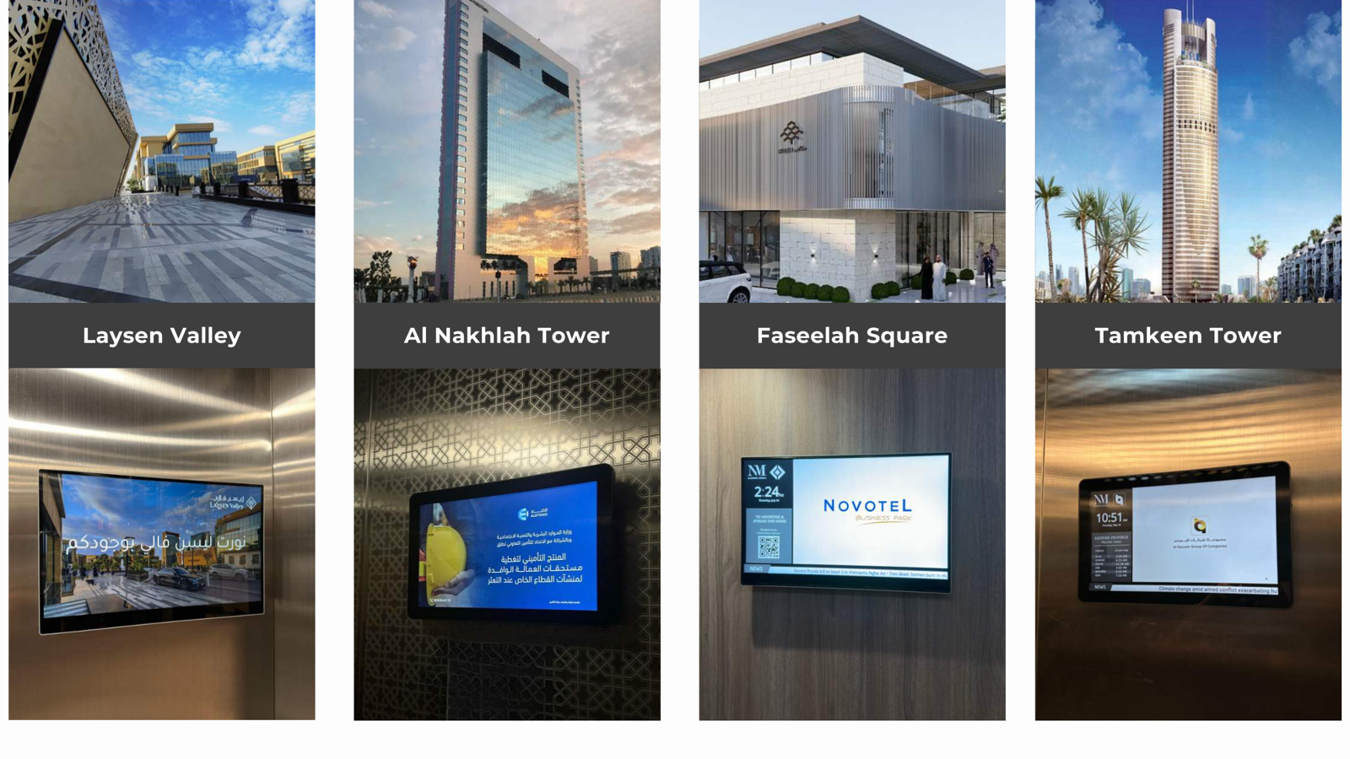
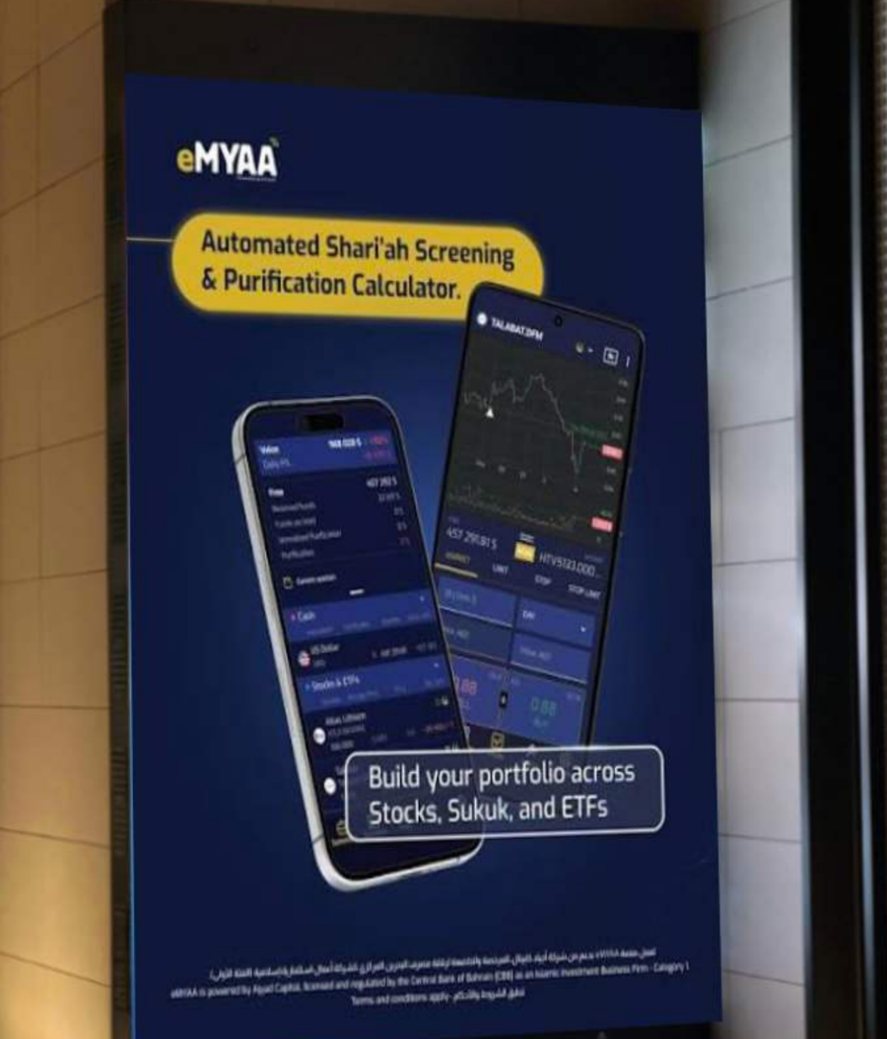
OUTDOOR AND ELEVATOR MEDIA, SAUDI ARABIA
Outdoor options from Nadher Media: 91 screens in Saudi Arabia
LATEST OFFER, 23 SEP
USD 44,800 + VAT
8 weeks, 91 screens, 30% below the original rate of USD 64,000.
83
8
Elevator screens, 83 towers | The Zone LED screens, 8 faces (eMYAA mock-up)
Duration
Original rate
eMYAA rate
Ad plays
towers
LED faces
elevator screens
The Zone, Riyadh
2 weeks
-
USD 16,000
0.84M
4 weeks
USD 32,000
USD 27,200
1.67M
All prices in USD + VAT. Proposal only, not yet approved.
8 weeks
USD 64,000
USD 44,800
3.35M
12 weeks
USD 96,000
USD 67,200
5.02M
eMYAA Trading Platform | Saudi Market Plan
5
Notes:
Nadher Media proposals 16 and 23 Sep 2026, Saudi screens only (the Al Liwan Bahrain weekend screens in the 16 Sep offer are left out). Elevator screens in 83 commercial towers (Al Nakhlah, Tamkeen, Faseelah Square, Laysen Valley and others in Riyadh and the Eastern Province) and 8 LED screens at The Zone, Riyadh. Plays per Nadher: 2,490 an hour (ad plays, not unique viewers). 2-week rate has no original price in the offer. USD at 3.75.

Slide 6
JODEL, SAUDI ARABIA
Jodel: 2.5 million impressions in 7 days for USD 3,862.50
THE OFFER
PEER RESULT: BAHRAIN ISLAMIC BANK IN KSA
USD 3,862.50 + VAT
7 days over Saudi National Day
7 days | all of Saudi Arabia
4.15M
0.43%
525,000 display and video impressions + 24-hour takeover poll (2,000,000 impressions)
impressions
click rate
700+
240
2.5M
USD 1.53
21 to 35
app downloads
accounts opened
impressions
per 1,000
audience age
in 7 days
impressions
2.5M users in KSA
Proposal only, not yet approved. Best timed with a salary week, as in the BISB campaign.
eMYAA Trading Platform | Saudi Market Plan
6
Notes:
Nadher Media proposal for eMYAA, 16 Sep 2026: USD 3,862.50 + VAT, 7 days, all KSA: 525,000 display and video impressions plus a 24-hour takeover poll of 2,000,000 impressions, one round of ad consulting, unlimited creatives. Cost per 1,000 impressions: about USD 1.53. Jodel KSA: 2.5M active users, 800,000 monthly unique users, average CTR 0.44%. BISB case study (Nadher Media, Oct 2025).

Slide 7
FOR DISCUSSION
Where eMYAA and Vision Bank could work together
01
02
03
Market insight
Easy funding
Joint campaigns
What Saudi digital customers expect, and what has worked in your marketing.
Simple transfers between Saudi bank accounts and eMYAA.
Co-branded content and offers for first-time investors.
We would value your advice as we enter the Saudi market.
eMYAA Trading Platform | Saudi Market Plan
7
Notes:
Discussion topics only; nothing here is agreed.

Slide 8
Thank You
Invest Wisely. Trade Precisely.
Hatem Isa Hatem | Marketing Officer, WealthTech
hhatem@ajyadcapital.com | +973 17 565 007
Ajyad Capital, 37th Floor, Almoayyed Tower, Manama, Kingdom of Bahrain
Ajyad Capital is an Islamic investment firm (Category 1) licensed by the Central Bank of Bahrain.

