Slide 1
IT STATUS UPDATE
Vendors, Platform & Internal Systems
Prepared for the CEO | WealthTech | 01 October 2026
iGentech · Shufti Pro · QATestLab · Exante · Google Play compliance · Helpdesk

Slide 2

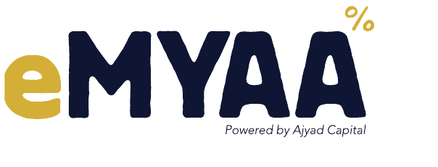
Executive Summary
STATUS AT A GLANCE
Area | Update | Status
iGentech | Invoice overrun resolved: billing cut from USD 10,750 to 5,625 (–48%) | RESOLVED
Shufti Pro – billing | Duplicate KYC charges refunded (USD 9,605) + USD 50 production test credit | RESOLVED
Google Play API update (Mention this is for security reasons – so it doesn’t get confused with new app) | Android build tested in 2 rounds: 99.4% pass. Deadline 01 Nov 2026 | DONE
Helpdesk | Deployed 17 Sep 2026, ahead of the 20 Sep target. | DONE
Shufti Pro – KYC | Enhanced KYC journey via SDK demo app. Target 08 Oct 2026 (let us mention this is a demo for internal use only and it wont be live) | IN PROGRESS
QATestLab | Engaged to review the Next App and prepare test cases | IN PROGRESS
Exante – Next App | First version due 08 Oct 2026. Complete release plan to be shared by next week. (mention the date of which we will do the sanity test - ) | IN PROGRESS
eMYAA Trading Platform | IT Status Update to CEO | 01 Oct 2026
2

Slide 3
Next App – Exante & QATestLab
PLATFORM · NEXT APP DELIVERY
Now
Next week
08 Oct 2026
After 08 Oct
QATestLab engaged
Release plan
Next App v1
Independent QA
Reviewing the Next App and preparing test cases
Full plan shared once QATestLab confirms its estimate
First version delivered by Exante
QATestLab tests v1 against prepared cases
WHY IT MATTERS
Using QATestLab gives an independent quality check before the Next App reaches users. Test cases are being written in parallel with Exante's build, so testing can start as soon as v1 arrives on 09 Oct.
eMYAA Trading Platform | IT Status Update to CEO | 01 Oct 2026
5

Slide 4
Android App – Google Play API Update
PLATFORM · COMPLIANCE
Google required an API update and republish by 01 Nov 2026 to keep the app on Google Play. The team delivered the build and we completed two test rounds: Round 1 by Abdulla, Round 2 by Malik. No major bugs were found, and the updated app was published on Google Play on 29 Sep 2026.
Module | Passed | Failed | Skipped | N/A
Base requirements | 48 | 1 | 13 | 2
AI Chatbot | 31 | 0 | 0 | 2
T&C + SCC | 12 | 0 | 0 | 0
Other Q1 requirements | 42 | 0 | 3 | 0
KYC onboarding | 25 | 0 | 3 | 0
MINOR ISSUES – NEXT RELEASE
99.4%
Watchlist items disappear when Shariah filter is on
Instrument tree keeps buffering on first open on the trade screen.
Withdrawal: beneficiary shows last name only.
Change display mode has no effect
Arabic Summary screen: Daily P/L not clearly visible
Exchange section should be hidden (USD base currency only)
pass rate (executed)
Passed 158
Skipped 19
None of these block the release.
N/A 4
Failed 1
Live on Google Play Store
182 cases · 159 executed · 158 passed
Published 29 Sep 2026, more than a month ahead of the deadline.
eMYAA Trading Platform | IT Status Update to CEO | 01 Oct 2026
6

Slide 5
Helpdesk – System Improvement Backlog
FEEDBACK
7
ID | Raised by | Improvement | Priority | Status
HD-001 | Suhail | Standalone desktop app for Client Experience | Low | DONE
HD-002 | Malik | Auto-acknowledgement email with ticket ID | Medium | DONE
HD-003 | Malik | Notify Client Experience on new tickets | Medium | DONE
HD-007 | Abdulla | Pause SLA timers on weekends | Low | IN PROGRESS
HD-004 | Eman | Knowledge Base linked to eMYAA support page | Low | NEW
HD-005 | Eman | Create ticket when chatbot user picks "Contact a Human" | Low | NEW
HD-006 | Eman | CRM integration: auto-create Helpdesk accounts for new users | Low | NEW
Items logged
3
Completed
1
In progress
3
New
HD-007 is being built after an SLA breach on a client inquiry raised on a Thursday.
eMYAA Trading Platform | IT Status Update to CEO | 01 Oct 2026
8

