Slide 1
eMYAA MARKETING UPDATE
Performance, Campaigns, Channel Activity, and Key Priorities
01 October 2026
Internal Management Update

Slide 2
OVERVIEW
Executive Summary
LAUNCHED
PERFORMING
GROWING
Google Ads & LinkedIn
Instagram Remains the Standout
LinkedIn Momentum
New paid channel went live 22 Sep, testing phase. Already 69.7% of website traffic.
2,116 followers, 2.27M all-time views; Reels drive 89.5% of interactions.
531 followers, +247 in 30 days (+6,075%); impressions and reactions both up double digits.
IN PROGRESS
NEEDS ATTENTION
OPEN ITEM
Content Pipeline on Track
Arabic Underperforming English
Deposits Reporting Gap
How-To video and Abdulelah Al Harbi posted; Manal Talal in production for mid-October.
Early Google Ads data: English leads on every metric, incl. 97% vs 87% engagement rate.
Gross deposits confirmed by Malek directly ($12,206); no export file yet restores this as a tracked metric.
eMYAA Trading Platform | Marketing Update | Internal Management Update
2

Slide 3
DASHBOARD
KPI Snapshot
480
App Downloads
vs 414 prior pull
587
Website Sessions
69.7% from Google Ads, since 22 Sep
2,116
Instagram Followers
all-time
531
LinkedIn Followers
+247 in last 30 days
69.7%
Paid Traffic Share
of 587 tracked sessions
97.2%
Engagement Rate, EN Ads
vs 86.9% Arabic, since 23 Sep
eMYAA Trading Platform | Marketing Update | Internal Management Update
3

Slide 4
CHANNELS
Channel Performance: Instagram & LinkedIn
Metric | Value
IG Total Views (all-time) | 2,271,132
IG Total Interactions (all-time) | 8,311
LinkedIn Impressions, 13-27 Sep | 559 (+118%)
LinkedIn Reactions, 13-27 Sep | 28 (+155%)
eMYAA Trading Platform | Marketing Update | Internal Management Update
4

Slide 5
CAMPAIGNS
Campaign & Content Tracker
Item | Status | Key Metric | Timing
Mention & Win | Live | 26.2K views, 1,129 likes on launch reel | 23 Sep to 20 Oct, timed before salary days
Ali Sabeel Video | Completed | 1.3M views to date | Completed 18 Sep
How-To Video (human presenter) | Posted | 319 views, 28 interactions | Posted, Sep
Abdulelah Al Harbi | Posted | Live on Instagram | Posted, Sep
Manal Talal | In Production | Brief sent, production started | Targeting mid-October
Monthly Content Calendar | Live | Being posted through September | Ongoing
Q3 to Q4 2026 Rollout: One Creator per Month
Jul: Musheera | Aug: Ali Sabeel | Sep: Abdulelah | Oct: Manal Talal | Nov: Hamed Al Bloushi
Posted | Posted | Posted | In Production | Scheduled
eMYAA Trading Platform | Marketing Update | Internal Management Update
5

Slide 6
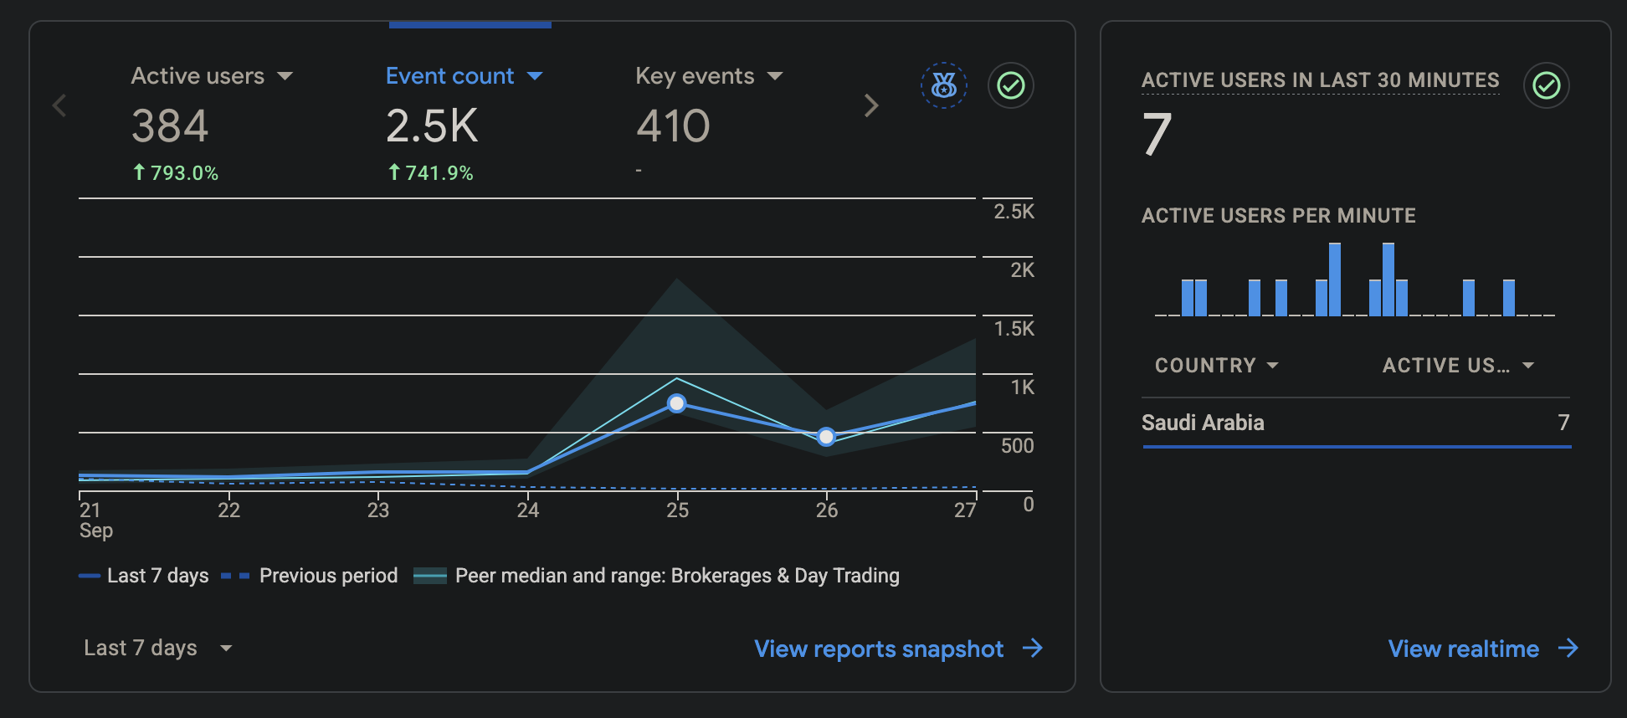
NEW CHANNEL
Paid Media: Google Ads & LinkedIn
Launched 22 September as a testing phase. Google Search targets Starter and Emerging investors; LinkedIn lead generation targets Affluent investors. $30,000 campaign, September to December, managed by Ignite (invoice TI7541). Interest targeting covers Saudi Arabia and Riyadh; location is restricted to Saudi Arabia residents only.
793%
Active Users, Week over Week
Following the Saudi test launch
558
New Users Driven to Site
Since campaign launch
The four traffic sources above account for 579 of 587 tracked sessions (98.6%); the remaining 8 sessions fall outside GA’s top-source breakdown.
eMYAA Trading Platform | Marketing Update | Internal Management Update
6

Slide 7
EARLY SIGNAL
English Is Outperforming Arabic in Saudi
In testing, the English version of the Google Ads campaign leads the Arabic version on every measured metric.
Metric | English | Arabic
Sessions | 212 (54.5%) | 176 (45.2%)
Active users | 208 (54.3%) | 175 (45.7%)
Engaged sessions | 206 (57.4%) | 153 (42.6%)
Avg. engagement time | 19s | 16s
Events per session | 6.49 | 5.44
Engagement rate | 97.17% | 86.93%
This is early data (since 23 Sep) and may reflect ad copy or targeting rather than audience preference. Recommendation: review the Arabic creative and targeting with Ignite before scaling spend.
eMYAA Trading Platform | Marketing Update | Internal Management Update
7

Slide 8
GOVERNANCE
Key Issues, Risks & Dependencies
Item | Type | Detail
LinkedIn follower count dropped 586 to 531 | Unverified metric | No source explains the decrease; needs Ignite or a platform export to resolve
Gross deposits reporting | Data gap | Confirmed by Malek directly ($12,206) but no spreadsheet export yet restores this as a tracked line
Arabic ad performance | Campaign risk | Trailing English on every metric since 23 Sep; review creative and targeting before scaling spend
Instagram/LinkedIn/X/TikTok exports | Reporting gap | No standing export or update cadence; each refresh this cycle relied on ad hoc screenshots
Ali Sabeel "Completed" status | Inference, not confirmation | Based on no further Ignite invoice since 18 Sep, not a direct close-out confirmation
None of the above represent a confirmed factual error — they are open items requiring a source, a decision, or a follow-up before the next reporting cycle.
eMYAA Trading Platform | Marketing Update | Internal Management Update
8

Slide 9
MOVING FORWARD
Next Steps
Item | Owner / Next Action | Timing
Scale Google Ads & LinkedIn | Marketing, with Ignite; review Arabic creative first | September to December
Manal Talal video | Production in progress | Mid October
Hamed Al Bloushi video | Scheduled, per rollout plan | November
Mention & Win | Continues, GCC-wide | Through 20 October
Fresh KPI export | Requested from Malek, to restore gross deposits reporting | This week
LinkedIn follower discrepancy | Follow up with Ignite for an explanation | Next reporting cycle
The story so far: a new paid channel launched and already drives most of our website traffic, paired with a steady drumbeat of new content. The next phase is to scale what is working, resolve the Arabic underperformance and the open data gaps, and keep shipping one creator a month through year end.
eMYAA Trading Platform | Marketing Update | Internal Management Update
9

Slide 10
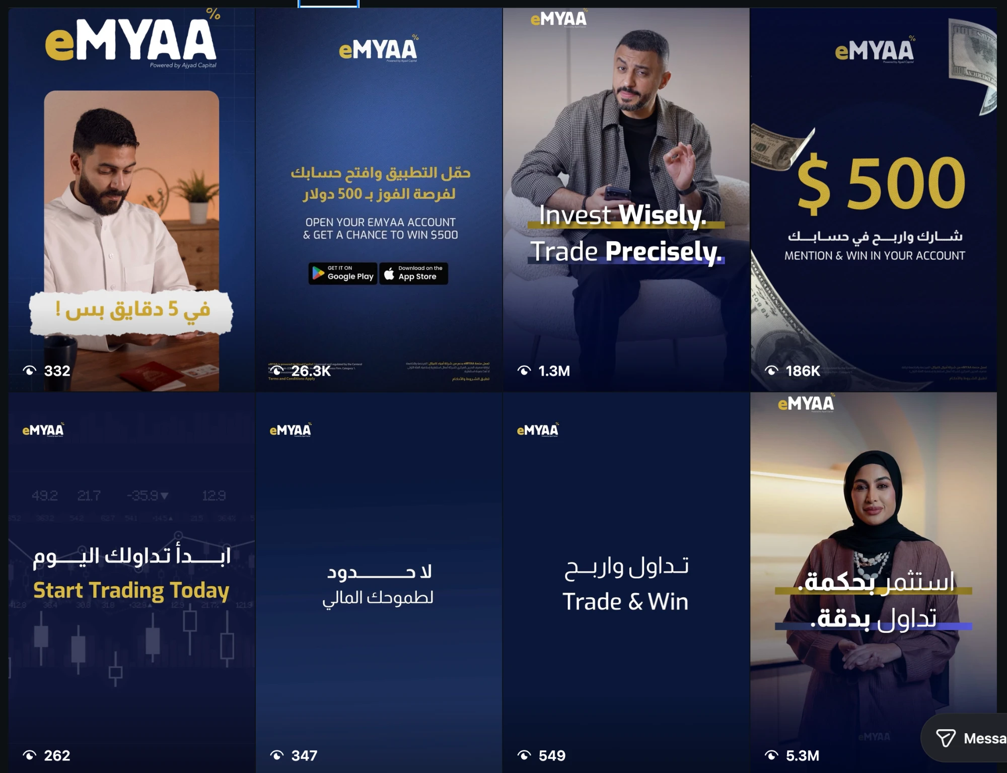
APPENDIX
Best Performing Content & Supporting Detail
Content | Views | Format
Musheera Reel | 5.3M | Video, presenter-led
Ali Sabeel Reel | 1.3M | Video, presenter-led
Mention & Win $500 | 186K | Graphic, campaign
Saudi Market Size Infographic | 515 | Graphic, static
Presenter-led video reels outperform static graphics by orders of magnitude — the basis for continued investment in human-led formats.
eMYAA Trading Platform | Marketing Update | Internal Management Update
10

