Slide 1


eMYAA Trading Platform
Performance Analysis
1st of October, 2026

Slide 2


Performance Update
490
61
70
$107.52
Total Downloads
Users Onboarded
Incomplete KYC Users
Revenue
prev 414
▲ +18.4%
prev 51
▲ +19.6%
From 14 May 2026 . till date
$12,206.00
$1,666.19
$10,539.81
55
Total Deposits
Total Withdrawals
Current AUM
Total Trades
prev $10,195.88
▲ +19.7%
prev $1,666.19
prev $8,529.69
▲ +23.6%
prev 47
▲ +17.0%
Key Highlights
Platform: downloads up, onboarding lagging
490 downloads (+18.4%), 61 clients (+19.6%); only 4 of 53 downloads since 22 Sep onboarded, 70 KYC incomplete.
Marketing: paid media testing, campaigns live
Google Ads brought 70% of Sep site traffic; Mention & Win and $5,000 campaigns live; Manal Talal video in October.
Client Experience and IT: clearing onboarding blockers
6 of 21 clients called onboarded (28.6%); Helpdesk live 17 Sep; Android security update live 29 Sep; Next App v1 due 08 Oct.

Slide 3
Key Performance Indicators & Volume Projections
KPI & Performance Detail
May
June
July
August
September
October
November
December
I. CLIENTS, CUMULATIVE
Achieved / Current
11
24
33
47
61
Target / Projected
20
24
28
33
39
46
54
64
Performance Gap
-9
+0
+5
+14
+22
II. NUMBER OF TRADES
Achieved / Current
8
17
5
16
9
Target / Projected
20
24
28
33
39
46
54
64
Performance Gap
-12
-7
-23
-17
-30
III. AVERAGE DEPOSIT PER CLIENT
Actual / Current
$364.82
$329.46
$261.42
$212.84
$200.10
Target / Projected
$5,000
$5,250
$5,513
$5,788
$6,078
$6,381
$6,700
$7,036
Performance Gap
-$4,635.18
-$4,920.54
-$5,251.58
-$5,575.16
-$5,877.90
IV. TOTAL DEPOSITS, CUMULATIVE
Achieved / Current
$4,012.99
$7,907.15
$8,626.91
$10,003.60
$12,206.00
Target / Projected
$100,000
$123,900
$153,512
$190,201
$235,660
$291,982
$361,766
$448,228
Performance Gap
-$95,987.01
-$115,992.85
-$144,885.19
-$180,197.89
-$223,454.00
Notes:
4

Slide 4
IT Progress Update

Slide 5
IT Status at a Glance
VENDORS, PLATFORM AND INTERNAL SYSTEMS | AS AT 01 OCTOBER 2026
Area | Update | Target / done | Status
iGentech | Invoice overrun resolved: billing cut from USD 10,750 to USD 5,625 (-48%). | Closed | RESOLVED
Shufti Pro, billing | Duplicate KYC charges refunded (USD 9,605), plus a USD 50 production test credit given as compensation. | Closed | RESOLVED
Google Play security update (current app) | Security API update Google requires for the current Android app. Not the Next App. 2 test rounds, 99.4% pass; live on Google Play. | Done 29 Sep (deadline 01 Nov) | DONE
Helpdesk | Deployed ahead of the 20 Sep target. Improvement backlog in the appendix. | Done 17 Sep | DONE
Shufti Pro, KYC demo | Enhanced KYC flow in the Shufti SDK demo app. Internal demo only; it will not go live. | 08 Oct 2026 | IN PROGRESS
QATestLab | Reviewing the Next App and preparing test cases, ready for v1. | Testing from 08 Oct | IN PROGRESS
Exante, Next App | First version due 08 Oct. Full release plan to be shared next week. Sanity test date to be confirmed. | v1: 08 Oct 2026 | IN PROGRESS
WealthTech CRM (Frappe) | One customer base in a single system. Starts now that Helpdesk is live. | 29 Oct 2026 | PLANNED
Reporting Dashboard | Real-time reporting options under review to support the business case. | TBC | EXPLORING
Notes:
Source: IT Status Update to CEO, 01 Oct 2026, slide 2, with the review comments applied: Shufti credit shown as compensation; CRM and Reporting Dashboard added in the same format; target date column added. The Google Play item is the security update to the current app, not the Next App. The Shufti KYC flow is an internal demo and will not go live. The sanity test date for Next App v1 was left blank in the source, so it shows as to be confirmed. iGentech: 10,750 to 5,625 is -47.7%.

Slide 6
Next App: Exante and QATestLab
PLATFORM | NEXT APP DELIVERY
Now
Next week
08 Oct 2026
After 08 Oct
QATestLab engaged
Release plan
Next App v1
Independent QA
Reviewing the Next App and writing test cases while Exante builds it.
Full plan shared once QATestLab confirms its estimate.
First version delivered by Exante.
QATestLab tests v1 against the prepared cases. Sanity test date to be confirmed.
WHY IT MATTERS
QATestLab gives an independent quality check before the Next App reaches users. Test cases are written while Exante builds v1, so testing can start as soon as v1 arrives on 08 Oct.
Notes:
Source: IT Status Update to CEO, 01 Oct 2026, slide 3. The source said testing starts when v1 arrives on 09 Oct but gives 08 Oct everywhere else; 08 Oct is used. Sanity test date not given in the source.

Slide 7
Android App: Google Play Security Update
CURRENT APP | SECURITY COMPLIANCE | NOT THE NEXT APP
Google required a security API update, republished by 01 Nov 2026, to keep the current app on Google Play. We ran two internal test rounds and found no major bugs.
Module | Passed | Failed | Skipped | N/A
Base requirements | 48 | 1 | 13 | 2
AI Chatbot | 31 | 0 | 0 | 2
T&C + SCC | 12 | 0 | 0 | 0
Other Q1 requirements | 42 | 0 | 3 | 0
KYC onboarding | 25 | 0 | 3 | 0
Total | 158 | 1 | 19 | 4
99.4%
MINOR ISSUES, NEXT RELEASE
1. Watchlist items disappear when the Shariah filter is on
2. Instrument tree keeps loading on first open of the trade screen
3. Withdrawal: beneficiary shows last name only
4. Change display mode has no effect
5. Arabic summary screen: daily P/L hard to see
6. Exchange section should be hidden (USD base currency only)
pass rate (158 of 159 executed)
Passed 158
Skipped 19
N/A 4
Failed 1
182 cases | 159 executed | 158 passed
Live on Google Play: 29 Sep 2026
More than a month before the deadline.
Round 1 and Round 2 combined.
None of these block the release.
Notes:
Source: IT Status Update to CEO, 01 Oct 2026, slide 4. This is the security API update Google requires for the current Android app, not the Next App. 182 cases: 158 passed, 19 skipped, 4 N/A, 1 failed; 158 of 159 executed = 99.4%. Module rows add up to the totals. Chart drawn from shapes so it imports into Canva. Tester names removed, in line with the review comment on the Helpdesk slide.

Slide 8
IT Progress Update: Product Roadmap
The Next Mobile App - v1 due 08 Oct 2026
Built by Exante and tested by QATestLab before release. A simpler, easier trading experience.
Guest Access - Planned 2027
Users can explore the platform before onboarding, removing KYC as a barrier to first experience.
Market Pulse Feature - In Discussion
In-app live market news to drive repeat engagement.
Note: EXANTE verifying data-provider access for white-labels.

Slide 9
Client Experience
Progress Update

Slide 10
Client Experience Overview
SINCE THE LAST CEO UPDATE | 20 SEP TO 1 OCT 2026
21
72
4
6
15
28.6%
Clients called
Clients emailed
WhatsApp clients
Completed onboarding
Still pending
Conversion (of clients called)
CLIENTS CALLED, BY WHERE THEY ARE NOW
Onboarded 6
Not onboarded 11
Funding gap 4
6
Onboarded (28.6%)
11
Not onboarded (52.4%)
4
Funding gap (19.0%)
Completed onboarding after the call
KYC or documents not finished
Onboarded, not yet funded: need support to fund
SUMMARY
Out of 21 clients called, 6 completed onboarding (28.6%). 15 are still pending: 11 have not finished onboarding and 4 are onboarded but have not funded yet.
Call results in the tracker: 12 reached, 2 no answer, 7 not yet logged. Email (72) and WhatsApp (4) cover clients we could not reach by phone.
Notes:
Team figures to 1 Oct: 21 called, 72 emailed, 4 WhatsApp, 6 completed onboarding. Pending 21 - 6 = 15; conversion 6 / 21 = 28.6%. Client types from the Client Monthly Tracker, weeks 8 and 9 (20 Sep to 1 Oct): 17 not onboarded (Potential Customer) and 4 funding gap (Funded Gap Customer). The 6 who completed onboarding are among the 17, which leaves 11. The previous Canva version said 6 of 20 = 20% and 14 = 80%; the correct figures for 20 would have been 30% and 70%.

Slide 11
Client Feedback and Next Steps
WHAT CLIENTS TOLD US AND WHAT WE DO NEXT
CLIENT FEEDBACK
PROPOSED NEXT STEPS, BY GROUP
Missing documents: many clients don't have their KYC documents ready at registration, which causes delays or drop-off.
KYC feels too long: verification takes longer than clients expect, and some stop halfway.
Fees: clients asked about our commissions and fees.
Deposits: several clients asked how to deposit by bank transfer.
Funding gap: 4 onboarded clients need support to fund. One asked about fees; two said they will fund soon.
Funding gap (4)
Send the fee schedule and bank transfer steps, then a follow-up call.
Not onboarded (11)
Onboarding email with the document checklist, then a second call on day 3.
CLIENTS FOLLOWED UP PER WEEK (TRACKER)
35
35
Onboarded (6)
8
6
9
12
Guide the first deposit by bank transfer so the account gets funded.
5
4
0
6 Aug
13 Aug
20 Aug
27 Aug
3 Sep
10 Sep
17 Sep
24 Sep
1 Oct
Week ending. Dark bars = this update (21). Early August weeks were mostly spam numbers.
To make the weekly update faster: log the result of every call (7 of 21 have none yet), and give each open client an owner, a due date and a next follow-up (none set in the last two weeks).
Notes:
Feedback from the current Canva version of the Overview slide, plus the funding-gap point asked for in the review comments. Funding-gap notes from the tracker (week 8): one asked about fees, two will fund soon, one with no note. Next steps are proposals that follow the Client Interaction Journey in the appendix. Tracker check: weeks 8-9 have no owner, due date, next follow-up or funding value filled in, and 7 week-9 rows have no stage.

Slide 12
Marketing

Slide 13
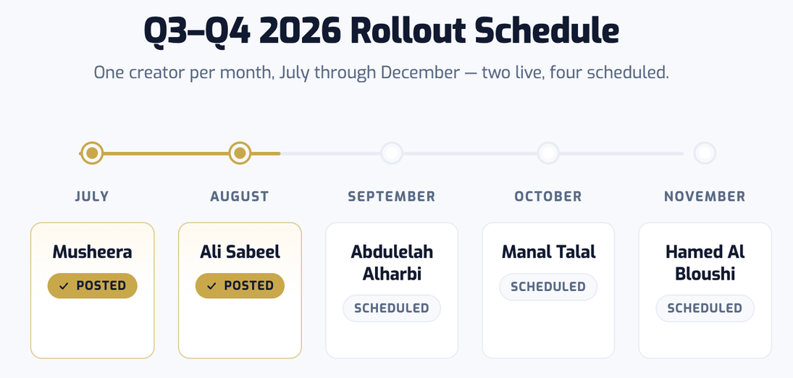
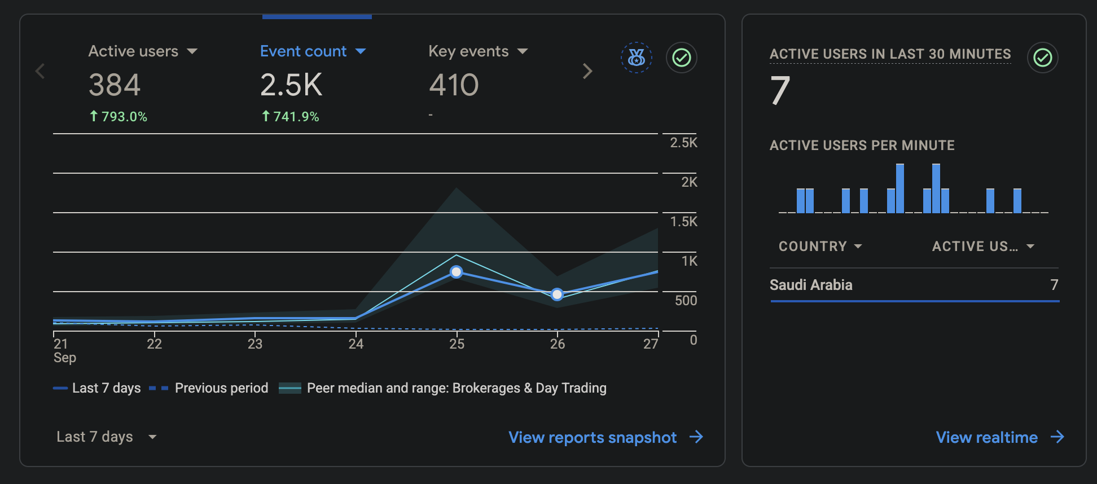
Sponsored Ads: What's Live Now
Campaign | Status | Notes
Mention & Win | Live, 23 Sep to 20 Oct | Timed before salary days; 26.3K views, 1,129 likes on launch post
Ali Sabeel Video | Completed 18 Sep | GCC-wide targeting, 3-week run completed, no further spend invoiced
What is Actioned & In Progress
Campaign | Status | Notes
Monthly Calendar | Completed | New How To video with a human presenter posted
Abdulelah Al Harbi | Completed | Video live on Instagram
Manal Talal | Scheduled for 22 October | Brief sent, video production started
NEW CHANNEL: GOOGLE ADS & LINKEDIN
Testing since 22 Sep. Google Search (Starter/Emerging) + LinkedIn lead gen (Affluent). Interest targeting: Saudi Arabia and Riyadh; location restricted to Saudi Arabia residents only. $30,000 campaign, Sep to Dec (Ignite, TI7541).
In testing, English is outperforming Arabic: 212 vs 176 sessions, 97% vs 87% engagement rate.
Google Analytics: website traffic, 21 to 27 Sep 2026

Slide 14
Thank You
Invest Wisely. Trade Precisely.

Slide 15
Appendix

Slide 16
Platform Initiatives Roadmap
Target: 20 Sep 2026
DONE
Helpdesk Deployment - Frappe Helpdesk
Deployed by WealthTech IT on 17 Sep 2026, ahead of the 20 Sep target. Cybersecurity approval was received on 20 August.
Live since 17 Sep 2026
WealthTech CRM - Frappe CRM
PLANNED
Target: 29 Oct 2026
Cybersecurity has approved Frappe applications. Frappe's CRM module will hold one customer base. Starts now that Helpdesk is live.
Reporting Dashboard
EXPLORING
Under R&D - date TBC
Exploring options for a real-time analytics dashboard for eMYAA. Looking into different modules to support our Business Case.

Slide 17






Systems Planning & Deployment
INTERNAL WEALTHTECH TECHNOLOGY OPERATIONS
01
Helpdesk Deployment
02
WealthTech CRM Rollout
03
Reporting Dashboard
TARGET 20 Sep 2026
TARGET 29 Oct 2026
TARGET TBC
Deployed on 17 Sep 2026, ahead of the 20 Sep target.
Will bring the customer base into a single system. Starts now that Helpdesk is live.
Real-time reporting capability under evaluation, to support the business case.
EXPLORING
DONE
EXPLORING
DONE
EXPLORING
IN PROGRESS
PLANNING
DONE
PLANNING
DONE
PLANNING
NOT STARTED
IN PROGRESS
DEPLOYMENT
DONE
DEPLOYMENT
NOT STARTED
DEPLOYMENT
NOT STARTED
HELPDESK SOLUTION
Cost-Effective Annual cost of USD 600-1,000 (hosting only), about 83%-90% less than comparable vendor tools at USD 6,000-10,000.
In-House & Fully Customizable Full control over the source code, database, and future enhancements.
Helpdesk is live: Client Experience no longer tracks queries in Excel
eMYAA Trading Platform | CEO Update | 01 Oct 2026

Slide 18
Helpdesk: Improvement Backlog
FEEDBACK FROM THE TEAMS SINCE GO-LIVE ON 17 SEP
7
Improvement | Priority | Status
Standalone desktop app for Client Experience | Low | DONE
Auto-acknowledgement email with ticket ID | Medium | DONE
Notify Client Experience of new tickets | Medium | DONE
Pause SLA timers on weekends | Low | IN PROGRESS
Knowledge base linked to the eMYAA support page | Low | NEW
Create a ticket when a chatbot user picks "Contact a Human" | Low | NEW
CRM link: create Helpdesk accounts for new users automatically | Low | NEW
Items logged
3
Completed
1
In progress
3
New
The weekend SLA pause is being built after an SLA breach on a client query raised on a Thursday.
Notes:
Source: IT Status Update to CEO, 01 Oct 2026, slide 5. Names and IDs removed and slide moved to the appendix, as the review comments asked. Counts: 7 logged = 3 done + 1 in progress + 3 new.

Slide 19
IT Progress Update
Exante - Status Update
Corporate Client Onboarding
Aligned with the Exante team on the end-to-end process for onboarding corporate clients.
New Application Release
First version of the Next App due 08 Oct 2026. Full release plan to be shared next week.
Sanity / Smoke Tests
The Android security update passed two internal test rounds (99.4%) and went live on Google Play on 29 Sep. Sanity test date for Next App v1: to be confirmed.

Slide 20
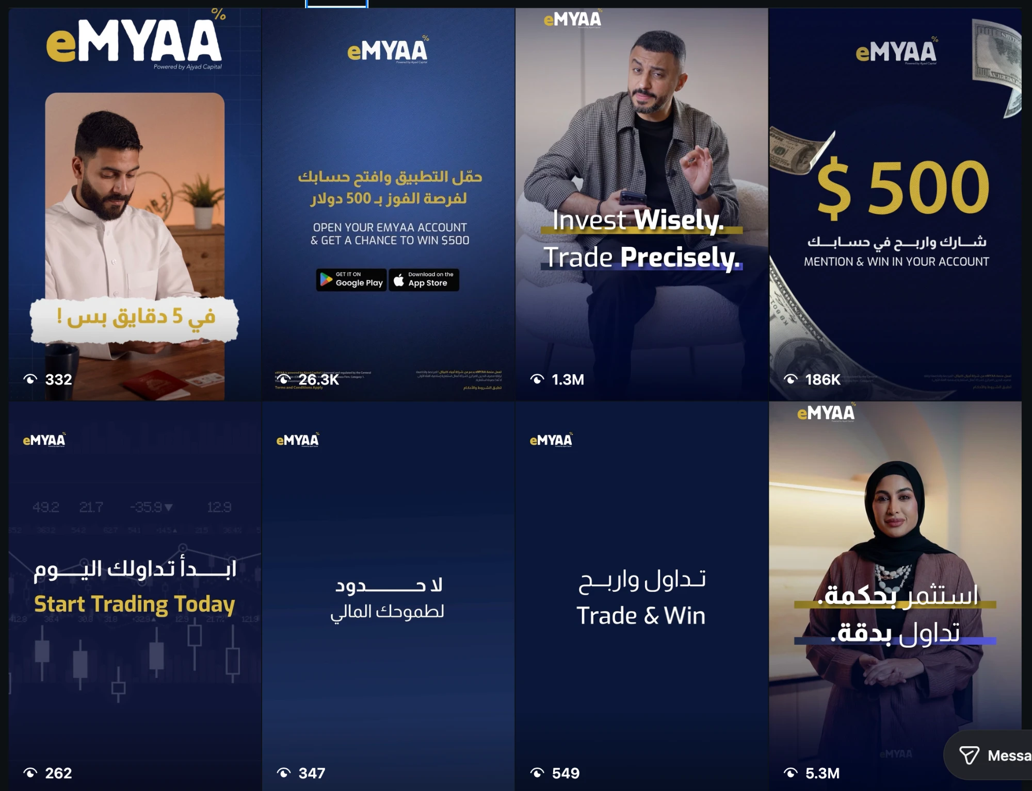
Instagram: Standout Channel
Metric | Value | Notes
Followers | 2,116 | -
Views (all-time) | 2,271,132 | 59.2% Reels / 38.1% Stories
Interactions (all-time) | 8,311 | 72.4% from Reels
Top Performing Content
Content | Result
Musheera Reel | 5.3M views
Ali Sabeel Reel | 1.3M views
Mention & Win $500 | 186K views
Saudi Market Size Infographic | 515 views

Slide 21
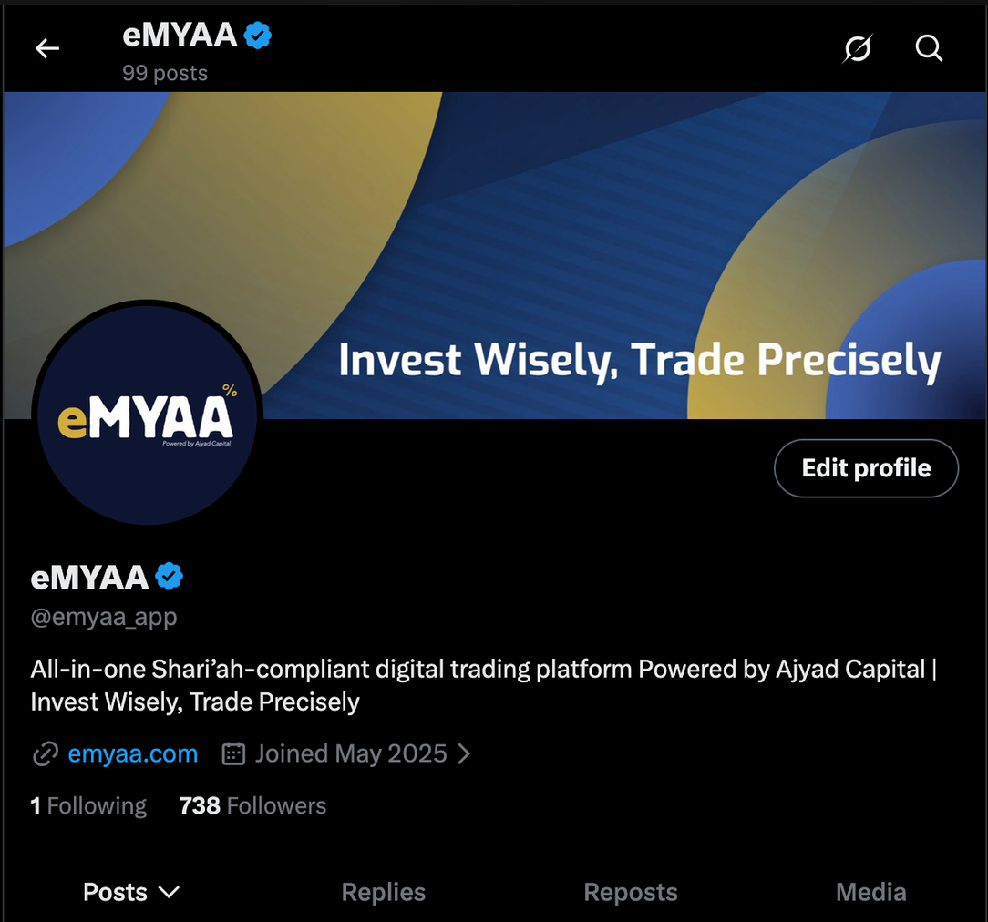
X, LinkedIn & TikTok
Platform | Metrics | Notes
X | 738 followers, 99 posts | Audience quality is real: 96.4% Bahrain, 3.6% Saudi, however still Instagram is heavily outperforming X.
LinkedIn | 531 followers | 247 new followers in 30 days (vs 4 before, +6,075%); 13-27 Sep: 559 impressions (+118%), 28 reactions (+155%)
Tiktok | 15 followers, 176 total likes | Lowest interactions between all platform/ audience not suitable for eMYAA

Slide 22
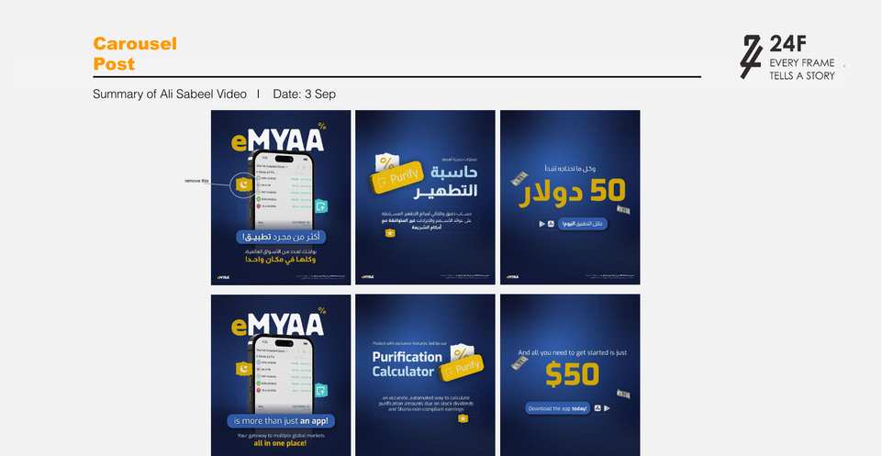
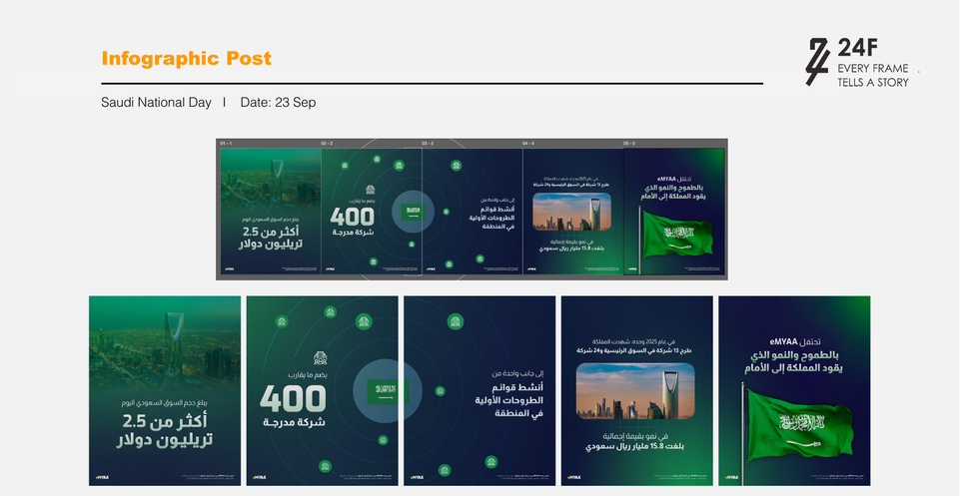

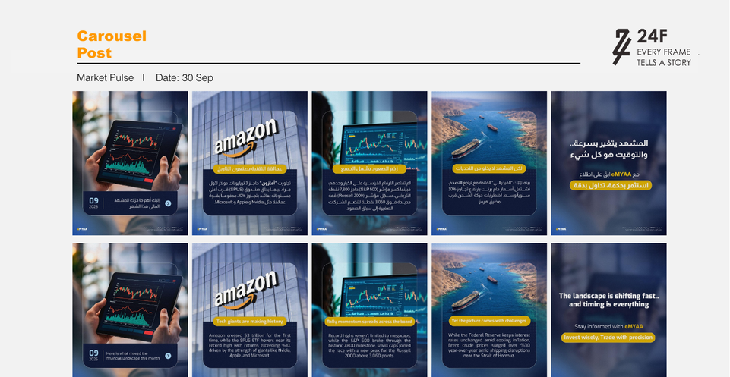
September Artwork Preview
3 Sep - Ali Sabeel Recap
23 Sep - Saudi National Day
27 Sep - GCC Market Spotlight
30 Sep - Market Pulse
*Work in progress

Slide 23
Website Analytics
587
Visits
542
Active Users
558
New Users
Traffic Sources
Source | Visits | Notes
Paid (Google Ads) | 409 (69.7%) | google / cpc, campaign live since 22 Sep, already the top traffic source
Direct | 92 (15.7%) | No campaign or referral tag - typed URL, bookmark, or app share
Search | 39 (6.6%) | Organic Google search
Referral | 32 (5.5%) | ajyadcapital.com, Instagram, Facebook, Google Tag Assistant (7 test visits)
The four sources above account for 572 of the site’s 587 sessions (97.4%); the other 15 are ChatGPT (9) and source not available (6). GA4 export, 1-28 Sep.

Slide 24
Client Interaction Journey
1
2
3
DAY 1 CALL
DAY 1 EMAIL
DAY 3 CALL
DAY 3 EMAIL
4
First Contact
Email Reminder
Second Call
Follow-Up Email
Reach out directly by phone. Guide the client through whatever step they're stuck on.
Send campaign emails to re-engage clients who remain stuck mid-onboarding or have not yet funded their account
Send a reminder email at the end of the day outlining the steps required to progress through their current stage.
follow up with a second call, conveying greater urgency and offering to walk the client through the process live.
Contact Channels
Phone Calls: direct phone outreach for onboarding guidance and follow-ups
Emails: reminders, document lists, and campaign follow-ups
Business WhatsApp (In Progress): planned addition to reach clients faster and more directly

