Slide 1




eMYAA Trading Platform
Progress Update
1st of October, 2026

Slide 2









Performance Update
PERFORMANCE
490
61
70
$140.21
Total Downloads
Users Onboarded
Incomplete KYC Users
Revenue
prev 414
▲ +18.4%
prev 51
▲ +19.6%
prev $107.52 ▲ +30.4%
$12,206.00
$1,666.19
$10,539.81
55
Total Deposits
Total Withdrawals
Current AUM
Total Trades
prev $10,195.88
▲ +19.7%
prev $1,666.19
prev $8,529.69
▲ +23.6%
prev 47
▲ +17.0%
Key Highlights
Platform: downloads up, onboardings to follow
490 downloads (+18.4%), 61 clients (+19.6%); only 4 of 53 downloads since 22 Sep onboarded (Testing phase of Google Ads).
Marketing: paid media testing, campaigns live
Google Ads brought 70% of Sep site traffic; Mention & Win, $5,000, and Abdulelah campaigns are live; Manal Talal video in October.
Client Experience and IT: clearing onboarding blockers
8 of 31 contacted clients onboarded (25.8%); Helpdesk launched.

Slide 3



Key Performance Indicators & Volume Projections
PERFORMANCE
61
$12,206.00
$200.10
Clients onboarded
Total deposits
Average deposit per client
156% of the 39 target
5.18% of the $235,660 target
Across all 61 onboarded clients
CUMULATIVE CLIENTS
CUMULATIVE DEPOSITS
Actual
Target
Actual
Target
▲ 30%
▲ 42%
61
47
Target $235,660
▲ 38%
▲ 118%
33
Target 39
24
▲ 97%
▲ 9%
▲ 16%
▲ 22%
11
$4,013
$7,907
$8,627
$10,004
$12,206
May
Jun
Jul
Aug
Sep
May
Jun
Jul
Aug
Sep
▲ Month on month growth
▲ Month on month growth
Notes:
4

Slide 4


Key Performance Indicators & Volume Projections
PERFORMANCE
KPI & Performance Detail
May
June
July
August
September
October
November
December
I. CLIENTS, CUMULATIVE
Achieved / Current
11
24
33
47
61
Target / Projected
20
24
28
33
39
46
54
64
Performance Gap
-9
+0
+5
+14
+22
II. NUMBER OF TRADES
Achieved / Current
8
17
5
16
9
Target / Projected
20
24
28
33
39
46
54
64
Performance Gap
-12
-7
-23
-17
-30
III. AVERAGE DEPOSIT PER CLIENT
Actual / Current
$364.82
$329.46
$261.42
$212.84
$200.10
Target / Projected
$5,000
$5,250
$5,513
$5,788
$6,078
$6,381
$6,700
$7,036
Performance Gap
-$4,635.18
-$4,920.54
-$5,251.58
-$5,575.16
-$5,877.90
IV. TOTAL DEPOSITS, CUMULATIVE
Achieved / Current
$4,012.99
$7,907.15
$8,626.91
$10,003.60
$12,206.00
Target / Projected
$100,000
$123,900
$153,512
$190,201
$235,660
$291,982
$361,766
$448,228
Performance Gap
-$95,987.01
-$115,992.85
-$144,885.19
-$180,197.89
-$223,454.00
Notes:
4

Slide 5
IT Progress Update

Slide 6

IT Status at a Glance
IT UPDATE
VENDORS, PLATFORM AND INTERNAL SYSTEMS | AS AT 01 OCTOBER 2026
Area | Update | Target / done | Status
iGentech | Invoice overrun resolved: billing cut from USD 10,750 to USD 5,625 (-48%). | Closed | RESOLVED
Shufti Pro, billing | Duplicate KYC charges refunded (USD 9,605), plus a USD 50 production test credit given as compensation. | Closed | RESOLVED
Google Play security update (current app) | Security API update Google requires for the current Android app. Not the Next App. 2 test rounds, 99.4% pass; live on Google Play. | Done 29 Sep (deadline 01 Nov) | DONE
Helpdesk | Deployed ahead of the 20 Sep target. Improvement backlog in the appendix. | Done 17 Sep | DONE
Shufti Pro, KYC demo | Enhanced KYC flow in the Shufti SDK demo app. Internal demo only; it will not go live. | 08 Oct 2026 | IN PROGRESS
QATestLab | Reviewing the Next App and preparing test cases, ready for v1. | Testing from 08 Oct | IN PROGRESS
Exante, Next App | First version due 08 Oct. Full release plan to be shared next week. Sanity test date to be confirmed. | v1: 08 Oct 2026 | IN PROGRESS
WealthTech CRM (Frappe) | One customer base in a single system. Starts now that Helpdesk is live. | 29 Oct 2026 | PLANNED
Reporting Dashboard | Real-time reporting options under review to support the business case. | TBC | EXPLORING
Notes:
Source: IT Status Update to CEO, 01 Oct 2026, slide 2, with the review comments applied: Shufti credit shown as compensation; CRM and Reporting Dashboard added in the same format; target date column added. The Google Play item is the security update to the current app, not the Next App. The Shufti KYC flow is an internal demo and will not go live. The sanity test date for Next App v1 was left blank in the source, so it shows as to be confirmed. iGentech: 10,750 to 5,625 is -47.7%.

Slide 7
Next App: Exante and QATestLab
IT UPDATE
PLATFORM | NEXT APP DELIVERY
Now
Next week
08 Oct 2026
After 08 Oct
QATestLab engaged
Release plan
Next App v1
Independent QA
Reviewing the Next App and writing test cases while Exante builds it.
Full plan shared once QATestLab confirms its estimate.
First version delivered by Exante.
QATestLab tests v1 against the prepared cases. Sanity test date to be confirmed.
WHY IT MATTERS
QATestLab gives an independent quality check before the Next App reaches users. Test cases are written while Exante builds v1, so testing can start as soon as v1 arrives on 08 Oct.
Notes:
Source: IT Status Update to CEO, 01 Oct 2026, slide 3. The source said testing starts when v1 arrives on 09 Oct but gives 08 Oct everywhere else; 08 Oct is used. Sanity test date not given in the source.

Slide 8
Android App: Google Play Security Update
IT UPDATE
CURRENT APP | SECURITY COMPLIANCE | NOT THE NEXT APP
Google required a security API update, republished by 01 Nov 2026, to keep the current app on Google Play. We ran two internal test rounds and found no major bugs.
Module | Passed | Failed | Skipped | N/A
Base requirements | 48 | 1 | 13 | 2
AI Chatbot | 31 | 0 | 0 | 2
T&C + SCC | 12 | 0 | 0 | 0
Other Q1 requirements | 42 | 0 | 3 | 0
KYC onboarding | 25 | 0 | 3 | 0
Total | 158 | 1 | 19 | 4
99.4%
MINOR ISSUES, NEXT RELEASE
1. Watchlist items disappear when the Shariah filter is on
2. Instrument tree keeps loading on first open of the trade screen
3. Withdrawal: beneficiary shows last name only
4. Change display mode has no effect
5. Arabic summary screen: daily P/L hard to see
6. Exchange section should be hidden (USD base currency only)
pass rate (158 of 159 executed)
Passed 158
Skipped 19
N/A 4
Failed 1
182 cases | 159 executed | 158 passed
Live on Google Play: 29 Sep 2026
More than a month before the deadline.
Round 1 and Round 2 combined.
None of these block the release.
Notes:
Source: IT Status Update to CEO, 01 Oct 2026, slide 4. This is the security API update Google requires for the current Android app, not the Next App. 182 cases: 158 passed, 19 skipped, 4 N/A, 1 failed; 158 of 159 executed = 99.4%. Module rows add up to the totals. Chart drawn from shapes so it imports into Canva. Tester names removed, in line with the review comment on the Helpdesk slide.

Slide 9
Client Experience
Progress Update

Slide 10



Overview
CLIENT EXPERIENCE
21
72
4
6
14
20%
Clients Called
Clients Emailed
WhatsApp Clients
Completed Onboarding
Still Pending (Clients Called)
Conversion (Client Called)
Summary
Out of 20 clients contact called, 6 have completed onboarding, giving a conversion rate of 20%. The remaining 14 clients (80%) are
still pending, representing the primary area for continued follow-up.
Client Feedback’s
Missing or incomplete documents: Many clients don't have the required KYC documents ready at the time of registration, causing
delays or drop-off
KYC process feels too long: Clients report the verification steps take longer than expected, leading to frustration and mid-process
abandonment
Clients inquired about our commissions and applicable fees.
Several clients requested guidance on how to deposit funds via bank transfer.

Slide 11

Overview
CLIENT EXPERIENCE
SINCE THE LAST CEO UPDATE | 17 SEP TO 1 OCT 2026
21
72
4
6
15
28.6%
Clients called (phone)
Email contacts
WhatsApp clients
Completed onboarding
Still pending
Conversion (of clients called)
CLIENTS CALLED, BY WHERE THEY ARE NOW
Onboarded 6
Not onboarded 11
Funding gap 4
6
Onboarded (28.6%)
11
Not onboarded (52.4%)
4
Funding gap (19.0%)
Completed onboarding after the call
KYC or documents not finished
Onboarded, not yet funded: need support to fund
SUMMARY
  Out of 21 clients called, 6 completed onboarding (28.6%). 15 are still pending: 11 have not finished onboarding and 4 are onboarded but have not funded yet.
  Call results in the tracker: 12 reached, 2 no answer, 7 not yet logged. Email (72) and WhatsApp (4) cover clients we could not reach by phone.

Slide 12
Client Feedback and Next Steps
CLIENT EXPERIENCE
WHAT CLIENTS TOLD US AND WHAT WE DO NEXT
CLIENT FEEDBACK
PROPOSED NEXT STEPS, BY GROUP
  Missing documents: many clients don't have their KYC documents ready at registration, which causes delays or drop-off.
  KYC feels too long: verification takes longer than clients expect, and some stop halfway.
  Fees: clients asked about our commissions and fees.
  Deposits: several clients asked how to deposit by bank transfer.
  Funding gap: 4 onboarded clients need support to fund. One asked about fees; two said they will fund soon.
Funding gap (4)
Send the fee schedule and bank transfer steps, then a follow-up call.
Not onboarded (11)
Onboarding email with the document checklist, then a second call on day 3.
Onboarded (6)
Guide the first deposit by bank transfer so the account gets funded.

Slide 13
Marketing

Slide 14

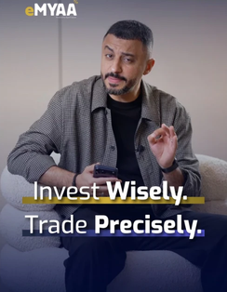
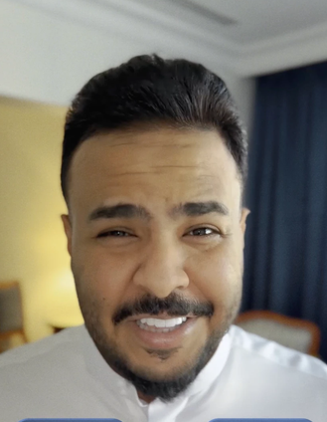


Marketing Efforts
MARKETING
SEPTEMBER: PAID MEDIA WENT INTO TESTING, TWO CAMPAIGNS ARE LIVE AND FOUR CREATOR VIDEOS ARE OUT
Effort | Status | Result so far | Next
LinkedIn Ads Affluent lead generation, Saudi | ● Setup Process Requires 3 to 5 working days | No results reported yet | Leads and cost per lead, 20 Oct
Google Ads Starter and Emerging, Saudi | ● Testing since 22 Sep | 409 website sessions, 70% increase of September site traffic | Optimize and scale depending on best performing content and keywords
Mention & Win $500 monthly contest, GCC | ● Live until 20 Oct | 186K views on the campaign post so far | Entries and accounts opened
$5,000 Prize Campaign 1 Aug to 31 Dec, draw 10 Jan | ● Live pages up | ---- | Additional support content in early October
Creator videos one a month | ● Posted 4 so far 3 left | 5.3M and 1.3M views; Manal Talal 22 Oct, Hamed Al-Balooshi 20 Nov & Ammar Alshaikh early Dec | Manal Talal’s Video
Social channels Instagram, LinkedIn, X, TikTok | ● Live | Followers: 2,116 / 531 / 738 / 15 | Increase focus on LinkedIn
BEST PERFORMING REELS
Musheera
5.3M
Ali Sabeel
1.3M
Abdulelah Al Harbi
views pending
How-to, presenter
332 views
Notes:
Paid media (Board plan): $30,000 Sep to Dec from the $62,477 reserve; Google Search Saudi $9K and other GCC $6K; LinkedIn Affluent Saudi $9K and other GCC $6K. Segments: Starter under $1K and Emerging $1K-5K via Google Ads; Affluent $5K-50K via LinkedIn lead gen. CAC targets Starter $167, Emerging $417, Affluent $882. GA4 shows only the two Saudi Google campaigns so far; LinkedIn lead forms keep users on LinkedIn, so no LinkedIn sessions is expected. Mention & Win: monthly $500 contest in all six GCC countries (24F briefing), approved caption 'Follow, mention, and open an eMYAA account for a chance to win $500'; $3,200 prizes and ads budgeted Sep-Dec; 186K and 26.3K views on campaign posts; current round 23 Sep to 20 Oct per team. $5,000 Prize Campaign: 1 Aug to 31 Dec 2026, draw 10 Jan 2027, prize $500 to $5,000 by trading-volume tier, one entry per $500 traded; landing pages live; bilingual T&Cs sent for approval 20 Jul, no sign-off on file. Creators: Musheera (Jul) 5.3M, Ali Sabeel (Aug, posted 2 Sep) 1.3M, Abdulelah Al Harbi (Sep) no view count yet, how-to video with presenter 332, Manal Talal on the October calendar for 22 Oct, Hamed Al Bloushi November per rollout. Social: Instagram 2,116 followers; LinkedIn 531 (586 in an earlier count; 247 new vs 4 in the prior 30 days); X 738 followers; TikTok 15 followers; no September exports for any channel.
2

Slide 15
Marketing Results
MARKETING
PAID SEARCH LIFTED TRAFFIC AND DOWNLOADS; ONBOARDING DID NOT FOLLOW YET
Net new app downloads and onboarded users between dashboard dates
70%
of September site sessions came from Google Ads
53
409 of 587 sessions, 1-28 Sep
+53
app downloads in the eight days of Google Ads
30
vs +14 the week before
20
14
+4
users onboarded in the same eight days of Google Ads
3
5
4
1
61 onboarded, 15 funded, as of 29 Sep
1-8 Sep
8-14 Sep
14-21 Sep
21-29 Sep (paid live)
App downloads added
Users onboarded
Notes:
Traffic: 587 sessions 1-28 Sep; google / cpc 409 (69.7%), direct 92, organic 39, referral 32 (incl. 7 Tag Assistant test sessions), ChatGPT 9, not available 6. 403 of 542 active users (74.4%) had Google Ads as first source. The GA home card reports 384 active users for 21-27 Sep, +793% vs the previous week; the prior week (about 43) is implied, not exported, so the figure stays 'reported'. Downloads (Android + iOS) on dashboard dates: 373, 403, 423, 437, 473; onboarded 48, 49, 52, 57, 60; funded accounts 13 on 21 Sep, 15 on 27 Sep; 54 trades. English vs Arabic Google Ads (1-28 Sep): engagement 97.2% vs 86.9%, key events per session 0.94 vs 1.05; the key event is not defined, so keep both live until it is defined and costed.
3

Slide 16
English vs Arabic
MARKETING
ENGLISH ADS LEAD ARABIC ON TRAFFIC AND ENGAGEMENT
English relative to Arabic, % difference, 1-28 Sep
ENGLISH CAMPAIGN
Sessions
+20.5%
212
97.2%
sessions
engagement rate
Active users
+18.9%
19.9s
Engaged sessions
+34.6%
per session
Engagement rate
+11.8%
Time per session
+24.2%
ARABIC CAMPAIGN
Events per session
+19.2%
176
86.9%
Total events
+43.6%
sessions
engagement rate
Key events
+8.1%
16.0s
per session
English ahead
Arabic ahead
Notes:
English vs Arabic, 1-28 Sep: sessions 212 vs 176 (+20.5%); active users 208 vs 175 (+18.9%); engaged sessions 206 vs 153 (+34.6%); engagement rate 97.2% vs 86.9% (+10.2 points, +11.8% relative); average engagement time per session 19.9s vs 16.0s (+24.2%); events per session 6.49 vs 5.44 (+19.2%); event count 1,376 vs 958 (+43.6%); key events 200 vs 185 (+8.1%); key events per session 0.94 vs 1.05 (Arabic ahead by 10.2%). Early data from about one week of spend, and spend per campaign is not in the export, so this compares engagement, not cost efficiency. The previous draft's claim that English leads 'on every measured metric' is not correct.
5

Slide 17
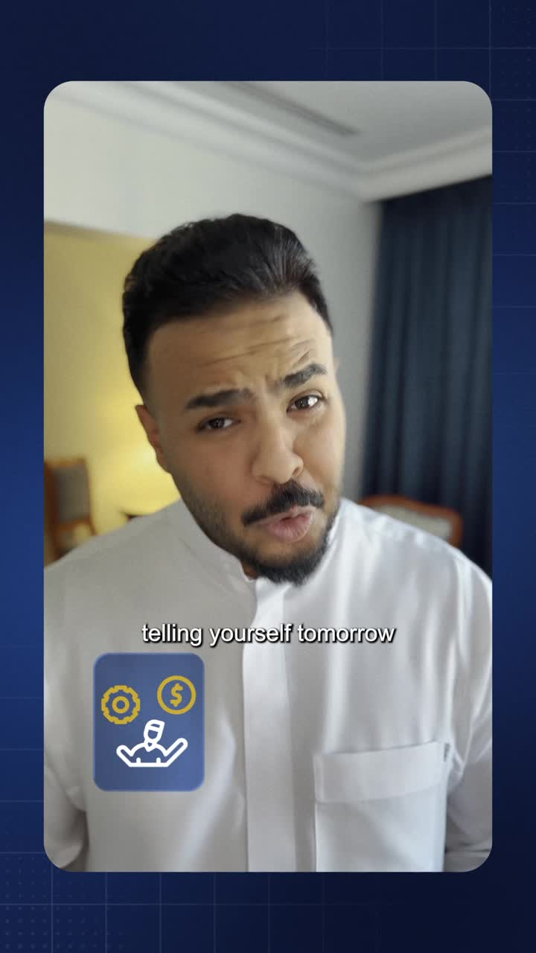

Abdulelah Masterclass & Google Ads
MARKETING
INFLUENCER VIDEO AND CAMPAIGN UPDATE | FOR WEALTHTECH ONLY
Campaign Update, Google Ads
Learning Phase
No reset required. The current learning phase does not need to be repeated.
Keyword Report:
Terence will share a full keyword performance report by Sunday. This will give the team more data to work with before any next decisions.
Conversion Tracking Issue:
An issue has been identified with Android Firebase conversion tracking. Despite over 62,000 impressions and 3,000 clicks, zero conversions were recorded. Terence is investigating and has advised holding off on scaling the campaign until this is resolved.
Notes:
English vs Arabic, 1-28 Sep: sessions 212 vs 176 (+20.5%); active users 208 vs 175 (+18.9%); engaged sessions 206 vs 153 (+34.6%); engagement rate 97.2% vs 86.9% (+10.2 points, +11.8% relative); average engagement time per session 19.9s vs 16.0s (+24.2%); events per session 6.49 vs 5.44 (+19.2%); event count 1,376 vs 958 (+43.6%); key events 200 vs 185 (+8.1%); key events per session 0.94 vs 1.05 (Arabic ahead by 10.2%). Early data from about one week of spend, and spend per campaign is not in the export, so this compares engagement, not cost efficiency. The previous draft's claim that English leads 'on every measured metric' is not correct.
5

Slide 18
Google Ads SEO Ranking
MARKETING
SCREENSHOT OF THE GOOGLE ADS RANKING
Notes:
English vs Arabic, 1-28 Sep: sessions 212 vs 176 (+20.5%); active users 208 vs 175 (+18.9%); engaged sessions 206 vs 153 (+34.6%); engagement rate 97.2% vs 86.9% (+10.2 points, +11.8% relative); average engagement time per session 19.9s vs 16.0s (+24.2%); events per session 6.49 vs 5.44 (+19.2%); event count 1,376 vs 958 (+43.6%); key events 200 vs 185 (+8.1%); key events per session 0.94 vs 1.05 (Arabic ahead by 10.2%). Early data from about one week of spend, and spend per campaign is not in the export, so this compares engagement, not cost efficiency. The previous draft's claim that English leads 'on every measured metric' is not correct.
5

Slide 19
Thank You
Invest Wisely. Trade Precisely.

Slide 20
Appendix

Slide 21
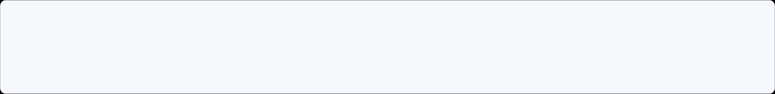
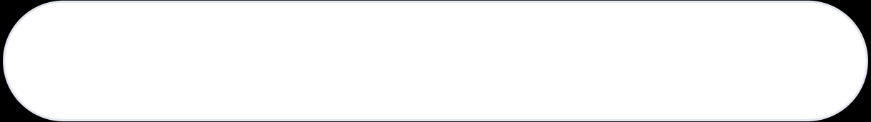
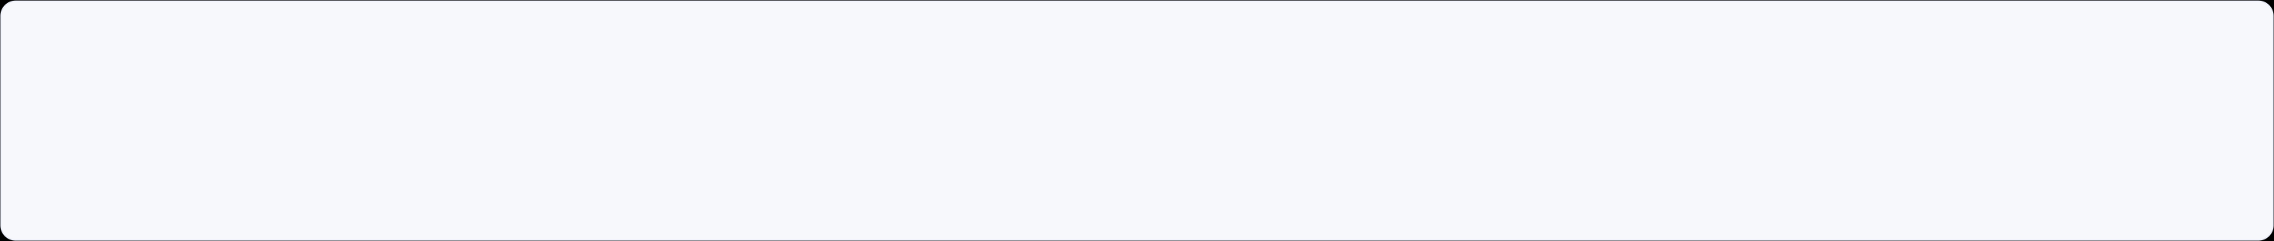
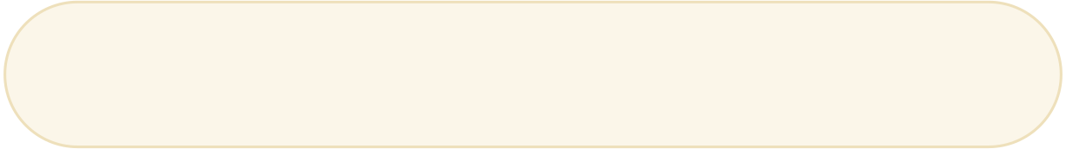
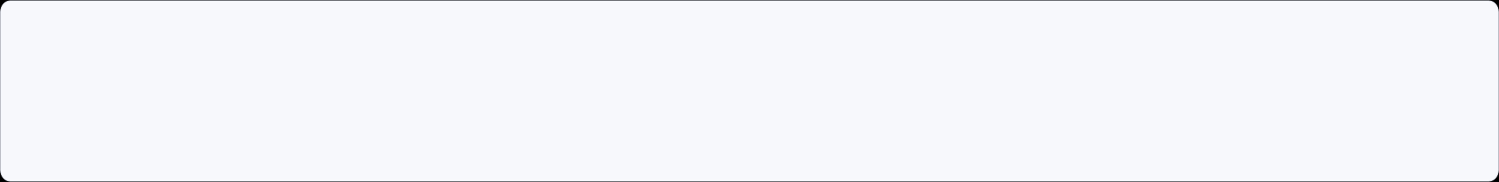
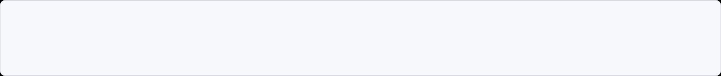


Platform Initiatives Roadmap
APPENDIX | IT
Target: 20 Sep 2026
DONE
Helpdesk Deployment - Frappe Helpdesk
Deployed by WealthTech IT on 17 Sep 2026, ahead of the 20 Sep target. Cybersecurity approval was received on 20 August.
Live since 17 Sep 2026
WealthTech CRM - Frappe CRM
PLANNED
Target: 29 Oct 2026
Cybersecurity has approved Frappe applications. Frappe's CRM module will hold one customer base. Starts now that Helpdesk is live.
Reporting Dashboard
EXPLORING
Under R&D - date TBC
Exploring options for a real-time analytics dashboard for eMYAA. Looking into different modules to support our Business Case.

Slide 22
Helpdesk: Improvement Backlog
APPENDIX | IT
FEEDBACK FROM THE TEAMS SINCE GO-LIVE ON 17 SEP
7
Improvement | Priority | Status
Standalone desktop app for Client Experience | Low | DONE
Auto-acknowledgement email with ticket ID | Medium | DONE
Notify Client Experience of new tickets | Medium | DONE
Pause SLA timers on weekends | Low | IN PROGRESS
Knowledge base linked to the eMYAA support page | Low | NEW
Create a ticket when a chatbot user picks "Contact a Human" | Low | NEW
CRM link: create Helpdesk accounts for new users automatically | Low | NEW
Items logged
3
Completed
1
In progress
3
New
Notes:
Source: IT Status Update to CEO, 01 Oct 2026, slide 5. Names and IDs removed and slide moved to the appendix, as the review comments asked. Counts: 7 logged = 3 done + 1 in progress + 3 new.

Slide 23
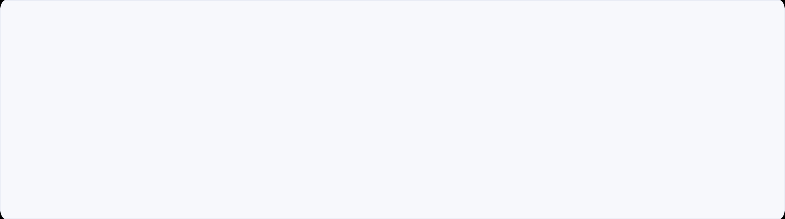
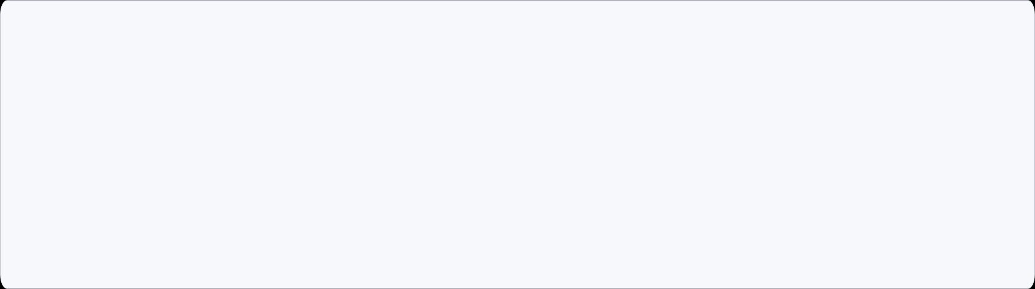
IT Progress Update
APPENDIX | IT
Exante - Status Update
Corporate Client Onboarding
Aligned with the Exante team on the end-to-end process for onboarding corporate clients.
New Application Release
First version of the Next App due 08 Oct 2026. Full release plan to be shared next week.
Sanity / Smoke Tests
The Android security update passed two internal test rounds (99.4%) and went live on Google Play on 29 Sep. Sanity test date for Next App v1: to be confirmed.

Slide 24
Google Ads and Installs
APPENDIX | MARKETING
GOOGLE ADS WENT LIVE ON 22 SEPTEMBER; INSTALLS THEN GREW AT THEIR FASTEST WEEKLY PACE OF THE MONTH
App installs, cumulative (Android + iOS)
FROM AD TO ACCOUNT
510
409
Google Ads sessions
GA4, 1-28 Sep
480
400
key events on those sessions
event not yet defined
450
+53 in 8 days
21-29 Sep, after launch
420
+14 in 7 days
14-21 Sep, before launch
+53
app installs, 21-29 Sep
all sources
390
+4
onboarded, 21-29 Sep
all sources
360
1 Sep
2
3
8
9
10
13
14
16
17
20
21
22 Sep
23
24
27
28
29 Sep
Ads live
Notes:
Installs (Android + iOS, cumulative) on dashboard report dates: 1 Sep 373, 2 Sep 389, 3 Sep 395, 8 Sep 403, 9 Sep 410, 10 Sep 414, 13 Sep 419, 14 Sep 423, 16 Sep 430, 17 Sep 432, 20 Sep 437, 21 Sep 437, 22 Sep 452, 23 Sep 454, 24 Sep 455, 27 Sep 473. Report dates are irregular, so the line is spaced by report, not by calendar day. Pace: +36 in the six days 21-27 Sep (6 a day) vs +30 in 1-8 Sep (4.3 a day, when the Ali Sabeel video and baseline sponsor ads were running) and +14 in 14-21 Sep. Split 21-27 Sep: Android +17, iOS +19. Funnel: 409 google / cpc sessions and 400 key events in GA4 (1-28 Sep); the key event is not defined in the export. Installs and onboarding come from the platform dashboard and cover all sources; there is no link yet from an ad click to an install. The app link (onelink.to/gpbwrg) already exists and can carry campaign tags. Onboarded users 57 to 60 over 21-27 Sep.
4

Slide 25






Systems Planning & Deployment
APPENDIX | IT
INTERNAL WEALTHTECH TECHNOLOGY OPERATIONS
01
Helpdesk Deployment
02
WealthTech CRM Rollout
03
Reporting Dashboard
TARGET 20 Sep 2026
TARGET 29 Oct 2026
TARGET TBC
Under review by the Compliance team since 07.09.2026
Will consolidate the customer base into a single, unified system after Helpdesk deployment.
Real-time reporting capability under evaluation, to support the business case.
EXPLORING
DONE
EXPLORING
DONE
EXPLORING
IN PROGRESS
PLANNING
IN PROGRESS
PLANNING
PLANNING
DONE
DONE
NOT STARTED
IN PROGRESS
DEPLOYMENT
IN PROGRESS
DEPLOYMENT
NOT STARTED
DEPLOYMENT
NOT STARTED
HELPDESK SOLUTION
Cost-Effective Annual cost of USD 600–1,000 (hosting only), delivering approximately 83%–90% savings versus comparable vendor solutions at USD 6,000–10,000.
In-House & Fully Customizable Full control over the source code, database, and future enhancements.
Helpdesk operations are currently managed manually via Excel by Client Experience

Slide 26
IT Progress Update
APPENDIX | IT
Exante — Status Update
Corporate Client Onboarding
Aligned with the Exante team on the end-to-end process for onboarding corporate clients.
New Application Release
Following up with the Exante team on the release of the new version of the application.
Sanity / Smoke Test Results
Following up with the team to receive sanity and smoke test results for the patched builds, required before we can publish the new builds to the app stores.

Slide 27

Client Interaction Journey
APPENDIX | CLIENT EXPERIENCE
1
2
3
DAY 1 CALL
DAY 1 EMAIL
DAY 3 CALL
DAY 3 EMAIL
4
First Contact
Email Reminder
Second Call
Follow-Up Email
Reach out directly by phone. Guide the client through whatever step they're stuck on.
Send campaign emails to re-engage clients who remain stuck mid-onboarding or have not yet funded their account
Send a reminder email at the end of the day outlining the steps required to progress through their current stage.
follow up with a second call, conveying greater urgency and offering to walk the client through the process live.
Contact Channels
Phone Calls: direct phone outreach for onboarding guidance and follow-ups
Emails: reminders, document lists, and campaign follow-ups
Business WhatsApp (In Progress): planned addition to reach clients faster and more directly

