Slide 1



eMYAA PROGRESS
Presentation to Board Executive Committee (BEC)
Date: Monday, 14th September 2026
Notes:
1.7.2013
1.7.2013
1.7.2013
1.7.2013
‹#›
‹#›
‹#›
‹#›

Slide 2










Agenda
Executive Summary
WealthTech Technology Progress Update
Marketing Progress Update
Performance Update
eMYAA Trading Platform | Board Executive Committee Update
2

Slide 3
Executive Summary
Quick Summary
First Board Executive Committee review since eMYAA's 14 May 2026 launch. Covers platform stability, the marketing agency transition, and performance to date.
WealthTech Technology Recap
Platform stability since go-live. Roadmap covering internal systems (Helpdesk, CRM, Reporting Dashboard) and the next client-facing application scheduled for rollout.
Marketing Recap
The $80,000 budget, the move from TRACCS to specialized partners, and the H2 2026 plan through year end.
Performance Update
Where eMYAA stands against its KPI targets.
eMYAA Trading Platform | Board Executive Committee Update
3

Slide 4
WealthTech Technology
Progress Update
Notes:
1.7.2013
1.7.2013
1.7.2013
1.7.2013
‹#›
‹#›
‹#›
‹#›

Slide 5
Summary
PLATFORM PROGRESS
      Go-live achieved on 14 May 2026.
      Continuous development to enhance platform capabilities, user experience, and operational efficiency.
      Demonstrated resilience during the regional conflict, with limited operational impact and prompt service recovery.
NEXT APPLICATION RELEASE (PLANNED Q4 2026)
      New application to be delivered by EXANTE in Q4 2026, moving from the current MVP to a more refined, enhanced app with a cleaner, more intuitive UI/UX for a better trading experience.
WealthTech Technology
      Three internal systems are planned for deployment: Helpdesk, CRM, and a Real-Time Reporting Dashboard, to strengthen internal operations and reporting.
eMYAA Trading Platform | Board Executive Committee Update
5
Notes:
1.7.2013
1.7.2013
1.7.2013
1.7.2013
- remove the previous marks, they did not see them from before
‹#›
‹#›
‹#›
‹#›

Slide 6


Systems Planning & Deployment
INTERNAL WEALTHTECH TECHNOLOGY OPERATIONS
01
Helpdesk Deployment
02
WealthTech CRM Rollout
03
Reporting Dashboard
TARGET 20 Sep 2026
TARGET 29 Oct 2026
TARGET TBC
Cybersecurity approved, deployment underway for faster, more organized query resolution.
Will consolidate the customer base into a single, unified system after Helpdesk deployment.
Real-time reporting capability under evaluation, to support the business case.
EXPLORING
DONE
EXPLORING
DONE
EXPLORING
IN PROGRESS
PLANNING
DONE
PLANNING
DONE
PLANNING
NOT STARTED
IN PROGRESS
DEPLOYMENT
IN PROGRESS
DEPLOYMENT
NOT STARTED
DEPLOYMENT
NOT STARTED
HELPDESK SOLUTION
Cost-Effective Annual cost of USD 600–1,000 (hosting only), delivering approximately 83%–90% savings versus comparable vendor solutions at USD 6,000–10,000.
In-House & Fully Customizable Full control over the source code, database, and future enhancements.
Helpdesk operations are currently managed manually via Excel by Client Experience
eMYAA Trading Platform | Board Executive Committee Update
6

Slide 7



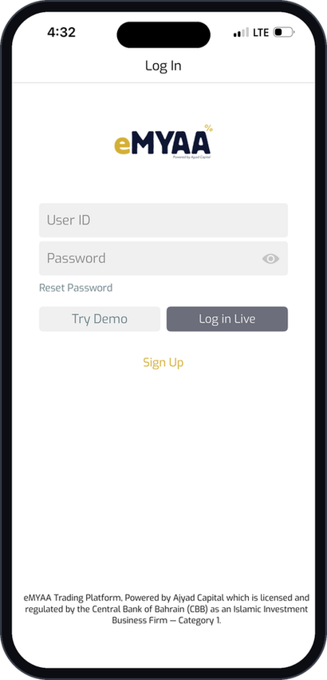
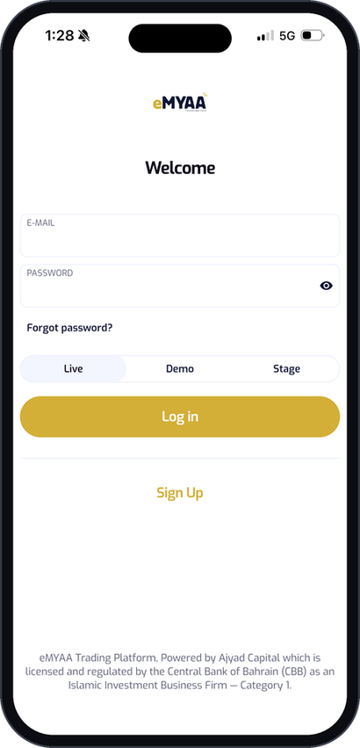
App UI Refresh: Login
CURRENT
NEW
What Changed
Clearer visual hierarchy with a single primary action.
The screen opens with the brand logo and a Welcome greeting, a warmer entry point.
Email and password fields carry floating labels in place of plain grey boxes.
Primary action restyled to the gold brand button, previously gray.
A single environment selector replaces the two competing buttons in the current build.
Warmer, more welcoming entry point.
Primary action restyled to the gold brand button, previously grey.
Modern aesthetic with clean UI.
eMYAA Trading Platform | Board Executive Committee Update
7

Slide 8
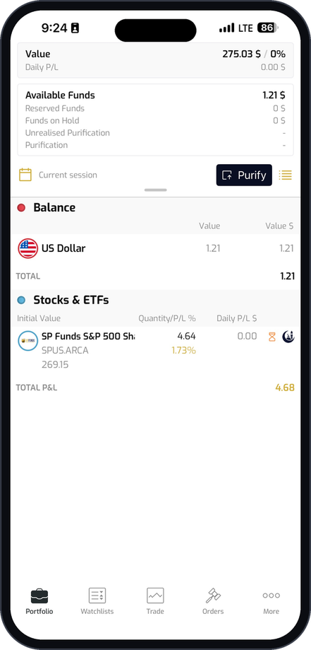
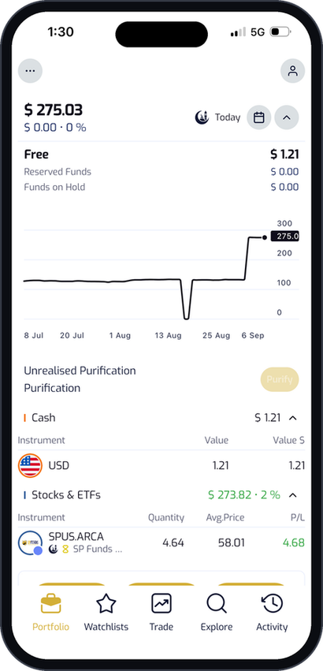
App UI Refresh: Portfolio
CURRENT
NEW
What Changed
Account value leads the screen as a large figure with daily change, previously a small Value row.
A performance chart across the selected period is added. The current build has none.
Purification is surfaced as its own row with a Purify action.
Every position speaks for itself: green for gains, red for losses, so performance is clear the moment the screen opens.
Bottom navigation changes from Orders and More to Explore and Activity shifting the emphasis toward discovery and recent actions.
eMYAA Trading Platform | Board Executive Committee Update
8

Slide 9
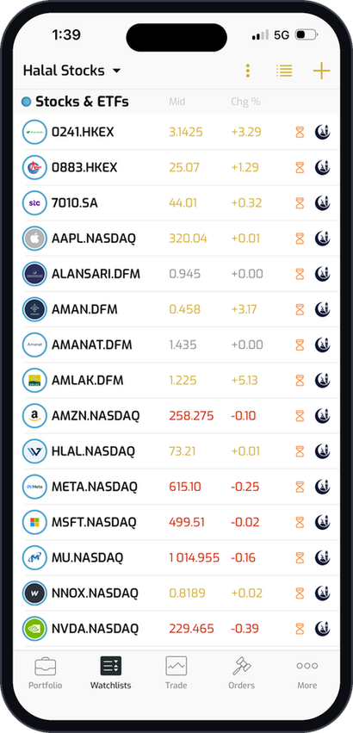
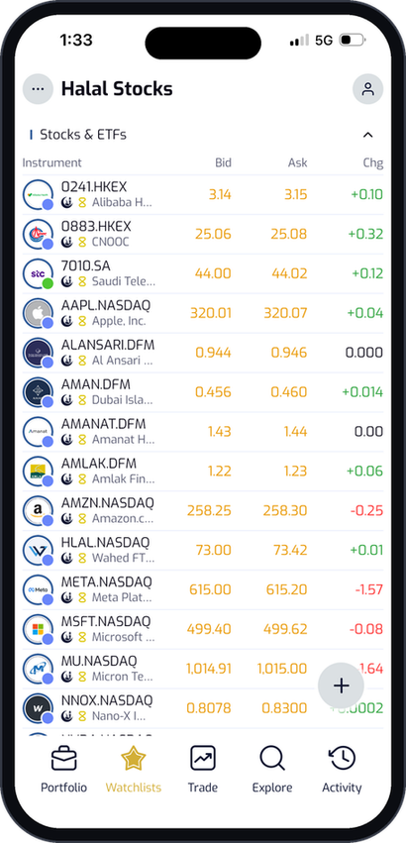
App UI Refresh: Watchlist
CURRENT
NEW
What Changed
Company names now sit beneath every ticker, so users always know exactly what they're trading.
Less icon clutter on each row means the numbers that matter stand out instantly.
Adding instruments is now a single tap away with a prominent floating action button.
eMYAA Trading Platform | Board Executive Committee Update
9

Slide 10
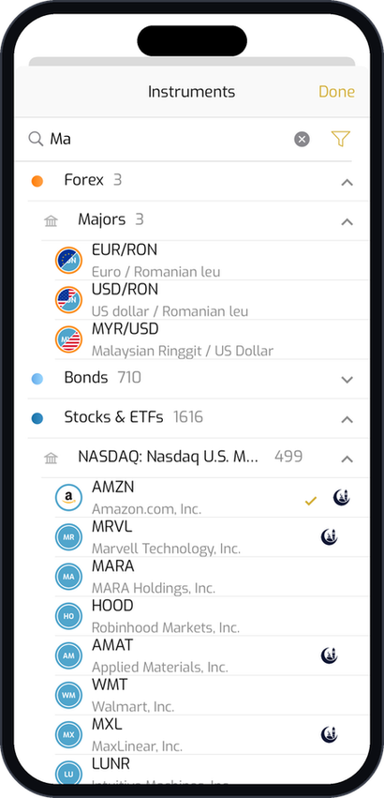
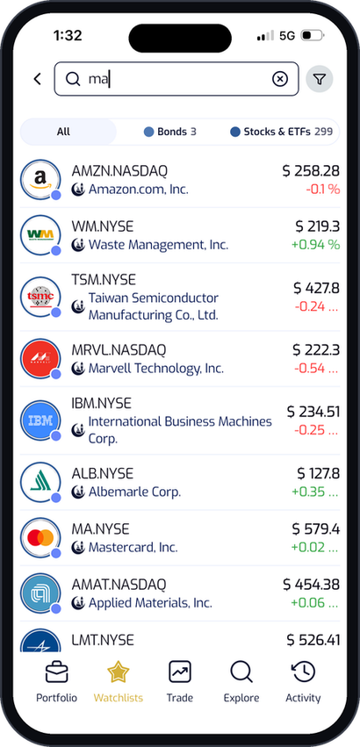
App UI Refresh: Instrument Search
CURRENT
NEW
What Changed
Search now returns a ranked list instantly. No more digging through nested categories.
Filtering moves to inline pills with result counts: All, Bonds, Stocks & ETFs.
Every result follows one clean layout: logo, ticker, name, price and change.
Live pricing appears on every row, so users can act without opening a single instrument.
eMYAA Trading Platform | Board Executive Committee Update
10

Slide 11
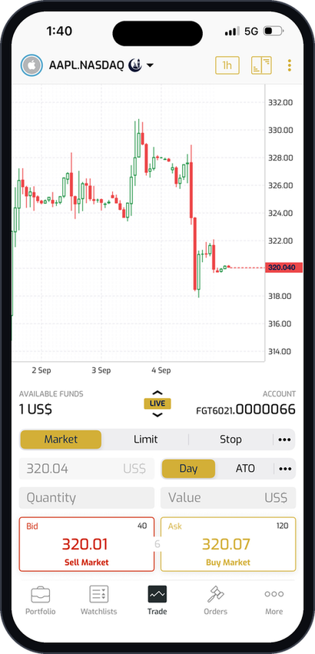
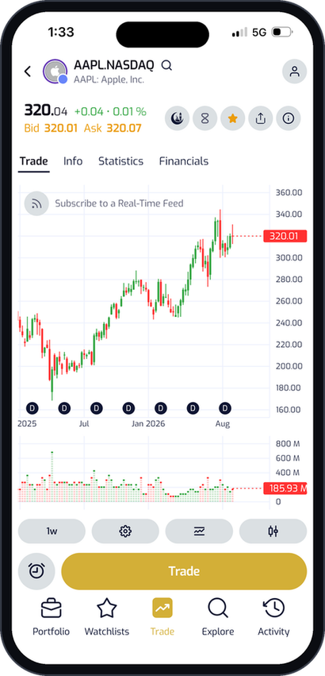
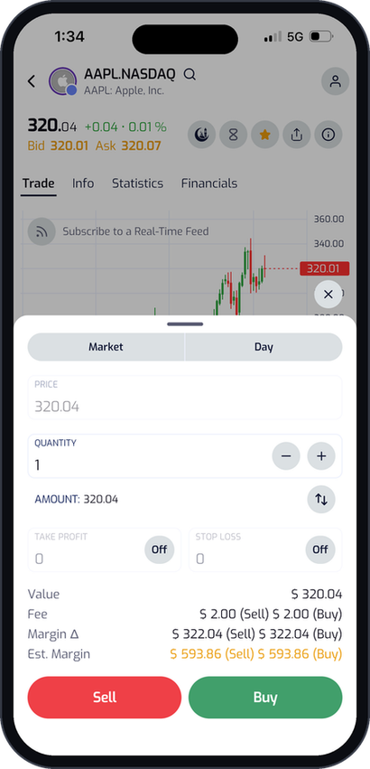
App UI Refresh: Trade Screen
CURRENT
NEW
NEW
What Changed
Info, Statistics and Financials now sit beside Trade, so users can research and execute without leaving the screen.
An interactive chart with adjustable timeframes, volume bars and indicators puts full price discovery in the user's hands.
Familiar red Sell and green Buy buttons so users always know exactly what they're placing.
eMYAA Trading Platform | Board Executive Committee Update
11

Slide 12
Marketing Progress Update
Notes:
1.7.2013
1.7.2013
1.7.2013
1.7.2013
‹#›
‹#›
‹#›
‹#›

Slide 13
Quick Recap
SOFT LAUNCH (BEFORE 14 MAY 2026)
Brand Built, Story Told, Launch Staged
The $80,000 2026 marketing budget was agreed in March, during a period of regional tension, since public attention was on the conflict, not on a new investment platform.
Key Milestone: Launch-day PR (GCC-wide, 14 May 2026): 20 articles, 8,712,000 total views, BHD 26,550 total ad-value equivalent free of cost.
LAUNCH & STABILIZATION (14 MAY - 30 JUN 2026)
Platform Live, First Paid Ads, First Red Flag Caught
eMYAA website (EN/AR) went live, onboarding incentive program launched, first paid social ads activated. A TikTok bot-fraud investigation found the platform's traffic was fake (Pangle ad network).
Key Milestone: Instagram reached 774 followers (+270% vs launch baseline) and 1.08M views in June.
AGENCY TRANSITION (JUL - AUG 2026)
Communications Agency Exited, Two Specialists Onboarded
        TRACCS Offboarded: Inconsistent support during Chairman feedback, reinforcing the need for a strategy change.
        Ad Inconsistencies: Sponsor ads targeted wrong regions (e.g., Madagascar instead of GCC), and TikTok generated fraudulent clicks.
        Specialist Restructure: Replaced the single generalist agency with 24F (content), Ignite (paid ads), and P2 (influencers) at a similar total cost (Out of 15+ agencies shortlisted).
Key Milestone: Instagram grew to 1,765 followers by 30 Aug (+128% since June) through the paid-ad gap; LinkedIn organic reactions hit a new high (68) on the lowest ad spend of the quarter.
eMYAA Trading Platform | Board Executive Committee Update
13
Notes:
1.7.2013
1.7.2013
1.7.2013
1.7.2013
- remove the previous marks, they did not see them from before
‹#›
‹#›
‹#›
‹#›

Slide 14

New Agency Breakdown
#1
#2
#3
Project 2
24F
Ignite
Role: Influencers
Role: Social Media Management
Role: Sponsor Ads
$9,036.50 total (One-off for 6 influencers)
$6,413 / month
$1,020 / month, ad spend separate
        Best prices of any influencer option evaluated. A fraction of the rates quoted through Traccs for comparable talent.
        Selected for their experience, many clients, and very positive feedback from the financial sector in the region.
        $1,020 / month covers ads management for up to 5 platforms (Instagram, LinkedIn, X, TikTok, YouTube) plus a monthly extended metrics report.
Total Cost of TRACCS: $7,579 / month
Total Cost of Current Agencies: $7,433 / month
eMYAA Trading Platform | Board Executive Committee Update
14

Slide 15
Influencer Strategy: Persona-Led
Influencer | Market | Agency | Price (USD)
Ali Sabeel | Bahrain | P2 | $1,060
Hamed Al Bloushi | Bahrain | P2 | $1,060
Manal Talal | Bahrain | P2 | $1,325
Musheera | Bahrain | P2 | $1,855
Abdulelah Alharbi | Saudi Arabia | P2 | $1,590
Ammar Alshaikh | Bahrain | P2 | $1,325
Hassan Mohammed | Bahrain | - | $2,120
Amwal (single story) | Bahrain | - | $662.50+
Dr Asaad | Bahrain | - | $17,490+
Mohammed al Nuaimi | UAE | - | $47,700+
Samah Al Hajeri | UAE | - | $47,700+
Ahmed Elgamal | UAE (Gulf) | - | $47,700+
Ali Alhamed | UAE | - | $92,750+
Amwal (6 month package) | UAE | - | $113,950+
P2's List Is Filtered by Customer Type, Not Just Reach
Each of the six influencers speaks to a different persona. eMYAA will run targeted messaging built for these distinct audiences, rather than one generic ad repeated across channels.
eMYAA Trading Platform | Board Executive Committee Update
15

Slide 16
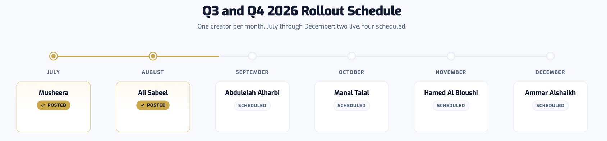
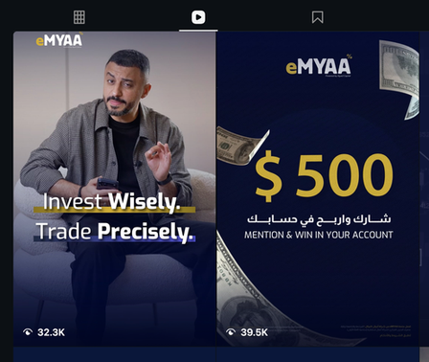
Marketing Campaigns
PAID MEDIA RELAUNCH & H2 CAMPAIGNS (24 AUG - DEC 2026, LIVE / PLANNED)
Two Campaigns Live, Raffle and Influencer Program Running Through Year End
The GCC-wide "Mention & Win" ($500/mo) and Ali Sabeel video are both live. The $5,000 Most Active Trader Raffle runs 1 Aug – 31 Dec (draw 10 Jan 2027), alongside an active 6-creator influencer program.
MENTION & WIN/ $5,000 CAMPAIGNS
Transparent Payouts Build Trust
Executed prizes and "Mention & Win" campaigns to address industry regulatory concerns following the ATME situation, using verifiable payouts to establish strong audience trust.
eMYAA Trading Platform | Board Executive Committee Update
16

Slide 17
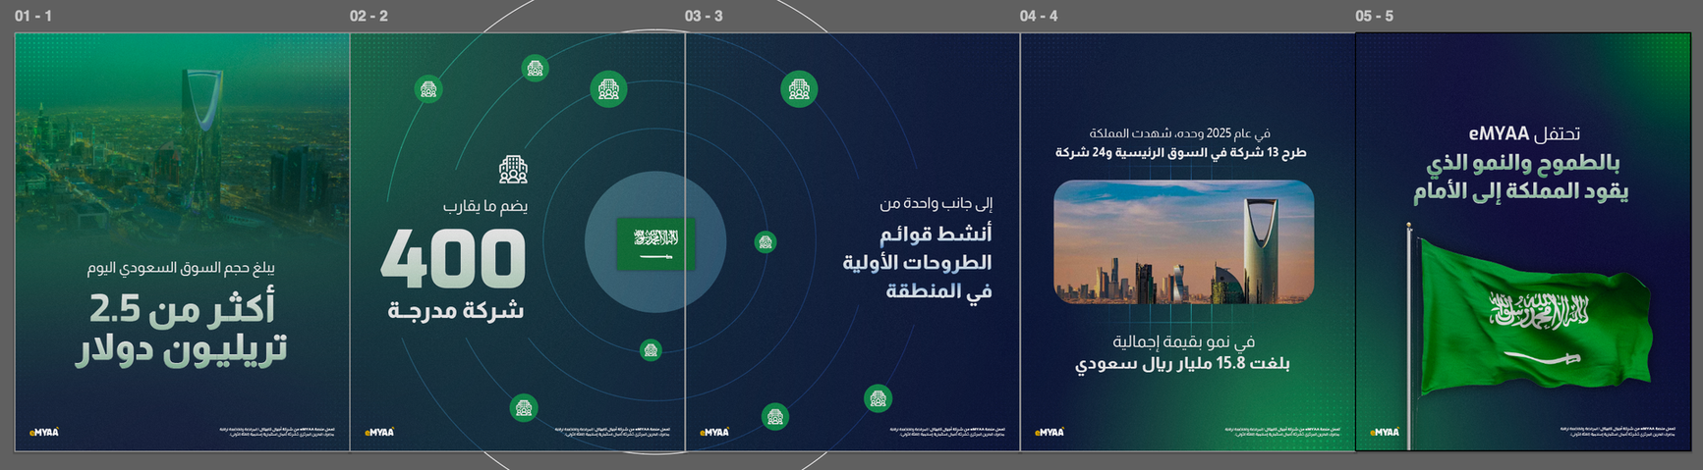
Q4 2026 Outlook
PRIMARY FOCUS
$5,000 Raffle Culminates, Utilize App Update as a Marketing USP, Influencers Strategy
ENGAGEMENT BEYOND CAMPAIGNS
New Artwork Direction, Monthly Newsletters, Introducing More Human Elements
eMYAA Trading Platform | Board Executive Committee Update
17

Slide 18

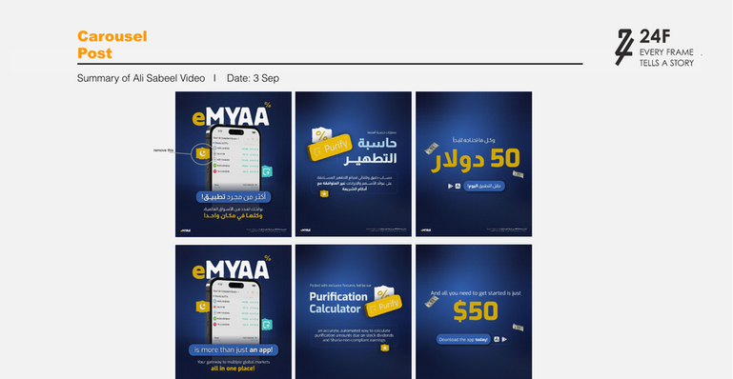
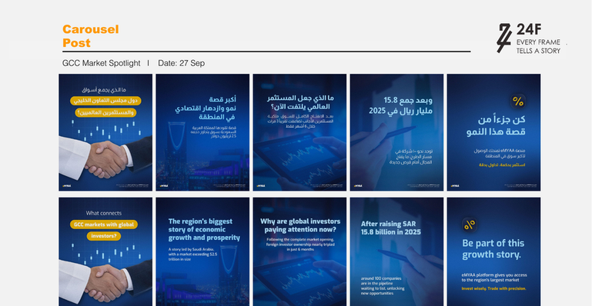
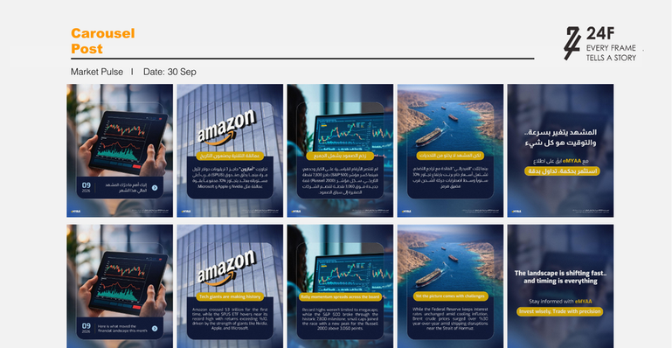
September Artwork Preview
Purification Recap
GCC Market Spotlight
Market Pulse
*Work in progress
eMYAA Trading Platform | Board Executive Committee Update
18

Slide 19
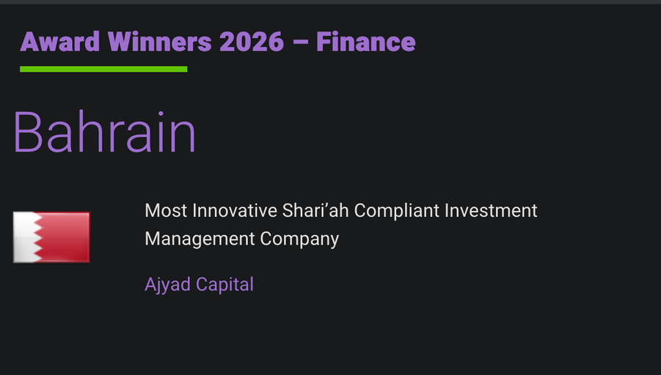
External Recognition
GLOBAL BUSINESS OUTLOOK AWARDS 2026, FINANCE
Most Innovative Shari'ah Compliant Investment Management Company
Ajyad Capital, Bahrain
Award Detail
Published Winners Listing
Awarding Body
Global Business Outlook
Category
Finance, 2026
Market
Bahrain
Application Process
Two month application
Cost to Ajyad Capital
Nothing has been paid. Ajyad can pay for physical delivery and marketing rights only.
eMYAA Trading Platform | Board Executive Committee Update
19

Slide 20

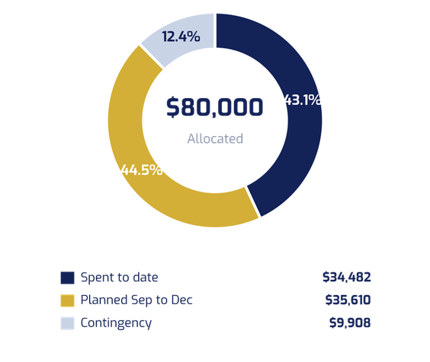
Marketing Budget
$80,000
Allocated Budget
$34,482
Spent to Date
$35,610
Planned to Year End
$9,908
Contingency (Other Marketing Expense)
Budget Utilization
Spent to Date, 14 May to 6 Sep
Plan to Year End, Sep to Dec
Item
Amount
Item
Amount
Sponsored ads and influencer boosts (TRACCS)
$21,533
Baseline sponsor ads, Sep to Dec (Ignite)
$18,400
Influencer program, 6 creators (Project 2)
$9,037
Mention & Win prizes and ads, Sep to Dec (Ignite)
$3,200
Ali Sabeel video sponsor ad, Instagram (Ignite)
$2,200
November app release coverage
$9,010
Mention & Win sponsor ad, Instagram (Ignite)
$400
$5,000 campaign prize, drawn 10 Jan 2027
$5,000
Mention & Win prizes, June to August
$1,100
Fintech Forward sponsorship
$26,500
Voiceover production, 4 videos (EnRoute PR)
$212
Total planned
$35,610
Total spent
$34,482
Agency Retainers, outside the $80,000 budget
TRACCS, 5 months to 19 July $37,895 24F social management, from August $6,413 a month Ignite ads management, from August $1,020 a month
Fintech Forward was canceled and the money moved into sponsor ads. Due to the competitive bidding prices and to increase sponsor ad exposure in the region.
eMYAA Trading Platform | Board Executive Committee Update
20

Slide 21
Performance Update
Notes:
1.7.2013
1.7.2013
1.7.2013
1.7.2013
‹#›
‹#›
‹#›
‹#›

Slide 22
Client Growth & Total Deposits (May - Sep, 2026)
Cumulative clients
Cumulative deposits
52
$10,195.88
+373% since May
Actual
Projected
+154% since May
Actual
Projected
+11%
$235,660
52
+42%
47
$190,201
+38%
$153,512
33
39
$123,900
+118%
24
33
$100,000
28
24
20
+2%
+97%
+9%
+16%
11
$4,013
$7,907
$8,627
$10,004
$10,196
May
Jun
Jul
Aug
Sep
May
Jun
Jul
Aug
Sep
eMYAA Trading Platform | Board Executive Committee Update
22
Notes:
1.7.2013
1.7.2013
1.7.2013
1.7.2013
- remove the previous marks, they did not see them from before
‹#›
‹#›
‹#›
‹#›

Slide 23
Performance Update
As of 13th of September, 2026
419
52
62
$107.52
Total Downloads
Users Onboarded
Incomplete KYC Users
Revenue
From 14 May 2026 till date
$10,195.88
$1,666.19
$8,529.69
47
Total Deposits
Total Withdrawals
Current AUM
Total Trades
Key Highlights
Client Base Is Growing
52 clients onboarded and 47 trades placed since launch, the platform's first live activity.
Deposits Are Building
$10,195.88 total deposited against $8,529.69 currently held in AUM, with early revenue of $107.52.
Onboarding Recovery Opportunity
We have 62 users who started but didn't complete KYC, giving us a ready pipeline to re-engage and convert them into fully onboarded clients.
eMYAA Trading Platform | Board Executive Committee Update
23
Notes:
1.7.2013
1.7.2013
1.7.2013
1.7.2013
- remove the previous marks, they did not see them from before
‹#›
‹#›
‹#›
‹#›

Slide 24
Key Performance Indicators & Volume Projections
KPI & Performance Detail
May
June
July
August
September
October
November
December
I. CLIENTS, CUMULATIVE
Achieved / Current
11
24
33
47
52
Target / Projected
20
24
28
33
39
46
54
64
Performance Gap
-9
+0
+5
+14
+13
II. NUMBER OF TRADES
Achieved / Current
8
17
5
16
1
Target / Projected
20
24
28
33
39
46
54
64
Performance Gap
-12
-7
-23
-17
-38
III. AVERAGE INVESTMENT PER CLIENT
Actual / Current
$364.82
$329.46
$261.42
$212.84
$196.07
Target / Projected
$5,000
$5,250
$5,513
$5,788
$6,078
$6,381
$6,700
$7,036
Performance Gap
-$4,635.18
-$4,920.54
-$5,251.58
-$5,575.16
-$5,881.93
IV. TOTAL DEPOSITS, CUMULATIVE
Achieved / Current
$4,012.99
$7,907.15
$8,626.91
$10,003.60
$10,195.88
Target / Projected
$100,000
$123,900
$153,512
$190,201
$235,660
$291,982
$361,766
$448,228
Performance Gap
-$95,987.01
-$115,992.85
-$144,885.19
-$180,197.89
-$225,463.77
eMYAA Trading Platform | Board Executive Committee Update
24
Notes:
1.7.2013
1.7.2013
1.7.2013
4
‹#›
‹#›
‹#›

Slide 25
Thank You
Invest Wisely. Trade Precisely.
Notes:
1.7.2013
1.7.2013
1.7.2013
1.7.2013
‹#›
‹#›
‹#›
‹#›

Slide 26
Appendix

Slide 27
Overview of CX
31
9
22
29%
139
Clients Contacted
Completed Onboarding
Still Pending
Conversion (of Total)
Clients Contacted
Summary
Out of 31 clients contacted, 9 have completed onboarding, giving a conversion rate of 29%. The remaining 22 clients (71%) are still pending, representing the primary area for continued follow-up.
Client Feedback
Missing or incomplete documents: Many clients don't have the required KYC documents ready at the time of registration, causing delays or drop-off
KYC process feels too long: Clients report the verification steps take longer than expected, leading to frustration and mid-process abandonment
eMYAA Trading Platform | Board Executive Committee Update
27

Slide 28
Client Interaction Journey
1
2
3
DAY 1 CALL
DAY 1 EMAIL
DAY 3 CALL
DAY 3 EMAIL
4
First Contact
Email Reminder
Second Call
Follow-Up Email
Reach out directly by phone. Guide the client through whatever step they're stuck on.
Send campaign emails to re-engage clients who remain stuck mid-onboarding or have not yet funded their account.
Send a reminder email at the end of the day outlining the steps required to progress through their current stage.
Follow up with a second call, conveying greater urgency and offering to walk the client through the process live.
Contact Channels
Phone Calls: direct phone outreach for onboarding guidance and follow-ups.
Emails: reminders, document lists, and campaign follow-ups.
Business WhatsApp (In Progress): planned addition to reach clients faster and more directly.
eMYAA Trading Platform | Board Executive Committee Update
28

Slide 29
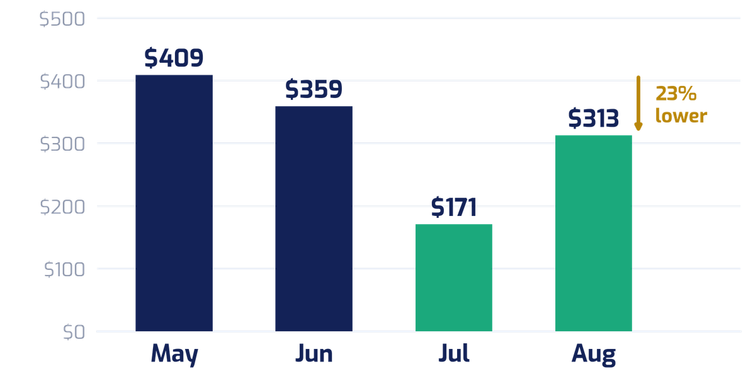
Customer Acquisition Cost
Cost per client acquired, measured against ad spend. Agency retainers excluded.
$308
Cost per Client
14 May to 6 Sep, blended
23%
Lower Than May
$409 in May to $313 in August
49
Clients Acquired
14 May to 6 Sep 2026
Cost per Client by Month
Ad Spend vs Clients
Month
Ad Spend
Clients
CAC
May
$4,500
11
$409
June
$4,668
13
$359
July
$1,539
9
$171
August
$4,383
14
$313
Sep, week 1
—
2
—
Total
$15,090
49
$308
September clients came from the Ignite campaigns booked and paid in August that ran into September.
Cost per client fell 23% from May to August while August delivered the strongest client growth of any month, 14 new clients on 3% less ad spend than May.
August figures are approved campaign budgets. Ignite has not yet reported delivered spend.
eMYAA Trading Platform | Board Executive Committee Update
29

Slide 30
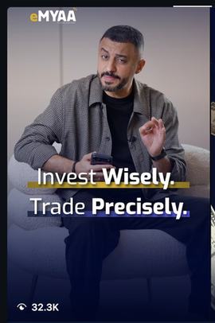

Instagram: Standout Channel
Metric | Value | Notes
Followers | 1,802 | -
Views (account insights) | 2,329,028 | Viewers 724,457; 0.7% from followers; 61.8% Reels / 35.9% Stories / 2.2% Posts
Interactions | 11,087 | 80.6% from non-followers; 78.8% from Reels
Accounts Engaged | 7,254 | -
Profile Visits | 5,990 | 38 external link taps
Top Performing Content
Content | Result
Ali Sabeel Reel | 497K views
Musheera Reel | 5.3M views, 660 likes, 8 comments
Mention & Win $500 | 3.9K interactions (Aug 25) - best-performing single post to date, up from 2.6K (Jul 16) and 1.5K (Jun 11)
eMYAA Trading Platform | Board Executive Committee Update
30

Slide 31
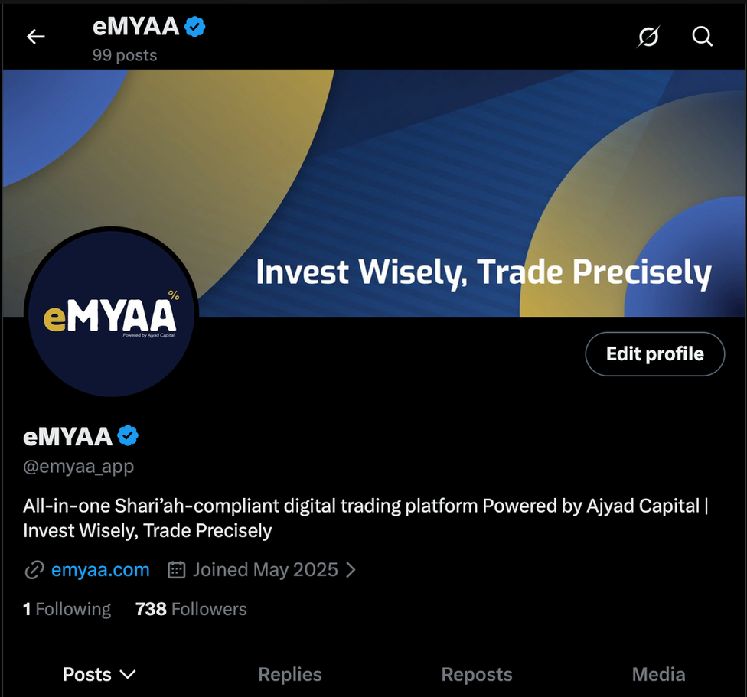
X, LinkedIn & TikTok
Platform | Metrics | Notes
X | 738 followers, 99 posts | Audience quality is real: 96.4% Bahrain, 3.6% Saudi
LinkedIn | 586 followers | Organic reactions grew: Jun 46 → Jul 20 → Aug 68 (best month)
TikTok | 15 followers, 176 total likes | Lowest interactions of all platforms / audience not suitable for eMYAA
eMYAA Trading Platform | Board Executive Committee Update
31

Slide 32
Website Analytics
4,301
Visits
3.8K
Unique Visitors
5.2K
Pageviews
88.99%
Bounce Rate
Traffic Sources
Geography (Top Countries)
Source
Visits
Country
Visits
Direct
2,092 (48.6%)
Bahrain
1,273 (29.6%)
Social
1,682 (39.1%)
Saudi Arabia
1,246 (29.0%)
Search
303 (7.04%)
Oman
518 (12.0%)
Referral
224 (5.21%)
United States
335 (7.79%)
China
130 (3.02%)
Egypt
100 (2.32%)
India
79 (1.84%)
United Arab Emirates
77 (1.79%)
Kuwait
63 (1.46%)
eMYAA Trading Platform | Board Executive Committee Update
32

Slide 33
Overall Rankings
All 12 agencies ranked by total score out of 100.
#
Agency
Specialty
Origin
Monthly Price (BHD / USD)
Fintech Clients
Score /100
#1
24F
Video Production
Bahrain
BHD 2,420 / $6,413
6
81
#2
Ignite
Social Media & Design
Bahrain
BHD 2,530 / $6,707
5
75
#3
Communion
Motion-First Creative
Bahrain
BHD 8,000+ / $21,200+
7
72
#4
The Only Agency
Entertainment/Govt
Saudi Arabia
BHD 5,300 / $14,045
6
69
#5
From6
Full-Service Marketing
Bahrain
BHD 4,955 / $13,128
2
62
#6
Traccs
PR & Communications
Saudi Arabia
BHD 2,862 / $7,585
6
61
#7
Chain Reaction
Performance Marketing
UAE
BHD 8,731 / $23,138
8
60
#8
YouYaa
WealthTech Branding
Dubai, UAE
BHD 5,660 / $15,000
8
50
#9
Carolina Mir
Fintech Onboarding
Bahrain
BHD 1,400 / $3,711
6
50
#10
Fathom
Design-Led Social
Bahrain
BHD 4,755 / $12,602
3
49
#11
GOamplify
Digital & Performance
Bahrain
BHD 6,000+ / $15,900+
4
45
#12
Memac Ogilvy
Integrated Comms
USA (Global)
BHD 4,102 / $10,867
0
39
eMYAA Trading Platform | Board Executive Committee Update
33
Notes:
1.7.2013
1.7.2013
1.7.2013
3
‹#›
‹#›
‹#›

Slide 34
Customer Acquisition Cost: Detail
Supporting detail for the CAC figures in the Marketing section.
Ad Spend Build-Up
Excluded from CAC
Mention & Win by Month
Item
Amount
Item
Amount
Month
Prize
Ads
Total
Platform ad spend, May to July
$10,707
Mention & Win prize money
$1,100
June
$100
$599
$699
Musheera boost and Mention & Win extension
$1,783
TRACCS ads management above platform spend
$9,044
July
$500
—
$500
Ignite campaigns: Ali Sabeel and Mention & Win
$2,600
Agency retainers, TRACCS, 24F and Ignite
see below
August
$500
$583
$1,083
Total ad spend, basis for CAC
$15,090
Total excluded
$10,144
Total
$1,100
$1,182
$2,282
eMYAA Trading Platform | Board Executive Committee Update
34

