Slide 1
TESTING PHASE RECAP
What We've Completed
In the last two weeks we launched a new acquisition channel and shipped new content. Both are already moving the numbers below.
480
App Downloads
(+48 vs last pull)
587
Website Sessions
(69.7% from the new Google Ads)
2,116
Instagram Followers
(+321 since launch)
531
LinkedIn Followers
(+6,075% new followers, 30 days)
Action | Status | Result
Google Ads & LinkedIn campaign | Launched 22 Sep | Already 69.7% of all website traffic
Mention & Win | Renewed, live 23 Sep to 20 Oct | 26.2K views, 1,129 likes on the launch reel
Ali Sabeel video | Completed 18 Sep | 1.3M views to date
New "How To" video (human presenter) | Posted | 319 views, 28 interactions
Abdulelah Al Harbi video | Posted | Live on Instagram
eMYAA Trading Platform | Marketing Update for the CEO

Slide 2
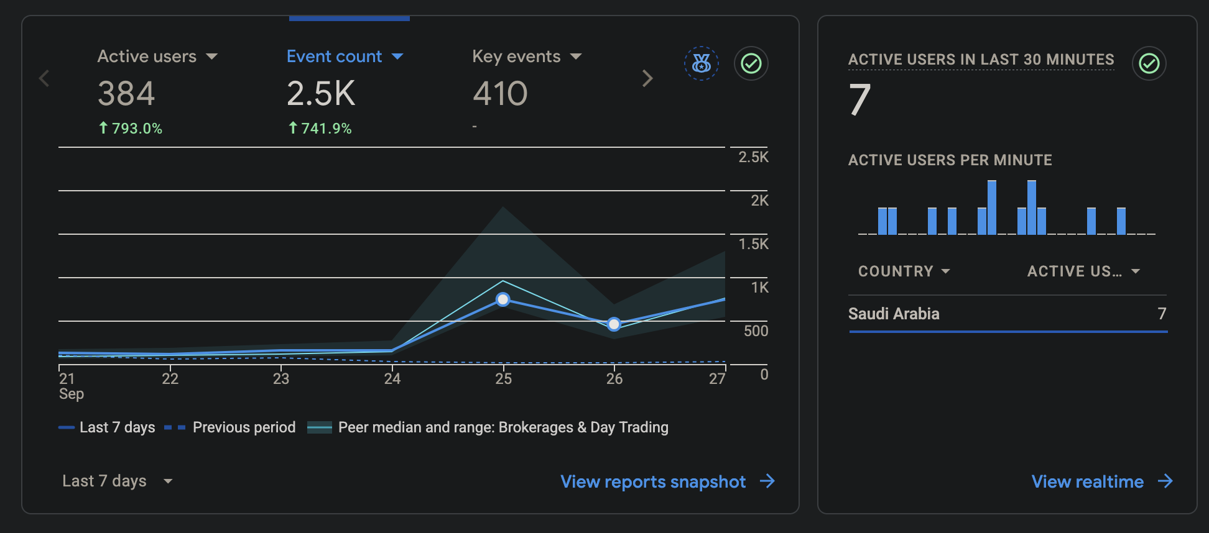
NEW CHANNEL
Google Ads & LinkedIn: The Launch
Launched 22 September as a testing phase: Google Search for Starter and Emerging investors, LinkedIn lead generation for Affluent investors. $30,000 campaign, September to December, managed by Ignite. Interest targeting covers Saudi Arabia and Riyadh; location is restricted to Saudi Arabia residents only.
The Effect: Website Traffic
793%
Active users, week over week
558
New users driven to the site
This is the direct line from the campaign to the business: the moment Google Ads went live, paid traffic overtook every other source combined, and total site activity jumped 793% in a single week.
eMYAA Trading Platform | Marketing Update for the CEO

Slide 3
CONTENT SHIPPED
New Video Content
Two new videos went live this cycle, both testing a more human, presenter-led format against our usual graphic style.
Video | Status | Result
New "How To" video, human presenter | Posted | 319 views, 28 interactions
Abdulelah Al Harbi | Posted | Live on Instagram, part of the Q3 to Q4 influencer rollout
Q3 to Q4 2026 Rollout: One Creator per Month
Musheera and Ali Sabeel posted. Abdulelah Al Harbi now posted. Manal Talal in production (brief sent). Hamed Al Bloushi scheduled for November.
Jul: Musheera | Aug: Ali Sabeel | Sep: Abdulelah | Oct: Manal Talal | Nov: Hamed Al Bloushi
Posted | Posted | Posted | In production | Scheduled
Why this matters: human-led content is a deliberate test against our graphic-only posts, to see which format drives more trust and action.
eMYAA Trading Platform | Marketing Update for the CEO

Slide 4
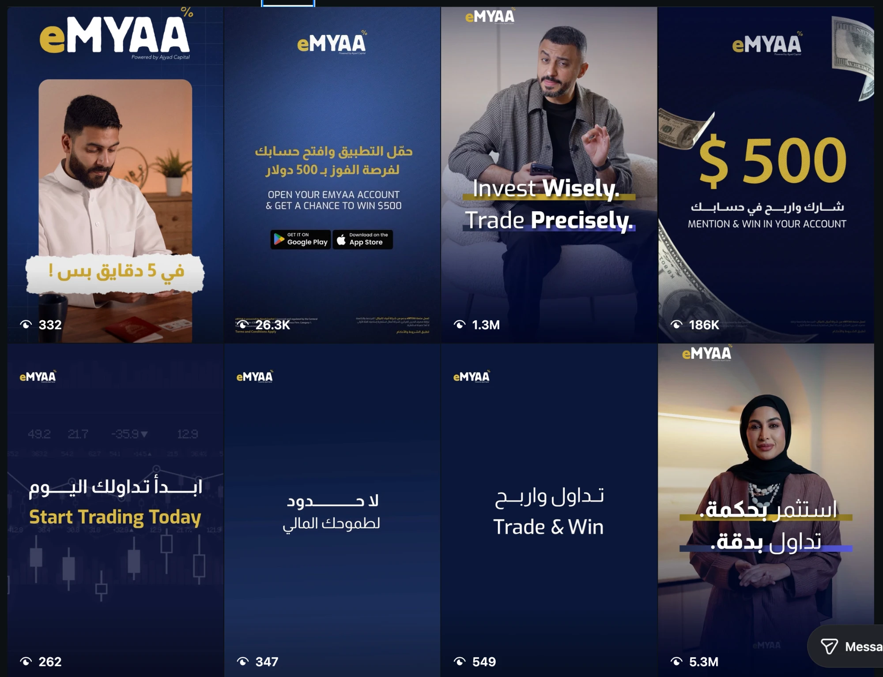
WHAT IS WORKING
Best Performing Content
Content | Views | Format
Musheera Reel | 5.3M | Video, presenter-led
Ali Sabeel Reel | 1.3M | Video, presenter-led
Mention & Win $500 | 186K | Graphic, campaign
Saudi Market Size Infographic | 515 | Graphic, static
The pattern is consistent: presenter-led video reels outperform static graphics by orders of magnitude. This is why we are investing further in human-led formats, like this month’s new "How To" video.
eMYAA Trading Platform | Marketing Update for the CEO

Slide 5
CHANNEL PROGRESS
Instagram: Standout Channel
2,116
Followers
2,271,132
Total Views
8,311
Total Interactions
Reels drive both the views and the interactions. Every format decision this quarter follows this data.
eMYAA Trading Platform | Marketing Update for the CEO

Slide 6
CHANNEL PROGRESS
LinkedIn: Building Credibility
531
Followers
+247
New followers, last 30 days
559
Impressions, 13-27 Sep (+118%)
28
Reactions, 13-27 Sep (+155%)
LinkedIn is our credibility channel for the Affluent segment, per the BEC guidance to increase LinkedIn focus for trust and governance. The follower base nearly tripled in 30 days, and it is now also carrying the LinkedIn half of the new Google Ads and LinkedIn campaign, generating leads for Placement.
eMYAA Trading Platform | Marketing Update for the CEO

Slide 7
THE FINDING
English Is Outperforming Arabic in Saudi
In testing, the English version of the Google Ads campaign is ahead of the Arabic version on every measured metric.
Metric | English | Arabic
Sessions | 212 (54.5%) | 176 (45.2%)
Active users | 208 (54.3%) | 175 (45.7%)
Engaged sessions | 206 (57.4%) | 153 (42.6%)
Avg. engagement time | 19s | 16s
Events per session | 6.49 | 5.44
Engagement rate | 97.17% | 86.93%
This is early data (since 23 Sep) and could reflect ad copy or targeting rather than a true audience preference. Recommendation: review the Arabic creative and targeting with Ignite before scaling spend.
eMYAA Trading Platform | Marketing Update for the CEO

Slide 8
MOVING FORWARD
What's Next
Item | Timing | Detail
Google Ads & LinkedIn | Sep to Dec | Scale from testing to full campaign; review Arabic creative first
Manal Talal video | Mid October | Brief sent, production started
Hamed Al Bloushi video | November | Scheduled, per the Q3 to Q4 rollout
Mention & Win | Through 20 October | Continues, GCC-wide, timed before salary days
Fresh KPI export | This week | Requested from Malek, to restore gross deposits reporting
The story so far: a new paid channel launched, it already drives most of our website traffic, and it is paired with a steady drumbeat of new content. The next phase is to scale what is working, fix what is not (the Arabic underperformance), and keep shipping one creator a month through year end.
eMYAA Trading Platform | Marketing Update for the CEO

