Slide 1
eMYAA MONTHLY PERFORMANCE REPORT
August 2026
Performance so far, the agency transition, social platform review, and September content plan
Filed 30 August 2026

Slide 2
eMYAA Performance
AJYAD CAPITAL
Cumulative since launch | Reporting period 14 May - 30 Aug 2026
359
Total App Downloads
194 Android + 165 iOS
47
Total Onboarded Users
+13 vs 5 Aug
$8,467.96
Total Deposits
−$58.95 vs 5 Aug
45
Total Trades
+15 vs 5 Aug
12 / 12
Deposited / Traded
9
Rejected KYC
154
Incomplete KYC
24 / 25
Tickets Resolved/Created
Key Highlights
iOS growth is outpacing Android for the first time.
iOS downloads grew +59 this period vs. +16 for Android - a real shift from the platform's historical Android lead.
Total deposits dipped, not grew, this cycle.
Despite 3 more users funding accounts, total deposits fell by $58.95 - net withdrawals outpaced new inflows. Being reported plainly rather than smoothed over.
KYC friction is widening faster than onboarding.
Incomplete KYC grew by 38 users this period, more than double the growth in completed onboarding (+13). This remains the single largest funnel gap on the platform.
Source: eMYAA - Daily Performance Dashboard.pdf, report date 30 Aug 2026, All Time. Compared to the 5 Aug 2026 snapshot.

Slide 3
OUR STORY THIS YEAR
How We Got Here: The Agency Transition, Closed Out
MID-JULY
Paid Social Went Dark - Unintentionally
Paid support on X and LinkedIn lapsed simultaneously around 9-10 July. Confirmed: this was not a strategic decision - it happened because of an agency transition gap, compounded by a Meta Business Verification that had been stuck for months.
27 JULY - 17 AUGUST
Specialized Partners Onboarded
24F (social content) kicked off 27 July; Ignite (paid ads) kicked off 13-17 August. Both replace the single generalist agency that was managing everything before, at a comparable combined cost.
20-27 AUGUST
Paid Media Resumed, Compliance Tightened
Two Instagram campaigns approved and now live: Mention & Win ($400) and the Ali Sabeel influencer video ($2,200). All prize messaging now locked to "up to $5,000" phrasing, never a flat guaranteed amount.
Source: Ignite and 24F email correspondence, Aug 2026.

Slide 4
EMYAA.COM
Website Analytics
656
Visits
+1,239% YoY
575
Unique Visitors
+1,454% YoY
975
Pageviews
+1,423% YoY
79.38%
Bounce Rate
0% YoY
Traffic Sources
Source
Visits
Notes
Direct
496 (75.5%)
No campaign or referral tag - typed URL, bookmark, or app share
Search
89 (13.5%)
Organic Google search
Referral
41 (6.24%)
ajyadcapital.com 28, chatgpt.com 3, others under 3 each
Social
31 (4.72%)
Instagram 22, Facebook 6, Twitter/X 3
Read
Traffic is real but small and concentrated in Direct, meaning most visits still come from people who already know the URL rather than organic discovery or paid referral. Bounce rate sits at 79.38% (0% YoY change, i.e. flat against last year, not improving). Reporting window shown is 31 May to 30 Aug 2026; e-commerce/revenue fields read $0 because the site has no checkout flow to track.
Source: Squarespace Analytics, custom range 31 May - 30 Aug 2026, screenshots provided by user, 30 Aug 2026.

Slide 5
SOCIAL MEDIA
Instagram: Standout Channel, Two Results Confirmed Paid
Metric
Value
Detail
Note
Followers
1,765
59 posts
Views (90-day)
2,271,132
711,396 viewers
59.2% Reels / 38.1% Stories
Interactions (90-day)
8,311
5,715 accounts engaged
72.4% from Reels
Top Performing Content
Content
Result
Read
Ali Sabeel reel
28.1K views
Captured after the $2,200 Ignite paid boost went live (confirmed) - 28.1K views includes paid reach, not an organic-only figure.
Musheera reel
5.3M views, 660 likes, 8 comments
0.0125% engagement rate - paid reach (confirmed), not organic resonance. Views figure is boosted, not a genuine organic win.
Mention & Win posts ($500/$100)
Up to 2.6K interactions
Best-performing content type by a wide margin, consistently
$5,000 Campaign creative
11 interactions
Weakest-performing asset so far - early days, not yet boosted at time of review
Source: Instagram Professional Dashboard, live pull. Note: both Musheera and Ali Sabeel figures are confirmed paid/boosted, not organic.

Slide 6
SOCIAL MEDIA
X, LinkedIn & TikTok: Where Paid Support Actually Went
Platform
Size
Paid Status
Organic Read
X (Twitter)
738 followers, 99 posts
Impressions flatlined to zero mid-Jul through Aug 29
Audience quality is real: 96.4% Bahrain, 3.6% Saudi
LinkedIn
586 followers
Sponsored impr.: Jun 23,118 → Jul 6,629 → Aug 0
Organic reactions actually grew: Jun 46 → Jul 20 → Aug 68 (best month)
TikTok
15 followers, 176 total likes
No paid spend since the May fraud removal - by design
Confirms the deprioritization was correct: only 1 of 11 recent videos breaks 3 digits (189.5K)
OPEN QUESTION - NEEDS A DECISION
Both channels' engagement held up or improved on far less traffic once paid spend stopped - a real, if small, signal that the organic content itself is landing. The decision needed: reactivate paid support on one or both channels with real budget, or formally deprioritize them (as TikTok already was) so they stop reading as unexplained underperformance every month.
Unresolved: 490 of LinkedIn's 586 followers were recorded on a single day (24 June 2026), versus 0-2 on every other day in the 3-month window. Not characterized as a spike since the cause is unknown - could be a data or tracking artifact rather than a real follower event. Left open, not explained.
Source: X native analytics + Ads Manager export; LinkedIn Company Page analytics exports, Aug 2026.

Slide 7
DATA INTEGRITY
Attribution Review: One Fix Confirmed, One New Flag
CONFIRMED FIXED: The TikTok/Pangle Bot Traffic Is Gone
OneLink referrer data confirms the fix held permanently: Pangle-sourced clicks fell from 706,445 in May to 48,180 in June to zero in both July and August. The May bot-fraud finding that got TikTok pulled from paid media was correct, and the channel has stayed clean since.
NEW, UNEXPLAINED: A Similar Pattern Appeared 5-18 August
~3,300 link clicks in this window were classified as device type "Other" - not iPhone, Android, iPad, or Huawei - versus roughly 86 genuine iPhone and 250 genuine Android clicks across the entire month. These track almost exactly with a spike in t.co (X link shortener) referrals, dropping off a cliff after 19 August.
This cannot be explained by the new Ignite campaigns - those weren't approved until 24 August. The device signature is the same red flag pattern that caught the TikTok/Pangle fraud. This has not been explained yet and is flagged here rather than left out. By contrast, the genuine Android spike on 28-30 August (124 → 239 → 551) lines up cleanly with the real Ignite campaign launch and looks legitimate.
Source: OneLink (onelink.to/gpbwrg) referrer and device export, 11 May - 30 Aug 2026.

Slide 8
PAID MEDIA
Sponsored Ads: What's Live Now
Campaign
Budget
Status
Detail
Mention & Win
$400
Live 24 Aug
Instagram only, GCC-wide targeting, 3-week run through 15 Sep
Ali Sabeel Video
$2,200
Live now
Instagram only, GCC-wide targeting, paid boost confirmed as of this filing
Both campaigns are VAT-inclusive of their stated budgets, run through Ignite (onboarded 13-17 Aug), and represent the first paid social spend since the July lapse. Compliance note locked in with the agency: all prize messaging must read "up to $5,000," never a flat guaranteed amount - applies to all future creative, not just the $5,000 Campaign.
Source: Ignite email correspondence, 13-27 Aug 2026.

Slide 9
WHAT'S NEXT
September Content Calendar
Date
Format
Theme
Description
3 Sep
Carousel
Ali Sabeel Recap
"eMYAA is more than just an app" - summary of the influencer video
7 Sep
Animation
The Five-Minute Account
App tour: fast onboarding, don't waste time waiting
9 Sep
Carousel
Built on Trust, Built on Values
Shari'ah-compliant investment opportunities
15 Sep
Animation
Mention & Win $500
Monthly recurring prize mechanic
17 Sep
Animation
The Power of Consistency
Investing discipline messaging
21 Sep
Carousel
Purification & Payments
Purification calculator; adding Apple Pay & Google Pay
23 Sep
Infographic
Saudi National Day
Saudi market size ($2.5T+) as a timely cultural moment
27 Sep
Carousel
GCC Market Spotlight
Regional diversification narrative
30 Sep
Carousel
Market Pulse
Monthly market recap
Process improvement in place: design frames for animated content are now shared at least 3 days before the scheduled post date, giving proper time for animation and feedback before that stage begins.
Source: 24F September Content Calendar, shared 23 Aug 2026. Some slides in the working deck still carry open internal review comments - plan shown here is directionally final, not yet fully locked.

Slide 10
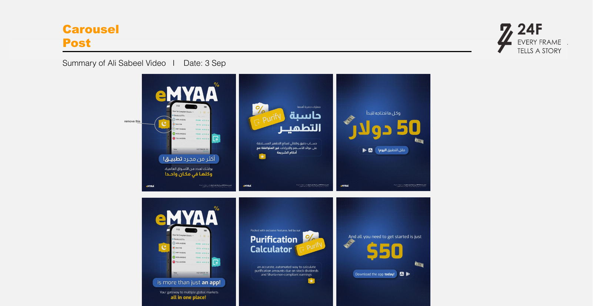
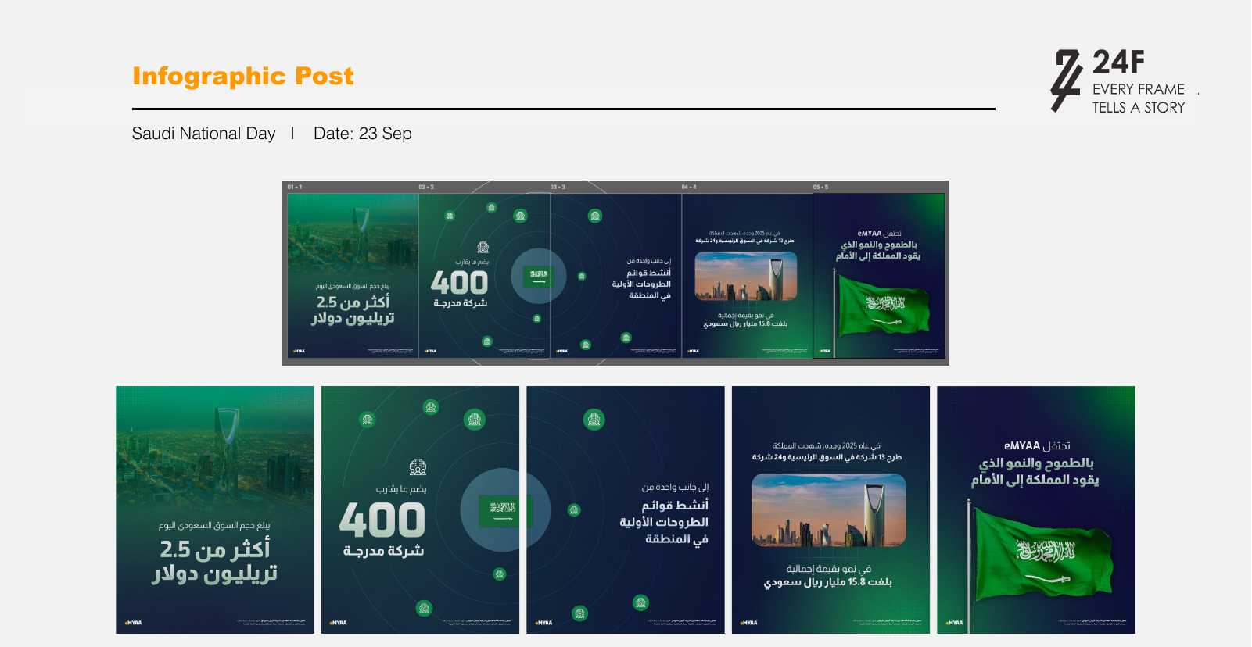
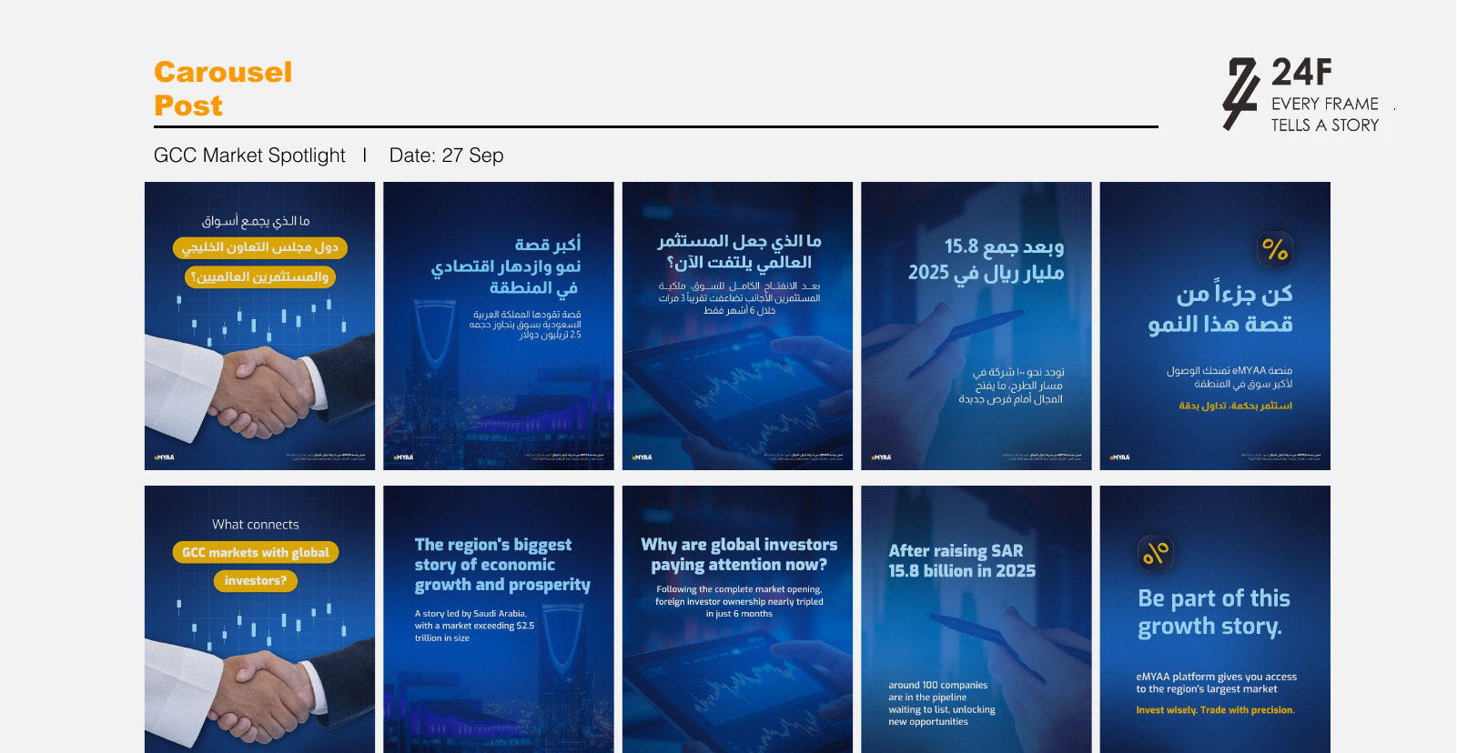
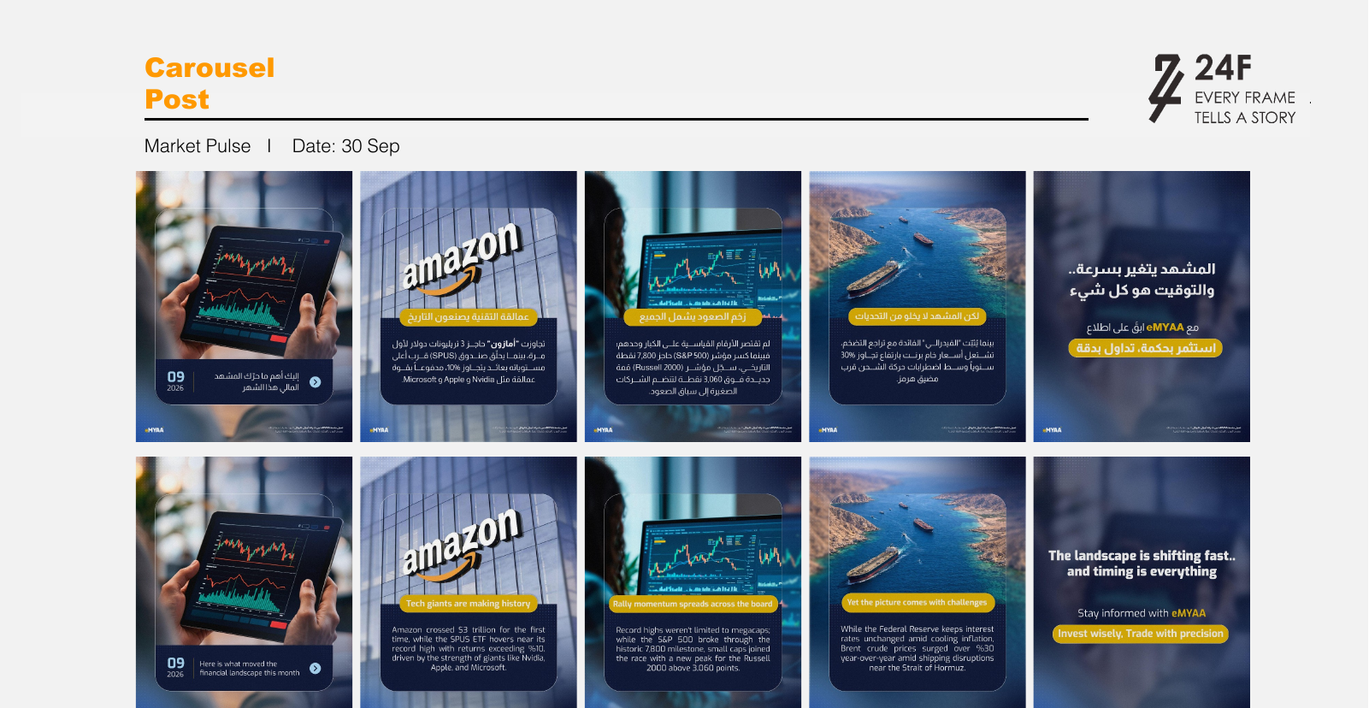
WHAT'S NEXT
September Artwork Preview
3 Sep - Ali Sabeel Recap
23 Sep - Saudi National Day
27 Sep - GCC Market Spotlight
30 Sep - Market Pulse
Source: 24F September Content Calendar deck, artwork drafts as shared 23-26 Aug 2026. Still a work in progress - not yet fully approved, subject to change before posting.

Slide 11
OPEN ITEMS
Needs Confirmation Before This Report Is Final
1
Facebook is not tracked yet (confirmed) - excluded from this and future reports until that changes.
2
PR/media coverage for August is not ready yet (confirmed) - will follow in a later cycle once available.
3
Website analytics (Squarespace) is now sourced (confirmed) - 656 visits, 575 unique visitors, 79.38% bounce rate, see Website Analytics slide.
4
Musheera's 5.3M-view reel is confirmed paid (boosted), not organic - explains the 0.0125% engagement rate. Do not present as an organic win.
5
Ali Sabeel's 28.1K views confirmed captured after the $2,200 paid boost went live - figure includes paid reach.
6
eMYAA Expense Tracker.xlsx - pending: awaiting reply from Ignite on ad spend to date to update it; budget slide still runs on the H2 Marketing Budget Plan only until then.
7
LinkedIn's single-day +490 follower count (24 Jun) - cause unknown, not confirmed as a genuine spike.
8
The 5-18 Aug "Other"-device / t.co click anomaly (~3,300 clicks) - cause unknown, flagged on slide 6.
9
Mention & Win duration confirmed via the approved Ignite ad brief: 3 weeks, 24 August - 15 September 2026 (per the approved caption T&Cs).
This report is filed with these items open rather than guessed at.

Slide 12
CLOSING
Wins This Month
1
The TikTok/Pangle bot-fraud fix held completely - zero fraudulent traffic in July or August, confirming the May decision was correct.
2
A real agency transition landed cleanly: 24F and Ignite are both onboarded and delivering, replacing a generalist agency with two specialists.
3
Paid social is live again after the July lapse - Mention & Win and Ali Sabeel's video are both running on Instagram with a locked compliance standard.
4
LinkedIn organic engagement hit its best month yet (68 reactions) in August, on the lowest impression count of the quarter - the content itself is working.
5
September's content calendar is fully planned and dated, with a new process to give animations proper production time.

Slide 13
Thank You
August 2026 | Invest Wisely. Trade Precisely.

