Slide 1



eMYAA Monthly
Performance Report
June 2026 | Post Launch Findings: May Performance
Notes:
1.7.2013
‹#›

Slide 2
Chairman’s Comments & Direction
Notes:
1.7.2013
‹#›

Slide 3



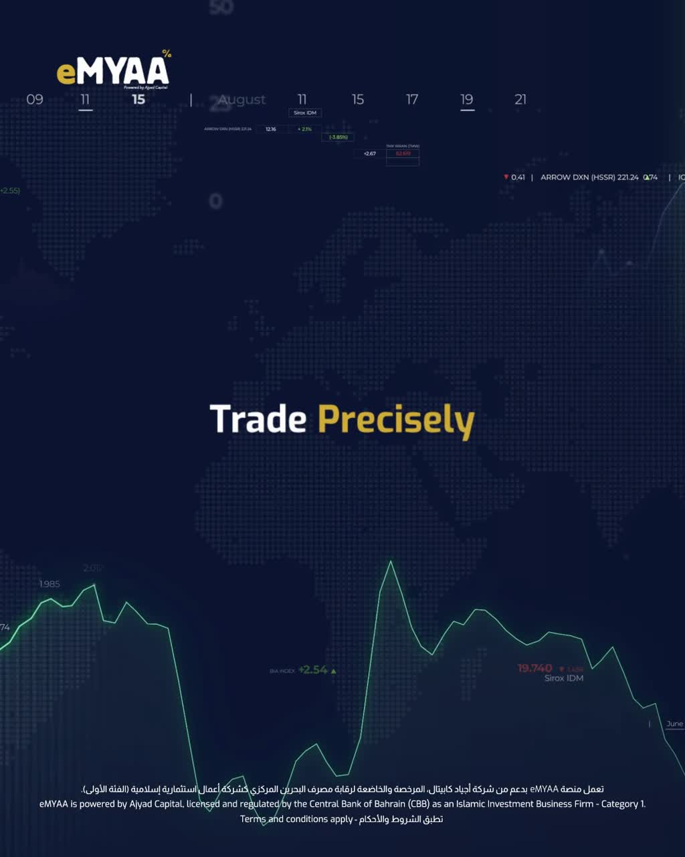

Content Strategy (Chairman’s Directions)
01
Dynamic First. No Static.
    Every asset must open with motion. High-net-worth audiences disengage within 3 seconds. Kinetic typography, UI fly-throughs, and micro-animations are non-negotiable from frame one.
02
GCC Regional Language
    All copy targets investors across دول مجلس التعاون الخليجي. Broad regional phrasing only. Zero political references. Zero localised dialects.
03
Four Content Pillars
    What is eMYAA.
    Platform Benefits.
    Why Should GCC Investors Choose eMYAA.
    Institutional Trust and CBB licensing.
(In progress)

Slide 4
Post Launch Findings:
May Performance
Notes:
1.7.2013
‹#›

Slide 5
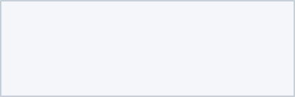
Executive Summary
2
$ 67.14
62
126
Total Funded Clients
Total Platform AUM
Total Onboarding Requests
Total App Downloads
(14–31 May)
Eligible Only
Android & iOS Stores
33%
100%
$ 6.00
82%
Percentage of Funded Clients
System Uptime
Total Revenue Generated
AI Client Support Resolution Score
Target: 99.99%
(14–31 May)
Key Highlights This Month
Platform launch (14–31 May):
  Executed our pilot marketing testing phase. With the sponsor ads campaigns officially ending today, June 1st 2026, our immediate next steps is to evaluate the initial performance data to strategically guide our upcoming marketing roadmap.
  eMYAA recorded its first live user activity with 2 funded accounts depositing a combined USD 67.14, confirming end-to-end payment rails are operational through bank transfer.
App store traction: 72 Android downloads and 54 iOS downloads achieved within the first 2 weeks of availability, both rated a perfect 5.0 stars with no negative reviews.
Zero compliance breaches: automated KYC controls successfully identified and rejected 5 ineligible applicants (age restrictions, expired documents), demonstrating robust regulatory adherence from day one.
Notes:
1.7.2013
2
‹#›

Slide 6
Onboarding & Funnel Integrity
11
100 %
6
4
Total Customers Who Completed KYC
KYC First-Pass Rate
Total Approved & Onboarded
Funded Gap (Not Invested)
Onboarding Funnel
Rejection Analysis (Top Reasons)
Requests | Count | % of Total
Total Onboarding Requests | 62 | -
KYC Completion Rate | 11 | 18%
KYC Incompletion Rate | 51 | 82%
Rejection Reason | Count | %
Age Restriction | 4 | 80%
Expired Documents | 1 | 20%
KYC Completion Gap (User Exit Points)
KYC Completion Rate
Exit Points | Count | %
Phone Verification | 22 | 43%
Document Submission (Passport & CPR) | 5 | 10%
Address Verification | 1 | 2%
Others | 23 | 45%
Requests | Count | % of Total
Approved | 6 | 55%
Rejected | 5 | 45%
Total Requests | 11 | 11
Notes:
1.7.2013
3
‹#›

Slide 7
Feature Intelligence & User Progression
82 %
18 %
3
14
AI Resolution Score
Agent Escalation Ratio
Total Cases Handled by Client Support
Total Cases Handled by AI Support
17
Total Cases handled by AI Support & Client Support
User Progression
Deposit & Withdrawal Activity
Requests | Count
Funded | 2
Not Funded | 4
Traded | 1
Not Traded | 5
Metric | This Month (USD)
Total Deposits | $ 67.14
Total Withdrawals | 0
Current AUM | $ 67.14
Notes:
1.7.2013
6
‹#›

Slide 8
Marketing & Ecosystem Growth
*5.7M+
332,941
45,196
22,726
$5,500
PR Media Reach
Instagram Views
X Impressions
LinkedIn Impressions
Pilot Test Ad Cost
20 Mentions / 17 Outlets
141,984 Accounts Reached
274 New Followers
(1,000%+)
3,504 Engagements
4 Platforms Activated
*Zero paid placement for any media outlet ensuring 5.7M+ reach for free.
Social Media Growth
Platform | Followers | Reach | Engagements
Instagram | 210 | 141,984 | 723
LinkedIn | 88 | 22,726 | 3,504
X | 274 | 45,196 | 25
TikTok | 15 | 1,100 | 62
Notes:
1.7.2013
9
‹#›

Slide 9
Website Analytics
268
3
73.1%
12.3%
45
Total Website Visits
Direct Traffic Share
Organic Search
Peak Day Visits
May (14-31)
196 direct visits
30 via Google
Launch day: 14 May
Traffic Sources Breakdown
Source | Visits | Share | Breakdown
Direct | 196 | 73.1% | Brand awareness and PR recall
Search (Total) | 33 | 12.3% | Google 30 / Bing 2 / Yahoo 1
Social Media (Instagram, X & LinkedIn) | 21 | 7.84% | Instagram 10 / X 8 / LinkedIn 3

Slide 10

PR & Media Coverage
Outlet | Date | Language | Reach (est.)
Zawya.com | 14/05 | EN / AR | 2,706,000
Alayam.com | 14/05 | AR | 1,038,000
Alwatannews.net | 14/05 | AR | 834,000
OpenPR.com | 14/05 | EN | 300,000
Alsyahaalarabia.com | 14/05 | AR | 3,000
Bizbahrain.com | 14/05 | EN / AR | 150,000
Saudishopper.com.sa | 14/05 | EN / AR | 150,000
25h.app | 14/05 | EN / AR | 75,000
Nabd.com | 14/05 | EN / AR | 150,000
100-100fm.com | 14/05 | AR | 75,000
Heidinews.net | 14/05 | EN / AR | 75,000
Sanews.sa | 14/05 | AR | 7,500
Notes:
1.7.2013
10
‹#›

Slide 11

PR & Media Coverage
Outlet | Date | Language | Reach (est.)
@bftbahrain (Instagram) | 14/05 | AR | 57,400 followers
@dinarbh973 (Instagram) | 14/05 | AR | 27,400 followers
@alayambusiness (Instagram) | 14/05 | AR | 27,600 followers
@cnnewss (Instagram) | 14/05 | EN / AR | 69,800 followers
@alsahatnews (X) | 14/05 | AR | 19,700 followers
Total Media Mentions
Overall Sentiment
20
Positive
Total Followers Reach on Social Media Platforms
201,900
Total PR & Media Coverage Reach
5,715,400
Notes:
1.7.2013
10
‹#›

Slide 12
Issues & Recommendations
Notes:
1.7.2013
‹#›

Slide 13
Issues & Blockers
Action | Issue | Category | Impact | Owner | Status
The WealthTech Team analyzed the onboarding report and Exante’s client area investment system, identified the target customers, and shared their details with Client Support for follow-up. | High drop-off at Phone Verification: 43% of stalled users did not complete KYC | Onboarding | High | Client Solution | In Progress
The WealthTech Team analyzed the onboarding report and Exante’s client area investment system, identified the target customers, and shared their details with Client Support for follow-up. | Onboarded-to-Invested Gap: 4 onboarded accounts remain unfunded, representing 67% of all approved accounts. | Deposit | High | Client Solution | In Progress
Status key: Open = unresolved | In Progress = being worked on | Resolved = completed this month
Notes:
1.7.2013
12
‹#›

Slide 14
Recommendations & Actions
01
Client Communications
03
Client Targetting
    Export emails of pending users and assign to Client Solutions Team for immediate follow-up.
    Deploy a customised HTML based re-engagement email with app download links (Android & iOS), social media handles and website.
    Track email click-through rates to measure conversion, report results in June.
    For users with available phone numbers, the Client Solutions team can conduct a verbal survey in order to understand any barriers preventing them to continue onboarding.
    Analyze the results of the marketing pilot phase, and prepare for a bigger targeted campaign through optimized channels and updated marketing content.
    Incorporate timely reminders with the cooperation of Client Solutions to encourage clients to trade.
04
Client Education
    Use social media channels to educate users on required documents and reduce onboarding friction.
    Include document requirements in the re-engagement email.
02
System Enhancements
    Investigate a persistent KYC journey, users resume from their last completed step, not the beginning.
    Timeline & cost will be considered once received from Exante.

Slide 15
Thank You
June 2026
Invest Wisely. Trade Precisely.
Notes:
1.7.2013
‹#›

Slide 16

Wins This Month
1
2
3
Win 1
Win 2
Win 3
Payment rails confirmed. First live trades placed. 100% uptime, and zero compliance breaches across 134 KYC applications. All in the first 14 days.
One release. 17 outlets. 20 clippings. 5,715,400 in media reach and 8,712,000 OTS. Zawya, Alayam, Alwatannews, and 13 others. Entirely earned. Zero paid placement.
126 downloads. Perfect rating on both stores. Zero negative reviews. 96.9% of X reach in Saudi Arabia. 62% of LinkedIn followers in Banking, Investment Management, or Financial Services.
Notes:
1.7.2013
11
‹#›

