Slide 1


eMYAA Trading Platform
Performance Analysis
1st of October, 2026

Slide 2


Performance Update
480
61
70
$107.52
Total Downloads
Users Onboarded
Incomplete KYC Users
Revenue
prev 414
▲ +15.9%
prev 51
▲ +19.6%
From 14 May 2026 . till date
$12,206.00
$1,666.19
$10,539.81
54
Total Deposits
Total Withdrawals
Current AUM
Total Trades
prev $10,195.88
▲ +19.7%
prev $1,666.19
prev $8,529.69
▲ +23.6%
prev 47
▲ +14.9%
Key Highlights
Steady top-of-funnel growth
Downloads reached 480 (up 15.9% from 414), showing continued organic interest in the platform.
Onboarding kept pace with acquisition
Users Onboarded grew approximately 19.6% (51→61) since the last update.
Paid Media Resumed
Two Instagram campaigns are live, with two additional influencers preparing their content for scheduled release.

Slide 3
Key Performance Indicators & Volume Projections
KPI & Performance Detail
May
June
July
August
September
October
November
December
I. CLIENTS, CUMULATIVE
Achieved / Current
11
24
33
47
61
Target / Projected
20
24
28
33
39
46
54
64
Performance Gap
-9
+0
+5
+14
+22
II. NUMBER OF TRADES
Achieved / Current
8
17
5
16
8
Target / Projected
20
24
28
33
39
46
54
64
Performance Gap
-12
-7
-23
-17
-31
III. AVERAGE INVESTMENT PER CLIENT
Actual / Current
$364.82
$329.46
$261.42
$212.84
$200.10
Target / Projected
$5,000
$5,250
$5,513
$5,788
$6,078
$6,381
$6,700
$7,036
Performance Gap
-$4,635.18
-$4,920.54
-$5,251.58
-$5,575.16
-$5,877.90
IV. TOTAL DEPOSITS, CUMULATIVE
Achieved / Current
$4,012.99
$7,907.15
$8,626.91
$10,003.60
$12,206.00
Target / Projected
$100,000
$123,900
$153,512
$190,201
$235,660
$291,982
$361,766
$448,228
Performance Gap
-$95,987.01
-$115,992.85
-$144,885.19
-$180,197.89
-$223,454.00
Notes:
4

Slide 4
IT Progress Update

Slide 5
IT Progress Update
The Next Mobile App — In Development
The new Mobile App will make trading effortless with a simpler, more intuitive experience.
Guest Access — Planned 2027
Users can explore the platform before onboarding, removing KYC as a barrier to first experience.
Market Pulse Feature — In Discussion
In-app live market news to drive repeat engagement.
Note: EXANTE verifying data-provider access for white-labels.

Slide 6
Client Experience
Progress Update

Slide 7
Overview
31
8
23
25.8%
Clients Contacted
Completed Onboarding
Still Pending
Conversion (Client Contacted)
Summary
Out of 31 clients contacted, 8 have completed onboarding, giving a conversion rate of 25.8%. The remaining 23 clients (74.2%) are
still pending, representing the primary area for continued follow-up.
Client Feedback’s
Missing or incomplete documents: Many clients don't have the required KYC documents ready at the time of registration, causing
delays or drop-off
KYC process feels too long: Clients report the verification steps take longer than expected, leading to frustration and mid-process
abandonment

Slide 8
Marketing

Slide 9
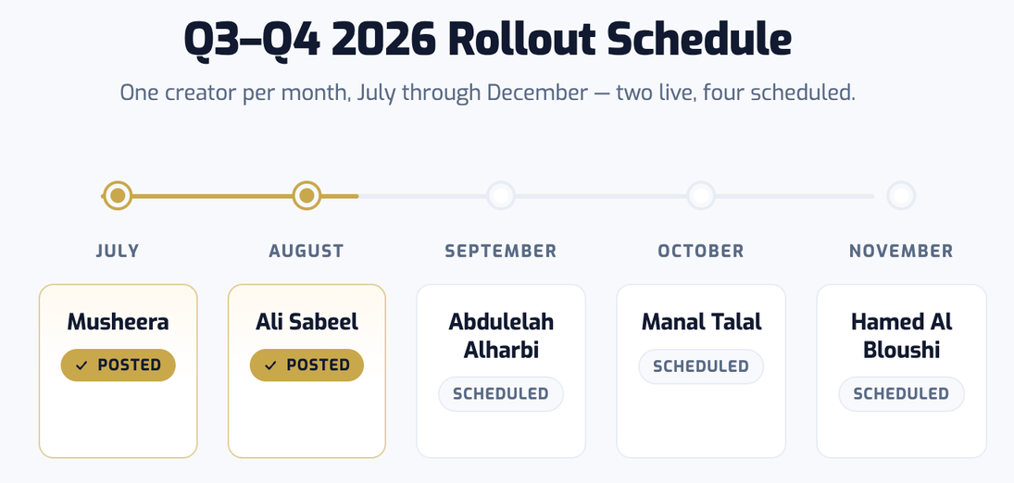
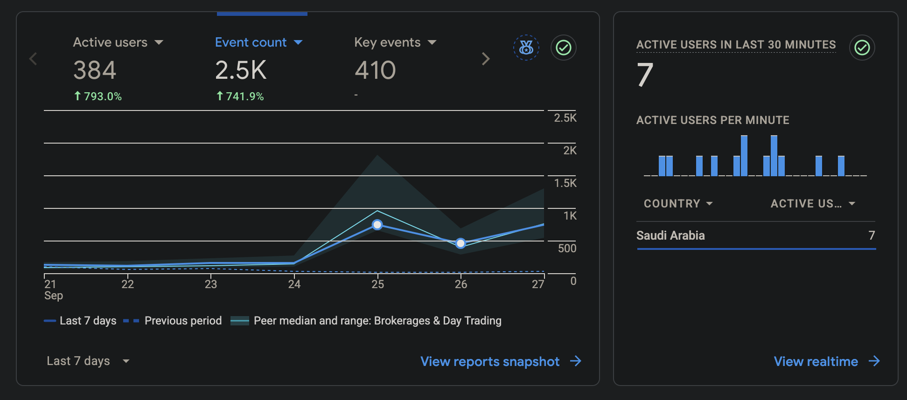
Sponsored Ads: What's Live Now
Campaign | Status | Notes
Mention & Win | Live, 23 Sep to 20 Oct | Timed before salary days; 26.2K views, 1,129 likes on launch reel
Ali Sabeel Video | Completed 18 Sep | GCC-wide targeting, 3-week run completed, no further spend invoiced
What is Actioned & In Progress
Campaign | Status | Notes
Monthly Calendar | Completed | New How To video with a human presenter posted
Abdulelah Al Harbi | Completed | Video live on Instagram
Manal Talal | Scheduled for end of October | Brief sent, video production started
NEW CHANNEL: GOOGLE ADS & LINKEDIN
Launched 22 Sep, testing phase. Google Search (Starter/Emerging) + LinkedIn lead gen (Affluent). Interest targeting: Saudi Arabia and Riyadh; location restricted to Saudi Arabia residents only. $30,000 campaign, Sep to Dec (Ignite, TI7541).
In testing, English is outperforming Arabic: 212 vs 176 sessions, 97% vs 87% engagement rate.
Google Analytics: website traffic, 21 to 27 Sep 2026

Slide 10
Thank You
Invest Wisely. Trade Precisely.

Slide 11
Appendix

Slide 12
Platform Initiatives Roadmap
Target: 20 Sep 2026
IN PROGRESS
Helpdesk Deployment — Frappe Helpdesk
Cybersecurity approval received on 20th August. Deployment to proceed, targeted to go live within the next two weeks. Deployment will be carried by WealthTech IT since Ajyad IT is not familiar with the process.
Under review by the Compliance since 07.09.2026
WealthTech CRM — Frappe CRM
PLANNED
Target: 29 Oct 2026
Cybersecurity has approved use of Frappe applications. Plan to deploy Frappe's CRM module to manage a unified customer base. It will be actioned after helpdesk.
Reporting Dashboard
EXPLORING
Under R&D — date TBC
Exploring options for a real-time analytics dashboard for eMYAA. Looking into different modules to support our Business Case.

Slide 13






Systems Planning & Deployment
INTERNAL WEALTHTECH TECHNOLOGY OPERATIONS
01
Helpdesk Deployment
02
WealthTech CRM Rollout
03
Reporting Dashboard
TARGET 20 Sep 2026
TARGET 29 Oct 2026
TARGET TBC
Under review by the Compliance team since 07.09.2026
Will consolidate the customer base into a single, unified system after Helpdesk deployment.
Real-time reporting capability under evaluation, to support the business case.
EXPLORING
DONE
EXPLORING
DONE
EXPLORING
IN PROGRESS
PLANNING
IN PROGRESS
PLANNING
PLANNING
DONE
DONE
NOT STARTED
IN PROGRESS
DEPLOYMENT
IN PROGRESS
DEPLOYMENT
NOT STARTED
DEPLOYMENT
NOT STARTED
HELPDESK SOLUTION
Cost-Effective Annual cost of USD 600–1,000 (hosting only), delivering approximately 83%–90% savings versus comparable vendor solutions at USD 6,000–10,000.
In-House & Fully Customizable Full control over the source code, database, and future enhancements.
Helpdesk operations are currently managed manually via Excel by Client Experience
eMYAA Trading Platform | Board Executive Committee Update
6

Slide 14
IT Progress Update
Exante — Status Update
Corporate Client Onboarding
Aligned with the Exante team on the end-to-end process for onboarding corporate clients.
New Application Release
Following up with the Exante team on the release of the new version of the application.
Sanity / Smoke Test Results
Following up with the team to receive sanity and smoke test results for the patched builds, required before we can publish the new builds to the app stores.

Slide 15
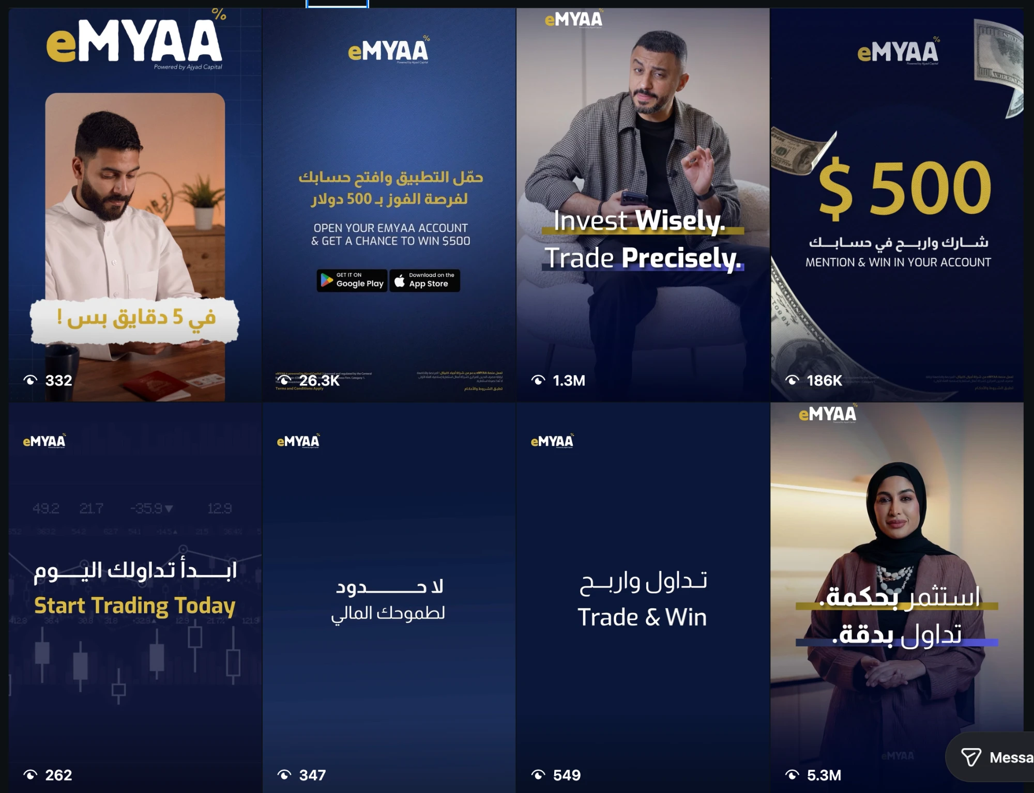
Instagram: Standout Channel
Metric | Value | Notes
Followers | 2,116 | -
Views | 2,271,132 | 59.2% Reels / 38.1% Stories
Interactions | 8,311 | 72.4% from Reels
Top Performing Content
Content | Result
Musheera Reel | 5.3M views
Ali Sabeel Reel | 1.3M views
Mention & Win $500 | 186K views
Saudi Market Size Infographic | 515 views

Slide 16
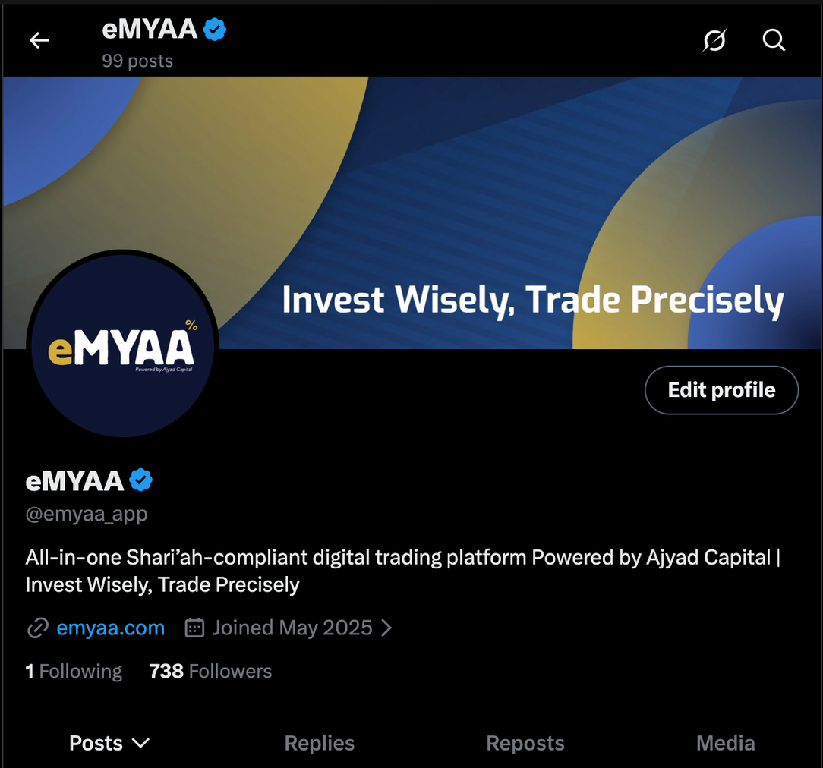
X, LinkedIn & TikTok
Platform | Metrics | Notes
X | 738 followers, 99 posts | Audience quality is real: 96.4% Bahrain, 3.6% Saudi, however still Instagram is heavily outperforming X.
LinkedIn | 531 followers | Followers up 247 in 30 days (+6,075%); 13-27 Sep: 559 impressions (+118%), 28 reactions (+155%)
Tiktok | 15 followers, 176 total likes | Lowest interactions between all platform/ audience not suitable for eMYAA

Slide 17
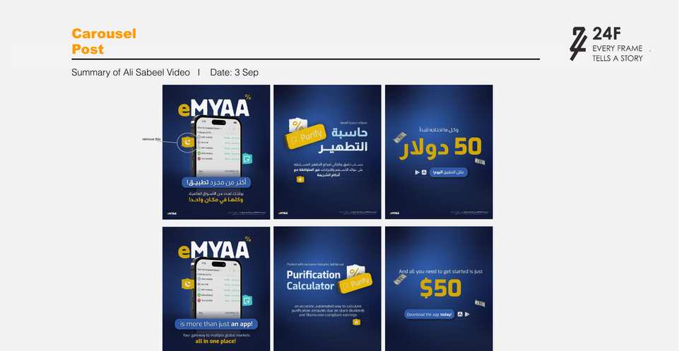
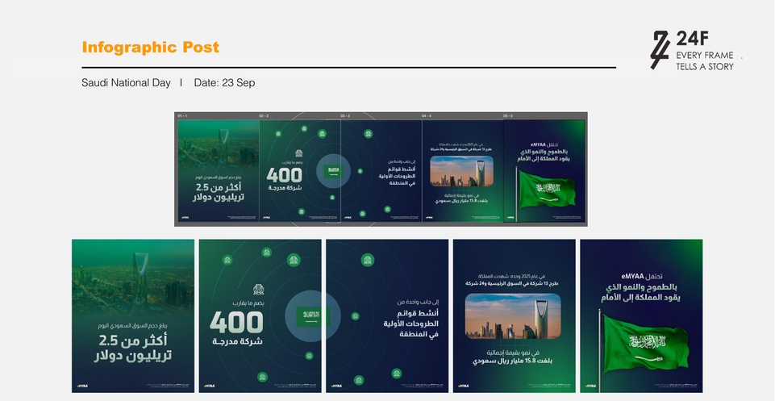

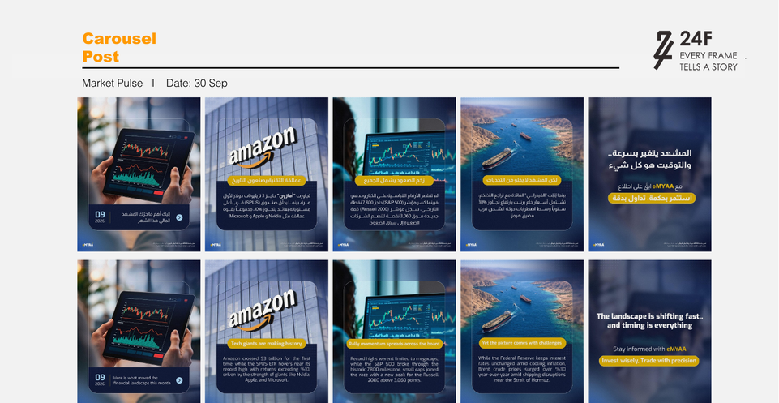
September Artwork Preview
3 Sep - Ali Sabeel Recap
23 Sep - Saudi National Day
27 Sep - GCC Market Spotlight
30 Sep - Market Pulse
*Work in progress

Slide 18
Website Analytics
587
Visits
542
Active Users
558
New Users
Traffic Sources
Source | Visits | Notes
Paid (Google Ads) | 409 (69.7%) | google / cpc, new campaign launched 22 Sep, already the top traffic source
Direct | 92 (15.7%) | No campaign or referral tag - typed URL, bookmark, or app share
Search | 39 (6.6%) | Organic Google search
Referral | 39 (6.6%) | ajyadcapital.com, Instagram, ChatGPT, Google Tag Assistant

Slide 19
Client Interaction Journey
1
2
3
DAY 1 CALL
DAY 1 EMAIL
DAY 3 CALL
DAY 3 EMAIL
4
First Contact
Email Reminder
Second Call
Follow-Up Email
Reach out directly by phone. Guide the client through whatever step they're stuck on.
Send campaign emails to re-engage clients who remain stuck mid-onboarding or have not yet funded their account
Send a reminder email at the end of the day outlining the steps required to progress through their current stage.
follow up with a second call, conveying greater urgency and offering to walk the client through the process live.
Contact Channels
Phone Calls: direct phone outreach for onboarding guidance and follow-ups
Emails: reminders, document lists, and campaign follow-ups
Business WhatsApp (In Progress): planned addition to reach clients faster and more directly

