Slide 1

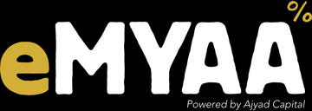

eMYAA in Saudi Arabia
MARKET ENTRY DISCUSSION
Channels, timing and cost | October 2026
Confidential. Prepared by eMYAA Marketing, Ajyad Capital.
Notes:
1

Slide 2
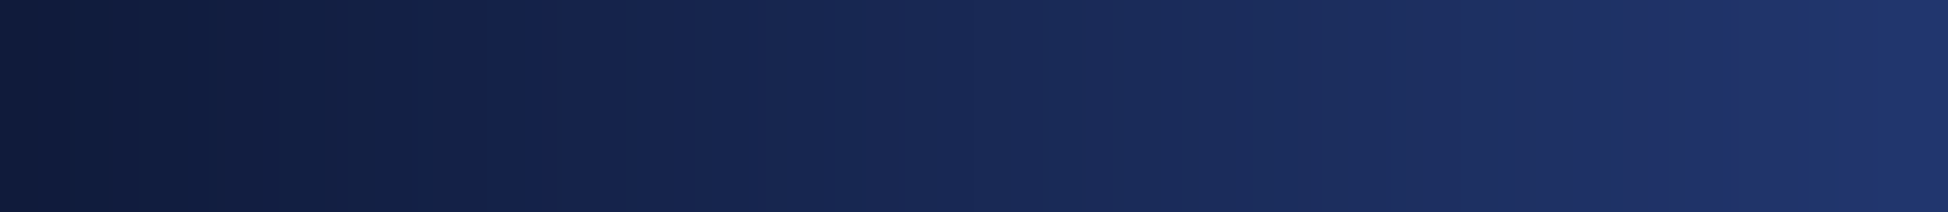


WHO WE ARE
eMYAA: a Shari'ah-compliant trading app for GCC investors
Shari'ah compliant
Arabic and English
Automated Shari'ah screening and purification calculator
Full bilingual app with AI support
USD 50 to start
Four markets
No account opening fees, and very competitive trading fees.
US, Saudi (Tadawul), Dubai (DFM), Hong Kong
Licensed Powered by Ajyad Capital, an Islamic investment firm (Category 1) regulated by the Central Bank of Bahrain. Live since May 2026.
eMYAA Trading Platform | Saudi Market Plan
2
Notes:
Ajyad Capital is licensed by the Central Bank of Bahrain as an Islamic investment firm, Category 1. eMYAA went live in May 2026.
2

Slide 3
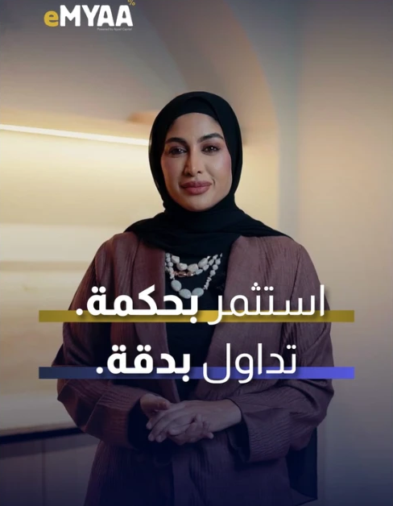
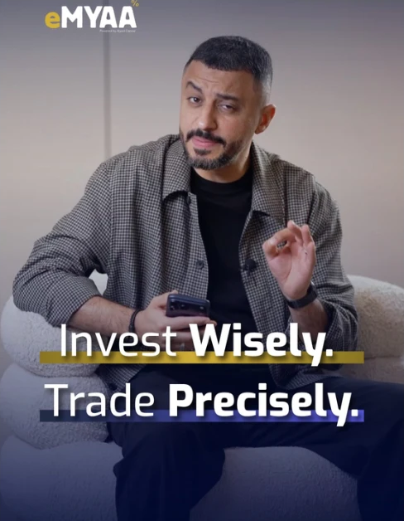
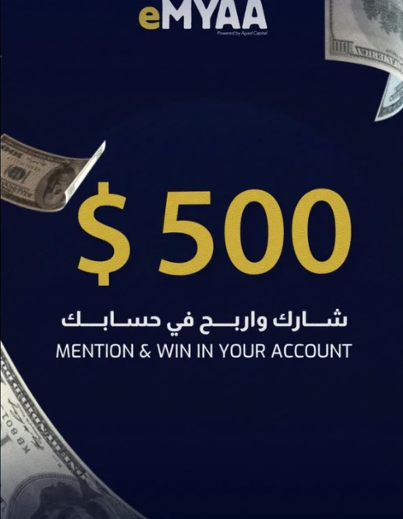
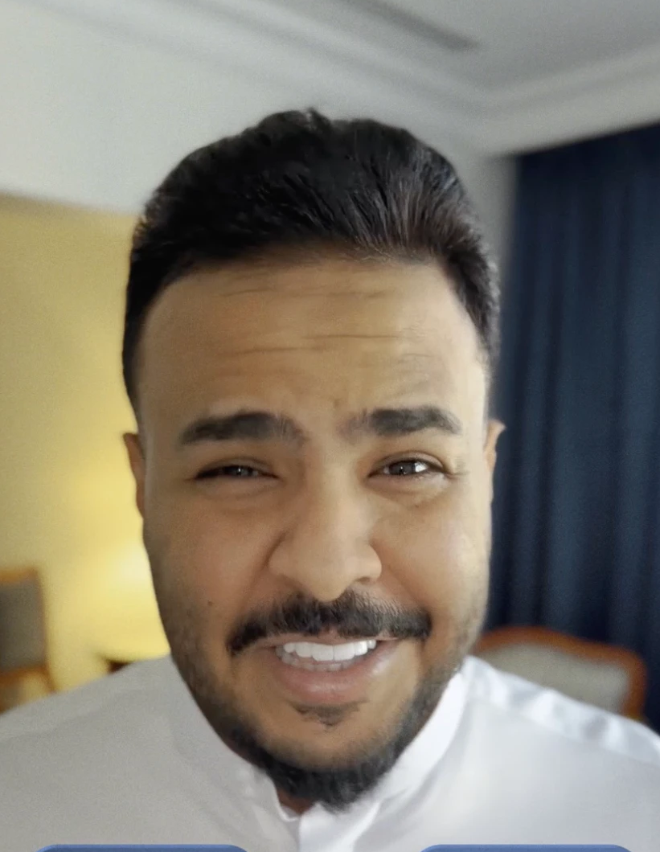
WHAT WE HAVE LEARNED SO FAR
Instagram, X and TikTok: What Worked and Why
Instagram
X (Twitter)
TikTok
OUR STRONGEST CHANNEL
REACH, BUT NOT IN SAUDI
PAUSED
2,116 followers, up from 774 at the end of June
2.27M views in 90 days, 72% of interactions from Reels
Creator reels: Musheera 5.3M and Ali Sabeel 1.3M views (paid boost)
Mention & Win: 266K views and 22,580 clicks for USD 600, 6 new accounts
738 followers, 96% in Bahrain and only 4% in Saudi
Saudi city tests in Jeddah, Dammam and Khobar in June
Engagement fell 42% in June while followers grew
Paid support paused since July
15 followers, 176 total likes
Bot traffic found in May: 706K fake clicks through a partner ad network
Paid ads stopped on 22 June; traffic has been clean since
Audience not yet a fit for investing content
WHY INSTAGRAM OUTPERFORMED
Real people, not animation: presenter-led creator videos built more trust than graphic explainers.
Paid boost on every key video: reach came from sponsoring creator content to the right GCC cities and ages.
Contests that ask for action: Mention & Win turns views into follows and new accounts.
Musheera
5.3M views
Ali Sabeel
1.3M views
Mention & Win
186K views
Abdulelah Al Harbi
October
eMYAA Trading Platform | Saudi Market Plan
3
Notes:
Sources: Instagram Professional Dashboard (Aug 2026 report: 1,765 followers, 2,271,132 views in 90 days, 72.4% of interactions from Reels; Musheera and Ali Sabeel views are paid boosted); Instagram followers 2,116 (Sep); June 2026 report (TRACCS / Sprout Social): Instagram 774 followers at 30 Jun, X engagement -41.8%; Mention & Win pilot 11-18 Jun: USD 600, 266,218 views, 22,580 clicks, 6 accounts; X: 738 followers, 96.4% Bahrain, 3.6% Saudi, App Screens Saudi tests (Jeddah, Dammam and Khobar) 4-13 Jun, paid support lapsed July; TikTok: 15 followers, 176 likes, Pangle bot clicks 706,445 in May, paid TikTok removed 22 Jun, zero Pangle clicks July and August.

Slide 4
WHAT WE HAVE DONE SO FAR
Marketing Activity Since Launch, May to October 2026
Campaign
Platform
When
Spend (USD)
Result
Long Form Launch
Instagram, LinkedIn
19 May to 1 Jun
1,700
231,850 impressions and 3,471 clicks across KSA, Bahrain, Oman, Kuwait
Astronaut (animation)
Instagram, TikTok, X
19 May to 1 Jun
3,700
Highest reach in May, but TikTok traffic was bots
App Screens
X, Saudi only
4 to 13 Jun
500
Product test in Jeddah, Dammam and Khobar
GCC Relaunch
Instagram, X, LinkedIn
8 Jun to 8 Jul
6,700
Followers grew on every channel in June
Mention & Win
Instagram, GCC
Monthly since Jun
500 prize + ads
Pilot: 266K views, 22,580 clicks, 6 new accounts for USD 600
Creator videos
Instagram
Jul to Oct
9,037
Musheera 5.3M and Ali Sabeel 1.3M views; Abdulelah in October
USD 5,000 Prize Campaign
Instagram, landing pages
1 Aug to 31 Dec
Prizes up to 5,000
Live; draw on 10 Jan 2027
Google Ads and LinkedIn
Saudi, then GCC
From 22 Sep
30,000
70% of September website visits (see next slides)
Spent to date: USD 34,482 (14 May to 6 Sep, from a USD 80,000 allocated budget), plus USD 30,000 for Google Ads and LinkedIn from Sep to Dec.
eMYAA Trading Platform | Saudi Market Plan
4
Notes:
Sources: July 2026 monthly report (sponsored ads May to July: Long Form Launch, Astronaut, App Screens, GCC Relaunch, Mention & Win pilot); Board update 17 Sep 2026 (marketing budget: USD 80,000 allocated, USD 34,482 spent 14 May to 6 Sep, influencer programme USD 9,037; USD 30,000 Google Ads and LinkedIn Sep to Dec); USD 5,000 campaign T&Cs; GA4 1-28 Sep. GCC Relaunch results were not reported separately.

Slide 5
DIGITAL PERFORMANCE CHANNELS
Two New Channels Targeting the Saudi Market
Channel and market
Budget
Target
Dates
Status
Google Search, Saudi
USD 9,000
Riyadh first
22 Sep to 31 Dec
Live
LinkedIn, Saudi
USD 9,000
Lead generation forms
6 Oct to 31 Dec
Live
Google Search, rest of GCC
USD 6,000
Qatar, UAE, Kuwait, Bahrain, Oman
Early Oct to 31 Dec
To be live
LinkedIn, rest of GCC
USD 6,000
Qatar, UAE, Kuwait, Bahrain, Oman
Early Oct to 31 Dec
To be live
Total
USD 30,000
22 Sep to 31 Dec
INITIAL RESULTS
A one-month test result for each channel will decide where the budget goes next.
70%
97% / 87%
of website visits
engagement rate
came from Saudi Google Ads
English ads / Arabic ads
eMYAA Trading Platform | Saudi Market Plan
5
Notes:
Google Ads targets Saudi Arabia and Riyadh, Saudi residents only (Ignite). GA4, 1-28 Sep: 409 of 587 site sessions (70%) from google / cpc; English ads 212 sessions (97.2% engagement), Arabic 176 (86.9%).
4

Slide 6
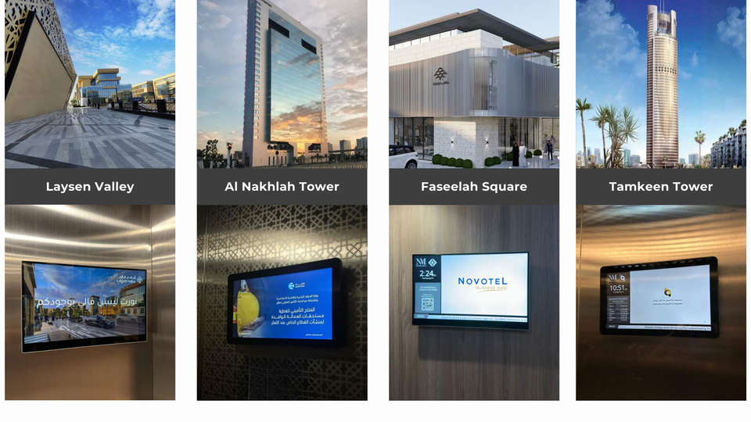
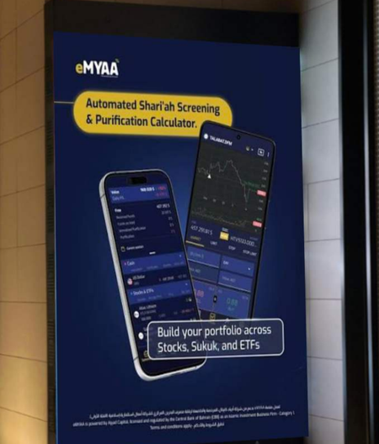
OUTDOOR AND ELEVATOR MEDIA, SAUDI ARABIA
Outdoor options from Nadher Media: 91 screens in Saudi Arabia
LATEST OFFER, 23 SEP
USD 44,800 + VAT
8 weeks, 91 screens, 30% below the original rate of USD 64,000.
Elevator screens, 83 towers | The Zone LED screens, 8 faces (eMYAA mock-up)
Duration
Original rate
eMYAA rate
Ad plays
83
8
2 weeks
-
USD 16,000
0.84M
4 weeks
USD 32,000
USD 27,200
1.67M
towers
LED faces
elevator screens
The Zone, Riyadh
8 weeks
USD 64,000
USD 44,800
3.35M
12 weeks
USD 96,000
USD 67,200
5.02M
eMYAA Trading Platform | Saudi Market Plan
6
Notes:
Nadher Media proposals 16 and 23 Sep 2026, Saudi screens only (the Al Liwan Bahrain weekend screens in the 16 Sep offer are left out). Elevator screens in 83 commercial towers (Al Nakhlah, Tamkeen, Faseelah Square, Laysen Valley and others in Riyadh and the Eastern Province) and 8 LED screens at The Zone, Riyadh. Plays per Nadher: 2,490 an hour (ad plays, not unique viewers). 2-week rate has no original price in the offer. USD at 3.75.
5

Slide 7
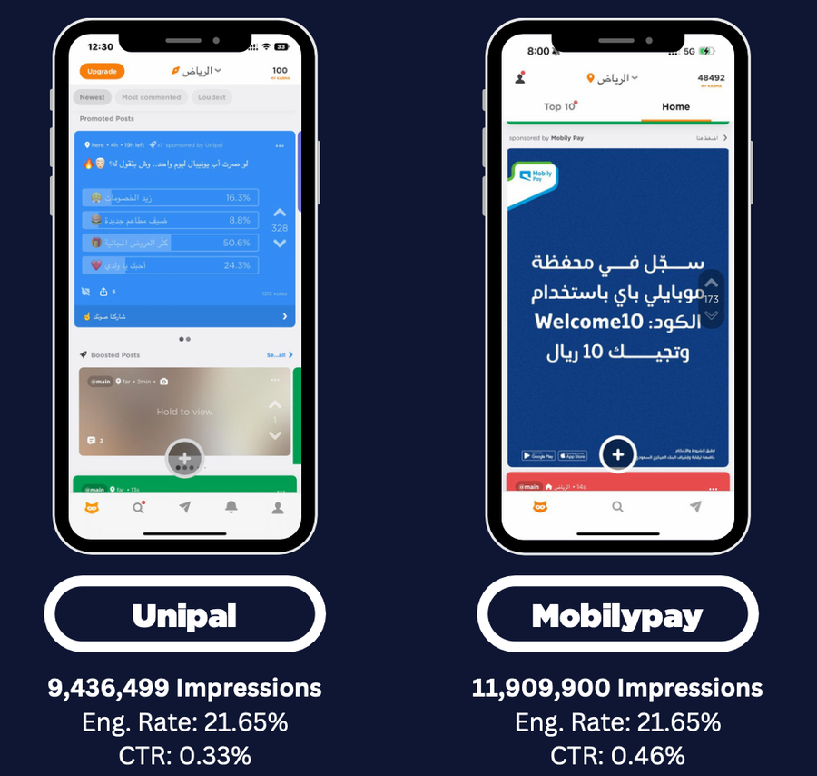
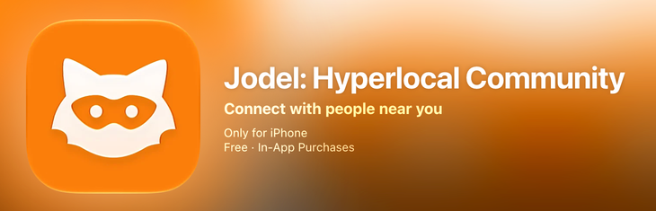
JODEL, SAUDI ARABIA
Jodel: 2.5 million impressions in 7 days for USD 3,862.50
THE OFFER
USD 3,862.50 + VAT
7 days | all of Saudi Arabia
525,000 display and video impressions + 24-hour takeover poll (2,000,000 impressions)
2.5M
USD 1.53
21 to 35
impressions
per 1,000
audience age
in 7 days
impressions
2.5M users in KSA
eMYAA Trading Platform | Saudi Market Plan
7
Notes:
Nadher Media proposal for eMYAA, 16 Sep 2026: USD 3,862.50 + VAT, 7 days, all KSA: 525,000 display and video impressions plus a 24-hour takeover poll of 2,000,000 impressions, one round of ad consulting, unlimited creatives. Cost per 1,000 impressions: about USD 1.53. Jodel KSA: 2.5M active users, 800,000 monthly unique users, average CTR 0.44%. BISB case study (Nadher Media, Oct 2025).
6

Slide 8
JODEL TAKEOVER POLL, EXAMPLE
An eMYAA Poll Built on Personal Goals
THE POLL, IN ENGLISH
Jodel | Riyadh
Sponsored
"If you started investing today, what is the first goal you would want to reach?"
eMYAA | Shari'ah-compliant investing
Pay off my debts
Buy a car
لو بديت تستثمر من اليوم، وش أول هدف تبي تحققه؟
Finish my studies
Get married
أسدد ديوني
WHY IT WORKS
Personal, not technical: it links investing to goals young Saudis already think about every day.
Everyone sees it: a 24-hour takeover poll reaches about 2 million impressions across the Kingdom.
Easy to answer, easy to share: one tap to vote, and results and comments are live.
A clear next step: the display ads that follow point voters to eMYAA.
أشتري سيارة
أكمل دراستي
أتزوج
FOLLOW-UP AD AFTER THE POLL
Live for 24 hours | tap to vote
كل هدف يبدأ بخطوة. ابدأ استثمارك المتوافق مع الشريعة من 50 دولار مع eMYAA
Every goal starts with a step. Start investing the Shari'ah-compliant way from USD 50 with eMYAA.
eMYAA Trading Platform | Saudi Market Plan
8
Notes:
Example copy for a Jodel 24-hour takeover poll (Nadher Media offer, 16 Sep 2026: about 2,000,000 poll impressions). Arabic in Saudi dialect. To be reviewed by compliance before use: no promise of returns, and the debt option should not suggest borrowing to invest.

Slide 9
FOR DISCUSSION
Where eMYAA and Vision Bank could work together
01
02
03
Market insight
Influencer Marketing
Sponsor Ad
What Saudi digital customers expect, and what has worked in your marketing strategy the most.
Which influencer categories, platforms, and audience profiles deliver the strongest engagement and customer acquisition results for financial services in Saudi Arabia?
What budget is required for sponsorship advertising, which locations should we prioritise beyond Riyadh, and where can we achieve the most efficient cost per click?
We would value your advice as we enter the Saudi market.
eMYAA Trading Platform | Saudi Market Plan
9
Notes:
Discussion topics only; nothing here is agreed.
7

Slide 10
Thank You
Invest Wisely. Trade Precisely.
Hatem Isa Hatem | Marketing Officer, WealthTech
hhatem@ajyadcapital.com | +973 17 565 007
Ajyad Capital, 37th Floor, Almoayyed Tower, Manama, Kingdom of Bahrain
Ajyad Capital is an Islamic investment firm (Category 1) licensed by the Central Bank of Bahrain.
Notes:
8

