Slide 1
ALINA
Advanced Line Identification and Notation Algorithm
How it labels taxiway centerlines automatically
Khan, Ganeriwala, Bhattacharyya, Neogi, Muthalagu — CVPR 2024 Workshops (arXiv:2406.08775)

Slide 2
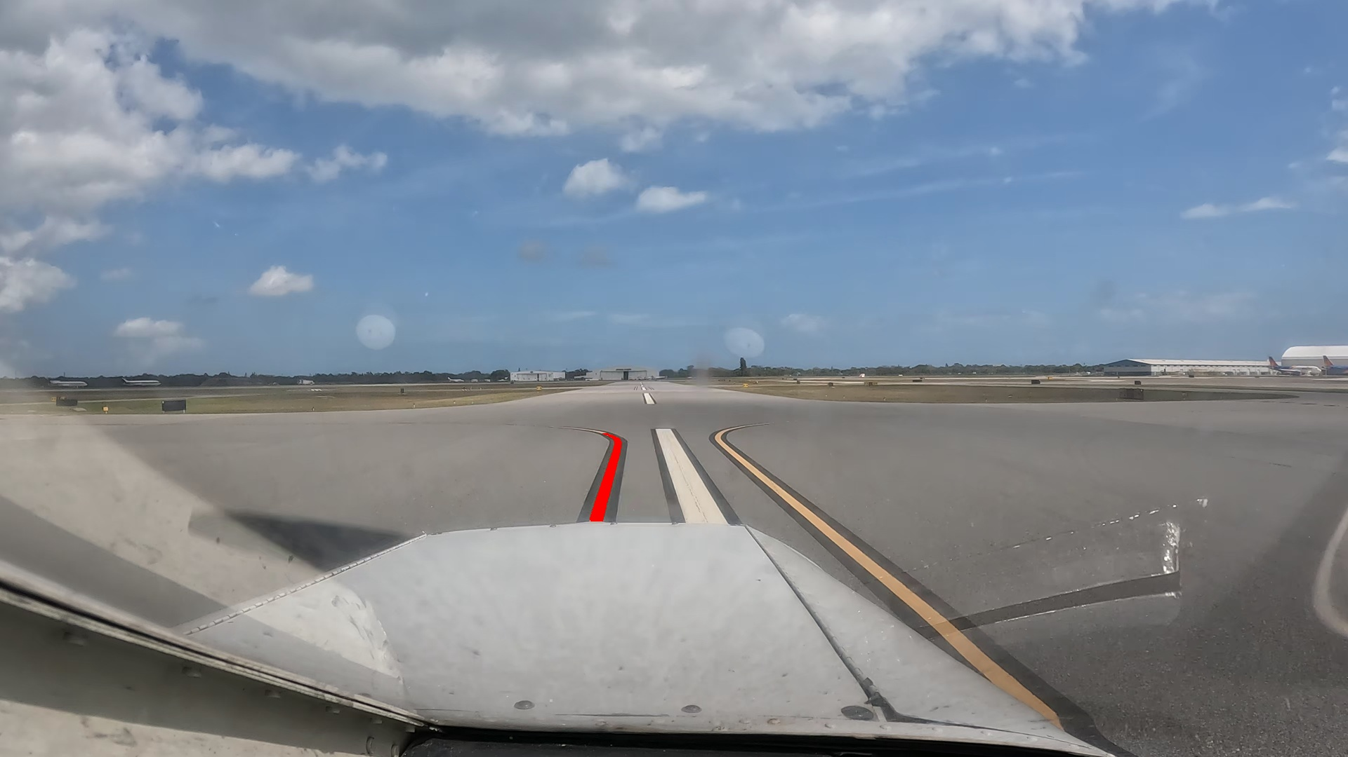
What is ALINA?
• An automatic labeling tool for airport taxiway video
• Finds the yellow centerline in each frame and records exactly which pixels belong to it
• Not a neural network: a classical computer-vision pipeline
• Outputs per frame: an annotated image (line in red) and a text file of x y pixel coordinates
• Purpose: produce the ground truth that supervised ML models (taxiway / lane detectors) need
ALINA output on vidd_1: centerline in red
ALINA explained | 2

Slide 3
Why it matters
Problem | How ALINA addresses it
Manual labeling is slow, expensive and error-prone | Labels automatically at ≈ 19.65 fps (50 ms per frame on a CPU)
≈ 33% of aircraft accidents (2015–2022) happened during taxiing | Creates training data for pilot-assist and autonomous taxi guidance
Previous method (CDLEM) needed a new ROI at every scenario change: 120 ROIs | One ROI per video: 3 ROIs for the same 60,249 frames
CDLEM: 91.14% detection at 120 ms per frame | ALINA: 98.45% detection at 50 ms per frame (≈ 2.4× faster)
• Scale: 60,249 frames from 3 videos of the AssistTaxi dataset (Melbourne MLB and Grant-Valkaria X59 airports), sunny and cloudy
ALINA explained | 3

Slide 4
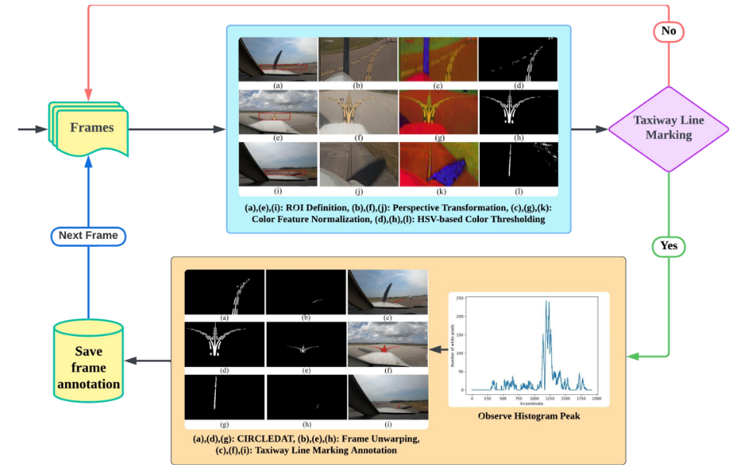
The pipeline at a glance
Method overview (from the paper)
ALINA explained | 4

Slide 5
Pipeline overview: six steps per frame
• 1. ROI: a trapezoid in front of the aircraft nose, clicked once on the first frame
• 2. Bird's-eye warp: a homography stretches the trapezoid to a top-down rectangle
• 3. Colour: HSV conversion, min-max normalisation, threshold → binary mask
• 4. Column histogram: count mask pixels per column; the peak column is the line
• 5. CIRCLEDAT: traverse all mask pixels connected to that peak
• 6. Unwarp: map the pixels back to the camera view; draw them in red and save x y
• Each step shrinks the problem or removes one source of error
ALINA explained | 5

Slide 6
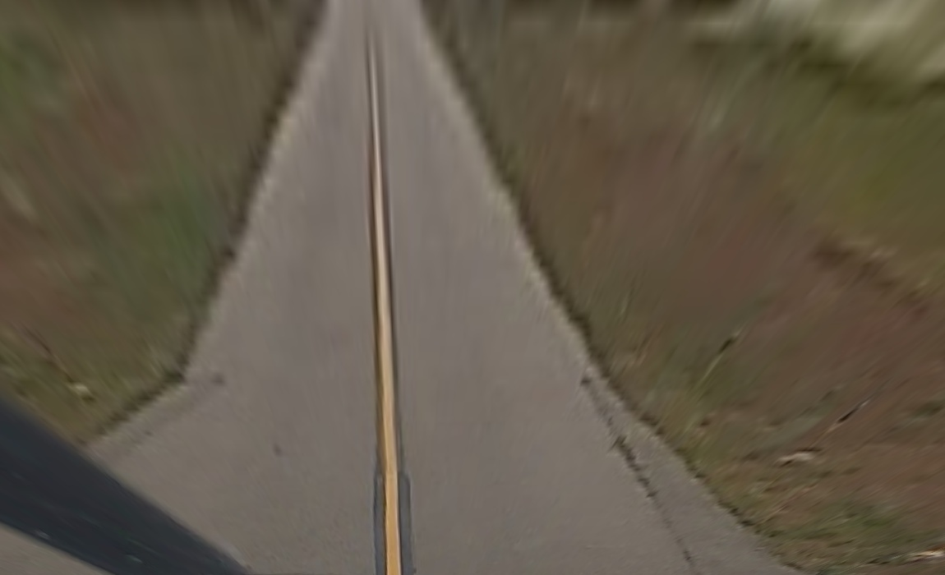
Step 1–2: ROI and bird's-eye warp
• The centerline always appears in roughly the same area in front of the nose
• The user clicks 4 points once per video; reused for all frames
• A homography (3×3 matrix from 4 source + 4 destination points) warps the trapezoid to the rectangle (50, 100)–(1200, 800)
• In the bird's-eye view the line is a roughly vertical stripe of constant width
• Excludes sky, grass and parked aircraft; cuts computation
Bird's-eye view of a medium ROI on vidd_2
ALINA explained | 6

Slide 7
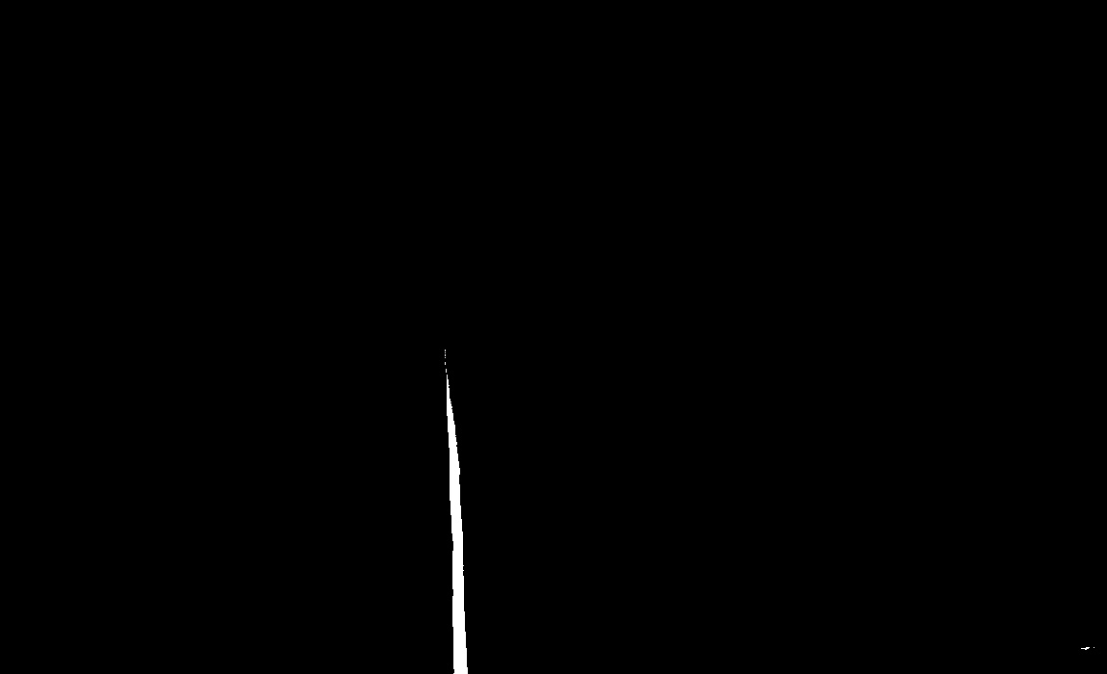
Step 3: colour normalisation and threshold
• Convert BGR → HSV: hue (which colour), saturation (how vivid), value (how bright)
• Min-max normalise each channel to 0–255 so sunny and cloudy frames are comparable
• Keep pixels in (0, 70, 170)–(255, 255, 255): vivid and bright → white (255), else black
• Bounds chosen from histograms of real line pixels
• Why HSV: lighting changes mostly move V, so the paint signature is steadier than in RGB
• There is no rule for white paint
Binary mask after thresholding
ALINA explained | 7

Slide 8
Step 4: column histogram — is there a line, and where?
• For every column of the mask, count the white pixels
• A real line in the bird's-eye view is a tall column → a clear peak; noise makes only small bumps
• Line accepted if the peak column has > 200 white pixels (min_white_pixels) and the peak exceeds peak_pixel_threshold
– The paper's ablation chose a peak threshold of 150 (0% false positives); the code default is 50
• Start point for the next step: the peak column at the mean row of its white pixels
• If no peak passes, the frame is saved with an empty label file
• Columns 0–300 of the mask are zeroed first (mask_ignore_left_columns)
ALINA explained | 8

Slide 9
Step 5: CIRCLEDAT — collect the whole line
• Circular Threshold Pixel Discovery and Traversal, a new algorithm in the paper
• Depth-first search from the start pixel: from each white pixel, look at every pixel within ±15 px (circular_threshold)
• Jumps small gaps, so it follows curves and dashed lines
• Collects only pixels connected to the line → unconnected noise is left out
• Cost O(k) in the number of line pixels vs O(m×n) for a sliding window (paper: 3.33 ms vs 10.90 ms)
• Side effect: anything touching the line (e.g. a bright aircraft nose in the mask) is pulled in too
ALINA explained | 9

Slide 10
Step 6: unwarp and outputs
Unwarp
Outputs per frame
• The inverse homography M⁻¹ projects the collected pixels back to the camera view
• Pixels are painted red on the original frame
• Only the single strongest line is traced per frame
• annotations/<frame>.jpg — red overlay
• textfiles/<frame>.txt — one 'x y' per line pixel
• Empty text file when no line was found
• timing log: labeled / no lines found, ms per frame
ALINA explained | 10

Slide 11
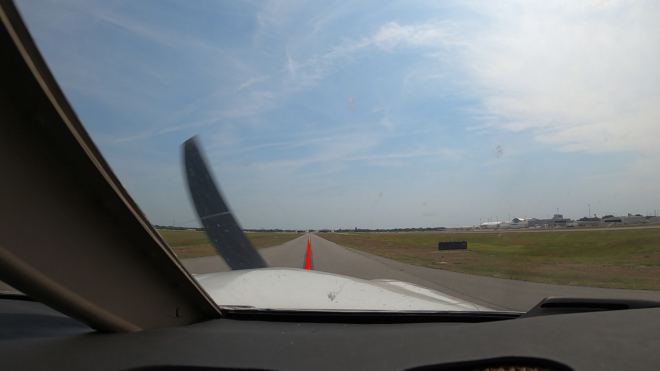
Input and output example
• Input: a folder of JPG frames per video + 4 ROI clicks
– vidd_1 is 4K (resized to 1080p in this project); vidd_2 and vidd_3 are 1080p
• Output: the same frame with the centerline in red, plus its coordinates
• 50 sample frames per video ship with the repo (data/Raw_Data, data/Labeled_Data)
vidd_2 frame labeled by ALINA
ALINA explained | 11

Slide 12
The data in the repository
Folder | Contents | Role
data/Raw_Data/vidd_1..3 | 50 raw frames per video | Input
data/Labeled_Data/vidd_1..3 | annotations/ (red overlays), textfiles/ (x y) | Authors' sample output
data/gt_alina_labels/canny_images | CBEM edge-map images | Visual reference for ground truth
data/gt_alina_labels/canny_textfiles | CBEM ground-truth coordinates (120 frames) | Evaluation truth
data/gt_alina_labels/ALINA_textfiles | ALINA output on the same 120 frames | What gets evaluated
• Only 17 of the 120 ground-truth frames have their raw image in the repo (vidd_1: 7, vidd_2: 10, vidd_3: 0)
ALINA explained | 12

Slide 13
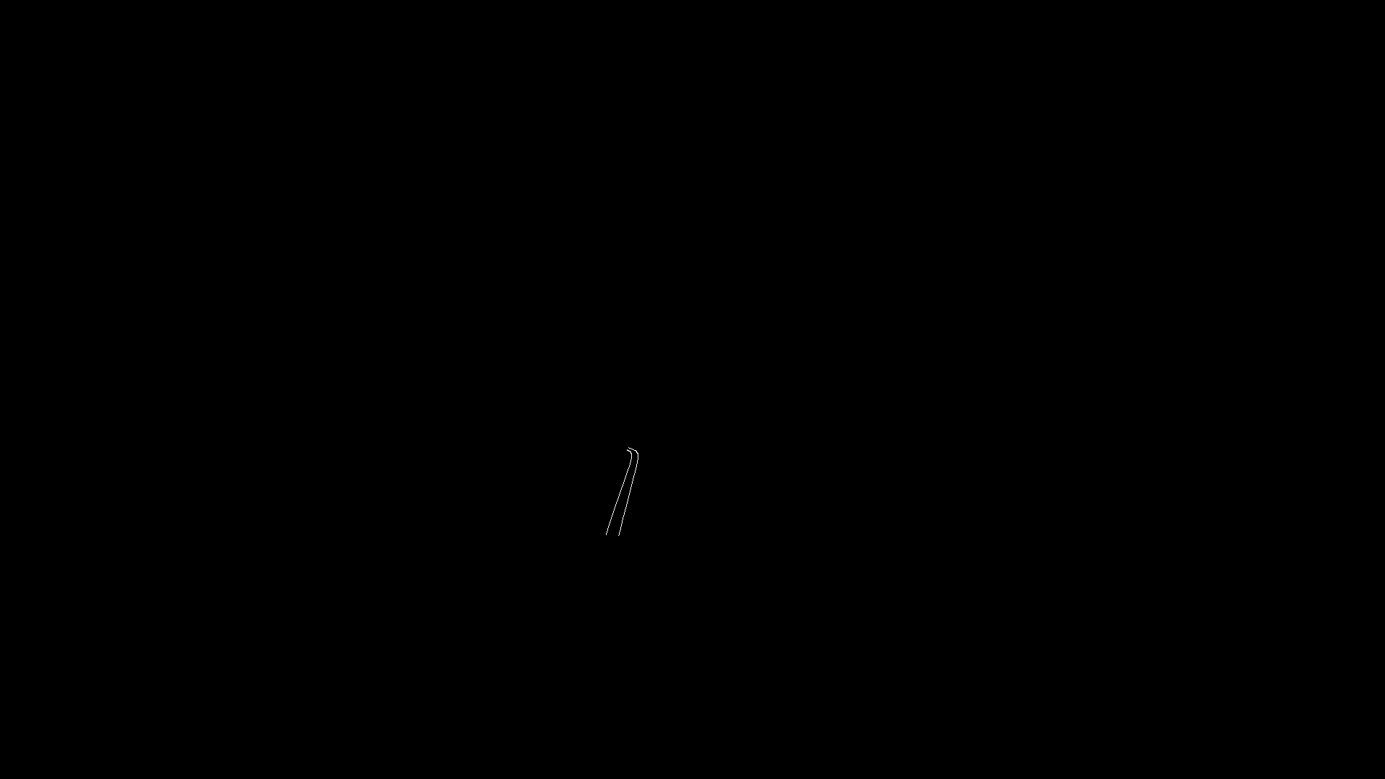
Ground truth: CBEM
• Canny-Based Edge Marking: how the authors made ground truth
• 120 frames picked at scenario changes (not at random), 40 per video
• A person outlines the marking; Canny edge detection inside the outline gives the edge pixels
• So the truth marks the edges of the paint, not the filled paint
• Dataset quirk: several CBEM files are byte-identical duplicates
CBEM edge image
ALINA explained | 13

Slide 14
How ALINA is evaluated
Metric on the 120 validation frames | Value
Recall (detection rate) — paper | 98.45%
Recall / precision / F1 — reproduced with alina evaluate | 98.44% / 92.29% / 95.17%
Same frames, exact pixel match F1 | 28.8
Same frames, pixel match within 3 px F1 | 87.4
• ALINA compares the set of x values and the set of y values separately, then averages: a predicted x counts if any true pixel has it
• Per frame, then averaged over frames; frames without an output file are skipped
• The authors prioritise recall: for taxiway safety a missed marking is worse than an extra pixel
ALINA explained | 14

Slide 15
Key parameters (alina/config.py)
Parameter | Default | Meaning
yellow_lower / yellow_upper | (0, 70, 170) / (255, 255, 255) | Normalised HSV paint range
min_white_pixels | 200 | White pixels needed in the peak column
peak_pixel_threshold | 50 | Minimum histogram peak (paper ablation: 150)
circular_threshold | 15 | CIRCLEDAT search radius (px)
mask_ignore_left_columns | 300 | Mask columns zeroed before the histogram
ROI destination rectangle | (50, 100)–(1200, 800) | Bird's-eye target of the homography
ALINA explained | 15

Slide 16
Where the time goes (paper, ms per frame)
Step | Time (ms)
Perspective warp | 4.41
HSV normalisation | 5.91
Thresholding | 1.05
Histogram | 28.71 (bottleneck)
CIRCLEDAT | 3.33
Remap | 6.68
Total | 50.09 (≈ 19.65 fps)
• In this project's Python version, CIRCLEDAT was far slower (1–37 s per frame) because its cost grows with the connected mask area
ALINA explained | 16

Slide 17
Running ALINA
• Environment: uv sync (Python 3.12, OpenCV, NumPy — pinned in uv.lock)
• Label a folder of frames (opens a window to click the ROI):
– uv run alina label --input-dir data/Raw_Data/vidd_2 --output-images-dir … --output-coords-dir …
• Evaluate against CBEM:
– uv run alina evaluate --canny-dirs data/gt_alina_labels/canny_textfiles/canny_textfiles_{1,2,3} --alina-dirs data/gt_alina_labels/ALINA_textfiles/ALINA_textfiles_{1,2,3}
• Helpers: alina video-to-frames, rotate-frames, resize-images, cbem, superimpose
ALINA explained | 17

Slide 18
Strengths and limitations
Strengths
Limitations
• Fast, CPU-only, no training data
• One ROI per video instead of one per scene
• Follows curves and dashes (CIRCLEDAT)
• Every step is inspectable
• ROI fixed per video: camera moves or sharp turns push the line out
• ROI size is fragile: 47/50 → 0/50 labeled frames (Q2)
• Hand-tuned HSV bounds; no white-paint rule
• Only one line traced per frame
• Lenient x/y-set metric
ALINA explained | 18

Slide 19
From ALINA to this assignment
• ALINA's two manual inputs are exactly what this assignment automates:
– Q3: ML chooses the ROI (Hough, K-means + RANSAC, GPT-5.5, Ridge)
– Q4: ML learns the colour threshold (Otsu, GMM, decision tree, logistic regression, MLP)
• Headline: automatic ROI raised vidd_1 CBEM F1 from 23.8 to 70.0 and labeled the curved vidd_3 for the first time
• Details: the companion deck Q3_Q4_Techniques_and_Results.pptx and assignment/REPORT.md
ALINA explained | 19

Slide 20
References
• Khan, Ganeriwala, Bhattacharyya, Neogi, Muthalagu. ALINA: Advanced Line Identification and Notation Algorithm. CVPR 2024 Workshops. arXiv:2406.08775
• Project page: khanhafeez.github.io/alina-project-page
• Original code: github.com/hafeezkhan909/ALINA
• This fork with Assignment 4: https://github.com/hatemphd/ALINA
ALINA explained | 20

