Slide 1
Automating ALINA's Manual Steps
with Machine Learning
Q3: choosing the region of interest · Q4: learning the colour threshold
Techniques and results
Assignment 4 · https://github.com/hatemphd/ALINA
Notes:
This deck covers questions 3 and 4: replacing ALINA's two hand-set inputs with machine-learning methods, and what the experiments showed.

Slide 2
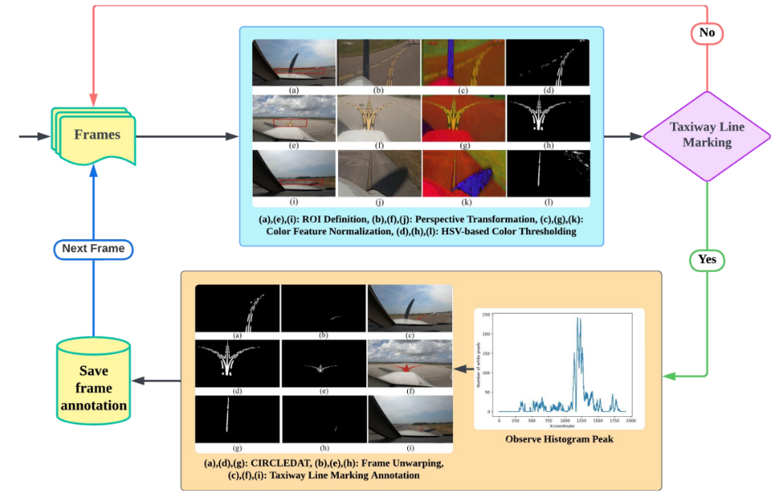
The problem: ALINA has two manual inputs
• ALINA labels taxiway centerlines with a classical CV pipeline; nothing in it learns
• Manual input 1 — where to look: a person clicks a trapezoid ROI on the first frame
• Manual input 2 — what counts as paint: a hand-set HSV range (0, 70, 170)–(255, 255, 255)
• Q3 replaces the ROI with ML; Q4 replaces the colour threshold
• ALINA's own code is never modified: each method plugs in where the manual step was
ALINA pipeline (from the paper)
Automating ALINA with ML: Q3 and Q4 | 2
Notes:
Everything downstream (warp, histogram, CIRCLEDAT traversal, unwarp) is ALINA's own code. Only the two manual inputs are replaced.

Slide 3
Lesson from Q2: the manual ROI is fragile
Video | Tight ROI | Medium ROI | Loose ROI
vidd_1 | 47 / 50 | 28 / 50 | 46 / 50
vidd_2 | 37 / 50 | 38 / 50 | 0 / 50
vidd_3 (curved) | 0 / 50 | 0 / 50 (46 with loosened thresholds) | 0 / 50
• Frames labeled out of 50: ROI size alone swings a video between 47/50 and 0/50
• Every ROI is warped to the same rectangle: a loose ROI makes the line thin and slanted, so no column passes the 200-pixel histogram test
• Design rule carried into Q3: a good ROI makes the line big and vertical in the bird's-eye view
Automating ALINA with ML: Q3 and Q4 | 3
Notes:
Q2 motivated the Q3 design: the problem is not finding the line, it is framing it so ALINA's column histogram can see it.

Slide 4
Q3: Choosing the ROI automatically
Five methods, one shared trapezoid builder

Slide 5
Q3 design: every method only has to find the line
• Each method outputs a line estimate (slope + intercept); a shared trapezoid builder places the ROI
– Line crosses top and bottom edges at the same fraction (0.55) → it comes out exactly vertical after the homography
– Shallow ROI (≈ 6% of frame height) ending just above the aircraft nose → the line fills the warp
• Sanity check + fallback: rejects near-horizontal lines and collapsed trapezoids (one bad vidd_3 ROI once produced 280,665 'line' pixels)
• Two modes: Q3a proposes one ROI on frame 1 and reuses it; Q3b proposes a new ROI on every frame
• Evaluation: ALINA's recall / precision / F1 against CBEM ground truth (vidd_1: 7 frames, vidd_2: 10), frames labeled, ROI time, jitter
Automating ALINA with ML: Q3 and Q4 | 5
Notes:
Separating 'find the line' from 'build the ROI' is what made the comparison fair: all methods get the same Q2-informed geometry.

Slide 6
Q3: the five ROI methods
# | Method | Family | Idea in one line | Why included
M1 | Hough transform | Classical CV | Yellow mask → Canny edges → line voting | Traditional lane finding; fast; the yardstick
M2 | K-means + RANSAC | Unsupervised | 10 colour clusters in Lab; robust line fit through the yellow one | Can colour grouping alone find the paint?
M3 | GPT-5.5 corners | Foundation model | Ask the model for the 4 ROI corners | The 'just ask the model' approach
M4 | GPT-5.5 points | Foundation model + geometry | Model marks 5 centerline points + nose; code builds the ROI | Same model as M3, narrower job
M5 | Ridge regression | Supervised | 32×18 thumbnail → line x at two rows | Simplest learned predictor
Automating ALINA with ML: Q3 and Q4 | 6

Slide 7
Q3 techniques (1/2): classical and unsupervised
M1 Hough transform
M2 K-means + RANSAC
• Plain English: every edge pixel votes for the lines it could lie on; lines with many votes are real
• Line written as ρ = x cos θ + y sin θ; peaks in the (ρ, θ) vote grid are lines
• Probabilistic variant (HoughLinesP) returns segments; keep the steep one nearest the centre
• + no training, 0.04 s, easy to check
• – assumes straight lines
• Plain English: sort pixels into 10 colour groups, call the most yellow one paint, then fit a line that ignores strays
• K-means minimises within-cluster distance (k-means++ start)
• RANSAC: fit to 2 random points, count inliers, keep the best, refit
• + no labels, no hand-set threshold
• – colour alone can't tell which yellow line the aircraft follows
Automating ALINA with ML: Q3 and Q4 | 7

Slide 8
Q3 techniques (2/2): foundation model and supervised
M3 / M4 GPT-5.5 vision-language model
M5 Ridge regression
• Plain English: show the frame with a labelled pixel grid, describe a good ROI, read back JSON
• M3: model gives the 4 corners (whole job)
• M4: model only points at the line + nose; code builds exact corners
• Replies cached in results/q3/proposals/ → reproducible without new API calls
• – 7–37 s per call, costs money, varies between calls
• Plain English: a weighted sum of thumbnail pixels predicts where the line crosses two rows
• Minimises ‖y − Xw‖² + α‖w‖² (L2 penalty keeps weights small)
• Trained leave-one-video-out on the published labels
• – 576 inputs, 2 training videos: it learned where lines usually are, not how to find one (overfitting)
Automating ALINA with ML: Q3 and Q4 | 8

Slide 9
Q3a results: one ROI from the first frame
Video | Method | Frames labeled | CBEM F1 | Published-label F1 | ROI time (s)
vidd_1 | Manual (Q2 medium) | 28 | 23.8 | 46.5 | –
vidd_1 | M1 Hough | 45 | 70.0 | 62.3 | 0.05
vidd_1 | M4 GPT points | 25 | 64.2 | 32.5 | 27.9
vidd_1 | M3 GPT corners | 20 | 13.2 | 5.8 | 28.6
vidd_2 | Manual (Q2 medium) | 38 | 91.6 | 76.7 | –
vidd_2 | M4 GPT points | 39 | 91.3 | 77.5 | 7.0
vidd_2 | M1 Hough | 39 | 83.2 | 68.7 | 0.03
vidd_3 | Manual (Q2 medium) | 0 | – | 0.0 | –
vidd_3 | M1 Hough | 16 | – | 32.8 | 0.04
• vidd_1: 23.8 → 70.0 · vidd_2: matches manual (91.3 vs 91.6) · vidd_3: 0 → 16 frames labeled
Automating ALINA with ML: Q3 and Q4 | 9
Notes:
M2, M3 and M5 rows for vidd_2 and vidd_3 are in the report. On vidd_3 only Hough labels anything with default thresholds.

Slide 10
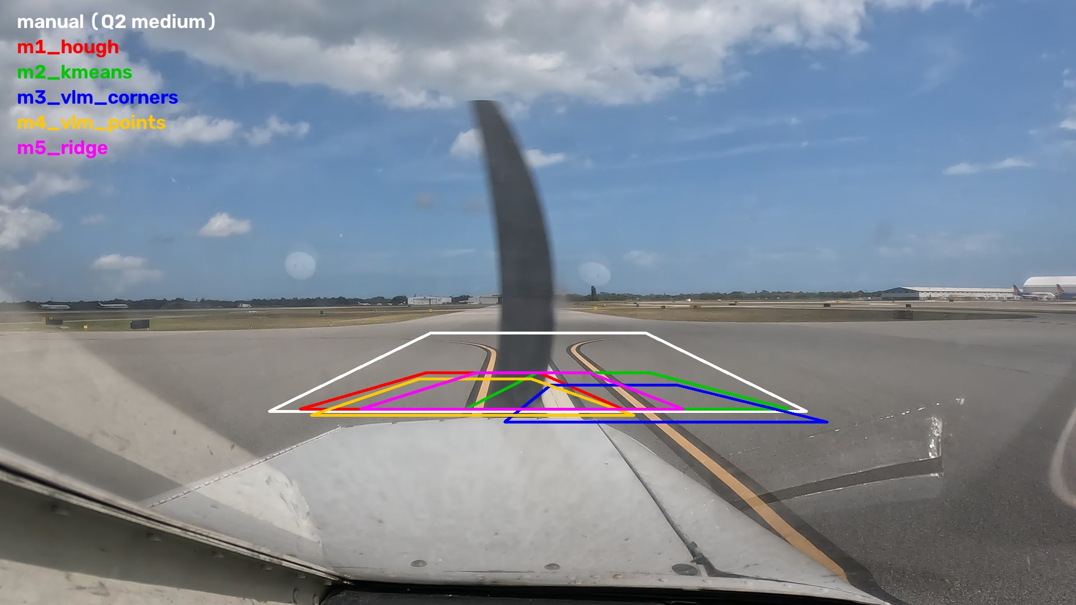
Q3: what the methods proposed on vidd_1
First-frame ROIs of all five methods on vidd_1 (results/q3/overlays/)
Automating ALINA with ML: Q3 and Q4 | 10
Notes:
M2 and M3 centred on vidd_1's other yellow line; the CBEM tracing covers only the left line in 5 of 7 frames.

Slide 11
Q3b results: a new ROI on every frame
Video | Method | Frames labeled (first → every) | CBEM F1 (first → every) | ROI jitter (px)
vidd_1 | M1 Hough | 45 → 47 | 70.0 → 71.5 | 41
vidd_1 | M2 K-means | 20 → 47 | 15.9 → 38.5 | 49
vidd_1 | M3 GPT corners | 20 → 47 | 13.2 → 25.1 | 54
vidd_1 | M5 Ridge | 43 → 32 | 25.0 → 26.5 | 112
vidd_2 | M1 Hough | 39 → 37 | 83.2 → 82.8 | 37
vidd_2 | M4 GPT points | 39 → 40 | 91.3 → 91.0 | 34
vidd_3 | M1 Hough | 16 → 22 | – | 130
vidd_3 | M2 K-means | 0 → 13 | – | 46
vidd_3 | M3 GPT corners | 0 → 26 | – | 209
• Helps when the first ROI was wrong (M2, M3 recover) and on curves (vidd_3)
• No gain for a good ROI on a straight taxiway; amplifies a weak method (Ridge fell back on 35/50 frames)
• For GPT: one paid call (15–36 s) per frame; GPT on curved vidd_3: M3 labels 26 frames, but agrees less with published labels than Hough
Automating ALINA with ML: Q3 and Q4 | 11

Slide 12
Q3 takeaways
• Automating the ROI works: matches the hand-drawn ROI on vidd_2, triples vidd_1, and gets curved vidd_3 labeled at all
• Geometry mattered more than the model: the shared 'big and vertical' trapezoid turned Q2's failures into detections
• Simple beat heavy: cheap Hough lines beat GPT-5.5 overall
• Give a big model a narrow job: GPT pointing at the line 64.2 vs drawing the box 13.2 (vidd_1)
• Per-frame ROI is worth it for curves and scene changes, paired with a sanity check
Automating ALINA with ML: Q3 and Q4 | 12

Slide 13
Q4: Learning the colour threshold
Five ML methods vs. ALINA's hand-set HSV rule

Slide 14
Q4 design: swap only the colour step
• label_frame = ALINA's process_image with the single cv2.inRange call replaced by masks(warped) → (yellow, white)
– With the baseline plugged in, it reproduces ALINA's output pixel for pixel
• Fixed ROI per video (the Q3a Hough ROI), so only the colour step differs between methods
• Training: leave-one-video-out; yellow labels from the published ALINA output (weak labels)
• White labels created here: the dataset has none, so one vidd_1 white stripe was traced by hand, CBEM-style (3 train / 5 test frames)
• Two scores: end-to-end ALINA F1 vs CBEM, and pixel-level mask IoU / F1 (yellow vs filled CBEM, white vs traced stripe) + false-white rate
Automating ALINA with ML: Q3 and Q4 | 14

Slide 15
Q4: the methods
# | Method | Family | Idea in one line | Why included
0 | Hand-set HSV range | Rule (baseline) | S ≥ 70 and V ≥ 170 = paint; no white rule | The step being replaced
1 | Otsu per frame | Unsupervised | Best 2-group cut of S and V, recomputed every frame | Simplest data-driven threshold
2 | Gaussian mixture | Unsupervised clustering | 5 colour blobs in Lab; name the yellow and white ones | Handles several materials
3 | Decision tree (depth 3) | Supervised | Learned yes/no questions = explicit inRange boxes | True drop-in replacement, readable
4 | Logistic regression | Supervised, linear | Weighted colour score per class (slanted boundary) | Standard simple baseline
5 | MLP (32-16) + context | Neural network | Pixel colour + 5×5 / 15×15 neighbourhood features | Sees shape as well as colour; stands in for a CNN
Automating ALINA with ML: Q3 and Q4 | 15

Slide 16
Q4 techniques (1/2): unsupervised, per frame
Otsu's method
Gaussian mixture model (GMM)
• Plain English: pick the cut that best splits a histogram into two tight groups
• Maximises between-class variance ω₀ω₁(μ₀ − μ₁)²
• + no labels; adapts to every frame's lighting
• – always returns a cut, even with one material → 30% false white on plain road
• Plain English: assume a few colour blobs (road, grass, yellow, white, shadow); find them; name them
• Fitted with Expectation-Maximisation; soft membership, tilted clusters
• Works in Lab (b* axis separates yellow)
• – always finds its K groups; ≈ 1 s per frame
Automating ALINA with ML: Q3 and Q4 | 16

Slide 17
Q4 techniques (2/2): supervised
Decision tree · Logistic regression
Neural network (MLP) with context
• Tree: flowchart of yes/no splits chosen to reduce Gini impurity; depth 3 keeps it readable
– Each leaf is literally a cv2.inRange box → pastes into ALINA
• LogReg: softmax over weighted colour scores; balanced class weights
– Slanted boundary, but still linear → misread sunlit yellow as white
• Plain English: layers of simple units learn curved boundaries
• 20 inputs → 32 → 16 → 3 classes; ReLU, Adam, early stopping
• Context features: neighbourhood means (5×5, 15×15) + local brightness spread
– Tells a thin bright stripe (paint) from a large bright area (aircraft nose)
• CNN not possible: no PyTorch on this Intel Mac
Automating ALINA with ML: Q3 and Q4 | 17

Slide 18
Q4 results: mask quality (pixel level)
Method | Yellow IoU | Yellow F1 | White IoU | White F1 | False white (% of ROI)
Baseline HSV | 0.793 | 0.884 | 0 | 0 | 0
M1 Otsu | 0.790 | 0.883 | 0.542 | 0.703 | 30.05
M2 GMM | 0.686 | 0.814 | 0.871 | 0.931 | 1.63
M3 Tree | 0.820 | 0.901 | 0.923 | 0.960 | 0.05
M4 LogReg | 0.661 | 0.796 | 0.618 | 0.764 | 0.34
M5 MLP | 0.831 | 0.907 | 0.967 | 0.983 | 0.01
• Learned methods make better masks and find white paint (baseline white F1 = 0)
• The MLP is best on both colours, with almost no false white
Automating ALINA with ML: Q3 and Q4 | 18

Slide 19
Q4 results: end to end through ALINA
Method | vidd_1 R / P / F1 | vidd_2 R / P / F1 | Frames labeled (v1 / v2 / v3) | Colour step (ms)
Baseline HSV | 59.1 / 96.0 / 70.0 | 78.3 / 88.9 / 83.2 | 45 / 39 / 16 | 23–28
M1 Otsu | 52.6 / 99.4 / 66.2 | 78.3 / 83.7 / 80.8 | 43 / 29 / 2 | 58–83
M2 GMM | 52.5 / 99.5 / 66.0 | 79.6 / 62.1 / 67.5 | 44 / 34 / 19 | 1,117–1,740
M3 Tree | 54.2 / 99.2 / 67.6 | 81.0 / 41.3 / 54.6 | 45 / 48 / 35 | 114–132
M4 LogReg | 16.0 / 42.9 / 22.1 | 79.2 / 81.4 / 80.2 | 29 / 41 / 35 | 298–347
M5 MLP | 53.9 / 98.5 / 67.0 | 81.0 / 82.8 / 81.9 | 44 / 39 / 18 | 1,380–1,612
• A better mask is not always a better label: the hand-set yellow rule still wins end to end on vidd_1 / vidd_2
• Learned thresholds help most where the rule struggles: dim, curved vidd_3 → 35 vs 16 frames labeled
Automating ALINA with ML: Q3 and Q4 | 19

Slide 20
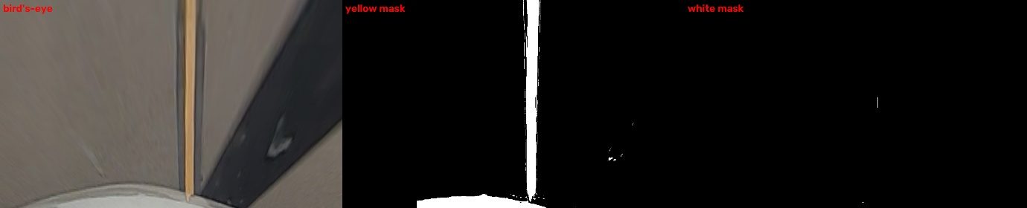
Why a better mask can give a worse label
• ALINA keeps everything connected to the histogram peak (CIRCLEDAT)
• The tree's yellow mask on vidd_2 is good (F1 0.899), but one learned box also covers the cream aircraft nose
• The nose touches the line → the traversal pulls it in → precision falls to 41%
• Logistic regression, trained on overcast videos, called the pale sunlit yellow of vidd_1 'white' (F1 22.1)
• Lesson: one wrong blob touching the line costs more than many small errors
Decision tree on vidd_2: bird's-eye | yellow mask | white mask
Automating ALINA with ML: Q3 and Q4 | 20

Slide 21
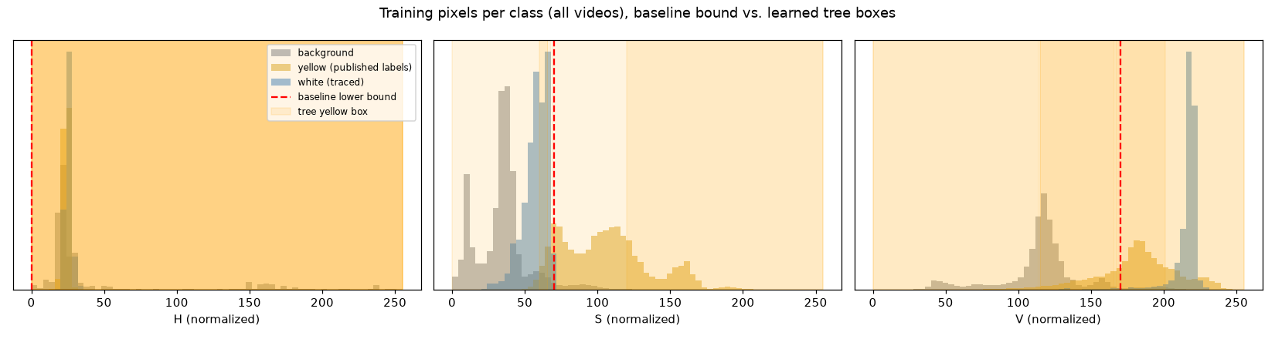
What the models learned about colour
• Hue is useless after ALINA's min-max normalisation: paint and pavement share hue ≈ 25
• Saturation does the work: every learned rule converges on S ≈ 59–71 (hand-set: 70)
• The tree lowers the brightness cut to V ≥ 115–140 (hand-set: 170)
• It adds a white rule the baseline lacks: S ≤ ~66–70, V ≥ ~191–205
Normalised HSV histograms: paint vs pavement
Automating ALINA with ML: Q3 and Q4 | 21

Slide 22
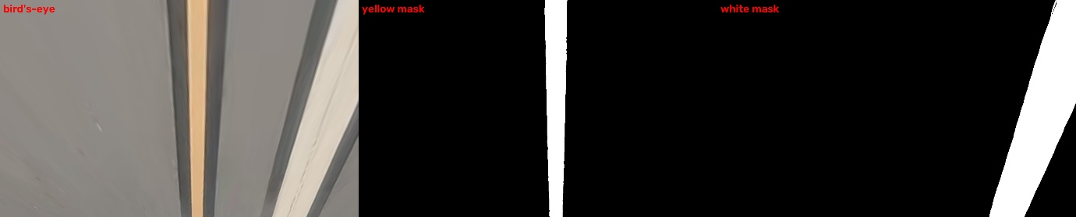
Q4: the best masks (MLP, vidd_1)
MLP on vidd_1 frame 00002: bird's-eye | yellow mask | white mask
Automating ALINA with ML: Q3 and Q4 | 22

Slide 23
Results across questions
Speed, best method per question, follow-up experiments

Slide 24
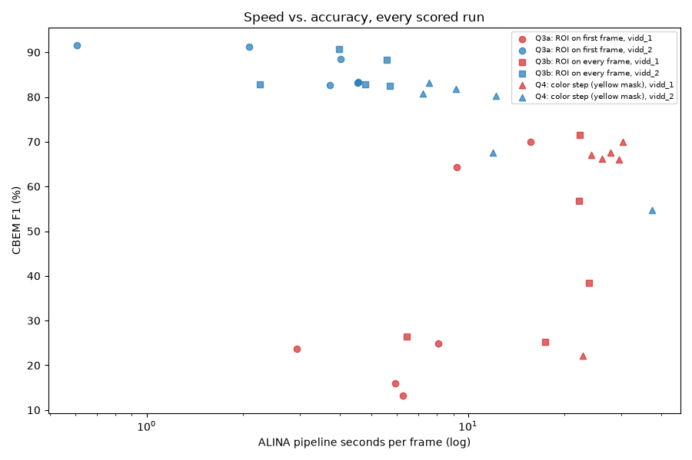
Speed vs accuracy
ROI proposal: < 0.4 s classical / supervised, 7–37 s GPT-5.5 · Colour step: 25 ms to 1.7 s · ALINA's pure-Python CIRCLEDAT dominates (1–37 s per frame)
Automating ALINA with ML: Q3 and Q4 | 24

Slide 25
Best method per question
Question | Best method | vidd_1 CBEM F1 | vidd_2 CBEM F1 | vidd_3 frames labeled
Q2 manual ROI | Medium ROI | 23.8 | 91.6 | 0
Q3a first-frame ROI | M1 Hough (v1, v3), M4 GPT points (v2) | 70.0 | 91.3 | 16
Q3b every-frame ROI | M1 Hough | 71.5 | 82.8 | 22
Q4 colour step | MLP (masks), tree (explicit thresholds); hand-set rule best end to end | 70.0 / 67.0 | 83.2 / 81.9 | 35 (tree)
Automating ALINA with ML: Q3 and Q4 | 25

Slide 26
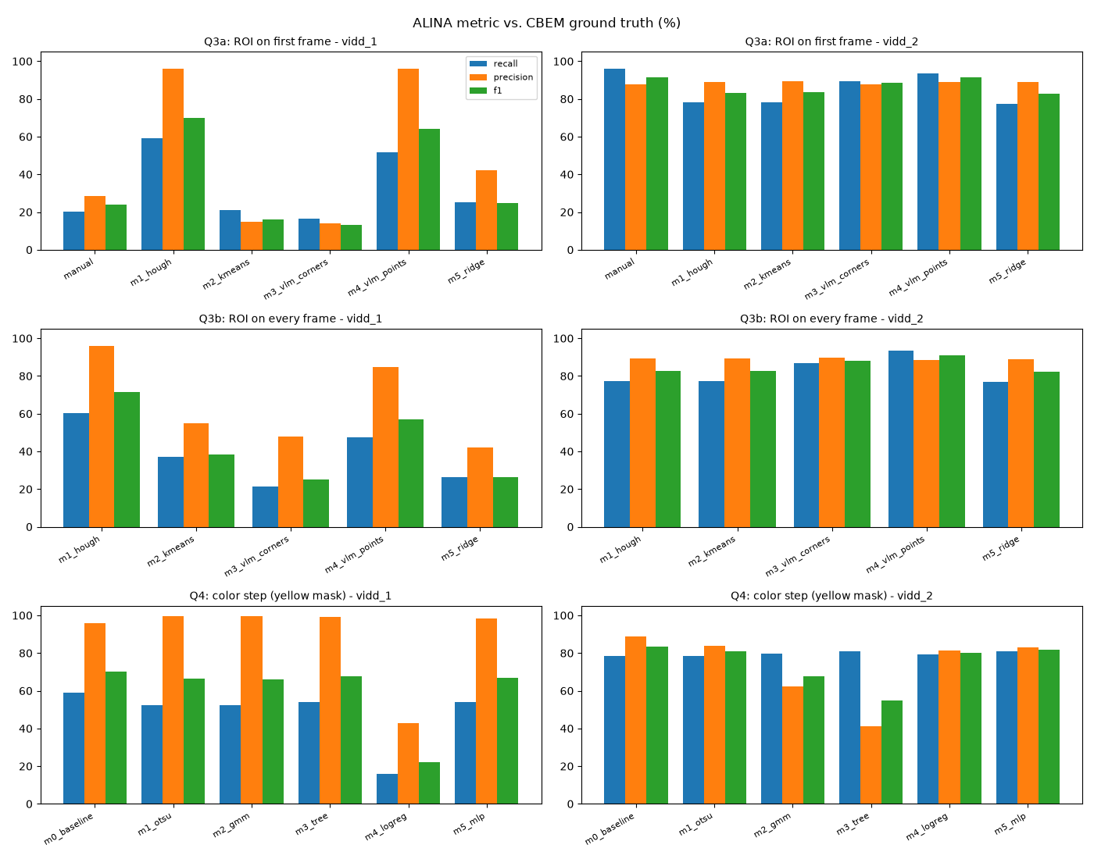
F1 by question and method
results/summary/f1_bars.png
Automating ALINA with ML: Q3 and Q4 | 26

Slide 27
Fast follow-up: five more colour ideas (mask quality)
Method | Yellow F1 | White F1 | False white % | Mask ms / frame | Train s
m0 baseline (re-run) | 0.884 | 0.000 | 0.00 | 13 | 0
m5 MLP (re-run, best in Q4) | 0.907 | 0.983 | 0.01 | 1009 | 41
Random forest | 0.902 | 0.984 | 0.00 | 1525 | 13
Gradient boosting (untuned) | 0.546 | 0.868 | 3.65 | 2005 | 4
Gaussian naive Bayes | 0.876 | 0.982 | 0.00 | 227 | 0.1
MLP + 3×3 opening | 0.908 | 0.983 | 0.01 | 921 | 43
CLAHE + hand-set rule | 0.886 | 0.000 | 0.00 | 25 | 0
• Same frames, ROI, training data and seed as Q4; re-runs match Q4 exactly. None clearly beats the MLP
• Limits are the labels (one white stripe) and the ROI (straight lines on curved vidd_3), not the classifier
Automating ALINA with ML: Q3 and Q4 | 27
Notes:
uv run python -m experiments.q4_fast_ideas — about 3.5 minutes on the laptop CPU. Mask-only test; end-to-end scores not measured.

Slide 28
A note on the metric: ALINA's F1 is generous
Metric on the paper's 120 validation frames | F1
ALINA formula: sets of x values and sets of y values, averaged | 95.2
Exact pixel match | 28.8
Pixel match within 3 px | 87.4
• ALINA counts a predicted x as correct if any true pixel has that x, at any height; duplicates collapse; missing files are skipped
• It measures coverage (right rows and columns), not exact placement
• This project kept ALINA's metric for comparability, but scored empty frames as 0 and added pixel-level IoU / F1
Automating ALINA with ML: Q3 and Q4 | 28
Notes:
experiments/metric_comparison.py. The ALINA column reproduces `alina evaluate` (F1 95.17).

Slide 29
Conclusions and recommendations
• The ROI matters most, and simple ideas used well beat heavy models
• Q3 (where to look): the big gains — vidd_1 23.8 → 70.0, vidd_3 from no labels to 16–22 frames — from cheap Hough lines + Q2's geometry
• Q4 (what counts as paint): smaller, specific gains — white-line detection, better masks, more coverage on dim footage
• Recommended setup:
– Hough-based automatic ROI, re-estimated per frame on curvy taxiways
– Hand-set yellow rule + the decision tree's white box
– MLP for footage whose lighting differs from the training data
Automating ALINA with ML: Q3 and Q4 | 29

Slide 30
Limitations and next steps
Limitations
Next steps
• Only 17 ground-truth frames; none for vidd_3
• Weak training labels (authors' ALINA output)
• White labels from one stripe in one video
• One run per method (GPT run-to-run variance not measured)
• No CNN (no PyTorch); lenient ALINA metric
• CBEM ground truth for vidd_3 and more white-paint frames
• Train colour models with the aircraft nose as background
• Shape check before CIRCLEDAT so blobs touching the line aren't traced
• Curved (polynomial) RANSAC and ROI tracking across frames
• Small CNN / U-Net once PyTorch is available
Automating ALINA with ML: Q3 and Q4 | 30

Slide 31
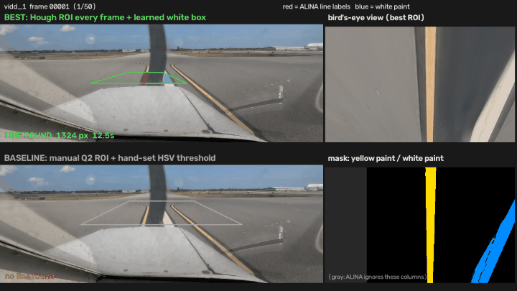
Resources
• Code and write-ups: https://github.com/hatemphd/ALINA
• Report: assignment/REPORT.md · Summary: assignment/Q3_Q4_Summary.md
• Study guide: assignment/ML_review_ideation.md
• Full experiment data (Google Drive): https://drive.google.com/file/d/1iIszTUjEguX2ebVMos0Et96VCIEvwA0y/view?usp=sharing
• Demo video: results/demo/alina_best_method.mp4
Demo: best pipeline vs manual ROI
Automating ALINA with ML: Q3 and Q4 | 31

