Slide 1

Database Modeling Techniques
E-R Diagrams
Dependency
Constraints over Relations

Slide 2

Modeling is simplified version of real-life complex objects.
The Entity-Relationship (E-R) model is a very popular modeling tool.
The E-R model provides
An excellent communication tool.
A simple graphical representation of a database.

Slide 3

An entity (or entity set) is represented by a rectangle. The name of the entity is written within the rectangle in a singular upper-case noun. For example, EMPLOYEE, STUDENT, COURSE.
The relationship between two entity sets is represented in a diamond-shaped box. The name of relationship is an active verb in lower-case. For example, supervises.
The types of relationship is called connectivity.
The lower and upper limit of relationship is called cardinality.
The optional relationship is shown with a small circle next to the optional entity.
The decomposition of a M:N relationship into two 1:M relationships involves a third composite entity, which is shown with a diamond in a rectangle.
The weak entities, which cannot exist by themselves, are shown with double-lined rectangles.

Slide 4

Simple Attribute.
Attribute that cannot be subdivided. For example, city, gender, or last name.
Composite Attribute.
Attribute that can be sub divided. For example, name or mailing address.
Single-valued Attribute.
Attribute with a single-value per entity. For example, first name or employee number.
Multi-valued Attribute.
Attribute with multiple values per entity. For example, student’s courses.

Slide 5

InvNo
InvDate
CustNo
ItemNo
Cust
Name
Item
Name
Item
Price
Qty
1001
04/14/00
212
1
Starks
Screw
$2.25
5
3
Bolt
$3.99
5
5
Washer
$1.99
9
1002
04/17/00
225
1
Connors
Screw
$2.25
2
2
Nut
$5.00
3
1003
04/17/00
239
1
Kapur
Screw
$2.25
7
2
Nut
$5.00
1
1004
04/18/00
211
4
Garcia
Hammer
$9.99
5

Slide 6

The primary key describes an entity.
The non-key attributes are functionally dependent on the primary key attribute(s).
Types of Dependencies
Total – a non-key attribute is totally dependent on primary key attributes.
Partial – a non-key attribute is dependent on part of the primary key.
Transitive – a non-key attribute is dependent on another non-key attribute.

Slide 7
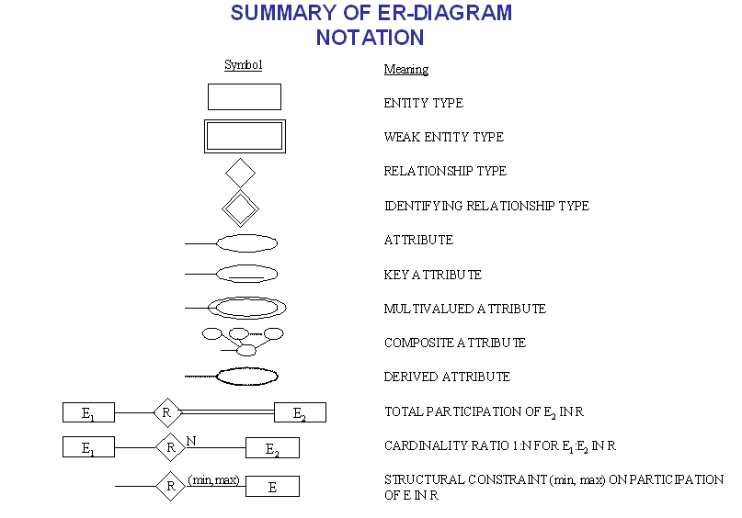

Slide 8
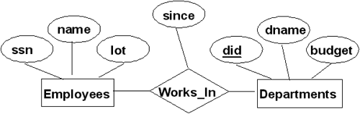
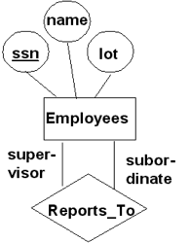

Slide 9
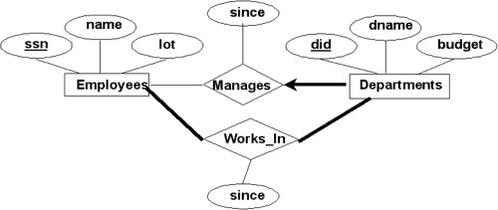

Slide 10
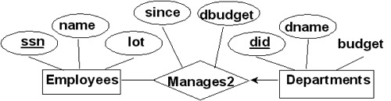
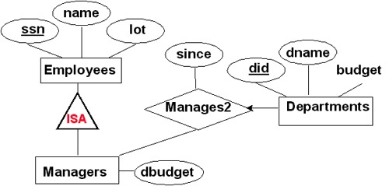

Slide 11
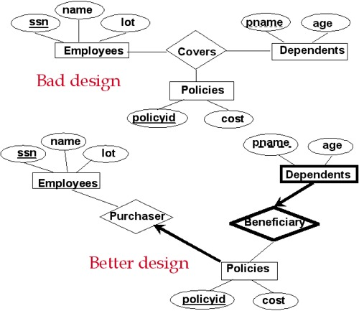

Slide 12
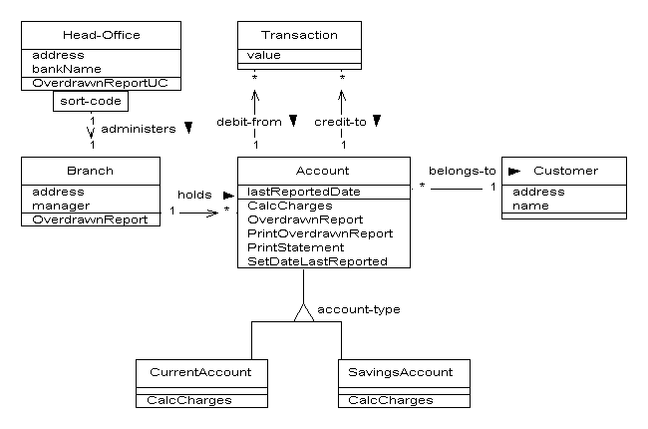

Slide 13
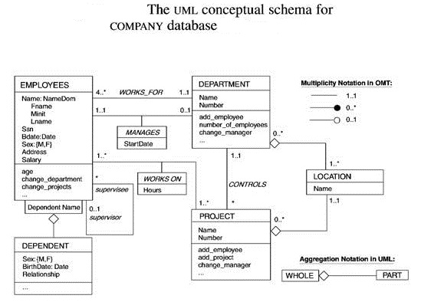

Slide 14
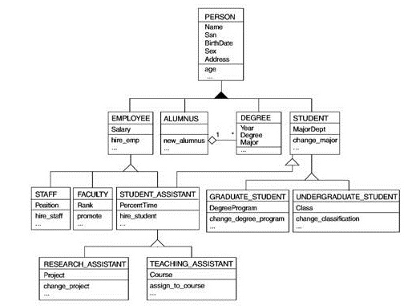

Slide 15

Constraints enforce rules. Without constraints no rules are enforced.
Constraints make a database a true relational database.
A legal instance of a relation - an instance that satisfies all specified constraints
Types of constraints:
  Integrity constraints (IC) - Entity IC and Referential IC
    condition that must be true for any instance of the database
    specified when the schema is defined
    checked when relations are modified
    define the primary key and the foreign keys with the table it references.
  Value constraints - define if NULL values are allowed, if UNIQUE values are required, and if only certain values are allowed in an attribute.

Slide 16
Constraint creation: A constraint can be created at the same time when the table is created ("column level" or "table level"), or it can be added to the table afterward .
column level - defined along with the definition of a column
Column datatype [CONSTRAINT constraint_name] constraint_type,
e.g., DeptId NUMBER(2) CONSTRAINT dept_deptid_pk PRIMARY KEY,
DeptId NUMBER(2) PRIMARY KEY,
table level - defined after all columns are defined
[CONSTRAINT constraint_name] constraint_type,
e.g., CONSTRAINT dept_deptid_pk PRIMARY KEY (DeptId),
PRIMARY KEY (DeptId),

Slide 17

Primary Key Constraints (or Entity Integrity Constraints)
No two distinct tuples can have same values in all key fields
Entity Integrity Constraint - no primary key value can be null.
a superkey - a set of fields that contains a key.
e.g., {sid} - primary key; {sid, gpa} - superkey
CONSTRAINT Students_sid_pk PRIMARY KEY (sid),
CONSTRAINT dependent_emp_dep_pk PRIMARY KEY (EmployeeId, DependentId),

Slide 18

If there exist many candidate keys, one of them should be chosen as the primary key.
Candidate keys can be specified using UNIQUE
e.g.,
CREATE TABLE Enrolled (sid CHAR(20), cid CHAR(20), grade CHAR(2),
PRIMARY KEY (sid, cid));
CREATE TABLE Enrolled (sid CHAR(20), cid CHAR(20), grade CHAR(2),
PRIMARY KEY (sid), UNIQUE(cid,grade));
CREATE TABLE Students (sid CHAR(20), name CHAR(30), login CHAR(20), age INTEGER,
gpa REAL, UNIQUE(name,age), CONSTRAINT StudentKey PRIMARY KEY (sid));

Slide 19
Foreign Key
A set of fields in one relation that is used to "refer" to a tuple in another relation (i.e., a logical pointer)
used to link among different relations
constraint: A foreign key must correspond to a primary key of the referenced relation
If all foreign key constraints are enforced, referential integrity is achieved, i.e., no dangling references.
e.g., "Only students listed in the Students relation should be allowed to enroll for courses.“
CREATE TABLE Enrolled (sid CHAR(20), cid CHAR(20), grade CHAR(2),
PRIMARY KEY (sid, cid), FOREIGN KEY(sid) REFERENCES Students);

Slide 20

Students); What if an Enrolled tuple with a non-existent sid is inserted?
What should be done when a Students tuple is deleted?
What happens when a Students tuple is updated on its primary key?

Slide 21
Students); What if an Enrolled tuple with a non-existent sid is inserted?
  Reject!
What should be done when a Students tuple is deleted?
What happens when a Students tuple is updated on its primary key?
  Choose among these options:
  Delete all Enrolled tuples that refer to it.
  Disallow deletion of a Students tuple that is referred to.
  Set sid in Enrolled tuples that refer to it to a default sid.
  (In SQL) Set sid in Enrolled tuples that refer to it to a NULL value meaning "unknown" or "inapplicable".

Slide 22
Students); What if an Enrolled tuple with a non-existent sid is inserted?
  Reject!
What should be done when a Students tuple is deleted?
What happens when a Students tuple is updated on its primary key?
Since SQL/92 and SQL/1999, all 4 options are supported:
  use CASCADE
  use NO ACTION - default option [ action (delete/update) is rejected]
  use SET DEFAULT (set foreign key value of referencing tuple)
  use SET NULL

Slide 23
e.g., CREATE TABLE Enrolled (sid CHAR(20), cid CHAR(20), grade CHAR(2),
PRIMARY KEY(sid, cid),
FOREIGN KEY(sid) REFERENCES Students
ON DELETE CASCADE
ON UPDATE NO ACTION)
meaning:
If a Students tuple is deleted, all Enrolled tuples that refer to it are to be deleted also.
If a Students tuple is updated on its sid attribute, this update will be rejected.
e.g., CREATE TABLE Enrolled (sid CHAR(20) DEFAULT '53666',
cid CHAR(20), grade CHAR(2),
PRIMARY KEY(sid, cid),
FOREIGN KEY(sid) REFERENCES Students
ON DELETE SET DEFAULT
ON UPDATE CASCADE)
meaning:
If a Students tuple is deleted, set the sid attribute in all Enrolled tuples that refer to it to the default value defined. (It makes more sense to use this option on a non-primary key attribute)
If a Students tuple is updated on its sid attribute, this update is also carried out in each Enrolled tuple that refers to the updated Students tuple.

Slide 24
When does a DBMS check and enforce the constraints?
A transaction
  a program that runs against a database
  may contain several statements (or commands)
When?
  at the end of each statement or
  at the end of the transaction?
By default, approach 1 is used.
Approach 2 provides great flexibility, but how?
  To set a constraint to be in DEFERRED mode - checking at COMMIT time
  e.g., SET CONSTRAINT constraint_name DEFERRED;

