Slide 1
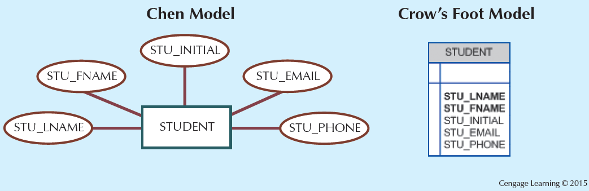
The Attributes of the Student Entity:
Chen and Crow’s Foot

Slide 2
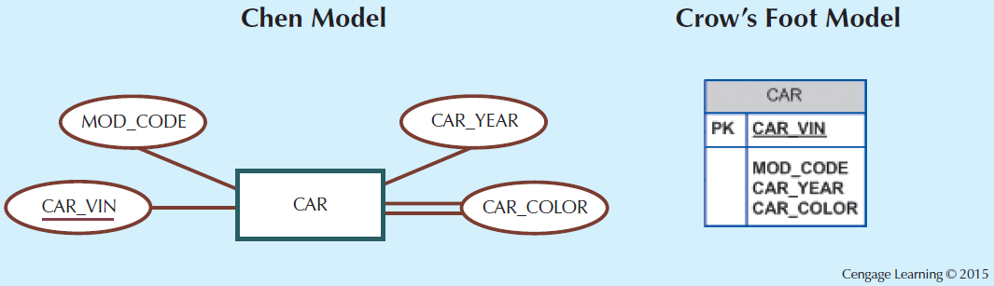
A Multivalued Attribute in an Entity

Slide 3
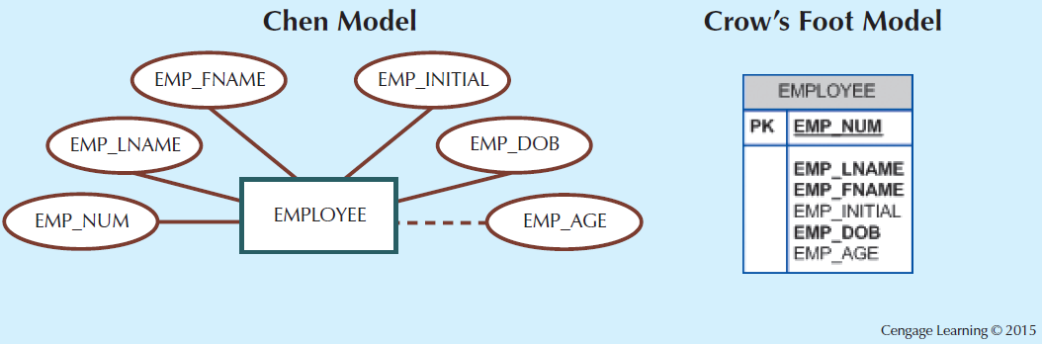
Depiction of a Derived Attribute

Slide 4
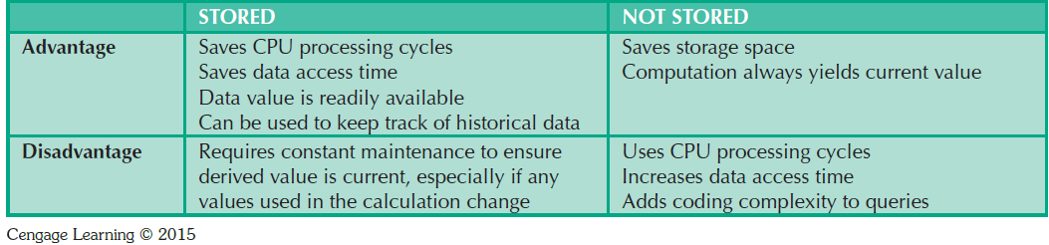
Advantages and Disadvantages of Storing Derived Attributes

Slide 5
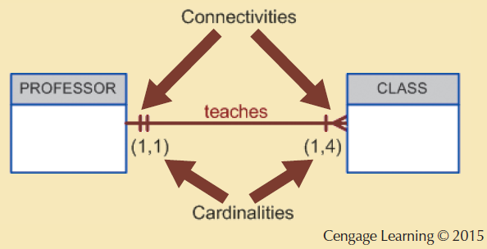
Connectivity and Cardinality in an ERD

Slide 6
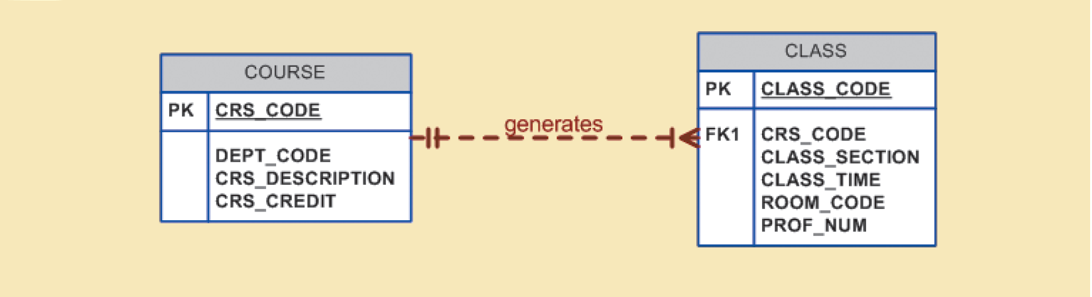
A Weak (Non-Identifying) Relationship between COURSE and CLASS
Cengage Learning © 2015

Slide 7
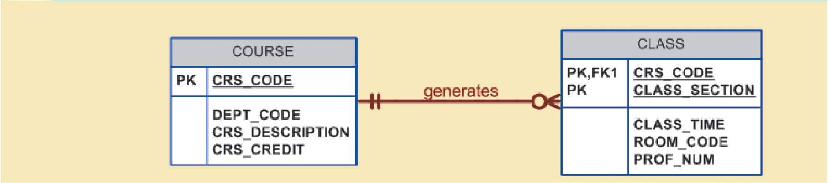
A Strong (Identifying) Relationship between COURSE and CLASS
Cengage Learning © 2015

Slide 8
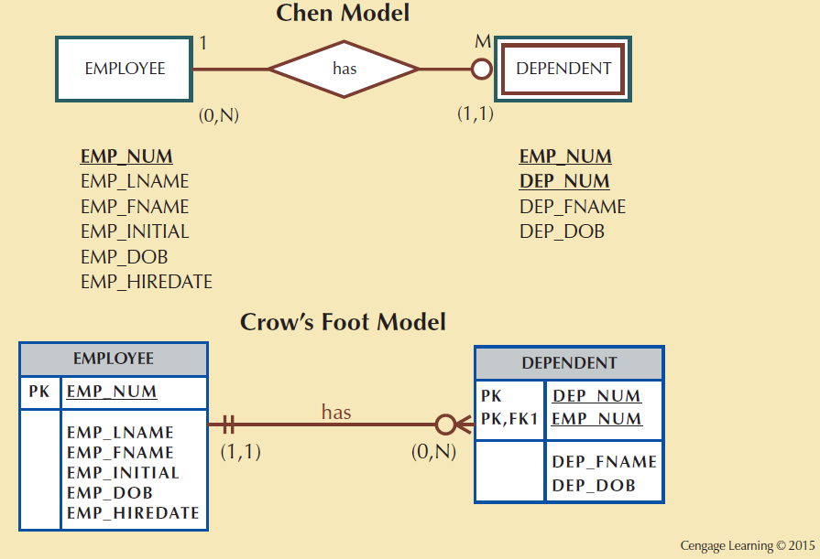
A Weak Entity in an ERD

Slide 9
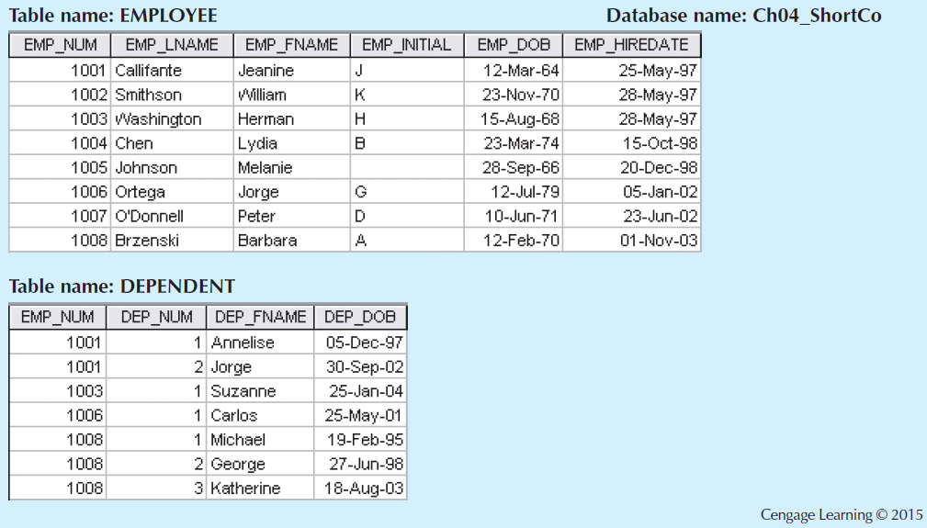
A Weak Entity in a Strong Relationship

Slide 10
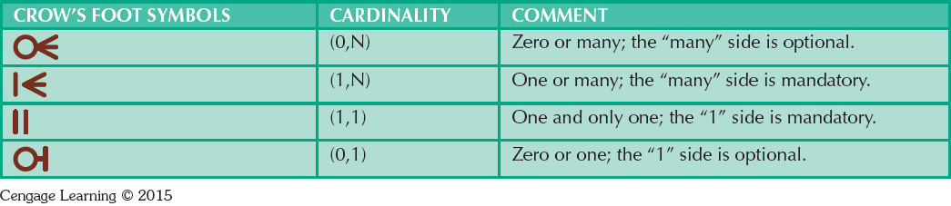
Crow’s Foot Symbols

Slide 11
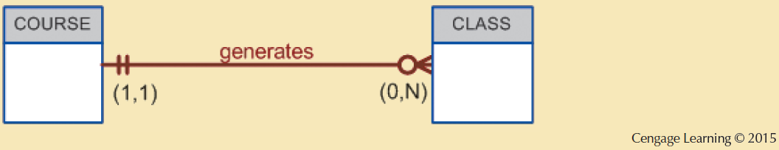
CLASS is Optional to COURSE

Slide 12
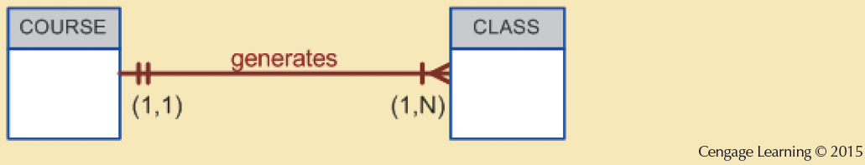
COURSE and CLASS in a Mandatory Relationship

Slide 13
Relationship Degree
Indicates the number of entities or participants associated with a relationship
Unary relationship: Association is maintained within a single entity
  Recursive relationship: Relationship exists between occurrences of the same entity set
Binary relationship: Two entities are associated
Ternary relationship: Three entities are associated

Slide 14
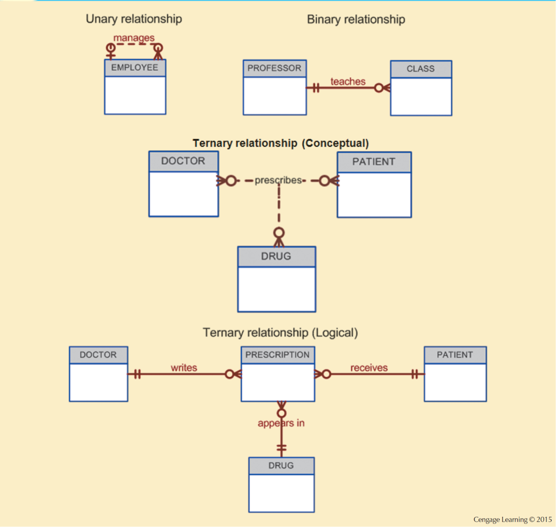
Three Types of Relationship Degree

Slide 15
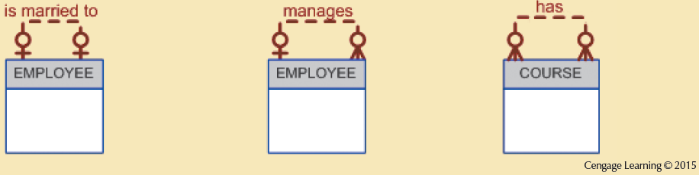
An ER Representation of Recursive Relationships

Slide 16
Associative Entities
Also known as composite or bridge entities
Used to represent an M:N relationship between two or more entities
Is in a 1:M relationship with the parent entities
  Composed of the primary key attributes of each parent entity
May also contain additional attributes that play no role in connective process

Slide 17
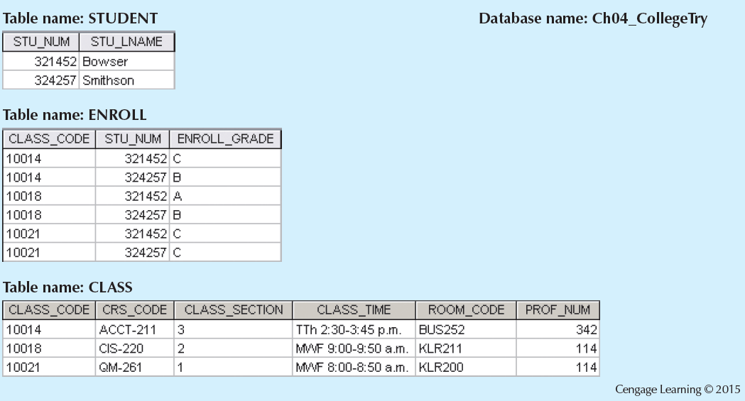
Converting the M:N Relationship into Two 1:M Relationships

Slide 18
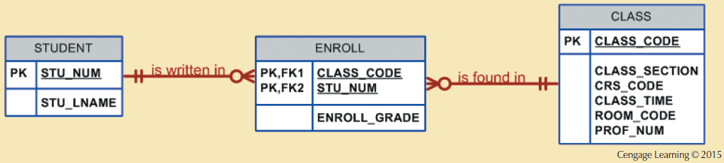
A Composite Entity in an ERD

Slide 19
Developing an ER Diagram
Create a detailed narrative of the organization’s description of operations
Identify business rules based on the descriptions
Identify main entities and relationships from the business rules
Develop the initial ERD
Identify the attributes and primary keys that adequately describe entities
Revise and review ERD

Slide 20
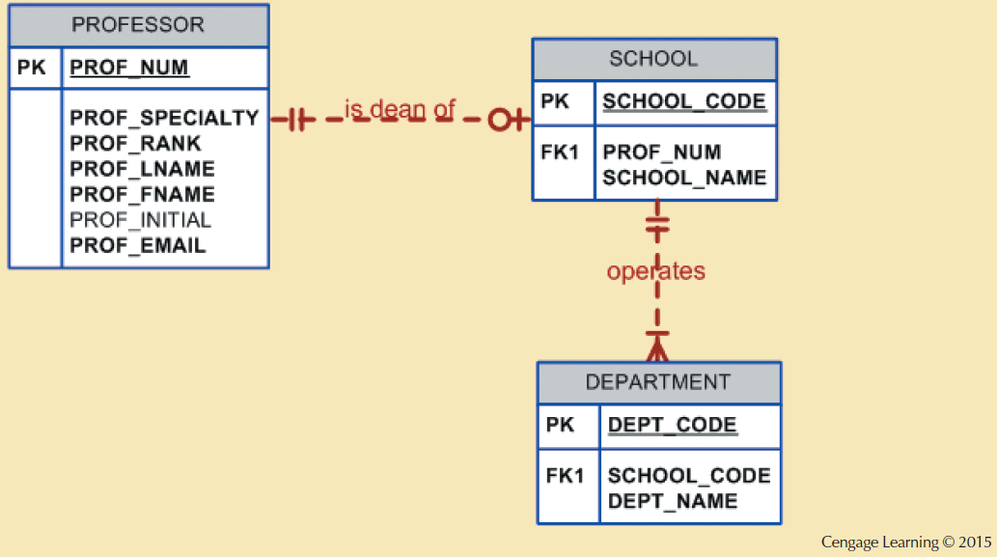
The First Tiny College ERD Segment

Slide 21
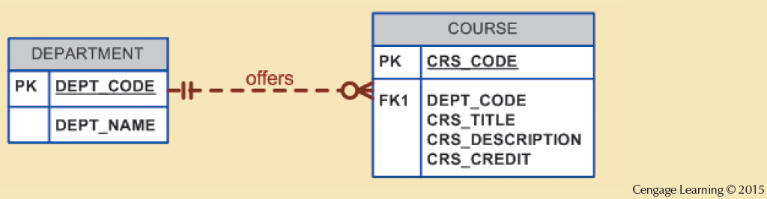
The Second Tiny College ERD Segment

Slide 22
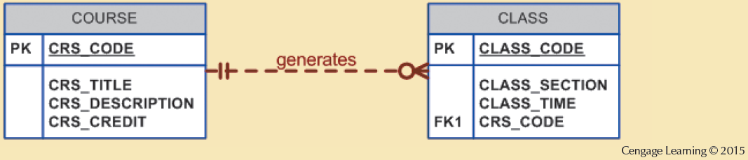
The Third Tiny College ERD Segment

Slide 23
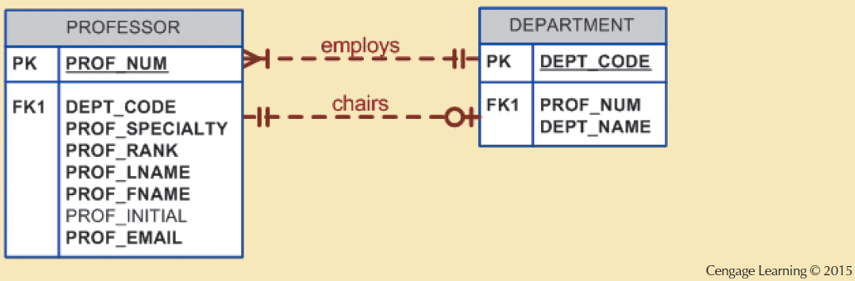
The Fourth Tiny College ERD Segment

Slide 24
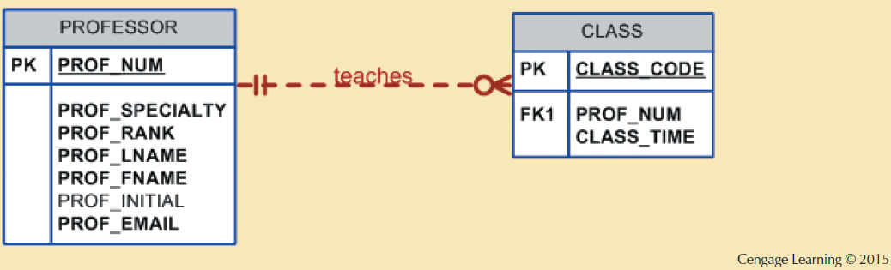
The Fifth Tiny College ERD Segment

Slide 25
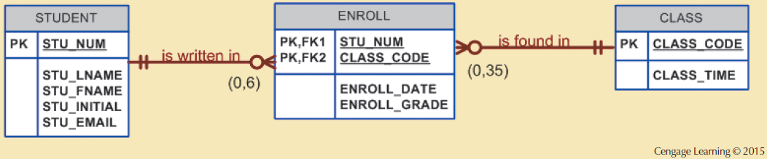
The Sixth Tiny College ERD Segment

Slide 26
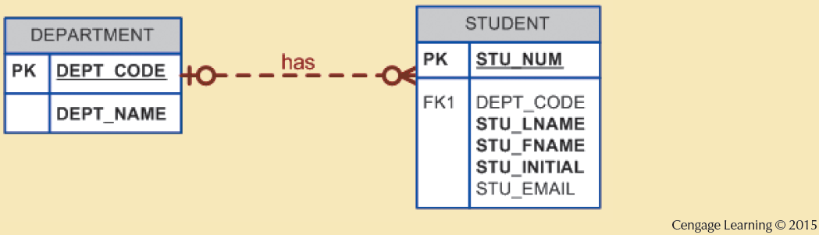
The Seventh Tiny College ERD Segment

Slide 27
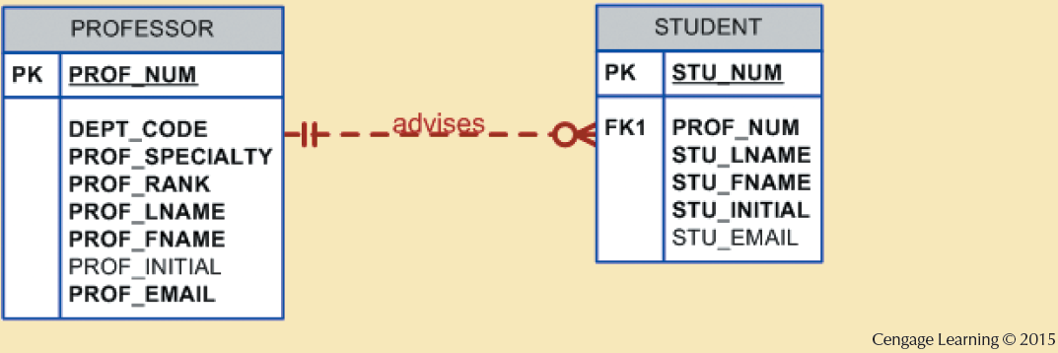
The Eighth Tiny College ERD Segment

Slide 28
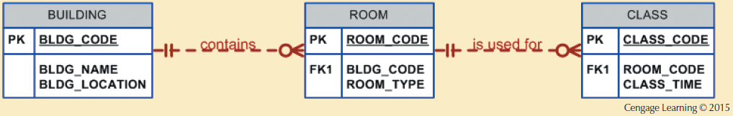
The Ninth Tiny College ERD Segment

Slide 29
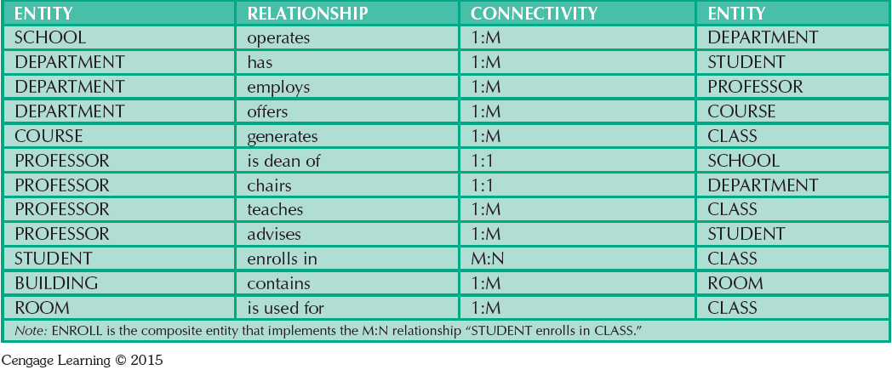
Components of the ERM

Slide 30
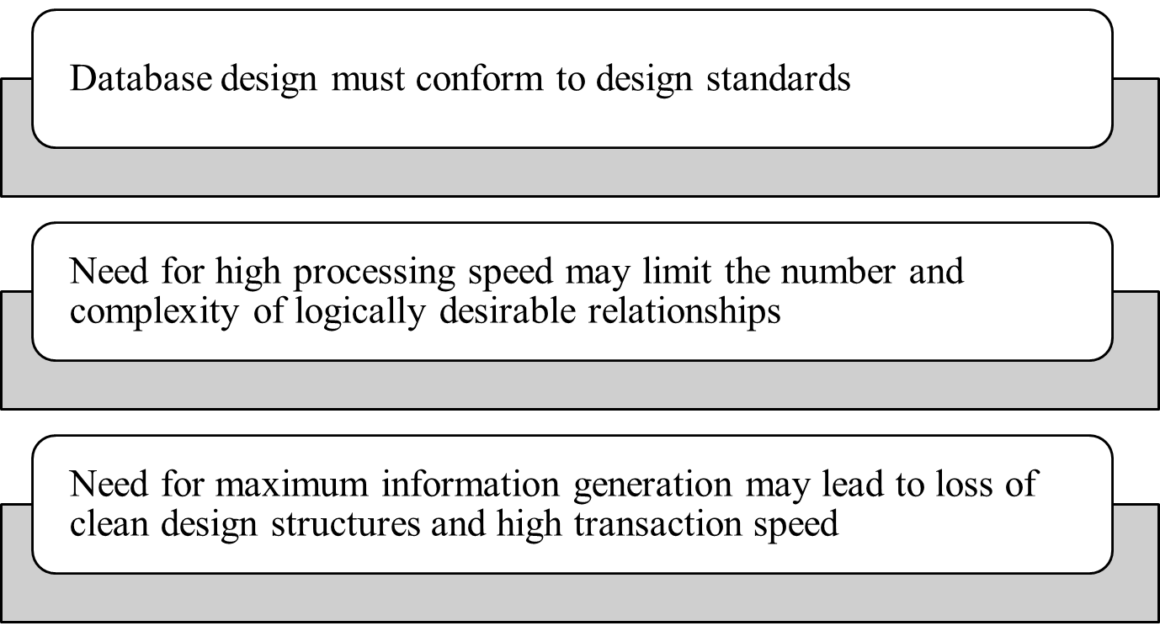
Database Design Challenges:
Conflicting Goals

Slide 31
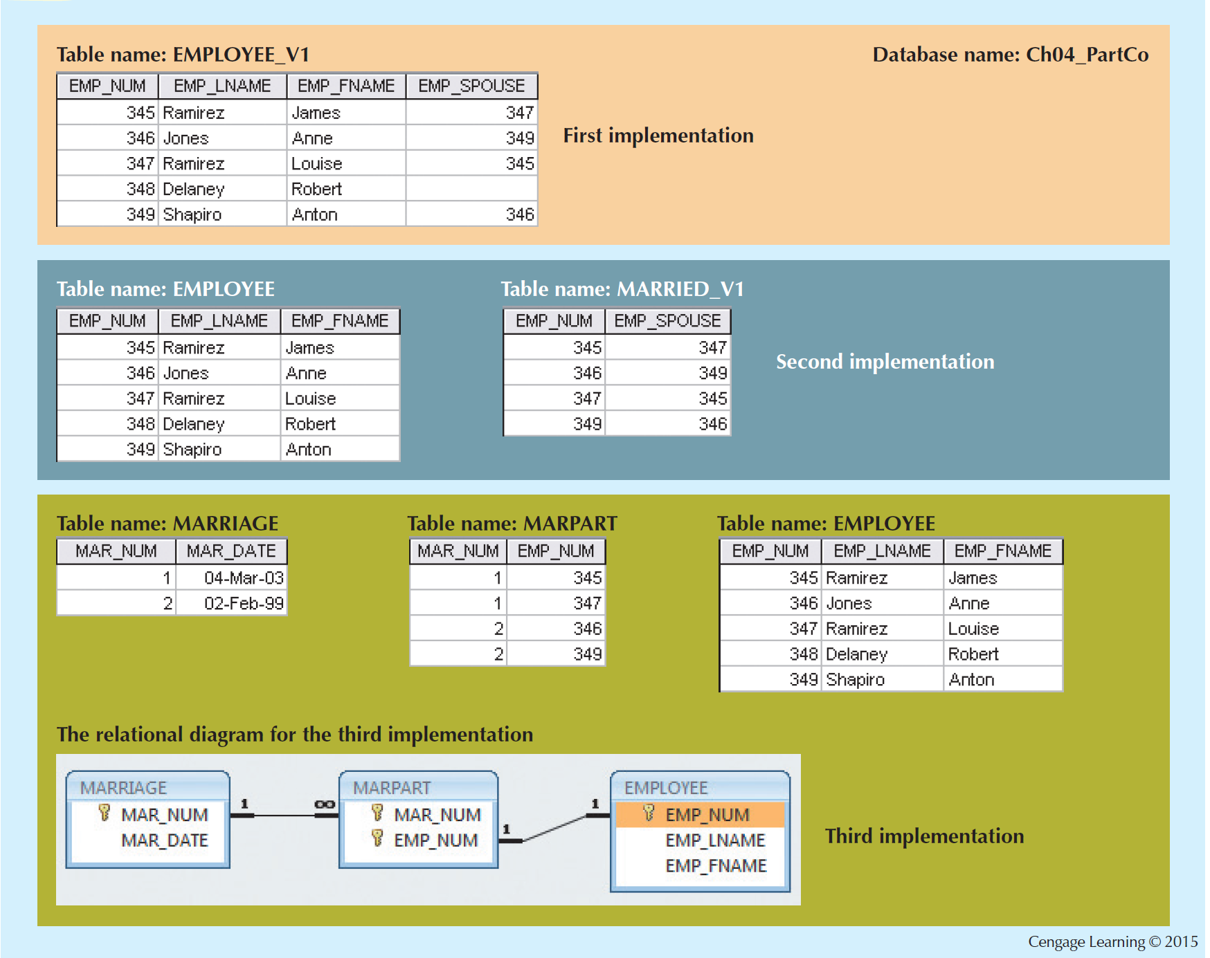
Various Implementations of the 1:1 Recursive Relationship

