Slide 1

Translating an ER/EER Diagram to a Relational Database Schema
Normal forms and Normalization
  Verification of correct and “good” schema

Slide 2
Map (Strong) Entity Sets
Map Weak Entity Sets (draw PK from parent/strong entity)
Map Relationship Sets
  1:1 => options for setting up 1, 2, or 3 relations
  1:M => M-side provides a key to the 1-side
  N:M => new relation needs to be created

Slide 3
Map multivalued attributes
  a new relation per each multivalued attribute
Map higher order relationship (ternary, 4-way, etc.)
  each higher order relationship becomes separate relations
Map of generalization hierarchies and set-subset relationships
  collapsing into one relation, or
  as many relations as the # of distinct classes

Slide 4

1
M
Customers
makes
Orders
M
N
provides
Products
1
M
1
Customers
makes
Orders
Vendors
M
M
N
provides
Products
contains
1
Vendors

Slide 5

An entity set can be mapped to a relation in a straightforward way.
Need: domain of each attribute; PK for each entity set
Customers (cust_id, cust_name, cust_address, cust_city, cust_state, cust_zip,
cust_country, cust_contact, cust_email)
Products (prod_id, prod_name, prod_price, prod_desc)
Orders (order_num, order_date)
Vendors (vend_id, vend_name, vend_address, vend_city, vend_state,
vend_zip, vend_country)

Slide 6

A relationship set ⬄ a table.
Need: descriptive attribute of the relationship; PK of each participating entity set (obviously becomes a foreign key)
1
M
Customers
makes
Orders
Introducing “Cust_id” as a foreign key into Orders table.
M
provides
Products
Introducing “Vend_id” as a foreign key into Products table.
1
Vendors
Products (prod_id, vend_id, prod_name, prod_price, prod_desc)
Orders (order_num, order_date, cust_id)

Slide 7
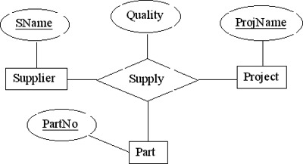
For each n-nary relation set R, where n > 2 create a new relation S to represent R
Include as foreign key attributes in S the primary key of the relations that represent the participating entity sets
Also include any descriptive attributes of the n-ary relation set as attributes of S.
The primary key is a combination of all the foreign keys that reference the relations representing the participating entity sets.
Supplier (SName, ...)
Project (ProjName, ...)
Part (PartNo, ...)
Supply (SName, ProjName, PartNo, Quality)

Slide 8
For each n-nary relation set R, where n > 2 create a new relation S to represent R
Include as foreign key attributes in S the primary key of the relations that represent the participating entity sets
Also include any descriptive attributes of the n-ary relation set as attributes of S.
The primary key is a combination of all the foreign keys that reference the relations representing the participating entity sets.
Orders
M
N
contains
Products
OrderItems (order_num, order_item, prod_id, quantity, item_price)

Slide 9

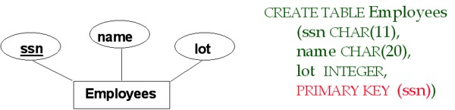
Employees (ssn, name, lot)

Slide 10
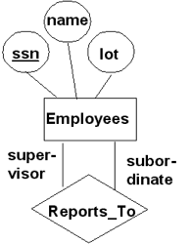
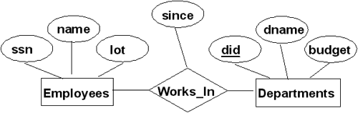
Works_In (ssn, did, since)
Reports_To (supervisor_ssn, subordinate_ssn)
CREATE TABLE Works_In (
ssn CHAR(11), did INTEGER, since DATE,
PRIMARY KEY (ssn, did),
FOREIGN KEY (ssn) REFERENCES Employees,
FOREIGN KEY (did) REFERENCES Departments)
CREATE TABLE Reports_To (
supervisor_ssn CHAR(11),
subordinate_ssn CHAR(11),
PRIMARY KEY (supervisor_ssn, subordinate_ssn),
FOREIGN KEY (supervisor_ssn) REFERENCES Employees(ssn),
FOREIGN KEY (subordinate_ssn) REFERENCES Employees(ssn))

Slide 11
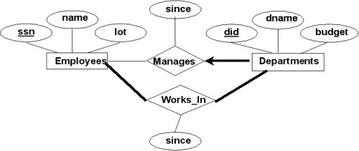
Manages (ssn, did, since)
The participation of the entity set Departments in "Manages" relationship set is total because each department is required to have a manager
The participation of the entity set Employees in "Manages" relationship set is partial because not every employee gets to manage a department.
CREATE TABLE Manages( ssn CHAR(11), did INTEGER, since DATE,
PRIMARY KEY (did),
FOREIGN KEY (ssn) REFERENCES Employees,
FOREIGN KEY (did) REFERENCES Departments)

Slide 12
Option 2: Since each department has a unique manager, you could combine Manages and Departments into one relation.
Dept_Mgr ( did, dname, budget, ssn, since)
CREATE TABLE Dept_Mgr (did INTEGER, dname CHAR(20), budget REAL, ssn CHAR(11), since DATE,
PRIMARY KEY (did),
FOREIGN KEY (ssn) REFERENCES Employees)

Slide 13
Does every department have a manager?
If "Yes", then there exists a participation constraint
  the participation of Departments in Manages is said to be total (vs. partial)
Every did value in Departments table must appear in a row of the Manages table (with a non-NULL ssn value)
What if the manager is fired?
ON DELETE NO ACTION -- An Employee tuple, pointed by a tuple in Dept_Mgr table, is not allowed to be removed.
Dept_Mgr ( did, dname, budget, ssn, since)
CREATE TABLE Dept_Mgr (did INTEGER, dname CHAR(20), budget REAL, ssn CHAR(11), since DATE,
PRIMARY KEY (did),
FOREIGN KEY (ssn) REFERENCES Employees ON DELETE NO ACTION)

Slide 14

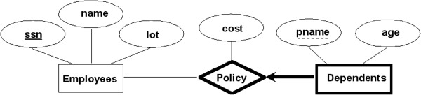
For each weak entity W in the ER schema with owner entity E, create a relation R that includes all the simple attributes of W as attributes of R.
In addition, include as foreign key attributes of R the primary key(s) of the relation(s) that correspond to the owner entity type(s).
The primary key of R is the combination of primary key(s) of the owner(s) and the partial key of the weak entity type W, if any.
  A weak entity can be identified uniquely only by considering the primary key of another (owner) entity.
  Owner entity set and weak entity set must participate in a one-to-many relationship set (1 owner, many weak entities)
  Weak entity set must have total participation in this identifying relationship set.
  Weak entity set and identifying relationship set are translated into a single table.

Slide 15
Dep_Policy (pname, ssn, age, cost)
CREATE TABLE Dep_Policy (pname CHAR(20), age INTEGER, cost REAL, ssn CHAR(11),
PRIMARY KEY (pname, ssn),
FOREIGN KEY (ssn) REFERENCES Employees DELETE ON CASCADE)
It is common to choose the propagate (CASCADE) option for the referential triggered action on the foreign key in R.
  When the owner entity is deleted, all owned weak entities must also be deleted (ON DELETE).
  When the owner entity is updated, all owner weak entities must also be updated (ON UPDATE).

Slide 16

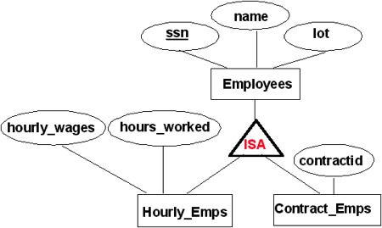
If A ISA B, every A entity is also considered to be a B entity.
Overlap Constraints: Can John be an Hourly_Emps as well as a Contract_Emps entity?
Covering Constraints: Does every Employees entity also have to be an Hourly_Emps or a Contract_Emps entity?

Slide 17
Two options to translate ISA hierarchies to relations:
Create 3 relations: Employees, Hourly_Emps, and Contract_Emps.
  Every employee is recorded in Employees
  For hourly employees, extra info recorded in Hourly_Emps (i.e., hourly_wages, hours_worked, ssn)
  If referenced Employees tuple is deleted, the corresponding Hourly_Emps tuple must be deleted.
  When a query involves only hourly employee(s), must perform a join to get some attributes.
Create just 2 relations: Hourly_Emps and Contract_Emps.
  Hourly_Emps (ssn, name, lot, hourly_wages, hours_worked)
  Each employee must be in one of these two subclasses (i.e., covering constraints).

