Slide 1
The Relational Model: Functional Dependencies and Normalization

Slide 2
Learning Objectives
Understand the following terms: Anomaly, three types of anomalies, functional dependency
Be able to identify insertion, deletion, and modification anomalies given a bad relational design
Informal guidelines for good relational database design
Formal concepts of functional dependencies and normal forms
First Normal Form (1NF)
Second Normal Form (2NF)
Third Normal Form (3NF)
BCNF (Boyce-Codd Normal Form)

Slide 3
Where does Normalization fit?
Data Structure
Understand Relational Model
Data Integrity
Translate ER into relational Model
Data Manipulation
Logical Design
How to translate?
Normalization

Slide 4
“Good Design”: What is it?
Good design should avoid the following properties whenever possible
Redundancy
Anomaly
Null values
Later we will also discuss what a good design is in formal terminology (i.e., Normal Forms, etc.)

Slide 5
Redundancy
Redundancy means
Repeated data entry.
Repeated changes in many places.
More storage space.

Slide 6
Example
A student has his SID, SNAME
A class has its name and number of credits
We assume that each student may take more than one class
SID
N
M
CNAME
Student
Takes
Course
SNAME
SEMESTER
CREDITS
We would have:
S(SID, SNAME)
C(CNAME, CREDITS)
SC(SID, CNAME, SEMESTER)

Slide 7
Example
What if we have a table:
S(SID, SNAME, CNAME, CREDITS, SEMESTER)
SID | SNAME | CNAME | CREDITS | SEMESTER
S12 | John White | MIS361 | 3 | Fall 01
S24 | Ann Beech | MIS361 | 3 | Fall 02
S16 | Dave Ford | MIS361 | 3 | Spring 01

Slide 8
Inconsistency: Anomalies
Anomaly
Error or inconsistency that may occur when a user tries to update a table with redundant data
It is caused by redundancy
Three types of anomalies:
Insertion Anomaly: Inconsistency when adding data
Deletion Anomaly: Inconsistency when removing data
Modification Anomaly: Inconsistency when updating data

Slide 9
Insertion Anomaly
Example:
SID | SNAME | CNAME | CREDITS | SEMESTER
S12 | John White | MIS361 | 3 | Fall 01
S24 | Ann Beech | MIS361 | 3 | Fall 02
S16 | Dave Ford | MIS361 | 3 | Spring 01
What if a new student comes?
If he hasn’t taken any classes yet, he doesn’t exist!?
Insertion anomaly – Insertion of one entity depends on information about another entity.

Slide 10
Deletion Anomaly
Example:
SID | SNAME | CNAME | CREDITS | SEMESTER
S12 | John White | MIS361 | 3 | Fall 01
S24 | Ann Beech | MIS361 | 3 | Fall 02
S16 | Dave Ford | MIS341 | 3 | Spring 01
What if Dave graduated?
MIS 341 no longer exist!
Deletion anomaly – deletion of one entity results in deletion of another entity.

Slide 11
Modification Anomaly
Example:
SID | SNAME | CNAME | CREDITS | SEMESTER
S12 | John White | MIS361 | 3 | Fall 01
S24 | Ann Beech | MIS361 | 3 | Fall 02
S16 | Dave Ford | MIS361 | 3 | Spring 01
What if MIS361 is now 5 credits?
How many rows do we need to update?

Slide 12
How to Avoid Anomaly?
Apparently, we should “split up” this big table into smaller tables
SID | SNAME | CNAME | CREDITS | SEMESTER
S12 | John White | MIS361 | 3 | Fall 01
S24 | Ann Beech | MIS361 | 3 | Fall 02
S16 | Dave Ford | MIS361 | 3 | Spring 01

Slide 13
How to Avoid Anomaly? (cont.)
How about ?
SID | CNAME | SNAME
S12 | MIS361 | John White
S24 | MIS361 | Ann Beech
S16 | MIS361 | Dave Ford
SID | SEMESTER
S12 | Fall 01
S24 | Fall 02
S16 | Spring 01
CNAME | CREDITS
MIS361 | 3

Slide 14
Anomalies: Summary
Anomalies often exist because of redundant data
Redundant data, in turn, is often caused by bad design that puts irrelevant data together
Example: Student and class are two separate entities. It doesn’t make sense to put them into one table
Goal of Normalization:
Decompose relations with anomalies to produce smaller, well-structured (without anomalies) relations
How? By analyzing Functional Dependencies

Slide 15
Semantics of the Relation Attributes – Guideline 1
Informally, each tuple in a relation should represent one entity or relationship instance
Attributes of different entities should not be mixed in the same relation
Only foreign keys should be used to refer to other entities
Entity and relationship attributes should be kept apart as much as possible
Bottom line: Design a schema that can be explained easily relation by relation. The semantics of attributes should be easy to interpret.

Slide 16
Semantics of the Relation Attributes – Guidelines 2 and 3
Design a schema that does not suffer from the insertion, deletion, and update anomalies.
Relations should be designed such that their tuples will have as few NULL values as possible
Attributes that are NULL frequently could be placed in separate relations (with the primary key)

Slide 17
Functional Dependency (FD)
FDs are used to specify formal measures of the “goodness” of relational designs
FDs and Keys are used to define normal forms for relations
FDs are constraints that are derived from the meaning and interrelationships of the data attributes. (i.e., A constraint between two attributes or two sets of attributes.
First, notice that we are concerned about attributes now.
No entities, not even tables! We are working inside ONE table
Definition:
Attribute B is functionally dependent on attribute A if for every instance of A, the value of A uniquely determines the value of B. A ➔B
A set of attributes X functionally determines a set of attributes Y if the value of X determines a unique value for Y. X ➔Y

Slide 18
Functional Dependency (FD)
X ➔Y holds if whenever two tuples have the same value for X, they must have the same value for Y.
For any two tuples t1 and t2 in any relation instance r(R):
X ➔ Y in R specifies a constraint on all relation instances r(R)
FDs are derived from the real-world constraints on the attributes
Examples:
SSN ➔ EmpName
Proj_Num ➔ {Proj_Name, Proj_Loc}
{SSN, Proj_Num} ➔ Hours_on_Proj

Slide 19
Functional Dependency (FD)
An FD is a property of the attributes in the schema R
The constraint must hold on every relation instance r(R).
If K is a key of R, then K functionally determines all attributes in R (since we never have two distinct tuples with t1[K] = t2[K])

Slide 20
Example
SID | SNAME | CNAME | CREDITS | SEMESTER
S12 | John White | MIS331 | 3 | Fall 01
S12 | John White | MIS341 | 3 | Fall 01
S12 | John White | MIS451 | 3 | Fall 01
S24 | Ann Beech | MIS121 | 3 | Spring 01
S24 | Ann Beech | MIS331 | 3 | Fall 02
S16 | Dave Ford | MIS331 | 3 | Spring 01
If we know SID, can we get one and ONLY one sname? SID→SNAME
If we know SID, can we get one and ONLY CNAME?

Slide 21
Example
SID | SNAME | CNAME | CREDITS | SEMESTER
S12 | John White | MIS331 | 3 | Fall 01
S12 | John White | MIS341 | 3 | Fall 01
S12 | John White | MIS451 | 3 | Fall 01
S32 | John White | MIS121 | 3 | Spring 01
S24 | Ann Beech | MIS331 | 3 | Fall 02
S16 | Dave Ford | MIS331 | 3 | Spring 01
If we know SID, can we get a unique sname?
The answer is no. but SID→SNAME still holds

Slide 22
Another Example
Check whether these FDs hold:
{S#}->{CITY}
{S#,P#}->{QTY}
{S#,P#}->{CITY, QTY}
{S#,P#}->{S#, P#, CITY, QTY}
{S#,P#,CITY,QTY}->{S#,P#,CITY,QTY}
S#
P#
CITY
QTY
S1
S1
S2
S2
S3
S4
S4
S4
P1
P2
P1
P2
P2
P2
P4
P5
London
London
Paris
Paris
Paris
London
London
London
100
100
200
200
300
400
400
400

Slide 23
More About Functional Dependency
Again: Definition
A set of attributes Y are functionally dependent on X (X → Y, read “X functionally determines Y”), if:
Each X value is only associate with precisely ONE Y value
In other words, whenever two tuples have the same value for X, they must also have the same value for Y
Left Hand Side
(LHS)
Right Hand Side
(RHS)
X → Y
Determinant
Dependent

Slide 24
Trivial Functional Dependency
A FD is trivial if and only if the RHS (dependent) is a subset of the LHS (determinant)
In other words, if everything on RHS already appeared on LHS
S→city S,P→city S,P→qty
S,P→city,qty S,P→S,P,city,qty
S,P,city,qty → S,P,city,qty

Slide 25
Armstrong’s Axioms
Inference Rules for FDs: Given a set of FDs F, we can infer additional FDs that hold whenever the FDs in F hold
Armstrong’s Inference Rules:
IR1: Reflexivity:
If B is a subset of A, then A → B
Of course. However, it is trivial
IR2: Augmentation:
If A → B, then AC → BC
Example: if sid → sname, then sid, age → sname, age
IR3: Transitivity:
If A → B and B → C, then A → C
Example: if sid → gender and gender → softball/baseball, then sid → softball/baseball
IR1, IR2, IR3 form a sound and complete set of inference rules

Slide 26
Armstrong’s Axioms (cont.)
It is complete
Using the three rules above, we can find all FDs
It is sound
No additional FDs can be derived
In short, Armstrong’s axioms are rules

Slide 27
Armstrong’s Axioms (cont.)
Based on Armstrong’s Axioms, the following can be derived:
Decomposition: If A → BC, then A → B and A → C
Union: If A → B, and A → C, then A → BC
Composition: If A →B and C → D, then AC→ BD

Slide 28
Normalization of Relations
Normalization
The process of decomposing unsatisfactory “bad” relations by breaking up their attributes into smaller relations
Normal Form
Condition using keys and FDs of a relation to certify whether a relation schema is in a particular normal form.
Denormalization
The process of storing the join of higher normal form relations as a base relation – which is in a lower normal form.

Slide 29
Normalization of Relations
2NF, 3NF, BCNF based on keys and FDs of a relation schema
4NF based on keys, multi-valued dependencies(MVDs)
5NF based on keys, join dependencies (JDs)

Slide 30
Normal Forms
First Normal Form (1NF)
Table’s primary key is defined.
All non-key attributes show functional dependency on the primary key components.
Table does not contain multi-valued attributes.
All attribute values must be atomic.
A relation is in First Normal Form if and only if all columns are single valued.

Slide 31
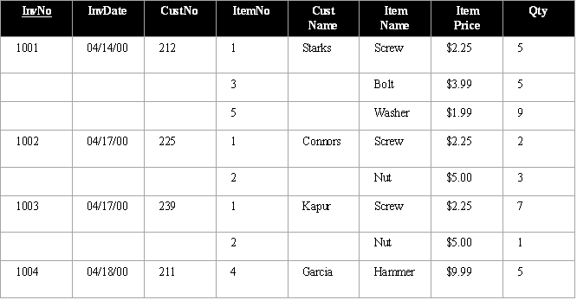
INVOICE Table in 0NF
Table contains multi-valued attributes. Therefore, this table is not in 1NF
A relation/table is in 1NF if every attribute in every row can contain only one single (atomic) value.

Slide 32
INVOICE Table in 1NF
InvNo
InvDate
CustNo
ItemNo
CustName
ItemName
ItemPrice
Qty
1001
04/14/00
212
1
Starks
Screw
$2.25
5
1001
04/14/00
212
3
Starks
Bolt
$3.99
5
1001
04/14/00
212
5
Starks
Washer
$1.99
9
1002
04/17/00
225
1
Connors
Screw
$2.25
2
1002
04/17/00
225
2
Connors
Nut
$5.00
3
1003
04/17/00
239
1
Kapur
Screw
$2.25
7
1003
04/17/00
239
2
Kapur
Nut
$5.00
1
1004
04/18/00
211
4
Garcia
Hammer
$9.99
5
ItemNo => ItemName, ItemPrice (partial dependency)
InvNo => InvDate, CustNo, CustName (partial dependency)
InvNo, ItemNo => Qty (total dependency)
Attribute CustName shows transitive dependency on CustNo.

Slide 33
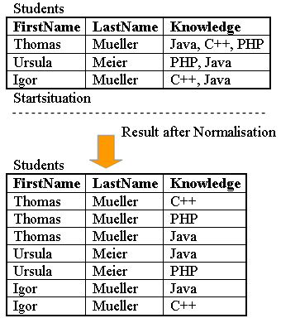
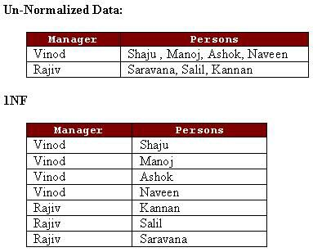
0NF to 1NF – examples

Slide 34
Normal Forms
Second Normal Form (2NF)
All 1NF requirements are satisfied.
There is no partial dependency, i.e., Partial dependency means “A non-key attribute is dependent on part of the primary key”
Do all attributes outside of the key functionally depend on the full key?
A relation is in 2NF if and only if it is in 1NF, and every non-key attribute is fully dependent on the primary key.

Slide 35
1NF to 2NF
(Removal of partial dependencies)
Write each primary key component (with partial dependency on it) on a separate line.
Write composite key on the next line.
INVOICE table decomposed into 2NF (3 tables):
INV (InvNo, InvDate, CustNo, CustName)
ITEM (ItemNo, ItemName, ItemPrice)
INVITEM (InvNo, ItemNo, Qty)

Slide 36
1NF to 2NF - examples
INVOICE table decomposed into 2NF (3 tables):
INV (InvNo, InvDate, CustNo, CustName)
ITEM (ItemNo, ItemName, ItemPrice)
INVITEM (InvNo, ItemNo, Qty)
Order Table decomposed into 2 tables:
ORDER (ItemNo, CustomerId, Quantity, CustomerCredit)
has partial dependencies:
ItemNo,CustomerId -> Quantity; CustomerId -> CustomerCredit
resolved to: ITEM (ItemNo,...)
CUSTOMER (CustomerId, CustomerCredit,...)
ORDER (ItemNo, CustomerId,, Quantity)

Slide 37
Normal Forms
Third Normal Form (3NF)
All 2NF requirements are fulfilled.
There is no transitive dependency.
Transitive dependencies means: “A non-key attribute is dependent on another non-key attribute”. A ➔ B, B ➔ C
e.g., In INV table, InvNo ➔ InvDate, CustNo;
CustNo ➔ CustName
Do any of the attributes outside of the key functionally depend on each other?
A relation is in 3NF if and only if it is in 2NF and has no transitive dependencies.

Slide 38
2NF to 3NF
All 2NF requirements are fulfilled
There is no transitive dependency. Transitive dependencies: A nonkey attribute is dependent on another nonkey attribute. A => B, B => C e.g., In INV table, InvNo -> InvDate, CustNo; CustNo -> CustName
Do any of the attributes outside of the key functionally depend on each other?
A relation is in 3NF if and only if it is in 2NF and has no transitive dependencies.

Slide 39
1NF to 2NF - examples
INVOICE table decomposed into 2NF (3 tables):
INV (InvNo, InvDate, CustNo, CustName)
ITEM (ItemNo, ItemName, ItemPrice)
INVITEM (InvNo, ItemNo, Qty)
Stock Table decomposed into 2 tables:
Stock (StockCode, Nation, ExchangeRate)
dependencies: StockCode -> Nation, Nation -> ExchangeRate
resolved to: Stock (StockCode, Nation, StockPrice, ...)
Nation (NationCode, NationName, ExchangeRate,...)

Slide 40
2NF to 3NF
Removal of transitive dependencies
Move attributes with transitive dependency to a new table.
Keep the primary key of the new table as the foreign key in the existing table. e.g., Database in 3NF: INV (InvNo, InvDate, CustNo) CUSTOMER (CustNo, CustName) ITEM (ItemNo, ItemName, ItemPrice) INVITEM (InvNo, ItemNo, Qty)
Stock Table decomposed into 2 tables:
Stock (StockCode, Nation, ExchangeRate)
dependencies: StockCode -> Nation, Nation -> ExchangeRate
resolved to: Stock (StockCode, Nation, StockPrice, ...)
Nation (NationCode, NationName, ExchangeRate,...)

Slide 41
Boyce-Codd Normal Form (BCNF)
A stronger version of 3NF
3NF does not cover the case when a relation has multiple candidate keys, where those candidate keys are composite, and the candidate keys overlap because they have at least one column in common.
A relation is in BCNF if and only if every determinant is a candidate key
Example:

Slide 42
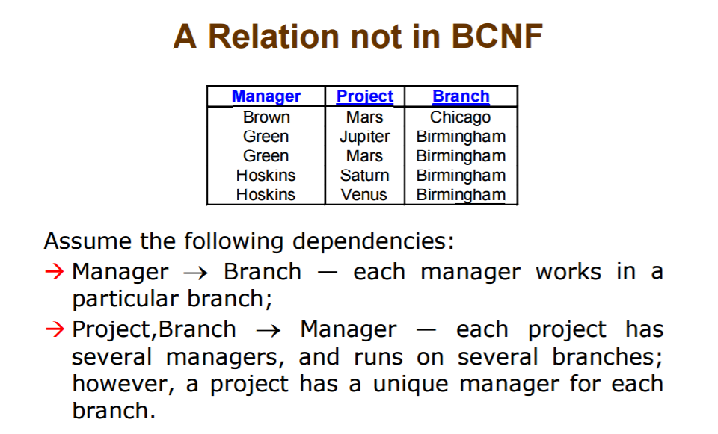
Boyce-Codd Normal Form (BCNF)
Example:

Slide 43
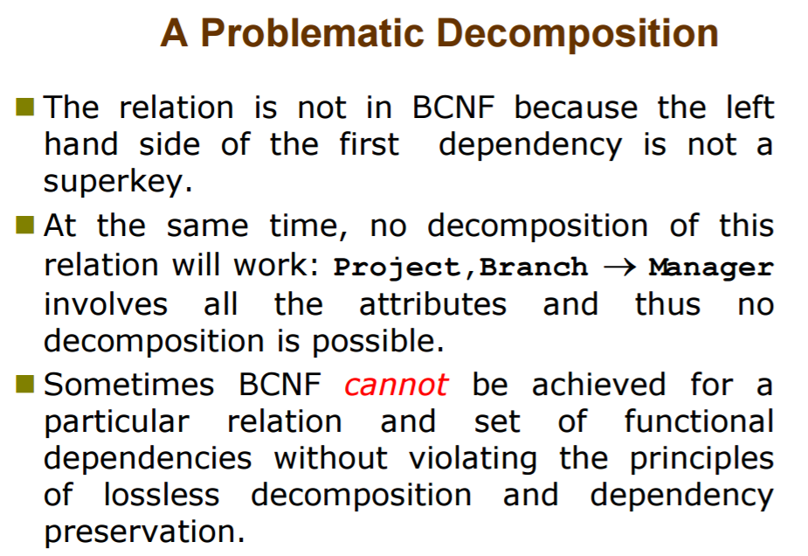
Boyce-Codd Normal Form (BCNF)

Slide 44
Normalization
A process of decomposing a table into many tables.
A process to increase table’s normal form.
A process to reduce redundancy.
The higher the normal form is,
the lower the redundancy.

Slide 45
Practical Use of Normal Forms
Normalization is carried out in practice so that the resulting designs are of high quality and meet the desirable properties
The practical utility of these normal forms becomes questionable when the constraints on which they are based are hard to understand or to detect
The database designers need not normalize to the highest possible normal form (usually up to 3NF, BCNF or 4NF)

