Slide 1
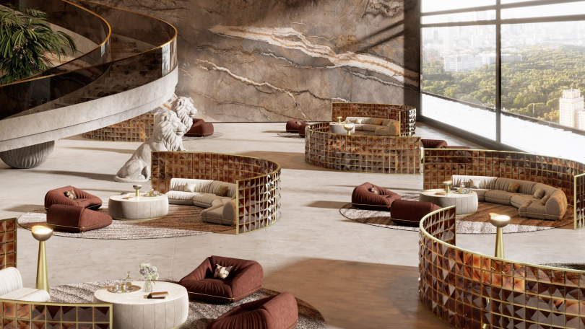
Strategic Analytics
AtliQ Hospitality
Performance Analysis
Strategic Insights for Revenue Optimization & Operational Excellence
Prepared by
Hathim Manaf

Slide 2
Overview
Executive Summary
Business Challenge
Analytical Approach
Strategic Opportunity
AtliQ Hospitality seeks to optimize hotel performance across multiple dimensions—cities, properties, room categories, and booking platforms—to enhance revenue, pricing strategy, and operational efficiency.
Comprehensive analysis using star schema data warehouse with temporal trend analysis, property-level benchmarking, channel segmentation, and KPI computation across all business dimensions.
Strong pricing power evidenced by high ADR (₹12,696) with significant opportunity to optimize occupancy (57.8%) through targeted demand management and channel optimization strategies.
Total Revenue
RevPAR
ADR
Occupancy
Realisation
₹1.69B
₹7,337
₹12,696
57.8%
70.1%
Annual
Per Room
Daily Rate
Average
Effective
Key Strengths
Critical Opportunities
• Premium pricing power: ADR of ₹12,696 demonstrates strong brand positioning.
• Occupancy optimization: 57.8% leaves significant upside potential.
• Weekday demand: 12.5% RevPAR gap indicates need for targeted promotions.
• Luxury segment dominance: 61.62% revenue from high-value guests.
• Weekend performance: 12.5% higher RevPAR on weekends (₹7,972 vs ₹7,083).
• Channel optimization: 29.9% revenue loss through cancellations and commissions.

Slide 3
Foundation
Business Context & Analytical Framework
01 Business Objectives
03 Analytical Methodology
Revenue & Occupancy Growth
1
Data Cleaning & Validation
Drive top-line expansion while optimizing capacity utilization across all properties.
Ensured data quality, completeness, and consistency.
Pricing Strategy Optimization
2
KPI Computation
Maximize RevPAR and ADR through data-driven pricing decisions.
Calculated core metrics: RevPAR, ADR, Occupancy, Realisation.
Revenue Leakage Reduction
3
Temporal Trend Analysis
Minimize losses from cancellations and no-shows.
Examined weekly patterns, seasonality, and demand volatility.
Channel Performance Enhancement
4
Property-Level Benchmarking
Optimize distribution mix and improve customer satisfaction.
Compared performance across cities and individual properties.
02 Data Architecture
5
Channel & Category Segmentation
Analysis built on star schema data warehouse ensuring data integrity and analytical flexibility.
Analyzed performance by booking platform and room category.
Key Metrics Framework
Dimension Tables
Fact Tables
Revenue Metrics
Utilization Metrics
Quality Metrics
• Date
• Bookings
Revenue, RevPAR, ADR
Occupancy, Realisation
Ratings, Cancellations
• Hotels
• Aggregated Bookings
• Rooms

Slide 4
Performance Metrics
Key Performance Indicators Dashboard
Comprehensive overview of AtliQ's financial and operational performance with industry context
Total Revenue
Annual
RevPAR
Per Room
ADR
Daily Rate
₹1.69B
₹7,337
₹12,696
Strong revenue base
Revenue efficiency
Premium positioning
Occupancy Rate
Realisation Rate
DSRN
Avg. Rating
57.8%
70.1%
2,528
3.7
Performance Interpretation & Strategic Implications
The business demonstrates strong pricing power with ADR of ₹12,696, significantly above mid-market segments. However, moderate occupancy at 57.8% indicates untapped demand and potential for optimization.
Revenue Efficiency
Revenue Loss
Optimization Potential
RevPAR/ADR: 57.8%
29.9% leakage
42.2% occupancy upside

Slide 5
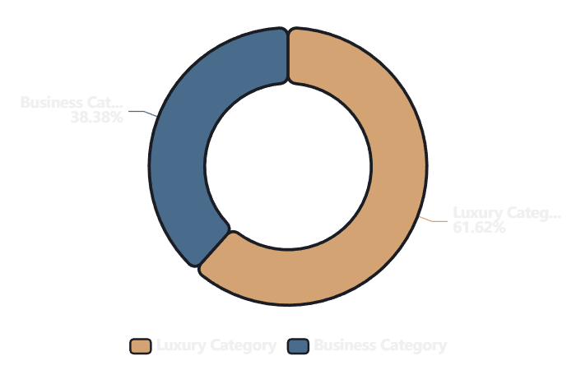
Market Segmentation
Revenue Composition & Market Segmentation
Understanding revenue drivers across customer segments for strategic positioning
Revenue Distribution by Category
Luxury Segment
61.62%
Dominant revenue contributor generating ₹1.04B annually. Reflects successful premium positioning and attraction of high-value guests.
Revenue Share
Strategic Focus
₹1.04B
Core Strength
Business Segment
38.38%
Significant secondary contributor at ₹650M annually. Provides stable weekday demand and diversifies customer base.
Revenue Share
Strategic Focus
₹650M
Weekday Anchor
Strategic Insight: Premium Positioning Drives Profitability
Luxury segment dominance indicates premium offerings are the primary profit driver. This suggests a clear strategy for continued investment in luxury experiences and expansion. Business segment provides weekday stability, creating an opportunity for hybrid positioning.

Slide 6
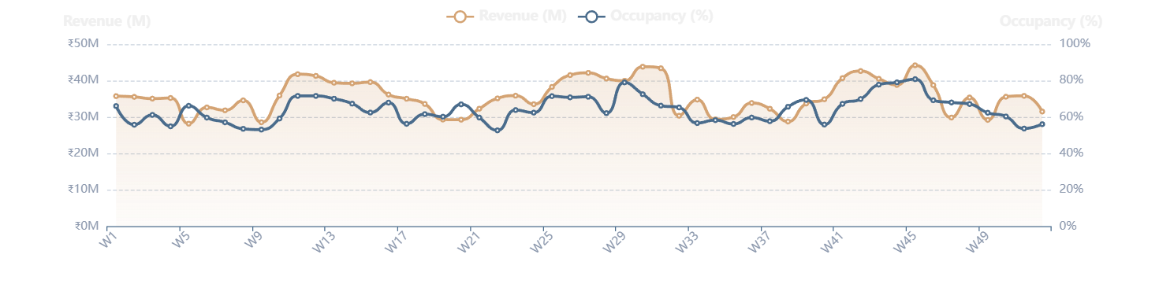
Temporal Analysis
Temporal Performance Trends
Weekly patterns and seasonal variations revealing demand volatility and pricing opportunities
Revenue Fluctuation
Pricing Stability
Demand Volatility
Weekly variations indicate seasonal demand patterns and pricing optimization opportunities throughout the year.
RevPAR and ADR stability demonstrate consistent pricing strategy, while occupancy varies with demand patterns.
Peaks and dips reveal clear demand volatility, creating opportunities for dynamic pricing strategies.
Weekly Revenue & Occupancy Trend Patterns

Slide 7
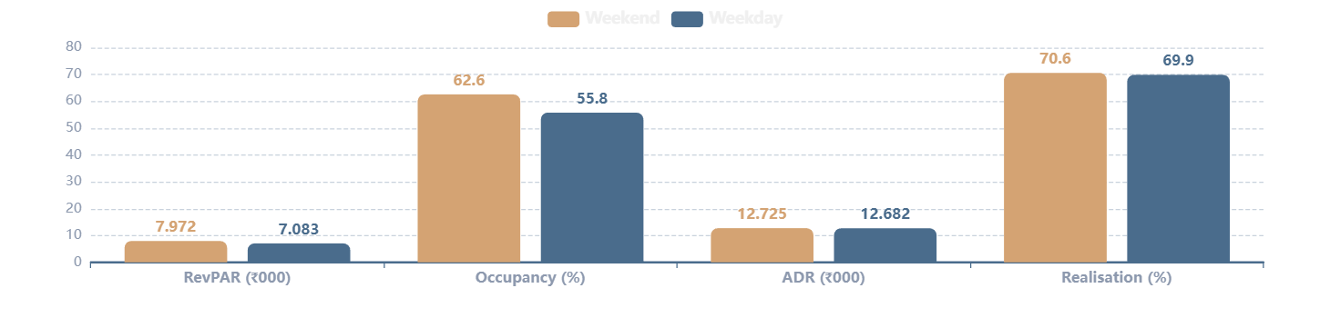
Demand Patterns
Day Type Performance Analysis
Weekend vs weekday performance reveals leisure-driven demand patterns and optimization opportunities
Weekend Performance
Peak Days
Weekday Performance
Standard Days
RevPAR
Occupancy
ADR
RevPAR
Occupancy
ADR
₹7,972
62.6%
₹12,725
₹7,083
55.8%
₹12,682
Leisure-driven demand peaks on weekends with premium pricing power and higher occupancy rates, indicating successful weekend positioning.
Business travel sustains weekdays with consistent pricing but lower occupancy, presenting clear opportunity for demand stimulation.
Weekend vs Weekday Performance Gap Analysis

Slide 8
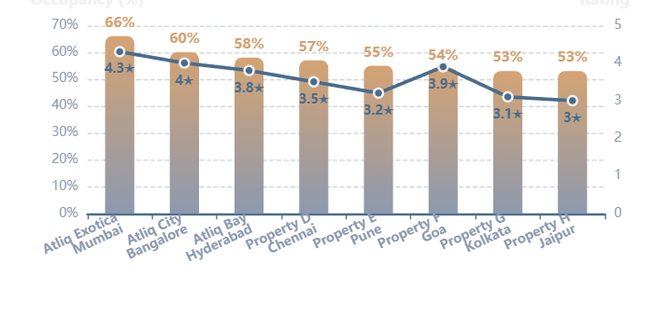
Property Analysis
Property-Level Benchmarking
Performance ranking across cities and properties revealing optimization opportunities
1
Atliq Exotica
2
Atliq City
3
Atliq Bay
Mumbai
Bangalore
Hyderabad
Revenue Rank
Occupancy
Revenue Rank
Occupancy
Revenue Rank
Occupancy
#1
~66%
#2
~60%
#3
~58%
Top performer in India's financial capital with highest revenue generation.
Strong performer in the tech hub, benefiting from business travel.
Solid contributor in the emerging market with balanced performance.
Property Performance Distribution
Performance Range Analysis
Occupancy Range
53% - 66%
Rating Range
3.0 - 4.3
Performance Gap
13 pts
Key Insights & Correlations
• Uneven performance: 13-point occupancy gap indicates potential for improvement.
• Rating correlation: Higher ratings linked to better performance.
• Location dynamics: Metro markets outperform emerging cities.

Slide 9
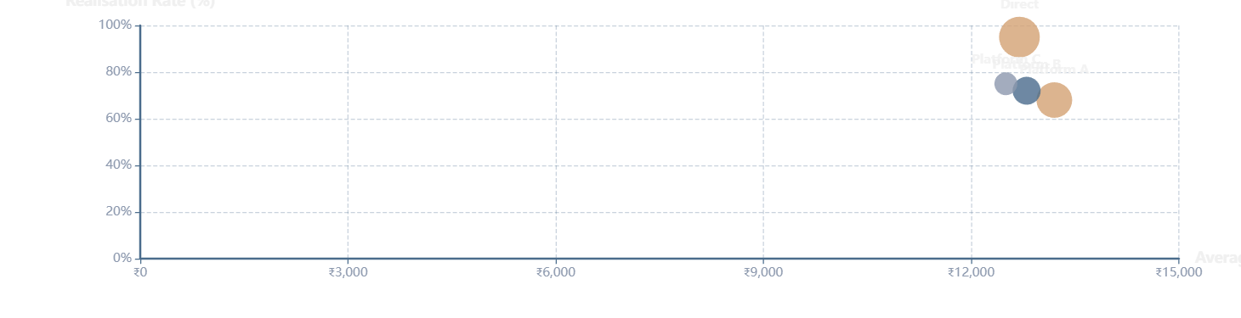
Distribution Analysis
Channel Performance & Revenue Realization
Booking platform effectiveness and optimization opportunities for net revenue improvement
Platform A
Platform B
Platform C
Direct
ADR
₹13,200
ADR
₹12,800
ADR
₹12,500
ADR
₹12,696
Realisation
68%
Realisation
72%
Realisation
75%
Realisation
95%
Channel Effectiveness: ADR vs Realisation Analysis
Channel Optimization Can Significantly Improve Net Revenue
Significant variation across platforms: some generate higher ADR but lower realisation due to commission structures (15-20%) and cancellation impacts. Direct channels achieve 95% realisation, emphasizing importance of driving direct bookings.

Slide 10
Key Drivers
Strategic Insights & Market Drivers
Synthesizing data patterns to establish foundation for targeted strategic interventions
Luxury Segment Dominance
Property-Level Variations
Primary revenue engine at 61.62% (₹1.04B), indicating successful premium positioning and strong brand equity.
13-point occupancy gap between top and bottom performers indicates significant optimization potential.
Strategic Implication
Strategic Implication
Double down on luxury experience and expansion.
Benchmark and replicate top performer strategies.
Weekend Demand Peaks
Channel Mix Effects
Weekend RevPAR 12.5% higher (₹7,972 vs ₹7,083), confirming leisure-driven demand and successful weekend positioning.
Significant variation in ADR and realisation across booking platforms, with direct channels achieving 95% realisation.
Strategic Implication
Strategic Implication
Focus on weekday demand stimulation.
Prioritize direct bookings and optimize channel mix.
Connecting Data Patterns to Market Dynamics
The analysis reveals three core business drivers: premium positioning strength, leisure demand patterns, and operational inconsistencies. These patterns establish a clear foundation for targeted interventions: leverage luxury dominance, bridge weekday gaps, and standardize excellence.

Slide 11
Action Plan
Business Recommendations & Action Plan
Prioritized strategic initiatives across four pillars for revenue optimization and operational excellence
Revenue Strategy
Operations
Luxury Segment Expansion
Performance Benchmarking
Capitalize on 61.62% revenue contribution.
Replicate top performer strategies across portfolio.
Weekday Promotions
Customer Experience
Bridge 12.5% RevPAR gap with targeted campaigns.
Improve ratings from 3.0-4.3 to 4.0+ consistently.
Dynamic Pricing
Capacity Optimization
Implement demand-based pricing during peak weeks.
Address 13-point occupancy gap through best practices.
Channel Optimization
Demand Management
High-Realisation Platforms
Dynamic Pricing
Prioritize channels with optimal ADR-realisation balance.
Use real-time pricing during high-demand periods.
Commission Negotiation
Low-Period Campaigns
Negotiate better terms to reduce revenue leakage.
Targeted marketing during demand dips to boost occupancy.
Direct Booking Push
Cancellation Management
Drive direct bookings for 95% realisation rates.
Implement policies to reduce revenue leakage.
Implementation Priority & Expected Impact
Phase 1 (0-3 months): Dynamic pricing, weekday campaigns. Phase 2 (3-6 months): Channel optimization, benchmarking. Expected impact: 8-12% RevPAR uplift, 5-7% occupancy increase.

Slide 12
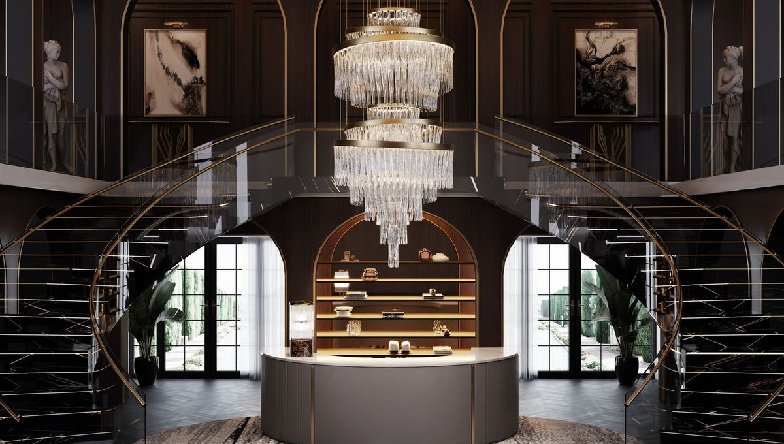
Strategic Summary
Conclusion & Next Steps
Analysis Summary
Strategic Impact
This analysis provides a comprehensive view of revenue performance, demand patterns, and channel effectiveness, establishing clear strategic direction.
Data-driven strategies can enhance occupancy, improve realization, and strengthen profitability through pricing, channels, and operations.
Next Steps & Implementation Roadmap
1
2
3
Immediate Actions
Medium-Term
Long-Term
• Deploy dynamic pricing
• Benchmark properties
• Expand luxury portfolio
• Launch weekday campaigns
• Optimize channel mix
• Strengthen brand position
• Audit channel performance
• Enhance guest experience
• Monitor KPIs quarterly
Thank You

