Slide 1

SALES PERFORMANCE ANALYSIS
Blinkit
Sales Analysis
Data-Driven Insights for Strategic Growth
Prepared by Hathim Manaf
January 2025
Power BI Analysis
8,523 Items Tracked
Multi-Outlet Analysis

Slide 2
NAVIGATION
Executive
Overview
01
Business Context
02
Dataset & Methodology
Objectives & requirements
Data scope & tools
03
Key Metrics
04
Sales Performance
Performance at a glance
Comprehensive analysis
05
Product Insights
06
Outlet Segmentation
Category performance
Size, tier & type
12 Sections
Temporal Trends
Recommendations
07
08
Comprehensive analysis across all key business dimensions
Year-over-year analysis
Strategic actions

Slide 3
STRATEGIC FOUNDATION
Business Context & Analysis Objectives
Business Requirement
Analysis Objectives
Blinkit needs to understand which products, outlet types, and locations contribute the most to sales in order to optimize critical business operations.
To analyze comprehensive sales data and identify high-performing segments across multiple business dimensions.
Inventory planning optimization
Product Categories
Outlet Segments
Sales Trends
Outlet strategy refinement
Operational decisions support
Analytical Framework & Tools
Data Processing
Visualization
Insight Generation
Comprehensive cleaning, aggregation, and transformation of retail sales data
Interactive dashboards and analytical reports for insight generation
Evidence-based recommendations supporting strategic decision-making
Power BI
Excel (CSV)
Enterprise-grade analytics platform

Slide 4
DATA FOUNDATION
Dataset Overview & Methodology
Product Attributes
Outlet Attributes
Item Type
Outlet Size
Location Tier
Product categories & classification
Small, Medium, High
Tier 1, 2, 3 cities
Fat Content
Outlet Type
Establishment Year
Low Fat vs Regular products
Supermarket, Grocery
2012-2022 period
Sales Metrics
Analytical Approach
Total Sales
Item Count
Data Cleaning
Aggregation
Visualization
Insights
Quality assurance
Metrics computation
Interactive dashboards
Evidence-based findings
Avg Sales
Avg Rating

Slide 5
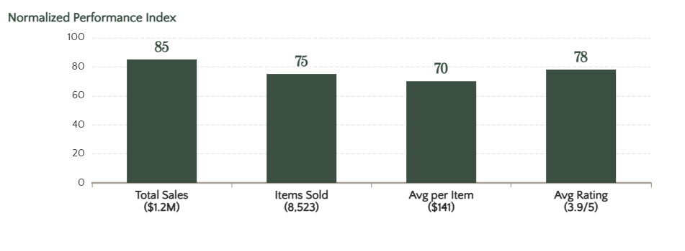
PERFORMANCE DASHBOARD
Key Performance Metrics at a Glance
TOTAL
VOLUME
AVERAGE
QUALITY
Total Sales Revenue
Total Items Sold
Average Sales per Item
Average Product Rating
$1,201,682
8,523
$141
3.9
Comprehensive revenue across all outlets and categories
Units sold across entire product portfolio
Mean revenue generated per individual product
Customer satisfaction score across portfolio
Performance Context
Metric Distribution Analysis
These four metrics provide a comprehensive view of Blinkit's sales performance, encompassing revenue scale, operational volume, product-level efficiency, and customer satisfaction.
Strong revenue generation capability
Healthy sales volume indicating market acceptance
Consistent per-unit revenue performance
Solid customer satisfaction ratings

Slide 6
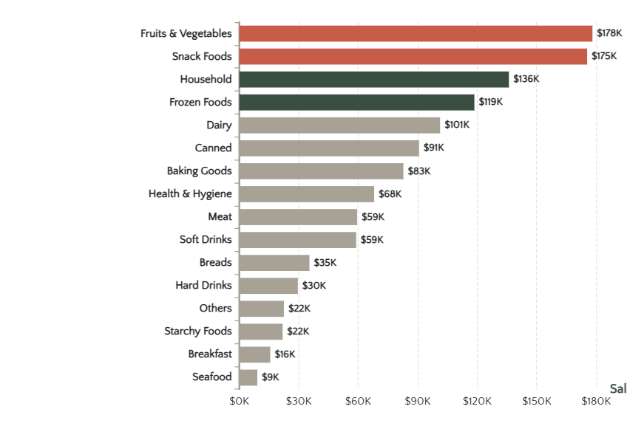
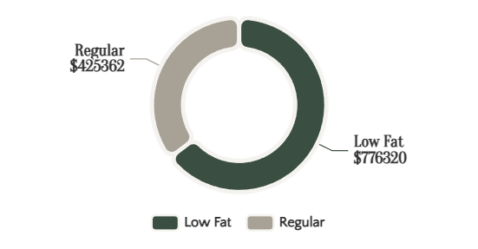
PRODUCT PERFORMANCE
Sales Performance by Product Category
Sales Revenue by Item Type
Fat Content Analysis
Top Performers
#1
Fruits & Vegetables
$178,124
#2
Snack Foods
$175,434
#3
Household
$135,977
#4
Frozen Foods
$118,559

Slide 7
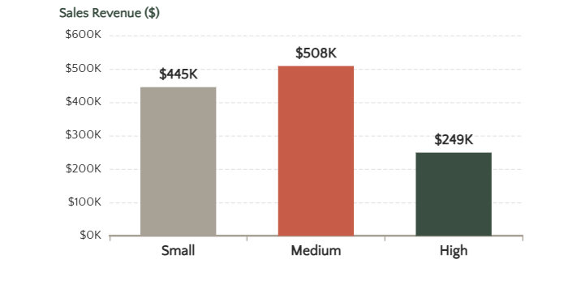
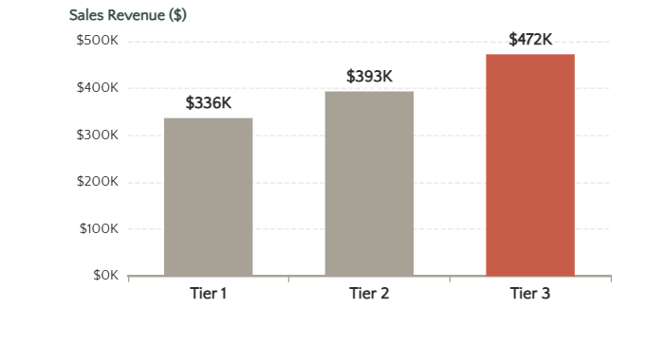

OUTLET ANALYSIS
Outlet Segmentation Performance
Sales by Outlet Size
Sales by Location Tier
Sales by Outlet Type
Key Insights
Medium outlets generate highest revenue
Tier 3 locations outperform urban tiers
Supermarket Type1 dominates with 65.5%

Slide 8
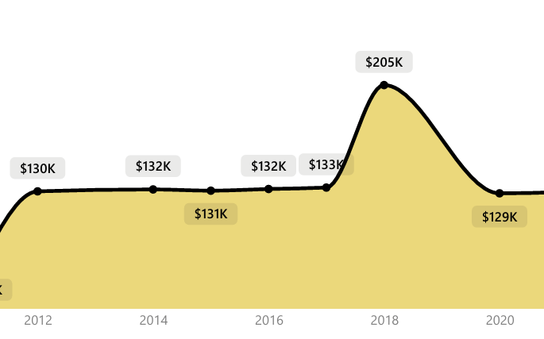
TEMPORAL ANALYSIS
Sales Trends by Establishment Year
Sales Evolution (2012-2022)
Peak Performance
Peak Year
2016
Peak Sales Revenue
$205,000
Trend Analysis
Growth Phase
2012-2016: Steady expansion
Decline Phase
2018-2022: Performance drop

Slide 9
KEY FINDINGS
Critical Insights & Performance Drivers
01
Top Revenue Categories
03
Medium-Sized Outlet Excellence
05
Supermarket Type1 Dominance
Fruits & Vegetables and Snack Foods emerge as the highest revenue-generating categories, collectively contributing $353,558 (29.4% of total sales).
Medium-sized outlets generate the highest revenue at $507,896, followed by small outlets. This suggests optimal operational efficiency in medium-scale setups.
Supermarket Type1 outlets dominate both revenue and volume, contributing $787,550 (65.5% of total sales) with consistent performance metrics.
$178,124
$175,434
42.3% Share
$507,896 Revenue
65.5% Share
5,577 Items
02
Low-Fat Product Dominance
04
Tier 3 Location Advantage
06
Post-2016 Sales Decline
Low-fat products contribute the majority of total sales at $776,320, representing 64.6% of revenue. This indicates strong health-conscious consumer preferences.
Tier 3 locations outperform Tier 1 and Tier 2 with $472,130 in sales, challenging assumptions about urban market superiority.
Sales peaked in 2016 at $205,000, followed by a consistent decline post-2018, indicating need for strategic intervention.
64.6% Share
$776,320 Revenue
39.3% Share
$472,130 Revenue
2016 Peak
-36.6% Drop
Strategic Implications
These insights reveal clear performance drivers and strategic opportunities for Blinkit's growth and optimization.
Focus on high-performing categories
Leverage low-fat product strength
Expand in Tier 3 markets
Reverse sales decline trend

Slide 10
ACTION PLAN
Strategic Recommendations for Growth
RECOMMENDATION #1
RECOMMENDATION #3
Prioritize High-Performing Categories
Target Tier 3 Expansion
Focus inventory investment and shelf space on Fruits & Vegetables ($178,124) and Snack Foods ($175,434) to maximize revenue generation.
Prioritize Tier 3 locations ($472,130) for future expansion given their superior sales performance compared to urban markets.
Fresh Produce
Snack Foods
Revenue Growth
Tier 3 Focus
Local Market
Expand Reach
RECOMMENDATION #2
RECOMMENDATION #4
Expand Medium-Sized Outlets
Strengthen Supermarket Type1
Scale the medium-sized outlet model ($507,896 revenue) as it demonstrates optimal efficiency and market penetration across locations.
Consolidate and strengthen Supermarket Type1 outlets ($787,550) which contribute 65.5% of total sales volume.
Scale Model
Optimize Ops
Replicate
Core Channel
65.5% Share
Invest More

Slide 11
ANALYTICAL BOUNDARIES
Limitations & Next Steps
Current Limitations
Recommended Next Steps
Simulated Dataset
Customer Segmentation Analysis
Dataset is simulated and not real operational data, which may affect insight applicability.
Integrate real customer demographic data to understand purchasing patterns, preferences, and lifetime value across different segments.
No Customer Demographics
Lacks customer demographic or profit margin information for deeper profitability analysis.
Profitability Analysis
Missing Real-Time Metrics
Incorporate cost data and profit margins to identify true profitability by category, outlet, and location tier.
No real-time operational metrics like delivery time or customer churn available.
Operational Efficiency Metrics
Methodological Note
This analysis demonstrates comprehensive data analysis and visualization capabilities using Power BI. The methodology encompasses data cleaning, aggregation, visualization, and insight generation to support data-driven decision-making processes.
Integrate real-time operational data including delivery times, order accuracy, and customer satisfaction scores.
Predictive Analytics
Develop forecasting models to predict sales trends, demand patterns, and optimal inventory levels.

Slide 12

ANALYTICAL ACHIEVEMENT
Driving Data-Driven
Excellence
This analysis demonstrates comprehensive capabilities in data processing, visualization, and insight generation, transforming raw sales data into actionable strategic recommendations.
Data Processing
Visualization
Insight Generation
Comprehensive cleaning, aggregation, and transformation
Interactive dashboards and analytical reports
Evidence-based recommendations for strategic decisions
The analysis highlights category performance, outlet segmentation, and temporal trends to support strategic decision-making. Continuous analytical improvement and evidence-based retail optimization will drive Blinkit's competitive advantage.
Power BI Analysis
January 2025
Hathim Manaf

