Slide 1
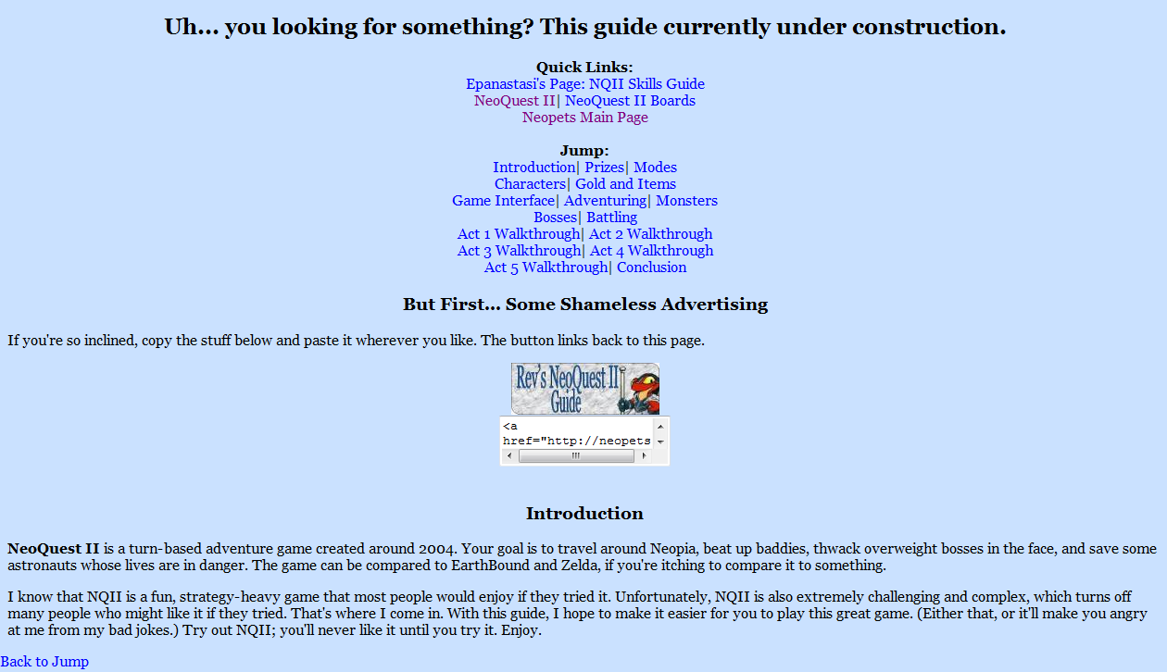
1.0 Blue Dinosaur
Version 1.0
This was my first jab at a petpage. It used old-school HTML with no CSS and was far from fancy. Or good.
“Blue Dinosaur”
Early July 2010

Slide 2
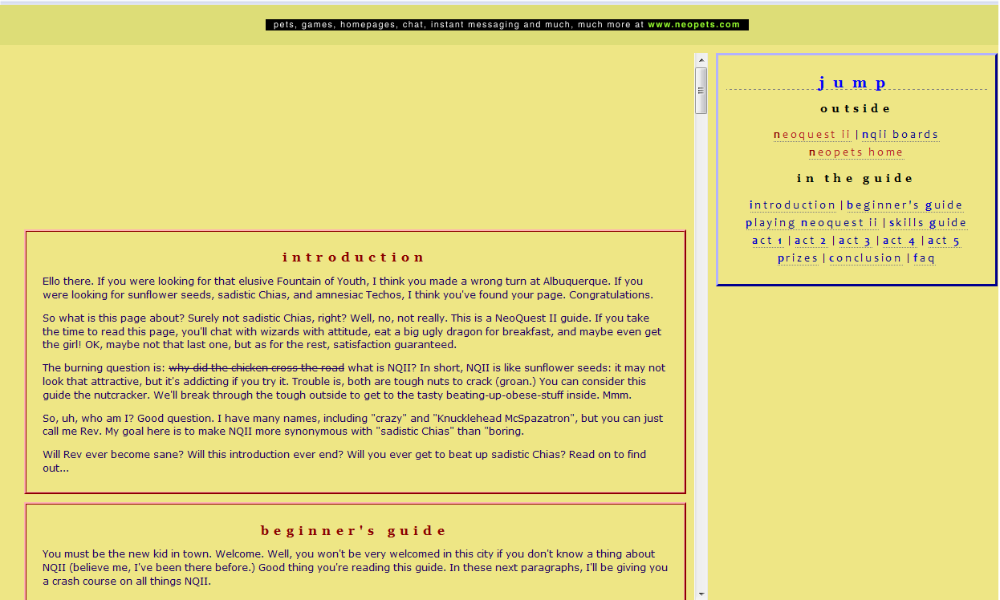
2.0 Golden Retriever
Version 2.0
“Golden Retriever”
Late July 2010
At this point I had learned CSS and put that to work. It was a cool layout (though not very pretty) but ran into problems (thanks a lot, IE) and got scrapped quickly.

Slide 3
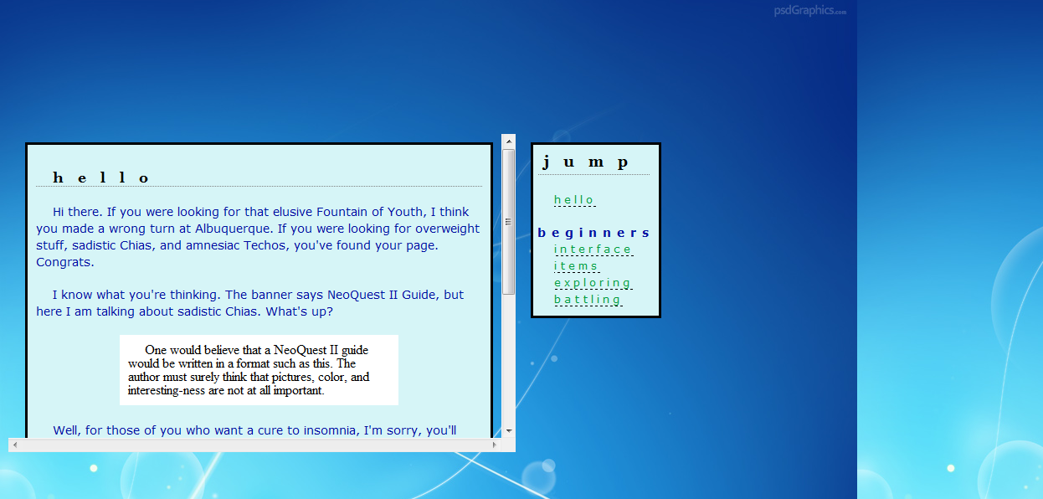
3.0 Back to Blue
Version 3.0
“Back to Blue”
Early August 2010
I couldn’t get 2.0 to work, so I started from scratch with a new layout. This shot is from 3.0’s very early stages.

Slide 4
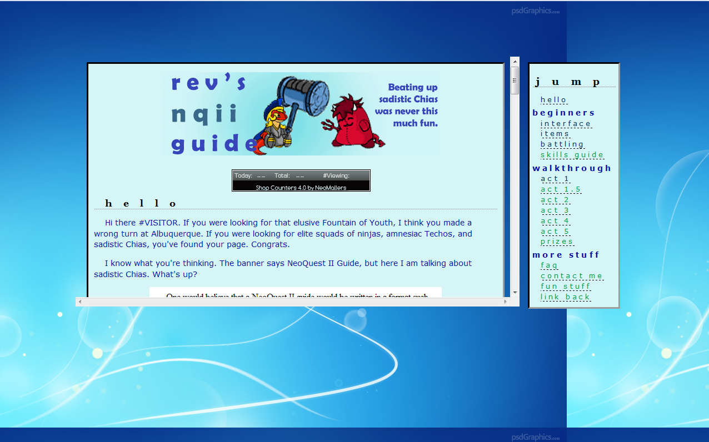
3.1 New Blue
Version 3.1.0
“New Blue”
Mid August 2010
This was the first presentation-quality version of the page. I expanded the width of the main box and improved the jump. There wasn’t much content though.

