Slide 1
Defining only streets as walkable areas using NavMesh

Slide 2
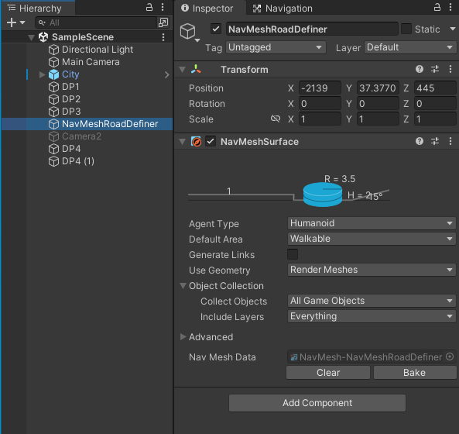
How to define the streets to follow and ignore grass and plants:
- To define the walkable areas and prevent the player to walk through hecken and grass etc., I used NavMesh.
- I created an empty game object and named it NavMeshRoadDefiner. In that game object, I added a NavMeshSurface as a component.
- it was humanoid and walkable.
- Then, I opened NavMesh game object and clicked "bake" in the inspector.
It nearly included everything but I should restrict it to the streets. In the next step, I explain how I de-selected other parts.

Slide 3
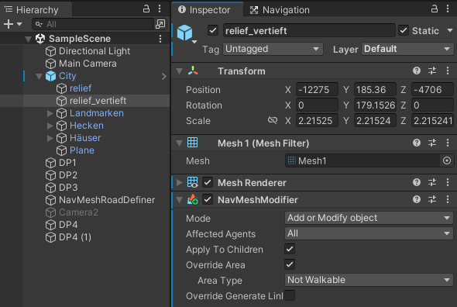
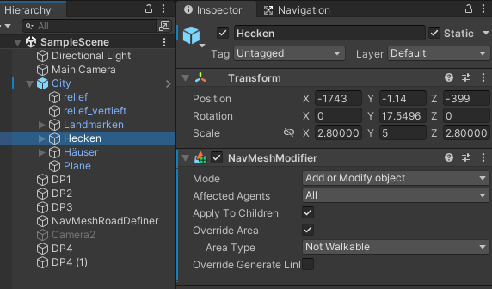
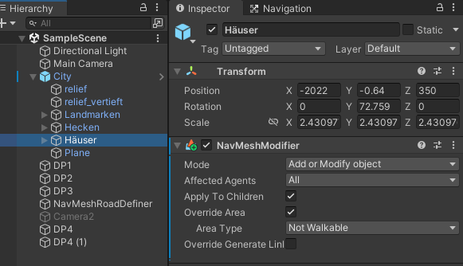
- Next, I opened relief_vertieft object in the inspector and I added a component "NavMeshModifier".
- I clikced "override area" and chose 'not walkable' area type.
- Then, I repeated the previous steps for hecken and häuser.
And I baked again. (as in the first page)

Slide 4
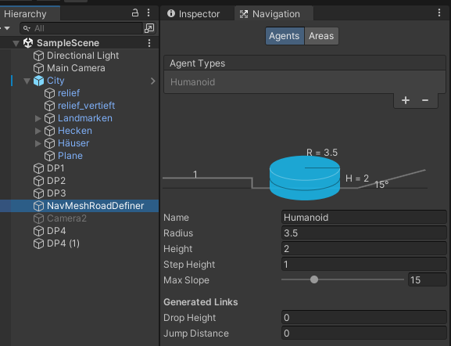
- To narrow down the street width, I increased the Navigation-Humanoid Radius. The higher it is, the narrower the street.
I needed this because in curved streets the player were going through the edges of the street.
When I narrow down the walkable area of the streets, it can no longer go to edges.
This works as the distance from the ‘banned’ areas. If the street is so narrow, the distance from both sides overlaps and makes it impossible to form a walkable path.

Slide 5
- Some hauses were tooking so much space on the streets and making it difficult for the NavMesh to define the streets as routes.
- To prevent it, I re-placed those houses:
- 46_01, 47_01, 47_02, 47_03, 47_04, 48_01, 48_02, 48_03,
- Then, I opened NavMesh game object and clicked "bake" in the inspector again.

Slide 6
Player Control

Slide 7
Decision Points

