Slide 1
Defining only streets as walkable areas using NavMesh

Slide 2
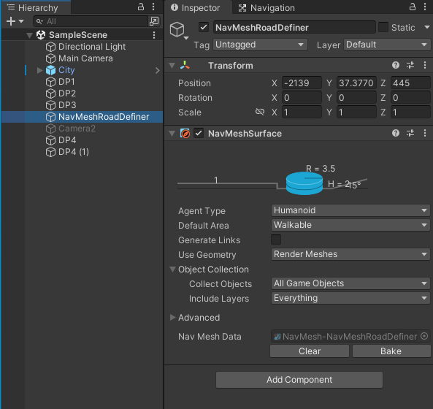
How to define the streets to follow and ignore grass and plants:
- To define the walkable areas and prevent the player to walk through hecken and grass etc., I used NavMesh.
- I created an empty game object and named it NavMeshRoadDefiner. In that game object, I added a NavMeshSurface as a component.
- it was humanoid and walkable.
- Then, I opened NavMesh game object and clicked "bake" in the inspector.
It nearly included everything but I should restrict it to the streets. In the next step, I explain how I de-selected other parts.

Slide 3
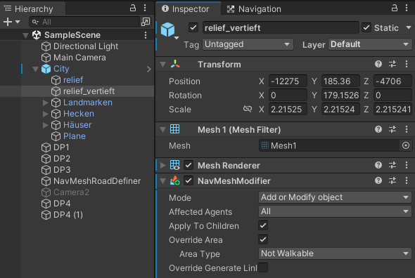
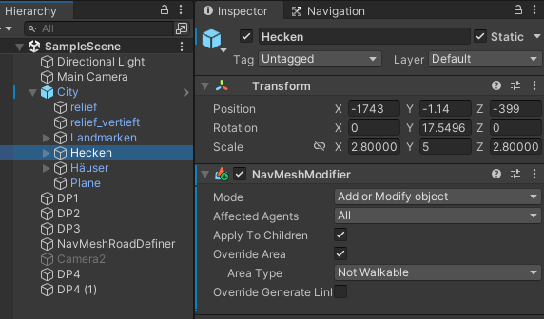
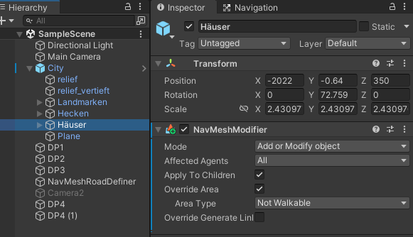
- Next, I opened relief_vertieft object in the inspector and I added a component "NavMeshModifier".
- I clikced "override area" and chose 'not walkable' area type.
- Then, I repeated the previous steps for hecken and häuser.
And I baked again. (as in the first page)

Slide 4
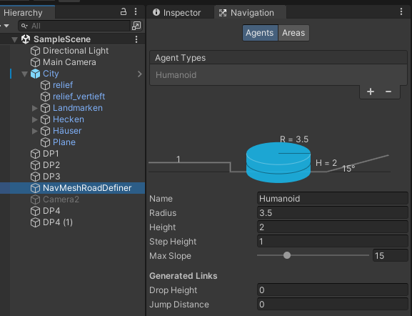
- To narrow down the street width, I increased the Navigation-Humanoid Radius. The higher it is, the narrower the street.
I needed this because in curved streets the player were going through the edges of the street.
When I narrow down the walkable area of the streets, it can no longer go to edges.
This works as the distance from the ‘banned’ areas. If the street is so narrow, the distance from both sides overlaps and makes it impossible to form a walkable path.

Slide 5
- Some hauses were tooking so much space on the streets and making it difficult for the NavMesh to define the streets as routes.
- To prevent it, I re-placed those houses:
- 46_01, 47_01, 47_02, 47_03, 47_04, 48_01, 48_02, 48_03,
- Then, I opened NavMesh game object and clicked "bake" in the inspector again.

Slide 6
Player Control

Slide 7
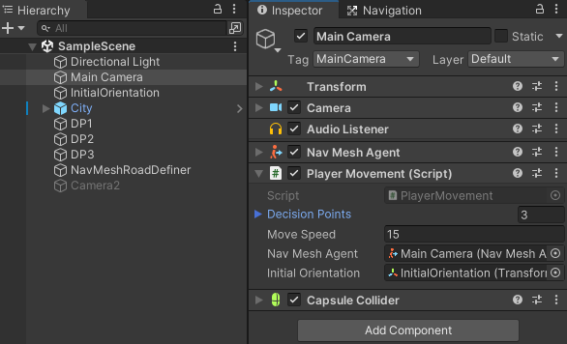
Main Camera is our Player
I added NavMeshAgent component to the Main Camera to make it move in the routes.
I attached the Player Movement Script to the main camera. In this script everything is defined.
To define the initial orientation, I created and empty game object and placed it to where I want the player to face at the beginning.
Then, under the Player Movement Script component, I dragged and dropped that InitialOrientation GameObject to the InitialOrientation area.

Slide 8
Decision Points

Slide 9
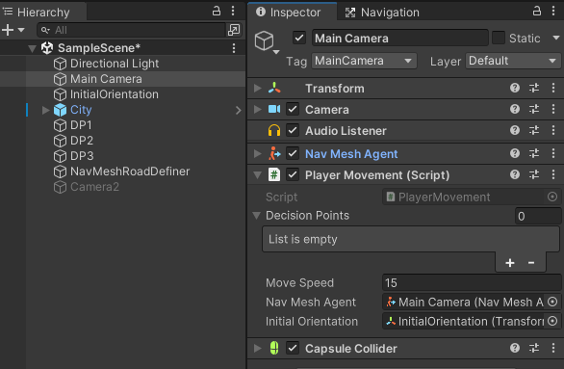
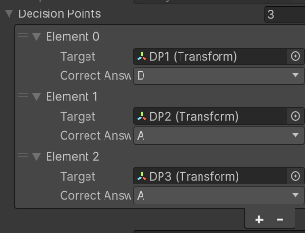
Under the player movement script component in the inspector, you see the Decision Points list.
Click plus sign to add the decision points.
Here, each element had the target and the correct answer to reach that target.
You should add the target decision point and select the correct button to reach that decision point.
For example, to go to DP1, ‚D‘ needs to be pressed.

Slide 10
Alert Messages

Slide 11
For the pop-up alert messages, I created a text object and implemented it in the PlayerMovement script. Then, I dragged that text GameObject to the Main Camera/Player Movement script.
In that text object, there the alertMessage script is attached.
In this script, two public functions are defined:
ShowAlert(string message): In player movement script, if I want to create a popup message, I create a string (myscript) and write the message in that. Then, I call this function ShowAlert(myscript) to show the alert message.
HideAlert(): this is to remove the alert message from the screen.
Within the player movement script:
if (shouldMove) # when it moves, no alert will be presented
alertMessageComponent.HideAlert();
if (isRotating) # when it is rotating
if (decCorrect) # if decision is correct
{
string rotationMessage = "Please rotate around to see your options and press button to proceed to the decision phase.";
alertMessageComponent.ShowAlert(rotationMessage);
}
else if (!decCorrect) # if decision is not correct
{
string errorMessage = "Your decision is wrong. You can rotate again or make a new response after pressing the space button.";
alertMessageComponent.ShowAlert(errorMessage);
}
if (rotationTimer >= rotationTimeLimit) # when the time is up, present alert.
string timeUpMessage = "Your time is up, please make your decision.";
alertMessageComponent.ShowAlert(timeUpMessage);
if (Input.GetKeyDown(KeyCode.Space)) # to remind them to make a decision.
string errorMessage = "Please make your decision.";
alertMessageComponent.ShowAlert(errorMessage);
If the decision is wrong:
string errorMessage = "Your decision is wrong. You can rotate again or make a new response after pressing the space button.";
alertMessageComponent.ShowAlert(errorMessage);

Slide 12
What is next?
Rotation sirasinda kalan süre ekranda yazsin.
Rotation sirasinda ‚Please look around. If you want to make a decision, press space button.‘ yazsin.
Decision sirasinda ekranda ‚Please select.‘ yazsin ve secenekler ciksin.
Secenekleri scene‘e ekle ve decision pointleri belirle.

Slide 13
Data Saving

Slide 14
I created a data list which includes trial data lists:
class Trial_Data
{
public string DP_Name { get; set; } // decision point name
public int Index_Number { get; set; } // the index number
public float ErrorNumber { get; set; } // number of errors
public float RT1 { get; set; } // reaction time during rotation
public float RT2 { get; set; } // reaction time during rotation
public float RT3 { get; set; } // reaction time during rotation
}
List<Trial_Data> data_list = new List<Trial_Data>(); // the list which consists of trial data

Slide 15
I created the required variables
private int numberofError = 0;
// Create possible reaction times for each try
private float RT_first = 0; // RT for the first try
private float RT_second = 0; // RT for the second try
private float RT_third = 0; // RT for the third try

Slide 16
If decision is correct
RT_first = rotationTimer;
data_list.Insert(currentDecisionIndex, new Trial_Data { DP_Name = decision_point_name,
Index_Number = currentDecisionIndex,
ErrorNumber = numberofError,
RT1 = RT_first,
RT2= RT_second,
RT3 = RT_third });
// reset the RTs and error number
RT_first = 0;
RT_second = 0;
RT_third = 0;
numberofError = 0;
if (currentDecisionIndex == 0)
{
decision_point_name = "DP1";
}
else
{
decision_point_name = decisionPoints[currentDecisionIndex-1].target.name;
}
I made this to keep correct track of the DP names.

Slide 17
If decision is correct
else
{
numberofError++;
if (numberofError == 1)
{
RT_second = rotationTimer;
}
else if (numberofError == 2)
{
RT_third = rotationTimer;
}
Increase the number of errors variable.
If it is the first error, then save the second RT.
If it is the third error, then save the third one
RT siralamasi dogru degil. 3.‘de dogru yapsa da onu RT1 diye kaydediyor. Bu siralamayi düzelt!!!

Slide 18
Get Subject ID

Slide 19
Design a welcome screen scene
I added an Input Field in the Welcome Screen Scene
I added Participant number text.
I created a script called GetSubID
In that script I created a function called ReadSubID
This function gets the entered string and assigns it to a variable.
Then, I added this script to a GameObject in the Scene
I added it to the ParticipantNumber text object
Then, in the InputField, at the OnEndEdit(String) filed, I added Participant Number text object and selected the function I created.

Slide 20
Send SubID and TimeInfo to PlayerMovement
In the playerMovement sctipt I declared a static string to call them in other scripts
public static string SubID;
In the GetSubID script, the function gets the input and assing it to SubID
public void ReadSubID(string s)
{ PlayerMovement.SubID = s; }
In GetSubID sctipt, I collected the time information to add the data file name.
I created a public static string exptime and I assigned the time information in that script.
Then, I named the data file in the PlayerMovement script:
private string fileName = SubID + "_" + GetSubID.exptime + ".csv";

Slide 21
SUBID and Conditions
In the GetSubID script, I turned subid string to an integer. Then, decided the scene order accordingly.
public void ReadSubID(string s)
{
PlayerMovement.SubID = s; // the SubID string in the Player Movement script is the input that this function gets
Debug.Log(PlayerMovement.SubID);
subIDint = int.Parse(s); // turn string SubID to integer
Debug.Log(subIDint);
if (subIDint % 2 == 0) // Check if SubID is even
{
sceneorder = new string[] { "MapA", "MapB" }; // The scene order is under File-Build Settings
}
else // SubID is odd
{
sceneorder = new string[] { "MapB", "MapA" };
}
Debug.Log(sceneorder[0]);
}

Slide 22
LoadScreen Script
I attached LoadLevel script to between scene instructions. When proceed it clicked, then the next scene is opened.
In this script, I created public static int i to keep track of test order.
Then, I call the array of sceneOrder I created in the GetSubID script.
According to i itetation, it opens the sceneorder[i] scene.
Then it increases i.
At the end of the experiment, when this instruction scene is last time called, i is 3. And if the i is 3, when the the button is clicked, the experiment ends.

