Slide 1
FRAGE
ilk formda kullanıcının giriş yapmasını isteyen,ikinci formda kullanıcıya cinsiyetini hangi şehirde yaşadığını ve hangi spor türlerinden hoşlandığını soran,üçüncü formda ise kullanıcıdan günün tarihini girmesini isteyen ve 60 saniye boyunca işlem yapmasa formları başa alan bir form uygulaması yazınız.
Schreiben Sie eine Formularanwendung, in der der Benutzer aufgefordert wird, sich im ersten Formular anzumelden, im zweiten Formular nach dem Geschlecht und der Stadt, in der er lebt, und nach den Sportarten, die er mag. In der dritten Form fordert er den Benutzer auf, das Datum des Tages einzugeben, und nimmt die Formulare für 60 Sekunden in Anspruch.
Write a form application that asks the user to login in the first form, in the second form, which asks the user in which city they live and their gender and which types of sports they like, and in the third form, they ask the user to enter the date of the day and handle the forms if they do not operate for 60 seconds.

Slide 2
Form 1
using System;
using System.Collections.Generic;
using System.ComponentModel;
using System.Data;
using System.Drawing;
using System.Linq;
using System.Text;
using System.Threading.Tasks;
using System.Windows.Forms;
namespace ProgramierungFinal1

Slide 3
{
public partial class Form1 : Form
{
public Form1()
{
InitializeComponent();
}
private void girisbtn_Click(object sender, EventArgs e)
{
string a = "b";

Slide 4
if (kullanicitxt.Text == "admin" && sifretxt.Text == "1234")
{
Form2 forma = new Form2();
forma.Show();
this.Hide();
a = "c";
}
else
{
MessageBox.Show(«Login fehlgeschlagen");
}
}

Slide 5
private void Kullanicilbl_MouseHover(object sender, EventArgs e)
{
Kullanicilbl.BackColor = Color.Green;
}
private void sifrelbl_MouseHover(object sender, EventArgs e)
{
sifrelbl.BackColor = Color.Red;
}
private void kullanicitxt_MouseHover(object sender, EventArgs e)
{
kullanicitxt.BackColor = Color.Aqua;
}
private void sifretxt_MouseHover(object sender, EventArgs e)
{
sifretxt.BackColor = Color.Gold;
}
}
}

Slide 6
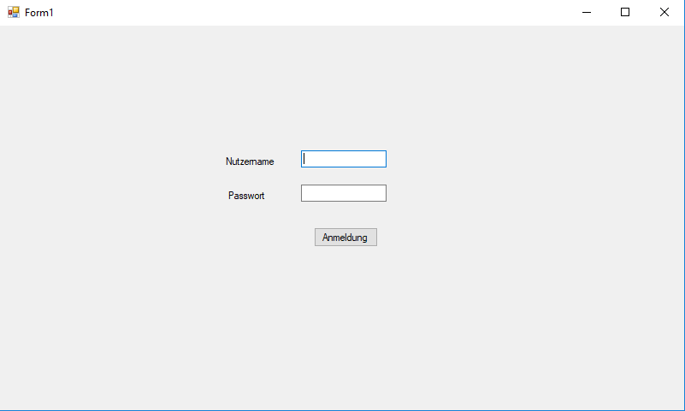

Slide 7
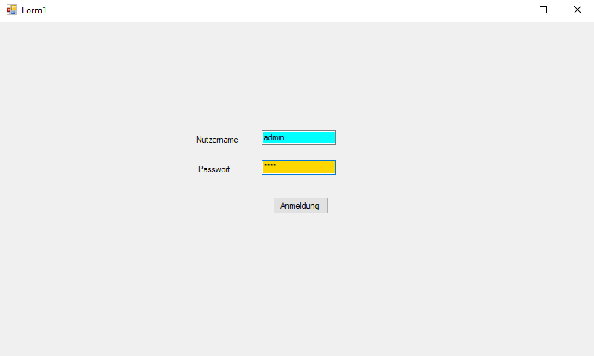

Slide 8
Form2
using System;
using System.Collections.Generic;
using System.ComponentModel;
using System.Data;
using System.Drawing;
using System.Linq;
using System.Text;
using System.Threading.Tasks;
using System.Windows.Forms;
namespace ProgramierungFinal1

Slide 9
{
public partial class Form2 : Form
{
public Form2()
{
InitializeComponent();
}
void function()
{
Form1 forma = new Form1();
forma.Show();
this.Hide();
}

Slide 10
private void button5_Click(object sender, EventArgs e)
{
function();
}
private void button6_Click(object sender, EventArgs e)
{
Form3 forma = new Form3();
forma.Show();
this.Hide();
}

Slide 11
private void button7_Click(object sender, EventArgs e)
{
listBox2.Items.Add(comboBox2.SelectedItem);
}
private void button8_Click(object sender, EventArgs e)
{
listBox2.Items.Add(textBox2.Text);
}
}
}

Slide 12
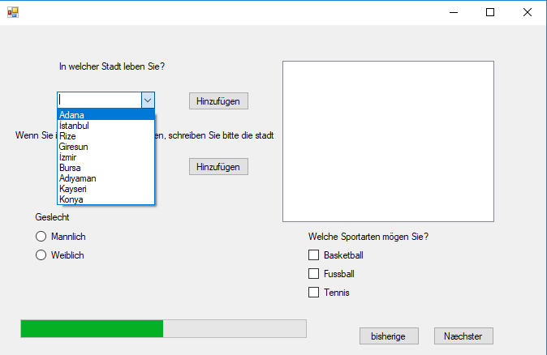

Slide 13
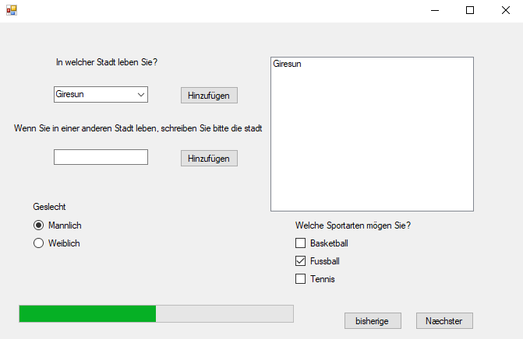

Slide 14
Form3
using System;
using System.Collections.Generic;
using System.ComponentModel;
using System.Data;
using System.Drawing;
using System.Linq;
using System.Text;
using System.Threading.Tasks;
using System.Windows.Forms;
namespace ProgramierungFinal1

Slide 15
{
public partial class Form3 : Form
{
public Form3()
{
InitializeComponent();
}

Slide 16
private void button1_Click(object sender, EventArgs e)
{
Form2 forma = new Form2();
forma.Show();
this.Close();
}
int sayi = 60;
private void timer1_Tick(object sender, EventArgs e)
{

Slide 17
if (sayi >= 0)
{
timer1.Interval = 1000;
timer1.Enabled = true;
int sayac = sayi--;
label2.Text = sayac.ToString();
while (sayac == 30)
{
MessageBox.Show("Noch 30 Sekunden");

Slide 18
}
}
else
{
Form1 forma = new Form1();
forma.Show();
this.Close();
}
}

Slide 19
private void Form3_Load(object sender, EventArgs e)
{
timer1.Interval = 1000;
timer1.Enabled = true;
}
}
}

Slide 20
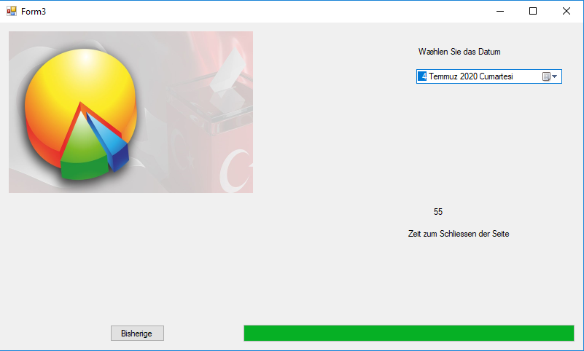

Slide 21
