Slide 1
EFFECT OF COVID-19 ON SPORT AND WEIGHT
Knowledge Mappıng and Data
H. Kemal İlter

Slide 2
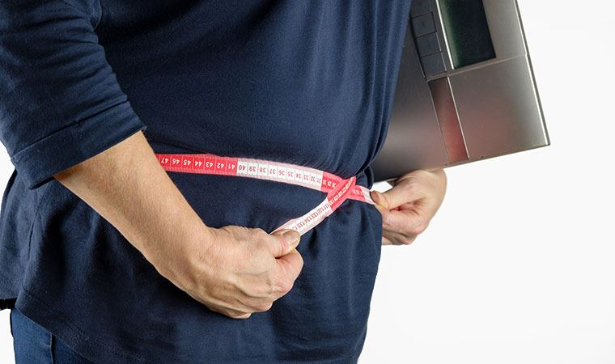
PROBLEM DESCRIPTION
The pandemic process that has been going on for about two years has affected all of us;
Today I will talk about a subject that I am also impressed with;
sport and weight problem ..

Slide 3
PROBLEM DESCRIPTION
Some researches show that people gain weight during the pandemic process and cannot actively exercise;
Why is not exercised and why is weight gain?
First of all, staying at home made us lazy so it is more difficult to do sports now, it was very easy to gain weight in this process that could not be done because we always ate at home whenever we were bored.

Slide 4
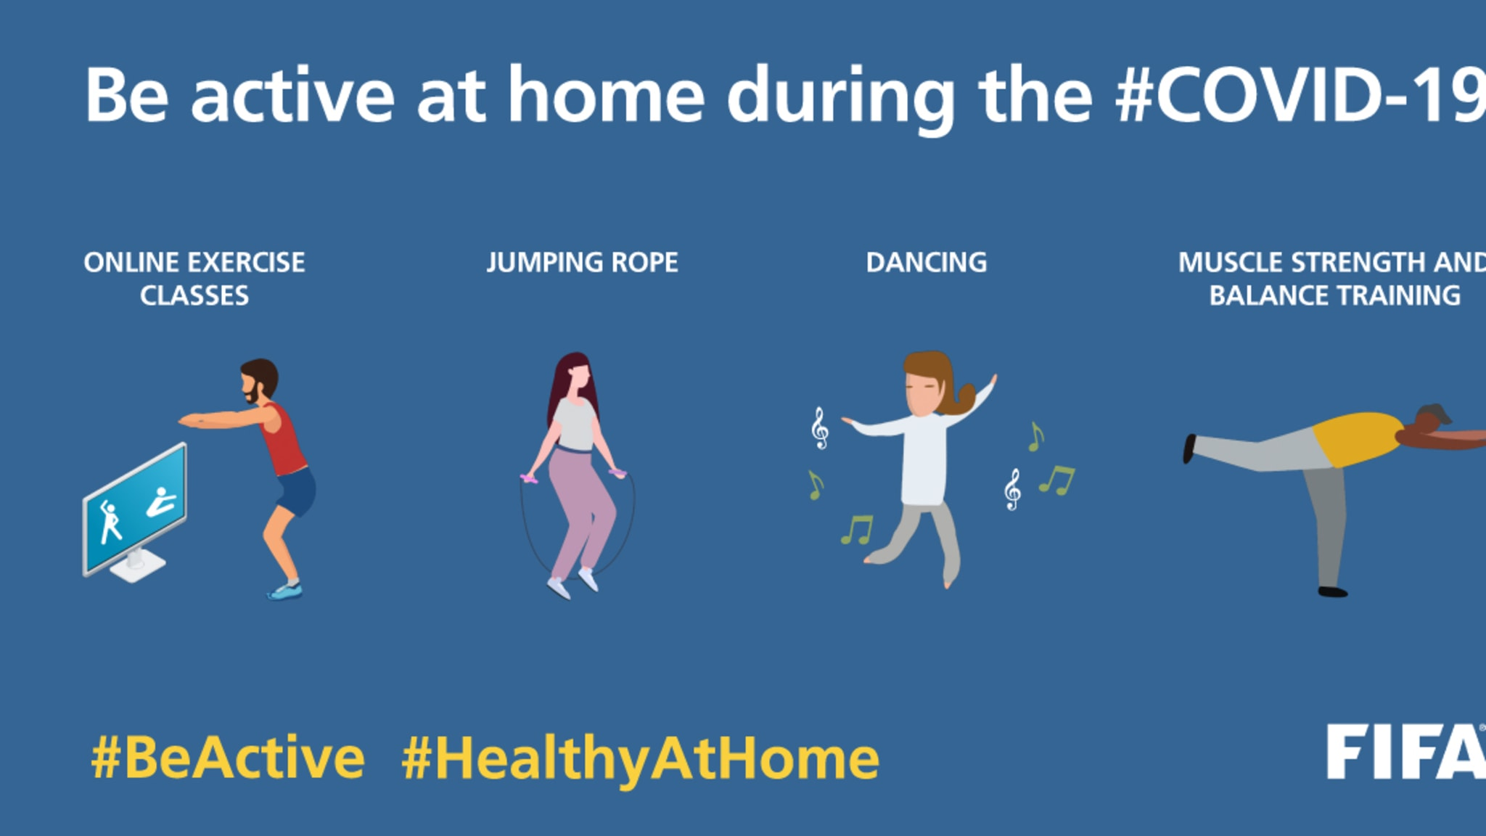
IMPORTANCE OF SPORTS
I think sport is an important point in human life, regular exercise causes countless changes in both our body and soul. Of course, these changes increase our health exponentially. In order to be healthy, fit and vigorous, we must exercise and be active at least three days a week.

Slide 5
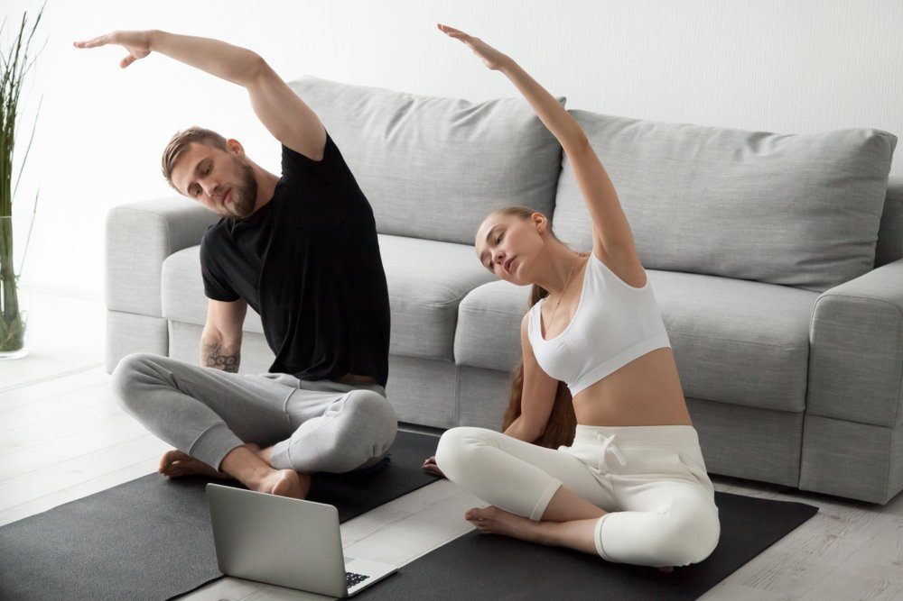
Son zamanlarda teknolojinin mevcudiyeti ile evde spor yapmak çok daha kolay. Youtube, Instagram, Twitch ve benzeri sosyal medya uygulamalarında video, resimli veya canlı spor yayınları yapılmaktadır.
Ayrıca araştırmalar, bu tür uygulamalar sayesinde karantinadaki sporun sağlıklı yönlerinin daha iyi anlaşıldığını ve insanların sporu öncelikleri arasına aldığını göstermektedir.

Slide 6
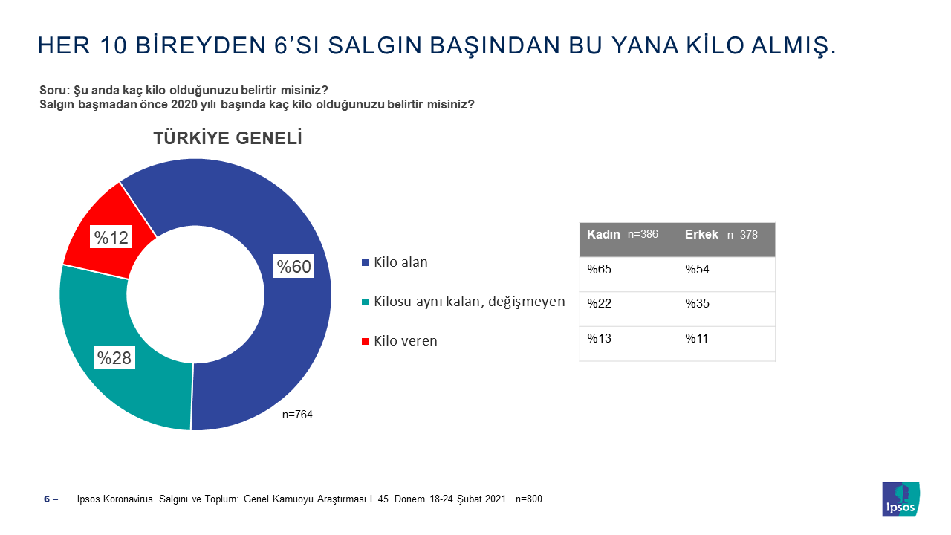

Slide 7
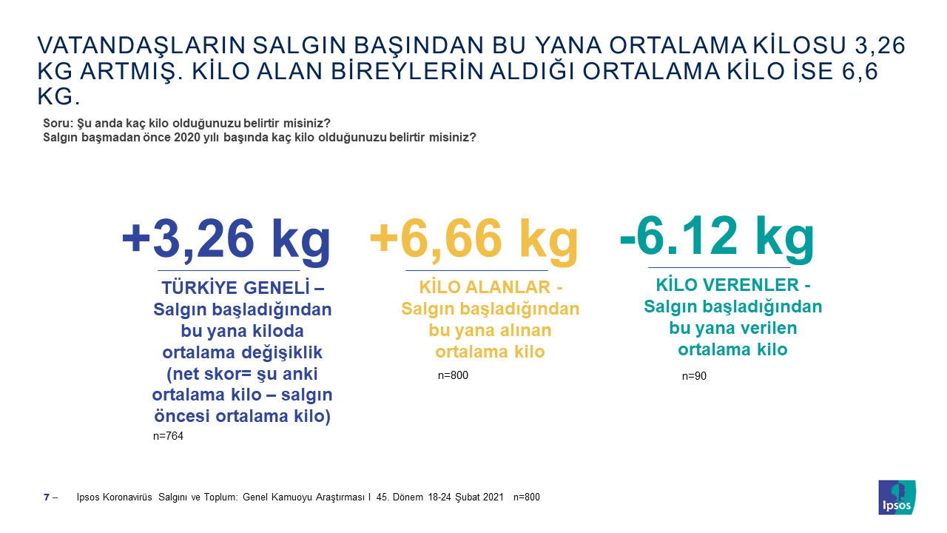

Slide 8
HATİCE SERİK
MIS -3
16030411011

