Slide 1

ZERO DEPENDENCY HACKATHON · TRACK F · OPEN / WILDCARD
llamini.cpp
A from-scratch llama.cpp core. Zero dependencies.
No ggml. No Python. No packages. libc and POSIX — and a Makefile.
C99
empty manifest
4 architectures
make → ./llamini
Notes:
RUN OF SHOW (~8 min with tape, ~10 with Q&A)
0:00–0:40 Slides 1–3. Title, why it exists, what shipped. Then play the tape.
0:40–5:40 Slide 4 — do not talk over the video. Voiceover is already in it.
5:40–6:00 Slide 5 recap only if a judge walked in late. Otherwise skip to Q&A.
Q&A ammo: 6 ldd · 8–9 four archs / PPL · 10–11 memory + why · 12 limits
Skip 7 (package table) unless someone asks what replaced ggml.
Cold open, matching Scene 1 of the demo video.
Say: llama.cpp runs inside Ollama, GPT4All, LM Studio — tools with over a hundred million downloads between them. This is what's actually inside it, rebuilt from scratch in C, with nothing but libc and POSIX. No ggml, no Python, no packages.
Then advance. If the room is already warm, skip 2–3 and go straight to the tape.

Slide 2
WHY THIS EXISTS
The inference engine nobody looks at
llama.cpp is load-bearing infrastructure. If it were a black box, so would every local LLM tool on a laptop.
Ollama
GPT4All · LM Studio
llama-cpp-python
179.8k GitHub stars
consumer apps
10.6k stars
100M+ Docker pulls
ship it under the hood
direct binding
depends on llama.cpp directly — pulled in and patched at build time
LM Studio's own blog credits “our llama.cpp engine”
the Python the rest of the stack actually calls
The thought experiment, grounded.
CVE-2024-3094 (xz-utils) was planted by a contributor persona over two years. Caught by one engineer noticing odd SSH timing — not a scan. If that class of compromise landed in llama.cpp instead of sshd, it would ride into every tool above. This project does not replace that stack. It makes the core readable, auditable, and reproducible by one person in a weekend.
llamini.cpp · Track F
2 / 14
Notes:
Do not overclaim. Say out loud: this is a hackathon-scale reimplementation of the core, not a production alternative to llama.cpp inside Ollama.
The value is legibility. GGUF, block dequant, RoPE, GQA — not a black box that has to be taken on faith from one upstream codebase.
vLLM is NOT on this list (separate engine). Don't add it.

Slide 3
WHAT SHIPPED
The core, written out by hand
GGUF parser
What you do not install
header, all 13 metadata types, tensor-info table, bounds-checked mmap
— ggml / llama.cpp as a library
9 quant formats
— sentencepiece / tiktoken
F32 F16 Q4_0 Q4_1 Q5_0 Q8_0 Q4_K Q5_K Q6_K
— numpy / a BLAS
Transformer pass
GQA/MQA attention, RoPE NORM+NEOX, SwiGLU/GeGLU, LayerNorm
— llama-cpp-python
— CMake, vcpkg, Conan
Two tokenizers
SentencePiece-BPE and byte-level BPE, from the file's own vocab
— any Python runtime
Four families
One command builds it.
make → ./llamini
LLaMA, Qwen2, GPT-2, Gemma — auto-detected from general.architecture
llamini.cpp · Track F
3 / 14
Notes:
This is the claim before the tape. Keep it short. The video will prove the build, the zero-download test, live inference, and ldd.
Emphasize: a .gguf is runtime input you supply, like cat needing a file — not a build dependency.

Slide 4
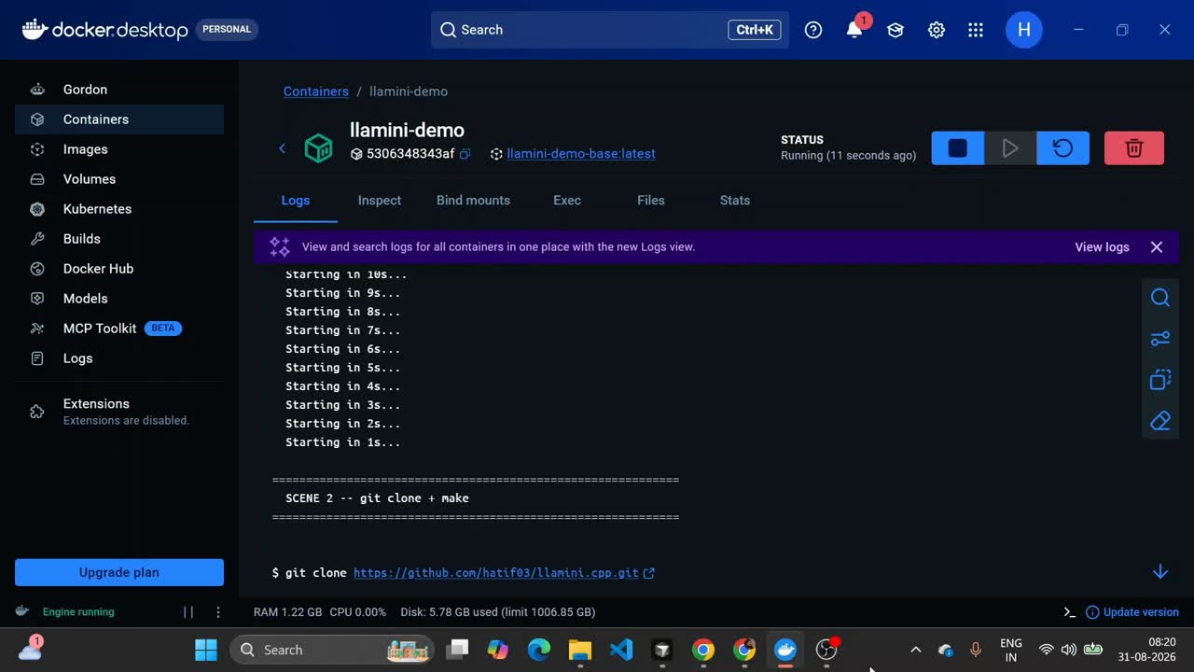

Slide 5
AFTER THE TAPE
Six things that tape just proved
01
02
03
One command
Zero downloads
Honest setup
make. No CMake, no vcpkg, no package manager — gcc and a Makefile.
./llamini --test builds a synthetic model in memory. The binary works before any .gguf exists.
--setup prints the curl command. HuggingFace is HTTPS-only; TLS or shelling out would break the rule.
04
05
06
Real inference
A checkable number
Empty manifest
GPT-2, real GGUF weights, byte-level BPE, a real transformer forward pass — live, at real speed.
Teacher-forced perplexity 20.58 on GPT-2. Three orders of magnitude below a broken model.
ldd: libc and libm only. grep for every package file: no output.
llamini.cpp · Track F
5 / 14
Notes:
Use this if a judge walked in late, or as a 20-second recap before Q&A.
Do not re-litigate the video. Point at 05 and 06 if you only have time for two.

Slide 6
ZERO-DEPENDENCY CRAFT
The proof, not the claim
$ ldd llamini
Linked libraries
linux-vdso.so.1
2
libm.so.6 => /usr/lib/x86_64-linux-gnu/libm.so.6
libc.so.6 => /usr/lib/x86_64-linux-gnu/libc.so.6
libc + libm
vdso and ld-linux are the kernel and the dynamic linker, not packages.
/lib64/ld-linux-x86-64.so.2
# libc and libm. Both standard. Nothing else.
Why --setup prints curl
$ grep -RIlE 'package.json|Cargo.toml|vcpkg.json|CMakeLists.txt' .
HuggingFace is HTTPS-only. Hand-rolling TLS, or quietly shelling out to curl, both break the rule. So the command is printed — you read it before you run it.
(no output = no matches)
llamini.cpp · Track F
6 / 14
Notes:
Match Scene 8. If a judge asks about -pthread: this glibc merges pthread into libc.so.6; the thread pool still uses real pthreads, resolved from libc. See deps-proof.txt.
If they ask 'why not just download the model': this slide's right card is the answer.

Slide 7
STDLIB.MD
What this replaces
People actually install | Replaced here by
ggml / llama.cpp as a library | gguf.c + model.c + gpt2.c
sentencepiece / libsentencepiece | tokenizer.c (SPM path, from the GGUF vocab)
byte-level BPE (tiktoken-adjacent) | tokenizer.c (second path, rank-based merges)
numpy / a BLAS | linear() in model.c (thread pool + lazy dequant)
llama-cpp-python, ctransformers | the CLI is the binary
huggingface_hub / silent curl | printed curl command + POSIX stat()
CTest / Unity / Check | --test + printf (C has no stdlib test runner)
llamini.cpp · Track F
7 / 14
Notes:
This is the Package Killer bonus, stated as a table. Don't read every row.
Say: every row has a rationale in STDLIB.md — including what we deliberately did NOT substitute (no true int8 quantized dot product, GPT-2 weights still eager).
Scope, out loud: not a ggml reimplementation. Four families, the quants those files actually use, no GPU, no LoRA, no batching.

Slide 8
GENERAL.ARCHITECTURE
Four families, auto-detected from the file
Model | Arch | Params | Tokenizer | PPL* | Facts
TinyLlama-1.1B-Chat | llama | 1.1B | SentencePiece | 13.28 | 1 / 3
Qwen2.5-0.5B-Instruct | qwen2 | 0.5B | byte-level BPE | 10.84 | 3 / 3
GPT-2 | gpt2 | 124M | byte-level BPE | 20.58 | 0 / 3
Gemma-2b-it | gemma | 2.5B | SentencePiece | 73.05 | 2 / 3
* Teacher-forced perplexity over the same ~35-token English corpus. Not comparable across vocab sizes — compare each number to its own random-guess ceiling: TinyLlama ~32,000 · Qwen2.5 ~151,936 · GPT-2 ~50,257 · Gemma ~256,128. All four sit two-to-three orders of magnitude below chance.
GPT-2 is its own module (fused QKV, LayerNorm, learned positions, no RoPE). Qwen2 needed NEOX RoPE, QKV bias, and Q5_0 — found by probing the real file, not assumed from the “Q4_K_M” name. Gemma was untestable at ~10–12 GB until lazy dequant dropped it to ~1.5 GB.
llamini.cpp · Track F
8 / 14
Notes:
Match Scene 7. Hold each Config: line in the video so it's readable.
Do not rank the four PPLs against each other without the ceiling caveat.
Mistral was skipped on purpose: its GGUF architecture is literally 'llama', so loading it would prove nothing new. Gemma2 (softcapping, sliding window) was a scoping decision.

Slide 9
--BENCH
Not “it looks like English”
20.58
13.28
10.84
73.05
GPT-2 PPL
TinyLlama PPL
Qwen2.5 PPL
Gemma-2b PPL
ceiling ~50,257
ceiling ~32,000
ceiling ~151,936
ceiling ~256,128
How the number is made
Teacher forcing: at every position, measure the probability the real logits assign to the actual next token. Never sampling. A uniform-random guess over a vocab has perplexity equal to the vocab size. 20.58 vs ~50,257 is the claim that the forward pass is doing language modeling, not emitting token-shaped noise.
No reference llama.cpp was linked to diff against — staying zero-dep. So this is a self-contained check, plus known-fact completions (Qwen 3/3, Gemma 2/3, TinyLlama 1/3, GPT-2 0/3). A 124M model missing “Paris” is a capability limit, not papered over as a pass.
llamini.cpp · Track F
9 / 14
Notes:
Match Scene 6. Freeze/zoom in the video on: Teacher-forced perplexity over 35 tokens: 20.58 and the session-summary block.
WRITEUP confession worth having ready: an AI search once invented a TinyLlama PPL citation that was not in the paper. That's why --bench compares against the vocab ceiling, a number that needs no citation.

Slide 10
THE NUMBER THAT BEATS REAL LLAMA.CPP
Less memory. Same machine. Unmodified upstream.
Model | llamini RSS | llama.cpp RSS | Winner
TinyLlama-1.1B | ~710 MB | ~1.12 GB | llamini
Qwen2.5-0.5B | ~480 MB | ~558 MB | llamini
Gemma-2b | ~1.54 GB | ~2.66 GB | llamini
GPT-2-124M | ~831 MB | ~169 MB | llama.cpp (disclosed)
Resident memory dropped ~6–7× after the CPU pass (4.4–4.9 GB → 700 MB–1.5 GB) — weights dequantize on demand from the mmap’d file, not a persistent f32 copy. That is also how Gemma-2b went from untestable to ~1.54 GB resident.
Built unmodified ggml-org/llama.cpp (commit 0b5be7e) from source, outside this repo, never vendored, never invoked by the submitted binary. GPT-2 loses because gpt2.c was not brought onto the lazy path — written down in STDLIB.md, not a mystery.
Do not claim a speed win. Timing on this WSL2 guest is noisy for both engines (llama.cpp’s own ± often exceeds its mean).
llamini.cpp · Track F
10 / 14
Notes:
Match Scene 9. STAY ON MEMORY. If a judge asks about tok/s, say: directional only, different measurement (our --bench includes prefill; llama-bench tg32 is pure decode), and the VM noise drowns both. The unambiguous number is RSS on TinyLlama / Qwen / Gemma.
Machine: i5-1235U, 16 GB host, WSL2 guest capped at ~7.6 GB — that's why Gemma was originally untestable.

Slide 11
CPU OPTIMIZATION · RESEARCHED FROM REAL GGML, REIMPLEMENTED IN LIBC
Two changes. Bit-identical output.
01 Persistent thread pool
02 On-demand row-chunk dequant
linear() used to pthread_create / pthread_join on every call — about nine spawns per layer per token. TinyLlama’s 22 layers: ~200 thread births to emit one word.
Now: a pool created once. Workers block on a condvar between jobs. No work-stealing, no NUMA — one hot call site.
Caught on paper before running: a naive broadcast lets idle slots read stale job data from the previous dispatch. Each worker now checks that its slot actually got work this round.
CPU batch-1 inference is memory-bandwidth bound. ggml never materializes a full f32 tensor — that’s the actual lever, not FLOPs.
Big weights (embeddings, lm_head, every projection) dequantize in 256-row chunks straight out of the mmap’d file, into a small scratch buffer, then the existing f32 dot product.
Chunk size is fixed, not “split by core count.” Gemma’s 256,128-row embed would otherwise need a multi-hundred-MB buffer per worker — the problem, moved down one level.
Measured: ~4.4–4.9 GB → ~700 MB–1.5 GB (6–7×). Gemma-2b went from untestable to verified at ~1.5 GB. Acceptance bar was bit-identical generated text against the pre-change binary, not “doesn’t crash.”
Still simpler than ggml, on purpose: no int8×int8 kernels, lazy path is serial, GPT-2 weights were not brought onto it. That’s the RSS loss on slide 10.
llamini.cpp · Track F
11 / 14
Notes:
This is the 'how' behind slide 10. Use it in Q&A, not before the tape.
Key sentence: we read ggml-cpu.c / quants.c, then reimplemented the two ideas inside libc+POSIX — we did not copy the source.
If they ask why the lazy path isn't threaded: bandwidth-bound work racing for the same bytes isn't an obvious win, and threading it reopens the Gemma scratch-buffer problem.

Slide 12
ARCHITECTURE.MD
One concern per file
gguf.c
main.c
model.c
mmap the file. Parse header, metadata, tensor-info. Don't touch weights yet.
Read general.architecture. gpt2 → gpt2.c. Else LLaMA-family (llama / qwen2 / gemma).
Config from namespaced keys. Big weights stay lazy. Norms/biases stay eager.
tokenizer.c
generate.c
kv_cache.c
Vocab lives in the GGUF. SPM or byte-level BPE, dispatched at load time.
Prefill every prompt token into the KV cache, then sample. Same forward_step as --bench.
One cache per layer, sized to kv_dim — not the full embedding width.
llamini.cpp · Track F
12 / 14
Notes:
Don't walk every file unless asked. The two details worth volunteering:
1. GPT-2 is a separate module because folding fused QKV + LayerNorm + no-RoPE into model.c would have made that file worse, not better. It still reuses linear() and causal_mha().
2. generate_autoregressive prefills the whole prompt. Early on, a bug only embedded the last token — fluent English, disconnected from the input. Tests caught the off-by-one that followed.

Slide 13
NAMED IN THE README, NOT PAPERED OVER
What this is not
Single-turn only
GPT-2 weights still eager
Every chat line resets every layer's KV cache. No conversational memory.
That's why GPT-2 RSS loses to llama.cpp. Written down, not left to be discovered in the table.
Chat template is TinyLlama-only
Lazy path is simpler than ggml
Best-effort from tokenizer_config.json, not verified against transformers. Qwen2 (ChatML) and GPT-2 are raw-completion.
Dequant to f32 scratch, then dot. No int8×int8 kernels. Serial, not thread-pooled — chunk size is for bounded memory, not peak FLOPs.
Partial quant coverage
No GPU, no LoRA, no batching
The 9 formats the four files actually use. Q2_K / Q3_K / Q8_K / IQ* return -1, never silently misread.
CPU, batch-1, one process. A weekend core, not a production engine.
Sampling is small
Mistral / Gemma2 / BERT skipped
Greedy default. --temp adds temperature + top-p. No top-k, no repetition penalty, no --seed.
Mistral's GGUF arch is literally “llama”. Gemma2 adds softcapping and sliding windows. BERT is a different product shape.
llamini.cpp · Track F
13 / 14
Notes:
Honesty is a scoring category here, not a vibe. If you only name two: single-turn, and GPT-2's eager weights (so the memory table doesn't look like a dodge).
Chat template wrinkle: typing '</s>' as text does NOT merge into the real EOS token. The prompt is built at token level and inserts eos_id directly.

Slide 14
NOTHING HERE IS A BLACK BOX
Every package. Every file. Every mistake.
STDLIB.md
ARCHITECTURE.md
Every package this would normally need, and exactly what replaced it.
Every file, in order, for a human who has never seen the tree.
BUILDLOG.md
deps-proof.txt
What was tried, including what made things worse.
ldd, the empty grep, the machine the numbers came from.
make && ./llamini --test
Questions — start with the tape, STDLIB.md, or the memory table.
Notes:
Match Scene 10. Close on the repo, not a slogan.
If time remains: offer to walk STDLIB.md live, or rerun --test / --bench.
Q&A likely hits: why not download models (TLS), why GPT-2 uses more RAM (eager weights), why Gemma PPL is higher (vocab ceiling), why no speed claim (measurement mismatch + VM noise).

