Slide 1
SNIFF
The AI mystery shopper
for your website
An autonomous browser agent that tests signup flows and audits landing pages the way a real, easily-confused human would — then tells you exactly why they left.
sniff-web.vercel.app
Hackathon submission · 2026

Slide 2
THE PROBLEM
“Why aren’t people signing up?” has no honest, evidence-backed answer today.
6.6%
70.2%
$260B
median landing-page conversion rate across all industries
average documented checkout/signup abandonment rate
in recoverable lost orders across US+EU e-commerce from fixable checkout/UX friction
Unbounce, 2025 Conversion Benchmark Report
Baymard Institute, 2025 (50-study meta-analysis)
Baymard Institute, checkout usability research
2

Slide 3
THE SOLUTION
An agent that behaves like a real visitor, not a script.
TRADITIONAL QA
SNIFF
• Hardcoded CSS selectors
• Breaks the moment the UI changes
• Tells you pass/fail, never why
• Can't judge confusing copy or clutter
• Looks at the real screenshot, like a person
• Decides the next click from what it sees
• Diagnoses root cause, severity, owner
• Scores clarity, trust, and friction directly
3

Slide 4
THE PRODUCT
Two surfaces, one agent.
01
02
Signup / Onboarding Testing
Landing-Page Conversion Audit
• Persona-driven runs (confused first-timer, impatient user, careful reader)
• Root-cause diagnosis: Backend / UX / Performance / Integration
• Severity classification P0–P3, escalated via Slack
• Overall score + 5-dimension breakdown (clarity, fit, action path, trust, depth)
• Annotated screenshot of exactly what it clicked
• Step-by-step narrative, copy rewrites, prioritized fixes — nothing paywalled
4

Slide 5
HOW IT WORKS
Three-tier reasoning stack — smart where it matters, cheap everywhere else.
TIER 1 · DETERMINISTIC
TIER 2 · JEV (ULTRA-FAST)
TIER 3 · GEMINI + K2-HORIZON
Free DOM/CSS checks
Sanity gate & routing
Vision-grounded judgment
Colors, fonts, link health, Core Web Vitals, SEO/meta — zero model calls
Goal-reached checks, context enrichment, decision critique
Navigation decisions, scoring, narrative, copy rewrites
5

Slide 6
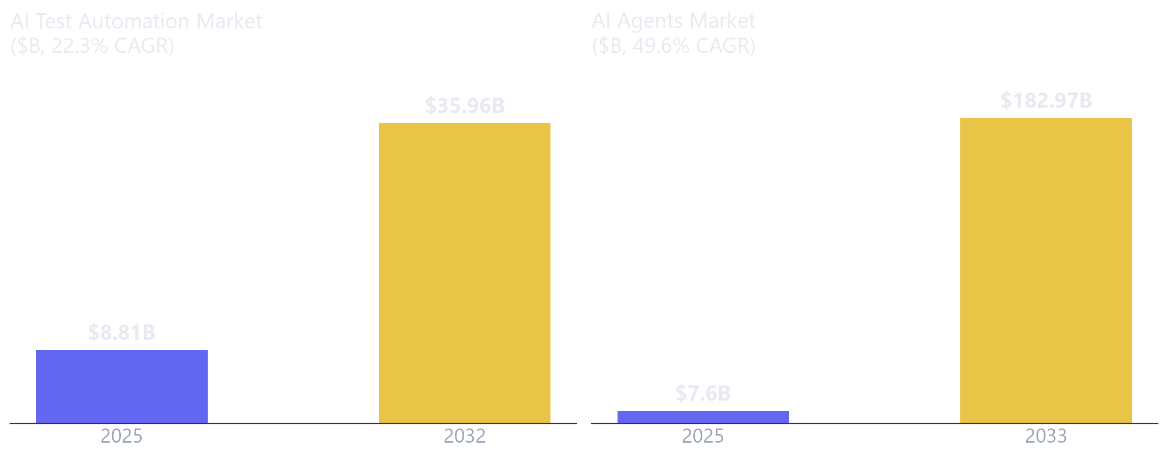
MARKET
The market this sits in is compounding fast.
Sources: MarketsandMarkets, “AI Test Automation Market” (2026) — marketsandmarkets.com
Grand View Research, “AI Agents Market Size To Reach $182.97 Billion By 2033” — grandviewresearch.com
6

Slide 7
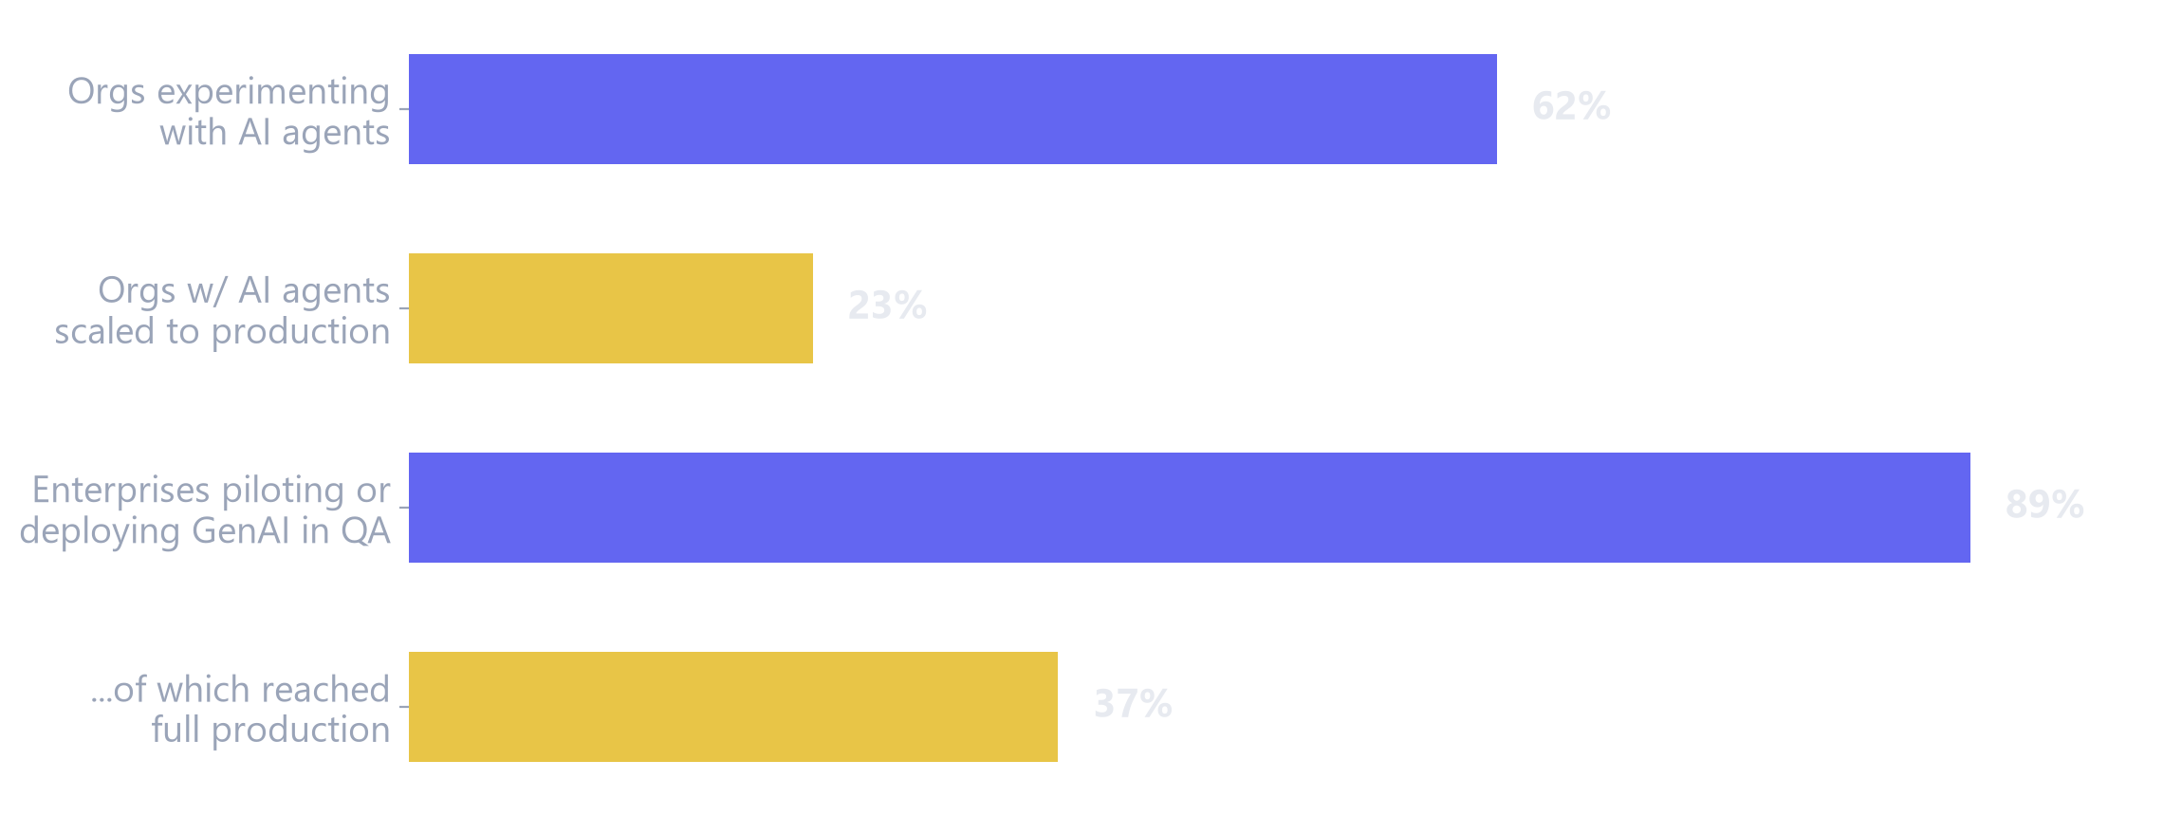
WHY NOW
Enterprises are already moving — most just haven’t scaled yet.
Gartner forecasts 70% of enterprises will have AI-augmented software testing tools in their engineering toolchain by 2028, up from ~20% in early 2025.
Sources: McKinsey & Company, “The State of AI in 2025” (2025) — mckinsey.com
Capgemini, “World Quality Report 2025–26” (17th ed.) — capgemini.com · Gartner, AI-Augmented Software Testing Tools Magic Quadrant (Oct 2025)
7

Slide 8
TRACTION
Built, tested, and live — not a mockup.
153 / 153
3
2
100%
automated tests passing
AI providers wired live — Gemini, k2-horizon, Jev
products in one agent — signup testing + conversion audit
public access — no signup required for judges
Deployed end-to-end: FastAPI backend on Cloud Run, Next.js frontend on Vercel. Verified with real runs and real audits against the live stack.
8

Slide 9
Try it live.
Paste any URL and watch an AI agent tell you the truth about your website.
sniff-web.vercel.app
9

