Slide 1
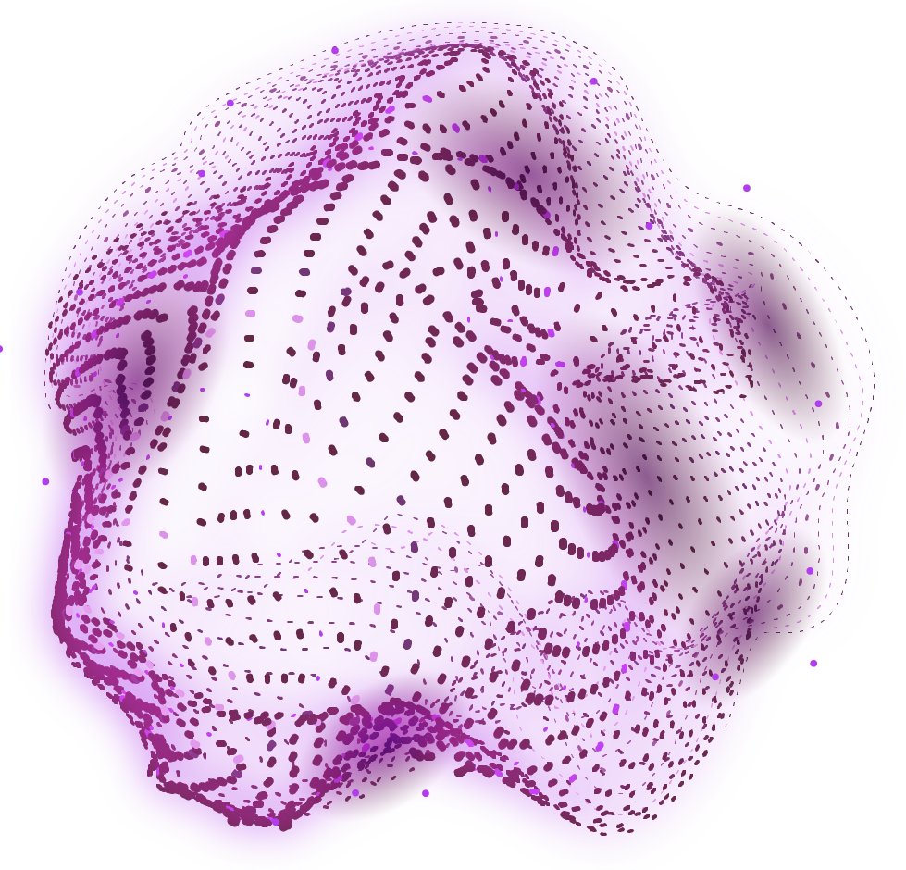
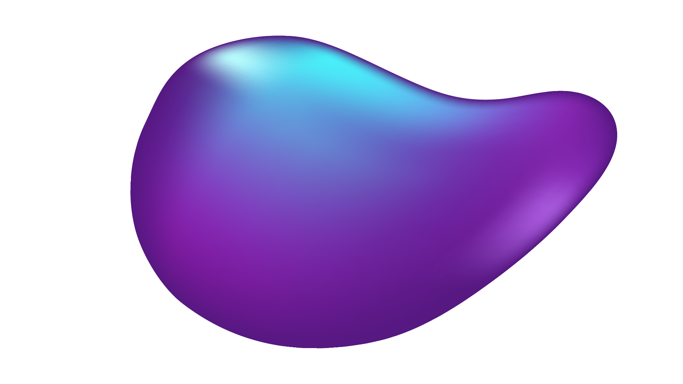

Pulse AI - ValveGuard
Dynamic Surveillance for Bioprosthetic Valve Durability
Athanasiou-Paraskevopoulou Maria – Medical Student
Chatzipapas Konstantinos – Electrical and Computer Engineering Student
Myaris Stylianos – Informatics Student
September 2026 – Dyania Health Hackathon

Slide 2
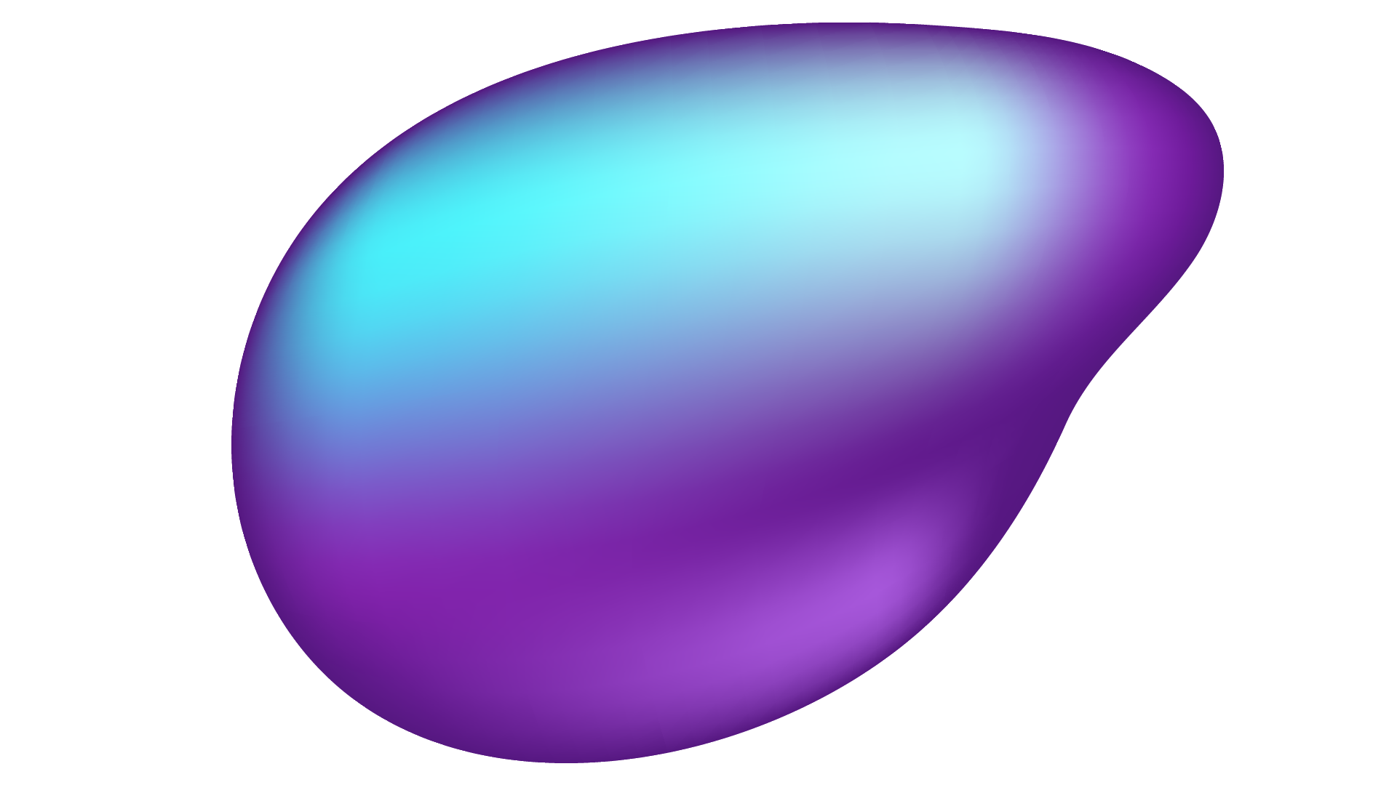
The Clinical Problem
What is SVD and why durability matters:
Current Workflow Failure
The Surveillance Gap
Bioprosthetic valves wear out over time.
The shift: patients receiving are younger than ever & outlive their bioprostheses.
Reactive Clinical Mindeset | Action triggered after symptoms - collapse
Loss to Follow-Up | Over 40% of post-AVR patients skip checkups once asymptomatic
Measurement Variability | Operator-dependent errors distort calculations
Clinical Cost | Irreversible myocardial remodeling, pulmonary edema, shock
Financial Cost | Emergent re-admissions, prolonged ICU stays, emergency procedures
Valve decay is silent until it is severe → standard annual follow-ups are too rigid.
Patients are often diagnosed 1 to 2 years too late – presenting to the ER with shortness of breath.
The stakes:
Caught early: <3% mortality
Caught late: - Emergency Fix: >8-10% mortality
The SAVR vs TAVR Uncertainty
SAVR (Surgical): Durability documented over decades.
TAVR (Transcatheter): Unique procedural wear-and-tear, medchanical stress.
TAVR moves into younger patients faster than the evidence.

Slide 3

Our Hypothesis
Learn
Reconstruct
Anticipate
- from thousands of valves.
Trained on serial echo trajectories across years of follow-up.
- for this one valve.
Builds the individual patient’s functional curve from their own follow-up measurements, even predicting the time of failure.
- before symptomps.
The curve’s shape is the information – risk as a function of time.
flat = stable ·
sloped = ageing · accelerating = the warning.

Slide 4
Study Overview
Target Population
Ground Truth Definition for SVD Y=1
Every criterion is change from the patient's own baseline echo. Adhering to VARC-3.
Stenosis: gradient rise AND a concomitant fall in valve area or Doppler velocity index · Moderate Δ≥10 → ≥20 mmHg · Severe Δ≥20 → ≥30 mmHg
Regurgitation: new or worsening intraprosthetic AR —· Moderate ≥1 grade → ≥moderate · Severe ≥2 grades → severe
A gradient that rises with no fall in area or velocity index is usually more flow, not a failing valve.
Confirmed, not single-shot: repeat echo ≥4 weeks later, or CT/TEE, or reintervention/death within 6 months
Evidence hierarchy: explant pathology > reintervention for a structural cause > serial echo..
All candidate events are adjudicated by an independent clinical events committee, blinded to model output — together with a random sample of records the algorithm called negative, so that missed events are detectable.
Adults with primary bioprosthetic SAVR or TAVR into native anatomy, with a baseline reference echo at 30–90 days and ≥1 later echo.
Exclusion
mechanical valve · valve-in-valve as index procedure
concomitant mitral/tricuspid replacement · active
endocarditis at the index operation · no baseline echo,
Event-free follow-up of patients who develop
endocarditis, paravalvular leak/thrombosis, NSVD after
implantation still contributes to the model.
Endpoints
Primary: the functional course of the valve and the transitions along it — normal → moderate → severe deterioration or failure-SVD (inc. SVD-related reintervention, SVD-related death)
Secondary: all-cause reintervention · clinically expressive failure · paravalvular leak progression · non-structural failure · all-cause mortality = competing risk

Slide 5



Why ValveGuard matters
Ideal Next Follow-Up Date
Recognizing a Blind Spot
A Self-Auditing Model
Arbitrary & annual →
risk-adapted follow-up intervals. (e.g. 3-6 months - high-risk vs 18-24 - stable low risk). Emergencies → scheduled re-do operations.
Medical system relieved, shifting slots toward patients who need them.
Deteriorating valves can sometimes hide behind normal gradients, as stroke volume falls. ValveGuard uses metrics such as Doppler Velocity Index and Effective Orifice Area, uncovering masked deterioration.
Predicts what the next echocardiogram will show — graded on it at the next visit. Accumulated forecast accuracy becomes running prospective validation at zero extra data cost.

Slide 6
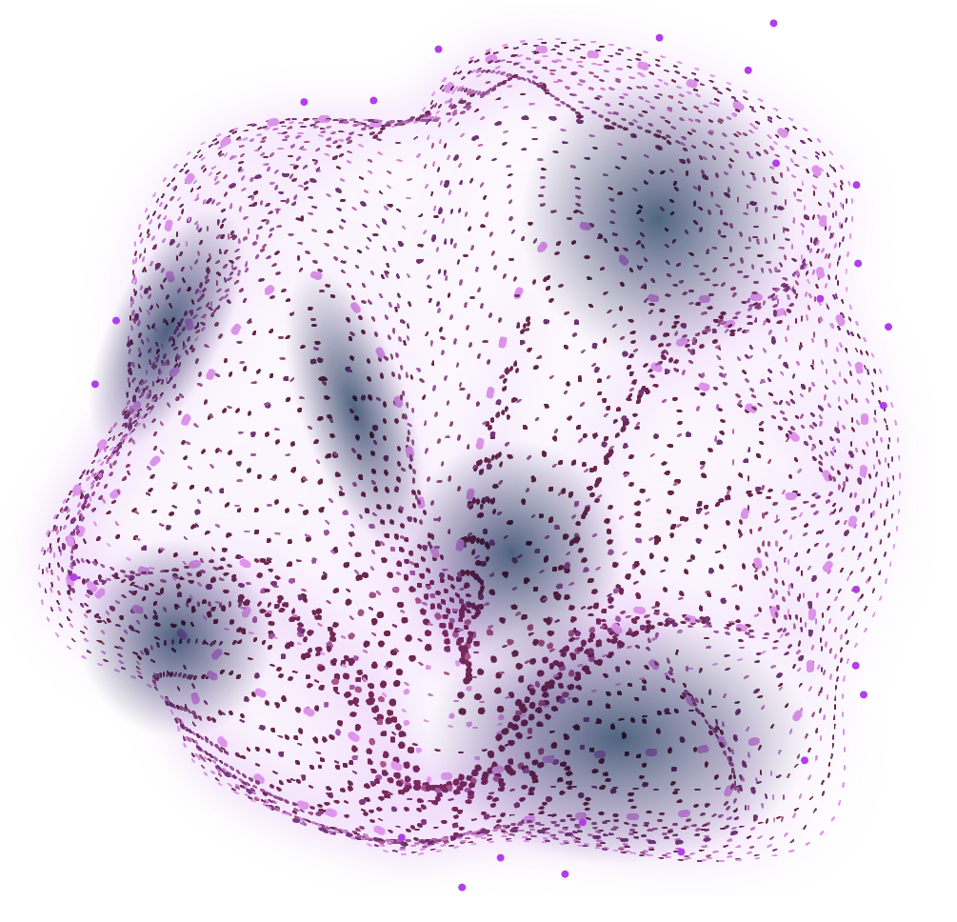
What validation needs
Next 3 months
Readiness
Pilot extraction, ~100 reports · Multi-Center Testing: 3,000–3,500 patients · ≥4.5 yr follow-up · Blinded committee, incl. random negatives · Registry linkage for mortality & reintervention · Leave-one-centre-out + temporal validation · Ethics, joint controllership, DPIA
Run the pilot extraction, publish the numbers · Freeze the label spec, build the pipeline · Fit the multi-state baseline, one centre · Submit to ethics in parallel Train dynamic survival models (landmarking/joint modeling), validate across TAVR vs. SAVR subgroups, and run Decision Curve Analysis (DCA).
Research software, not a medical device — no patient data yet, one unverified assumption, regulatory approval required before clinical use The framework is fully compliant with VARC-3 consensus definitions and ready for retrospective multi-center registry validation prior to clinical deployment.

Slide 7
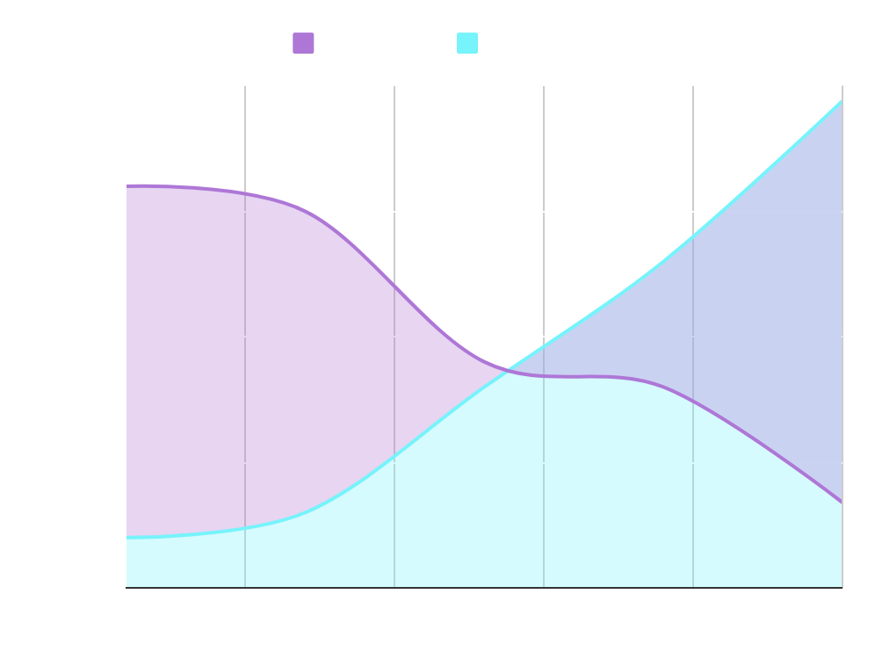

The Next Step – Exploratory Objective
The clinically useful output is where they cross.
The Heart Team's real decision: reintervene electively now, while the patient is still a good candidate, or wait and risk operating on a patient who has meanwhile become a worse one?
Two curves, opposite directions — failure risk rises, operability falls ·
exploratory figure — not a PulseAI output
Data this engine actually uses
Age, sex, BMI, SAVR vs TAVR, valve size; serial TTE (gradient, EOA, DVI, Vmax, EOAi, LVEF, AR); thrombosis / endocarditis / NSVD flags.
Not trained as operability: EuroSCORE II, STS-PROM, renal trend, PA pressures, Hb, albumin, prior HF admissions.
Surveillance only. Intervention recommendation is always null.

Slide 8
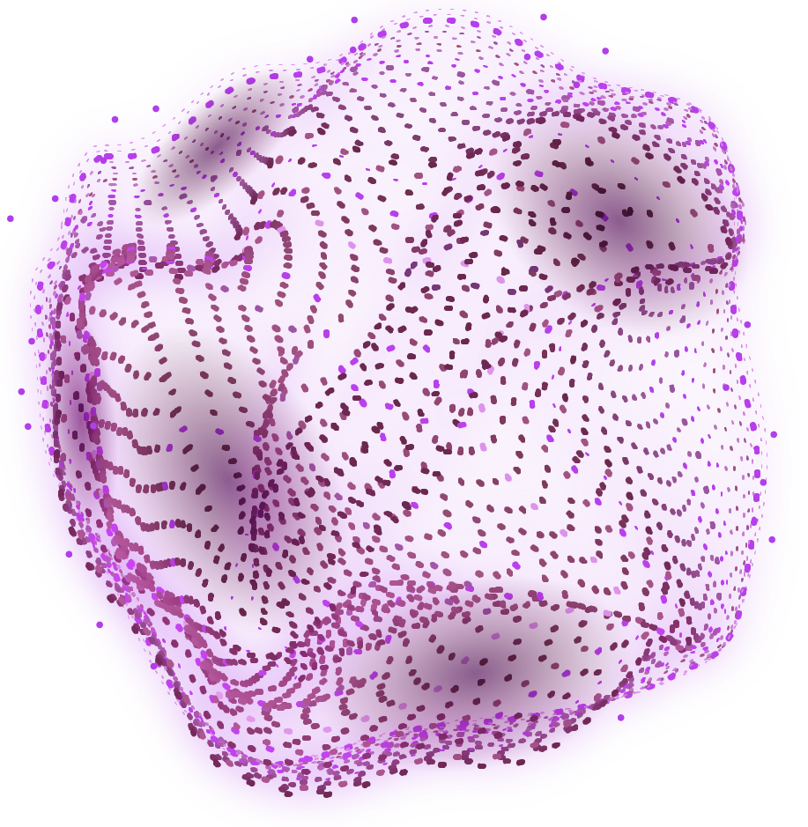
TIME FOR ENGINEERING...
01 Medical
Protocol, adjudication rules, and clinical constraints.
02 Machine learning
Five-layer ML engine implementation
03 Software
Thin web client, loopback inference APi, safety.
Live with the demo

Slide 9
five-layer engine
The medical team hands us the protocol. We compile it into five frozen layers: rules first, probability only when the case is eligible, action last and clinician-owned.
1
VARC-3 rules
2
Competing-risk CIF
3
Echo trajectory
4
Calibrate & safety
5
Surveillance interval
Returned to the medical team
Current HVD candidate · BVF / death cumulative incidence · next-echo path · calibrated risk or an explicit abstention · a review interval.

Slide 10
Five sub-engines
Input and output in clinical terms; mechanism underneath.
TIER 1
VARC-3 rules
TIER 2
Competing-risk CIF
TIER 3
Echo trajectory
TIER 4
Calibrate & safety
TIER 5
Surveillance policy
In: reference vs current TTE
Out: no HVD / 2 / 3 / indeterminate
Pure function, no neural net
Candidate HVD, not SVD
Same case = same result
In: baseline + serial history
Out: BVF and death CIFs
Irregular-time GRU
Stage 2 stays on the BVF clock
NSVD class untrained — withheld
In: same history + state
Out: next gradient, Vmax, EOA, DVI, AR
Second GRU, two heads
Progression only after Stage 2/3
LVEF untrained — withheld
In: raw CIF + missingness / OOD
Out: calibrated risk or abstain
PAVA isotonic maps, no extra net
Broken input → refuse to speak
Abstain is never shown as low risk
In: stage + 1-y risk + safety
Out: review now / 3 / 6 / standard
Clinician-owned step function
Draft policy → always review_now
Never chooses what to implant, provides tools for the medTeam

Slide 11
What we trained on
Hackathon proof of concept vs the protocol study the engine is written for.
This laptop demo
Expanded synthetic notes — 1,500 linked patients, serial TTEs, 30–90-day reference.
De-identified real notes are inventoried and hashed, not used as labels (year-only dates).
Real-world deployment
2,500–3,000 patients · 10,000–15,000 patient-years · ≥150–200 adjudicated SVD-HVD events.
Multi-center registry, blinded committee, including a sample of algorithm-negative records.

Slide 12
How the demo runs
Thin client
Static HTML/JS. No Node, no PyTorch in the browser, no checkpoints on disk in the UI.
Loopback API
FastAPI on 127.0.0.1:8000. POST /v1/inference is the only runtime boundary.
Hashed artifacts
Tier 2/3 weights, calibration maps, and policy load only if SHA-256 matches the manifest.
caution
Stage 3 or broken input withholds numeric risk.

Slide 13
Security for this demo
Loopback only
The demo binds to 127.0.0.1. No public ingress. Stale listeners are killed before start-demo.
If a remote client is needed
Use a Tailscale overlay. Do not publish the inference API on the open internet.
Future LLM use
Keep PHI on a local model, or a contractually safe API. Never paste identifiable notes into a public frontier chat.
Authentication
Today: smoke-test login for the hackathon UI. Any real record requires institutional SSO before data entry.

Slide 14
Thank you
PulseAI · ValveGuard — medical research to software

